Slide 1
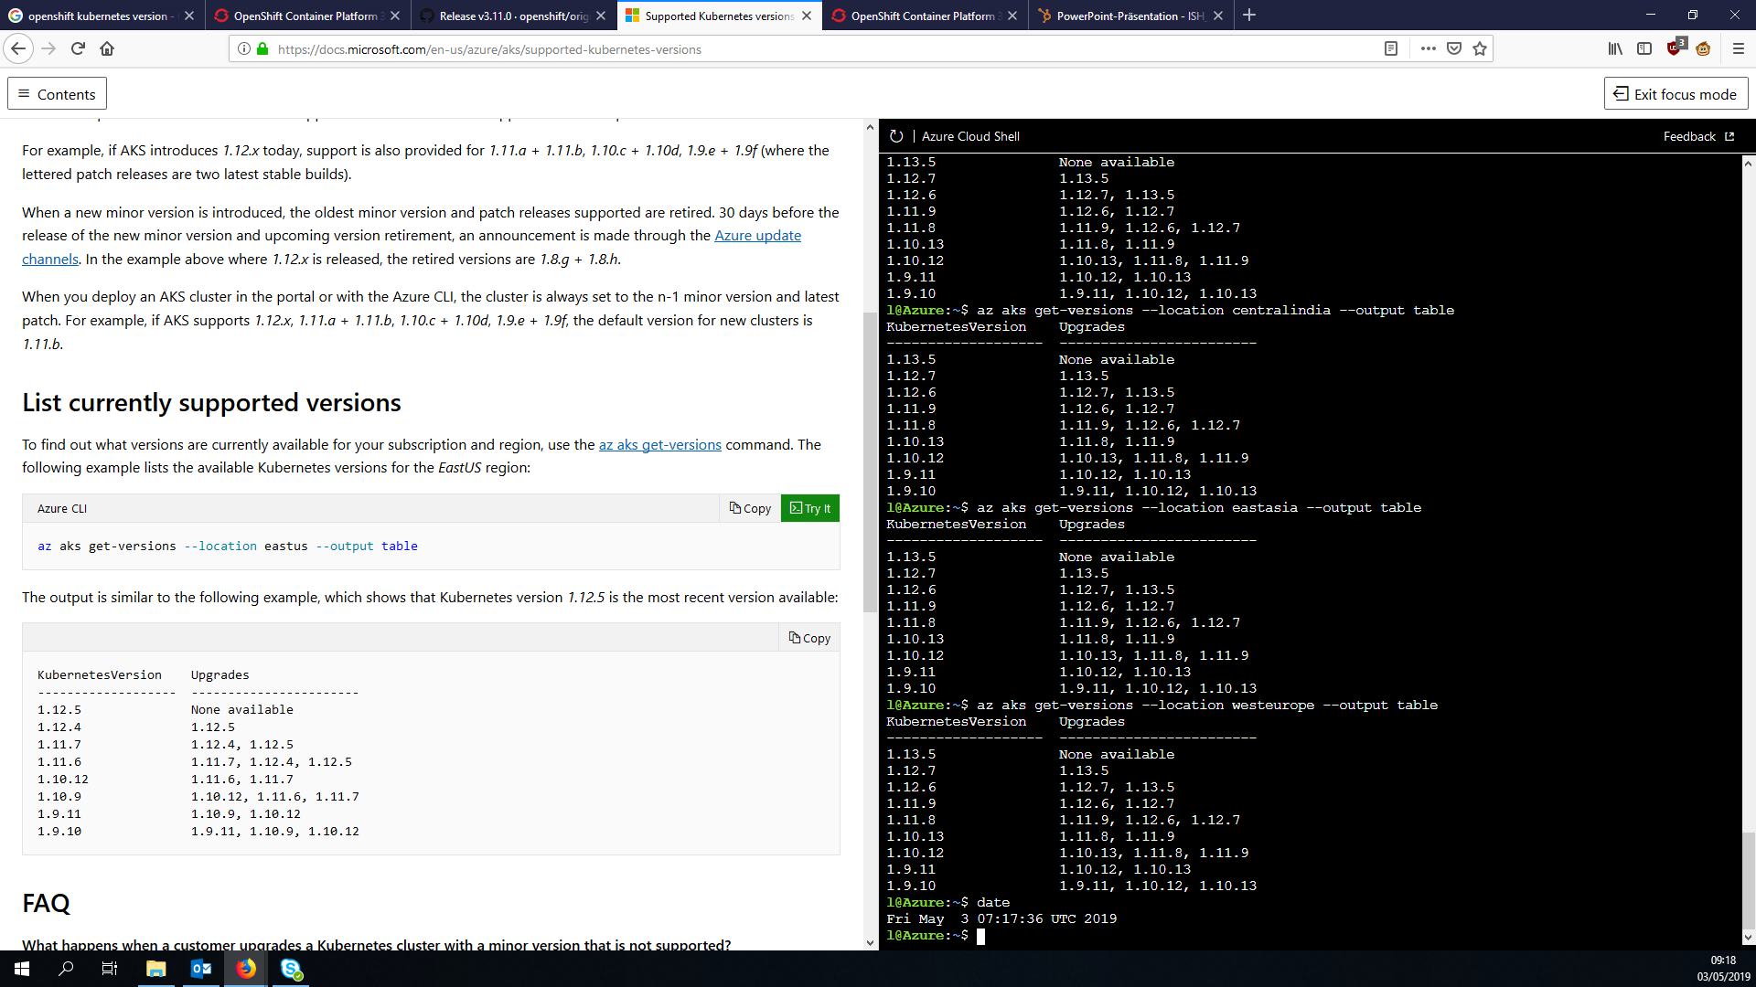
Notes:
Supported k8s versions on aks
Version Changelog(s) 1.11:
https://github.com/kubernetes/kubernetes/blob/master/CHANGELOG-1.11.md#changelog-since-v1119
Considerable changes:
action required: the API server and client-go libraries have been fixed to support additional non-alpha-numeric characters in UserInfo "extra" data keys. Both should be updated in order to properly support extra data containing "/" characters or other characters disallowed in HTTP headers. (#65799, @dekkagaijin)
https://github.com/kubernetes/autoscaler/releases/tag/cluster-autoscaler-1.3.1
ACTION REQUIRED: Removes defaulting of CSI file system type to ext4. All the production drivers listed under https://kubernetes-csi.github.io/docs/Drivers.html were inspected and should not be impacted after this change. If you are using a driver not in that list, please test the drivers on an updated test cluster first. ``` (#65499, @krunaljain)
kube-apiserver: the Priority admission plugin is now enabled by default when using --enable-admission-plugins. If using --admission-control to fully specify the set of admission plugins, the Priority admission plugin should be added if using the PodPriority feature, which is enabled by default in 1.11. (#65739, @liggitt)
The system-node-critical and system-cluster-critical priority classes are now limited to the kube-system namespace by the PodPriority admission plugin. (#65593, @bsalamat)

