Slide 1
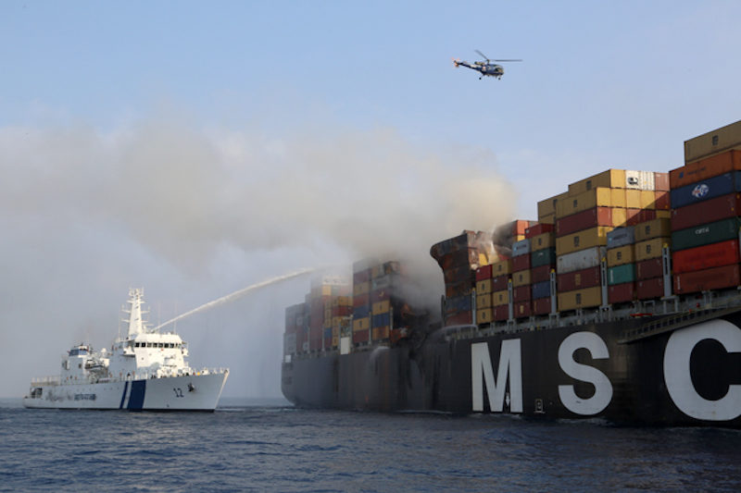
Notes:
Source: https://gcaptain.com/large-msc-containership-msc-daniela-suffers-fire-off-sri-lanka/

Slide 2
Thesis defendense
Lukas Grams, 2019-09-16

Slide 3
Agenda
Initial goals
Intended schedule
Updated schedule
Updated goals
Representation in thesis
Recap
Demo time

Slide 4
Initial goals
Generic security risks
Rating of security risks
How to mitigate (including best practices)
Compare on-prem & public cloud solutions
(Compare to cloud-hosted, self-managed solutions)
Scope:
K8s certified solutions & their components

Slide 5
Intended schedule
Research, practical tests
Attack vectors & mitigation pointers
Risk analysis & comparison
Practical implementation & best practice derivement
Write out notes to full thesis

Slide 6
Intended schedule
Research, practical tests
Attack vectors & mitigation pointers
Built from scratch to meet requirements
Risk analysis & comparison
Extensive risk model tailoring was necessary
Highly dependant on specific solutions
Practical implementation & best practice derivement
Reduced due to time constraints
Write out notes into full thesis

Slide 7
Updated schedule
Research, practical tests
Attack vectors & mitigation pointers
Risk analysis & comparison
Partial practical implementation & best practice derivement
Write out notes to full thesis

Slide 8
Updated goals
Initial version
Updated version
Generic security risks
Rating of security risks
How to mitigate (including best practices)
Compare on-prem & public cloud solutions
(Compare to cloud-hosted, self-managed solutions)
Generic security risks
Rating of security risks for to specific solutions
Pointers on how to mitigate (including some best practices)
Compare OCP 3.11 & AKS 1.11
(Compare to cloud-hosted, self-managed solutions)
Template for risk comparison & management

Slide 9
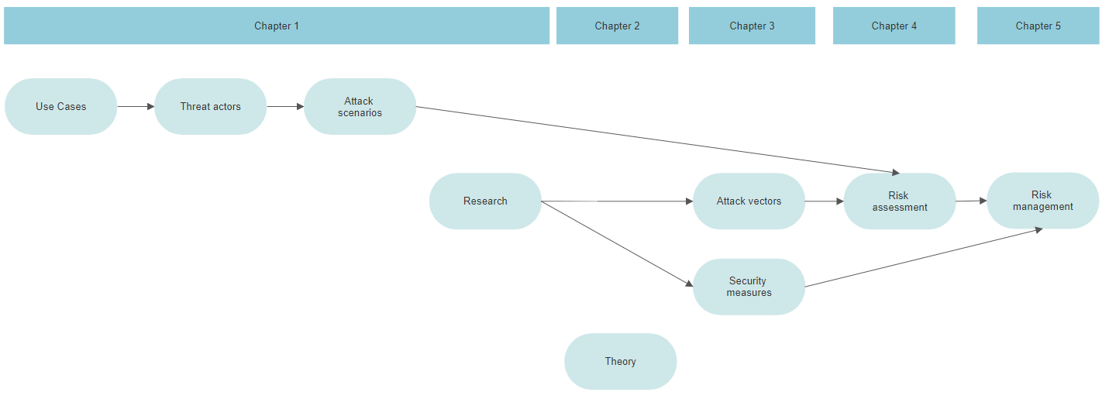
Representation in thesis
Notes:
Saved in:
https://cloud.smartdraw.com/editor.aspx?templateId=42c223ea-eb87-419a-b17f-006c3f87c746&flags=128#depoId=1YaJbYmJUjvXoCoDJ2I2djtIvbUvtx2pd&credID=240387

Slide 10
Recap
Unexpected challenges
Considerable additional work
Resulting shift from initial goals
Good end result
Would still not have done it if I knew
Practical part too small for my taste
Struggling with technology > Struggling with scope definition
Huge scope -> not much detail possible

Slide 11
Demo time
(please work)
Notes:
Source: https://giphy.com/gifs/justin-hope-hoping-fingers-crossed-l0NwNrl4BtDD7JCx2

Slide 12
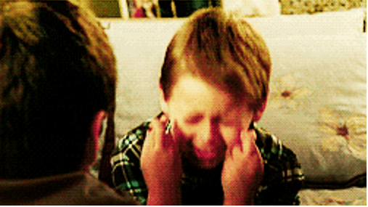
Demo time
(please work)

