Slide 1
Temperature
Vigo airport

Slide 2
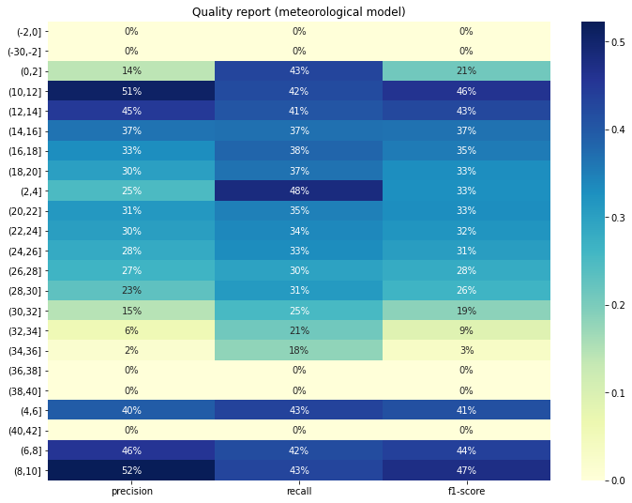
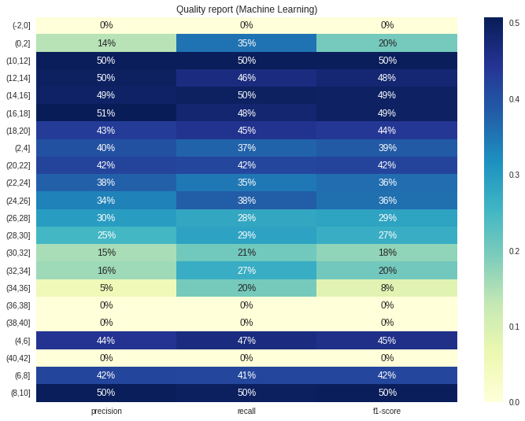
WRF point 0 vs Machine learning

Slide 3
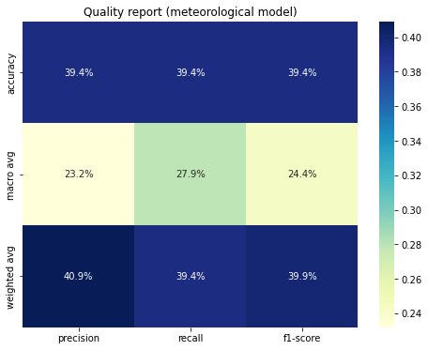
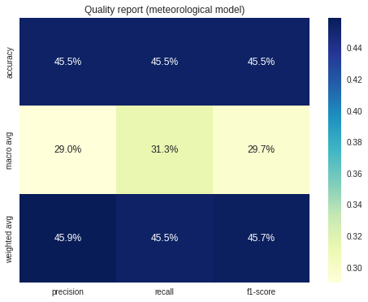
WRF point 0 vs Machine learning

Slide 4
