Slide 1
Quality report wind speed
LEVX Vigo airport

Slide 2
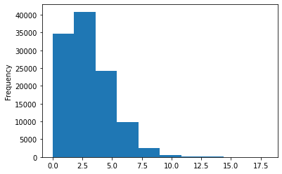
Wind speed (m/s), Station data
count | 221240
mean | 2,93
Std | 2,02
Min | 0,0
25% | 1,54
50% | 2,57
75% | 4,11
Max | 22,12

Slide 3
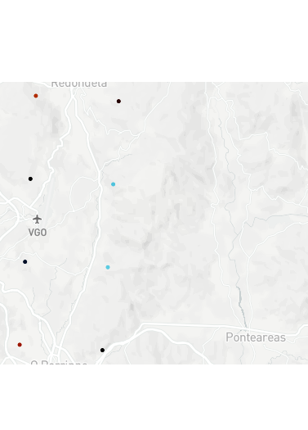
WRF Meteogalicia model
Resolution 4 Km

Slide 4
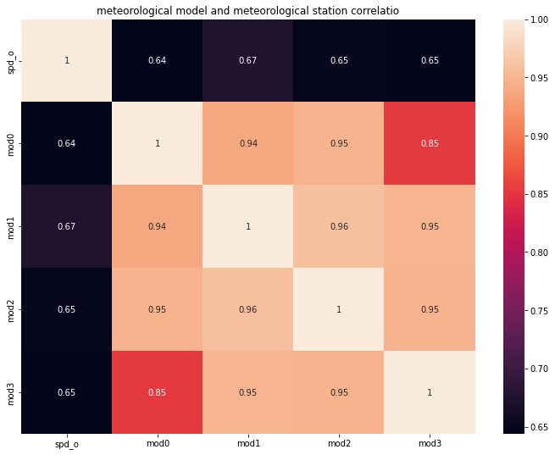
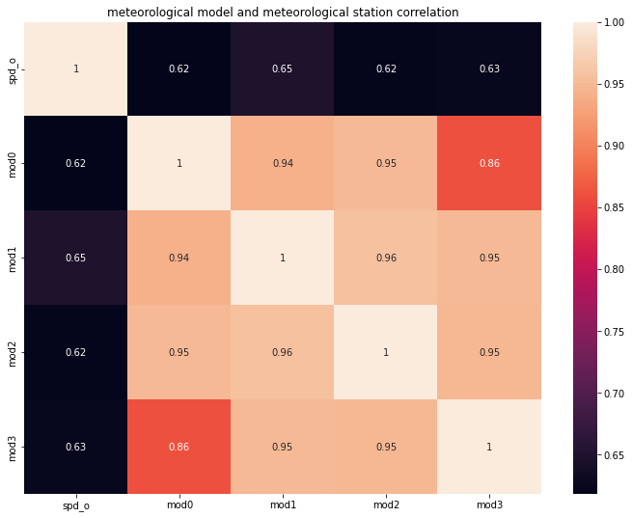
Compare correlation forecast Meteorological model D0 vs D1
Correlation station (spd_o) and model points (mod 0,1,2,3) forecast D0
Correlation station (spd_o) and model points (mod 0,1,2,3) forecast D1

Slide 5

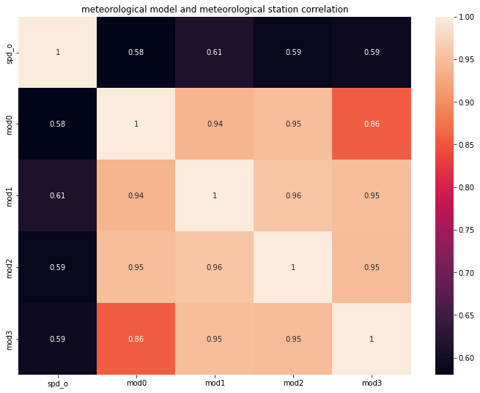
Compare correlation forecast meteorological model D1 vs D2
Correlation station (spd_o) and model points (mod 0,1,2,3) forecast D1
Correlation station (spd_o) and model points (mod 0,1,2,3) forecast D2

Slide 6
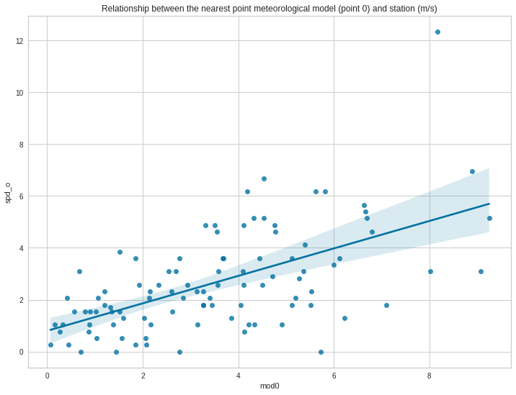
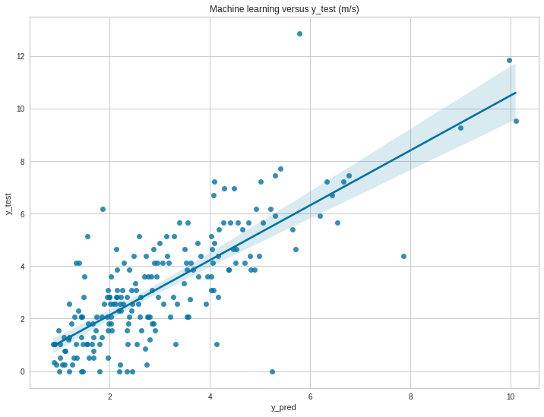
Forecast D0: machine learning vs WRF model
Forecast D0 Meteorological Model
Forecast D0 Macine learning

Slide 7
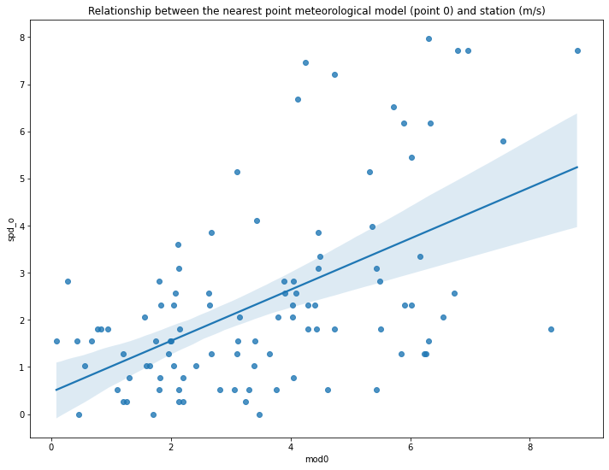
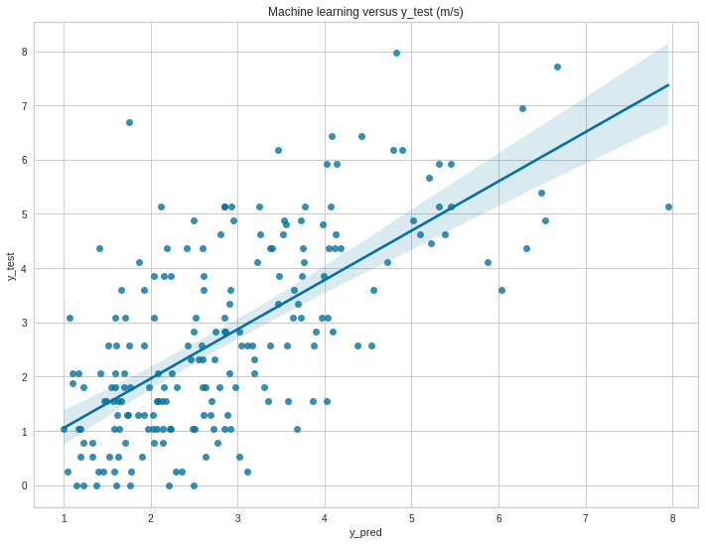
Forecast D1: machine learning vs WRF model
Forecast D1 Meteorological Model
Forecast D1 Macine learning

Slide 8
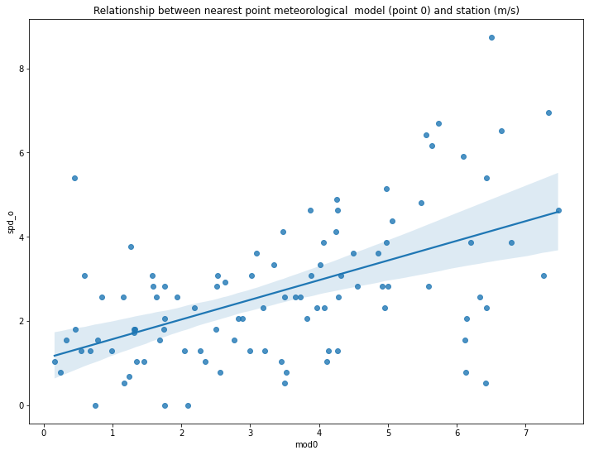
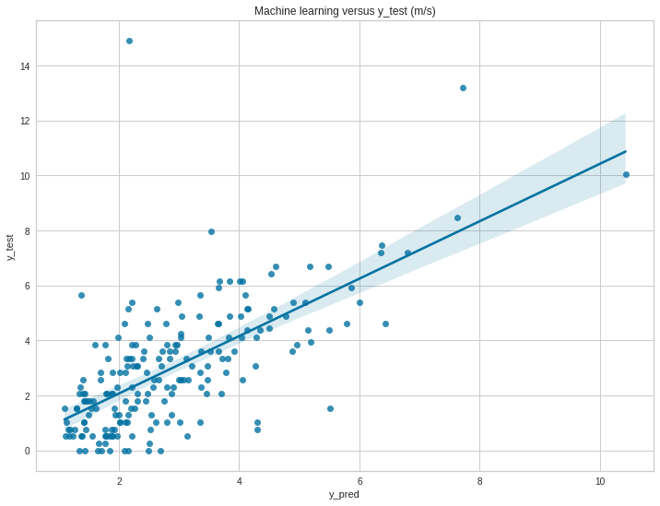
Forecast D2: machine learning vs WRF model
Forecast D2 Meteorological Model
Forecast D2 Macine learning

Slide 9
Quantitative REsults
Meteorological Model D0 | Machine learning D0
MAE:1.55 | MAE: 0.95
MSE: 4.15 | MSE: 1.51
R2: 0.25 | R2: 0.6
Meteorological Model D1 | Machine learning D1
MAE:1.58 | MAE: 1.01
MSE: 4.33 | MSE: 1.67
R2: 0.22 | R2: 0.56
Meteorological Model D2 | Machine learning D2
MAE:1.63 | MAE: 1.07
MSE: 4.65 | MSE: 1.92
R2: 0.16 | R2: 0.5

