Slide 1
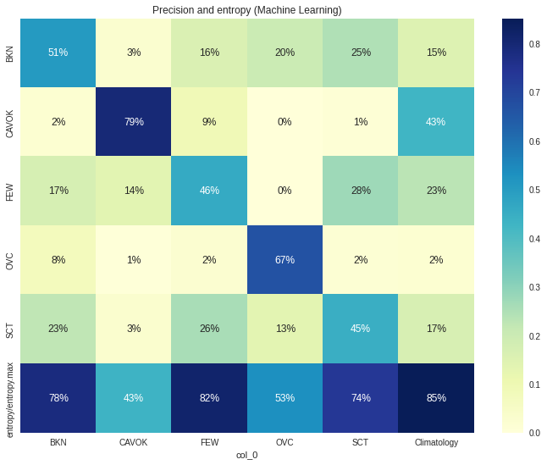
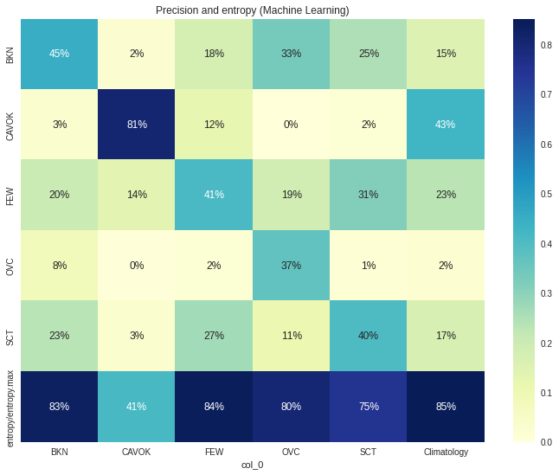
Precision and entropy
Extratree (estimators 250)
Lgbm (estimators 250)

Slide 2
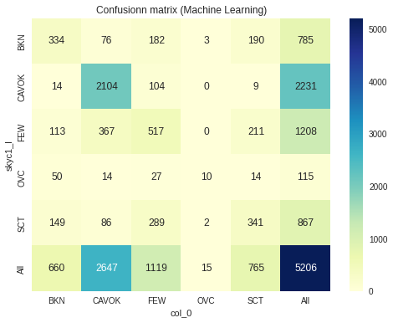
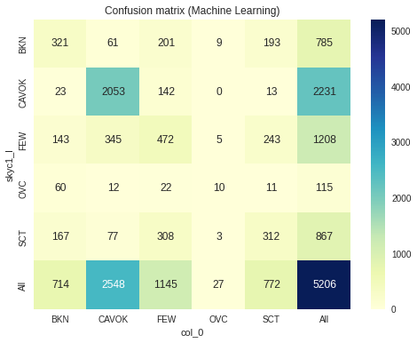
Confusion matrix
Extratree (estimators 250)
Lgbm (estimators 250)

Slide 3
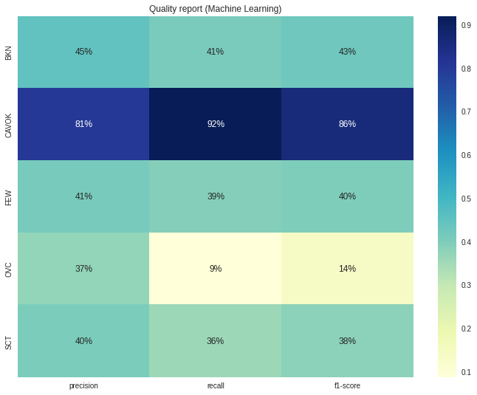
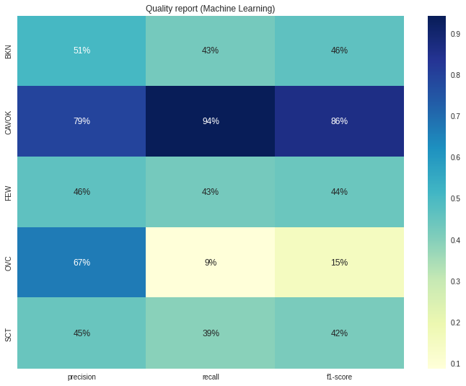
Quality report
Extratree (estimators 250)
Lgbm (estimators 250)

