Slide 1
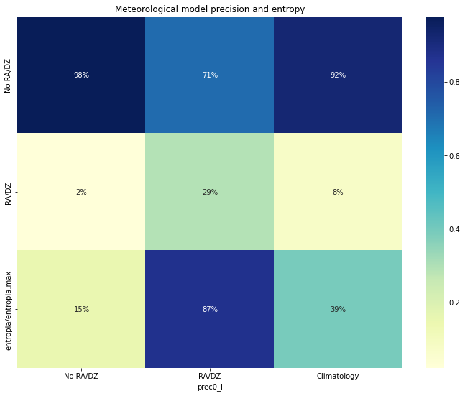
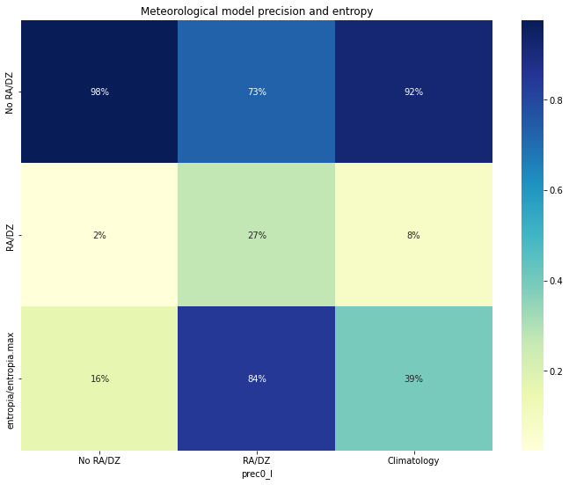
Precision and entropy
WRF (point 0) forecast D0
WRF (point 0) forecast D1

Slide 2
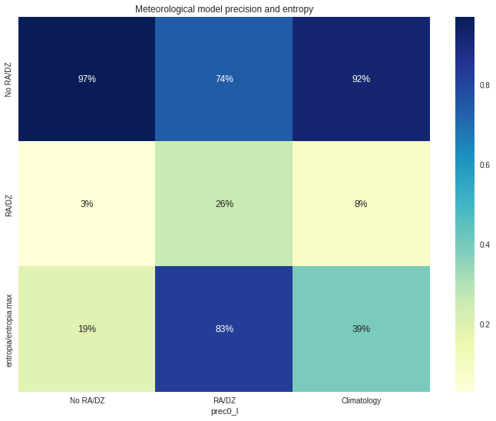
Precision and entropy
WRF (point 0) forecast D1
WRF (point 0) forecast D2

Slide 3
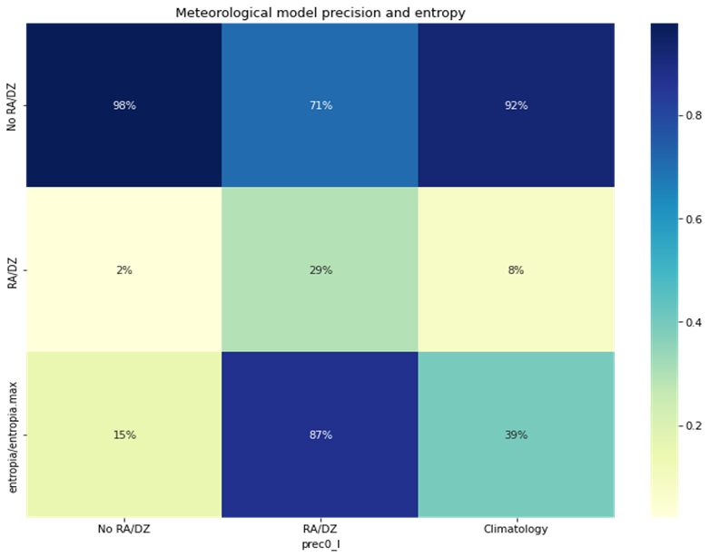
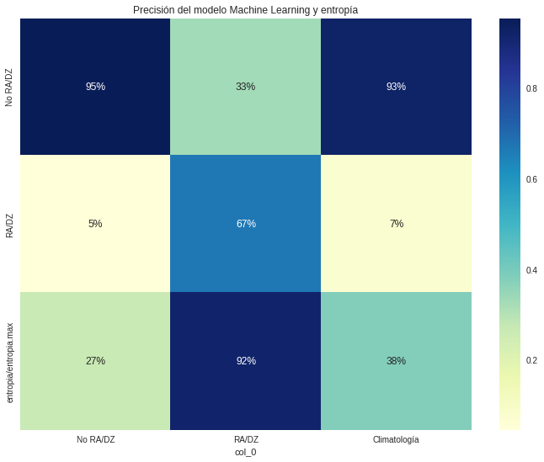
Precision and entropy
WRF (point 0) forecast D0
Machine learning forecast D0

Slide 4

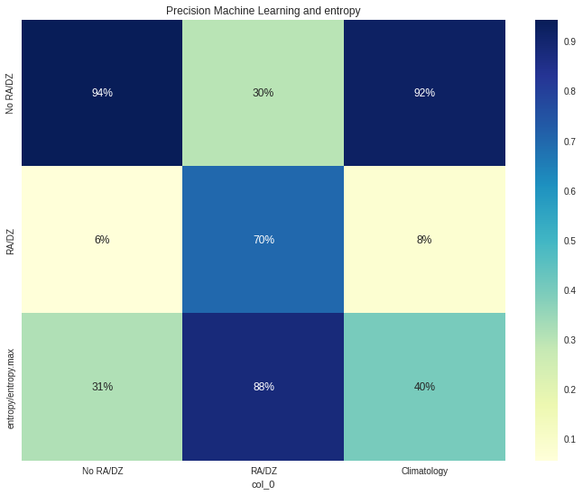
Precision and entropy
WRF (point 0) forecast D1
Machine learning forecast D1

Slide 5

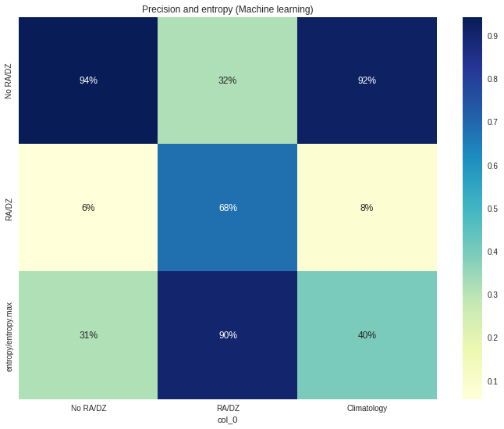
Precision and entropy
WRF (point 0) forecast D2
Machine learning forecast D2

