Slide 1
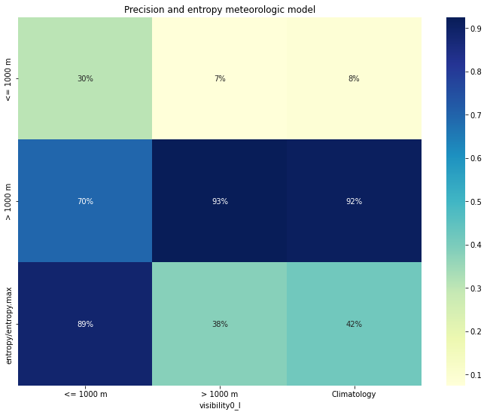
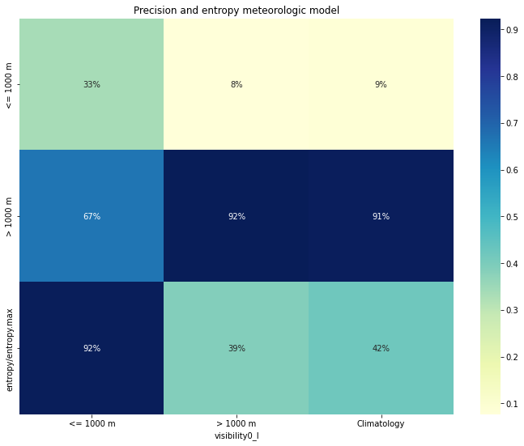
Precision and entropy
Meteorologic model Forecast D1(point 0)
Meteorologic model Forecast D0 (point 0)

Slide 2
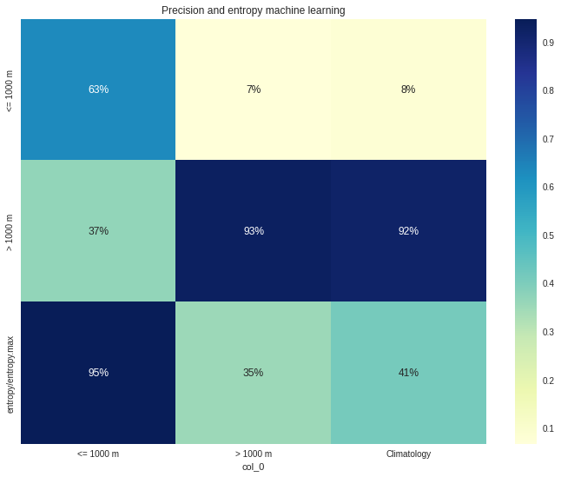

Precision and entropy
LGBM algorithm Forecast D0 (operational)
Meteorologic model Forecast D0 (point 0)

Slide 3


Precision and entropy
LGBM algorithm Forecast D1 (operational)
Meteorologic model Forecast D1 (point 0)

Slide 4
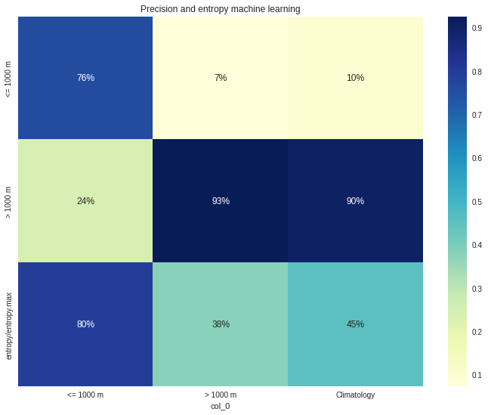
Precision and entropy
LGBM algorithm Forecast D0 (operational)
Extra tree algorithm Forecast D0 (no operational)

