Slide 1
Temperature
Vigo airport

Slide 2
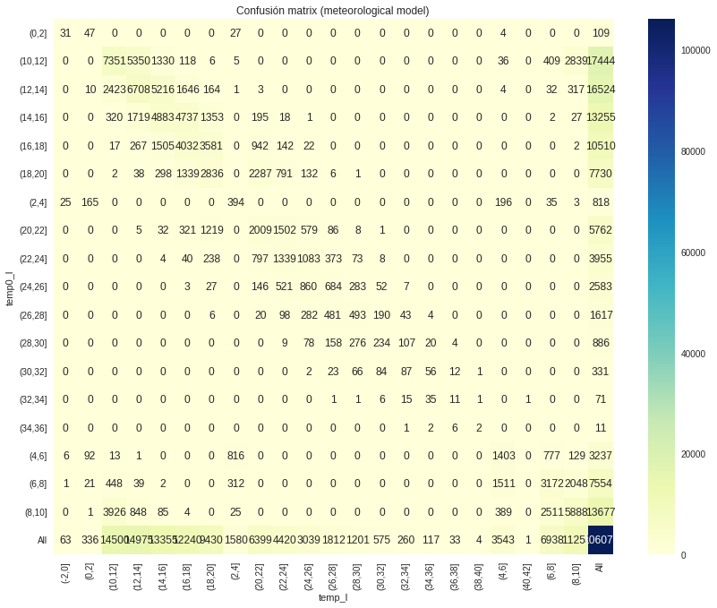
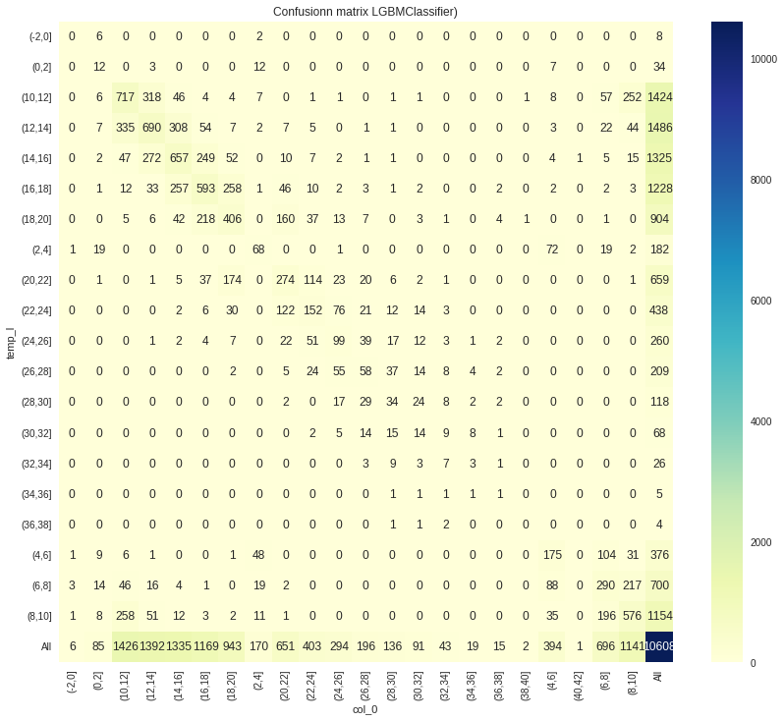
WRF point 0 vs LGBMclassifier

Slide 3
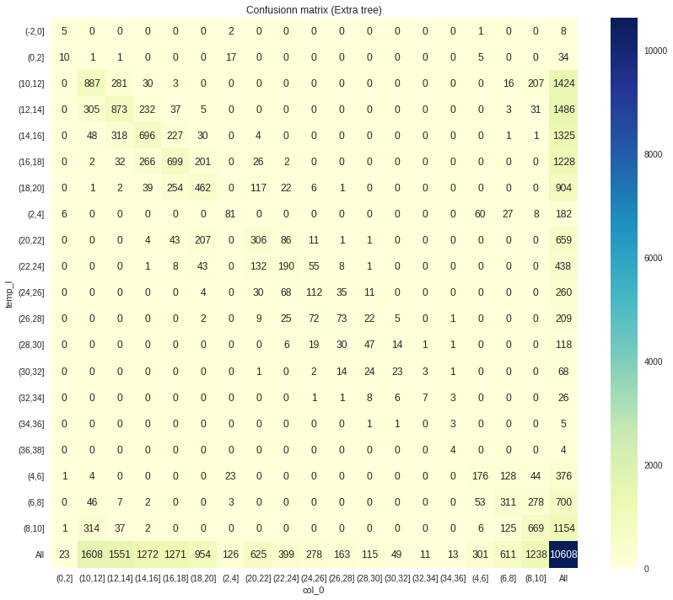
Extratree vs LGBMclassifier

Slide 4
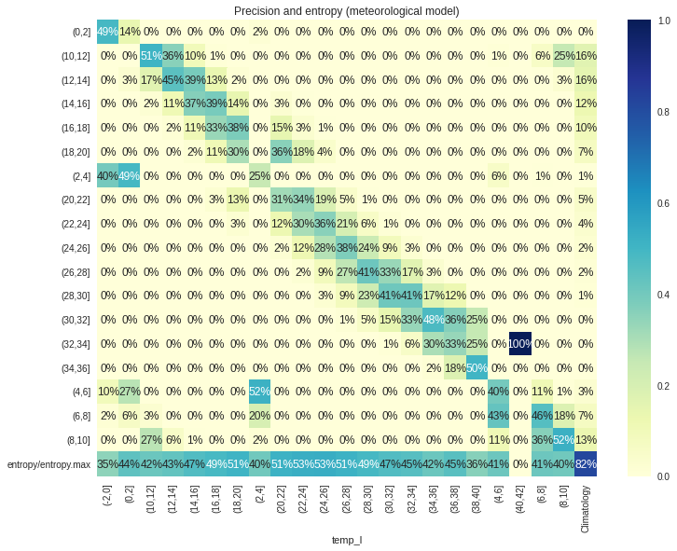
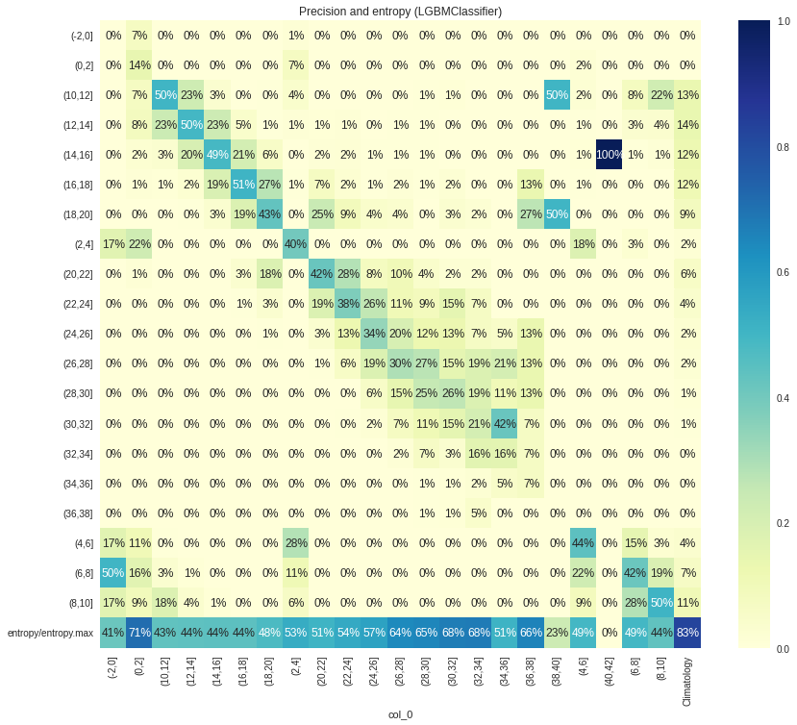
WRF point 0 vs LGBMclassifier

Slide 5
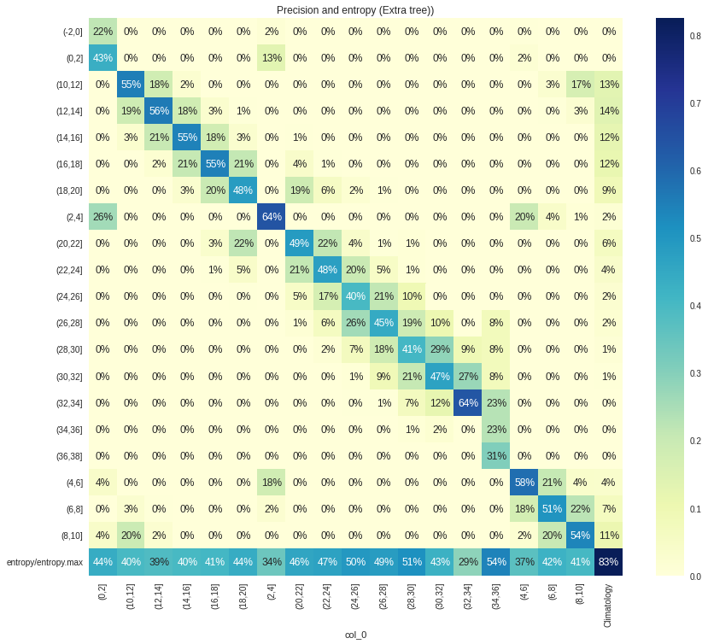
extratree vs LGBMclassifier

Slide 6
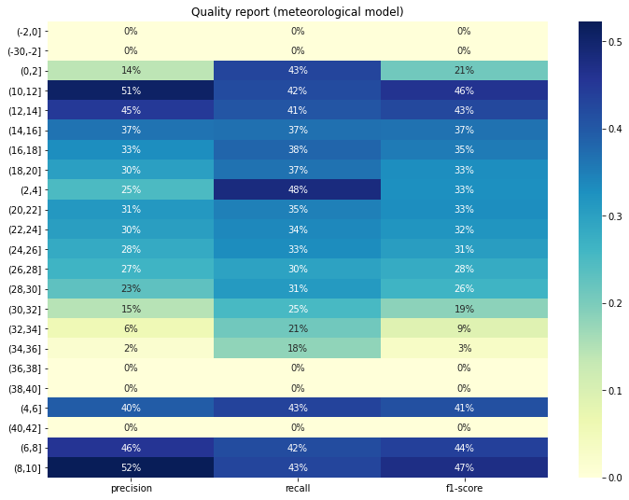
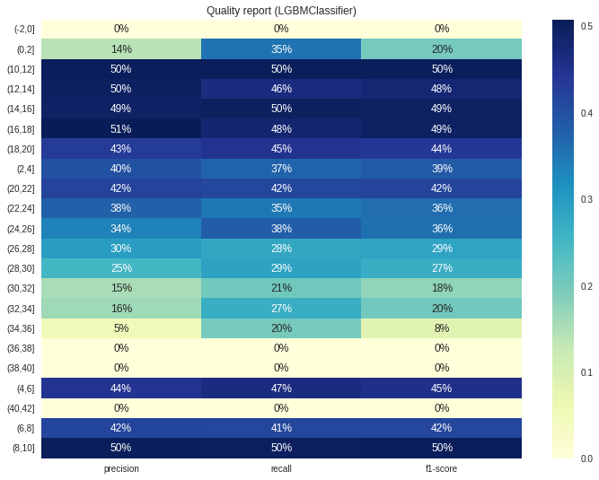
WRF point 0 vs LGBMclassifier

Slide 7
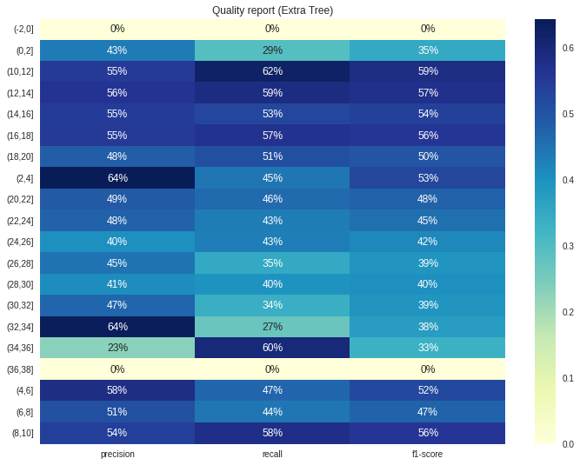
Extratree vs LGBMclassifier

Slide 8
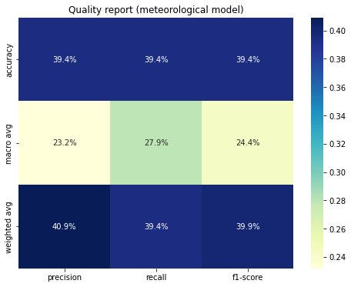
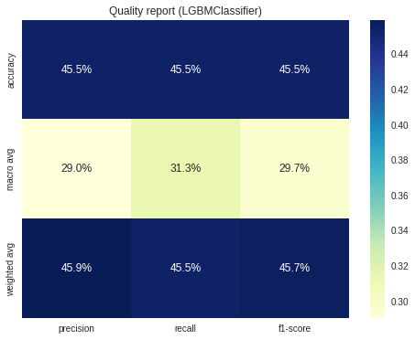
WRF point 0 vs Machine learning

Slide 9
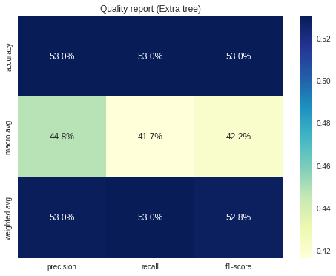
Extratree vs LGBMclassifier

