Slide 1
Function

Slide 2
Python Functions
A function is a block of code which only runs when it is called.
You can pass data, known as parameters, into a function.
A function can return data as a result.

Slide 3
Creating a Function
In Python a function is defined using the def keyword:
Example
def my_function(): print("Hello from a function")
Output:
When it call by some other,
Print Hello from a function

Slide 4
Calling a Function
To call a function, use the function name followed by parenthesis:
Example
def my_function(): print(" Hello from a function ") my_function()
Output:
Hello from a function

Slide 5
Parameters
Information can be passed to functions as parameter.
Parameters are specified after the function name, inside the parentheses. You can add as many parameters as you want, just separate them with a comma.

Slide 6
The following example has a function with one parameter (fname). When the function is called, we pass along a first name, which is used inside the function to print the full name:
Example
def my_function(fname): print(fname + " Refsnes") my_function("Emil") my_function("Tobias") my_function("Linus")
Emil Refsnes Tobias Refsnes Linus Refsnes

Slide 7
Default Parameter Value
The following example shows how to use a default parameter value.
If we call the function without parameter, it uses the default value:
Example
def my_function(country = "Norway"): print("I am from " + country) my_function("Sweden") my_function("India") my_function() my_function("Brazil")

Slide 8
I am from Sweden I am from India I am from Norway I am from Brazil

Slide 9
Passing a List as a Parameter
You can send any data types of parameter to a function (string, number, list, dictionary etc.), and it will be treated as the same data type inside the function.
E.g. if you send a List as a parameter, it will still be a List when it reaches the function:
Example
def my_function(food): for x in food: print(x) fruits = ["apple", "banana", "cherry"] my_function(fruits)

Slide 10
apple banana cherry

Slide 11
Return Values
To let a function return a value, use the return statement:
Example
def my_function(x):
return 5 * x
print(my_function(3))
print(my_function(5))
print(my_function(9))

Slide 12
15 25 45

Slide 13
Keyword Arguments
You can also send arguments with the key = value syntax.
This way the order of the arguments does not matter.
Example
def my_function(child3, child2, child1): print("The youngest child is " + child3) my_function(child1 = "Emil", child2 = "Tobias", child3 = "Linus")

Slide 14
The youngest child is Linus

Slide 15
Arbitrary Arguments
If you do not know how many arguments that will be passed into your function, add a * before the parameter name in the function definition.
This way the function will receive a tuple of arguments, and can access the items accordingly:
Example
If the number of arguments are unknown, add a * before the parameter name:
def my_function(*kids):
print("The youngest child is " + kids[2])
my_function("Emil", "Tobias", "Linus")

Slide 16
The youngest child is Linus

Slide 17
Arbitrary Arguments Examples
** feature is similar, but it only works for keyword arguments—it collects them into a new dictionary
>>> def f(**args):
print(args)
>>> f()
{}
>>> f(a=1, b=2)
{'a': 1, 'b': 2}

Slide 18
Arbitrary Arguments Examples
>>> def f(a, *pargs, **kargs):
print(a, pargs, kargs)
>>> f(1, 2, 3, x=1, y=2)
1 (2, 3) {'y': 2, 'x': 1}

Slide 19
Calls: Unpacking arguments
>>> def func(a, b, c, d):
print(a, b, c, d)
>>> args = (1, 2)
>>>args += (3, 4)
>>> func(*args)
# Same as func(1, 2, 3, 4)
1 2 3 4

Slide 20
Calls: Unpacking arguments
>>> args = {'a': 1, 'b': 2, 'c': 3}
>>> args['d'] = 4
>>> func(**args)
# Same as func(a=1, b=2, c=3, d=4)
1 2 3 4

Slide 21
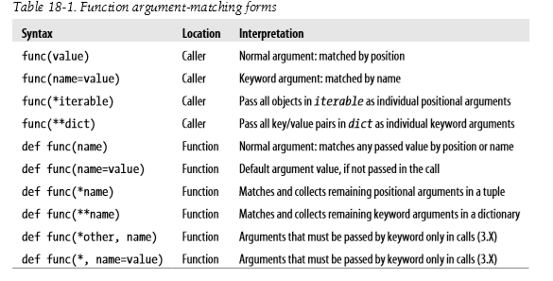

Slide 22
Scope of Variables
All variables in a program may not be accessible at all locations in that program. This depends on where you have declared a variable.
The scope of a variable determines the portion of the program where you can access a particular identifier. There are two basic scopes of variables in Python −
Global variables
Local variables

Slide 23
Global vs. Local variables
Variables that are defined inside a function body have a local scope, and those defined outside have a global scope.
This means that local variables can be accessed only inside the function in which they are declared, whereas global variables can be accessed throughout the program body by all functions. When you call a function, the variables declared inside it are brought into scope. Following is a simple example −

Slide 24
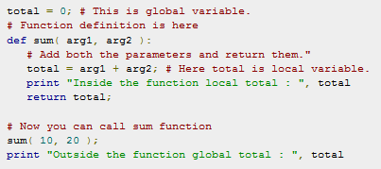

Slide 25
Output:
Inside the function local total : 30
Outside the function global total : 0

Slide 26
Function Recursion
Python also accepts function recursion, which means a defined function can call itself.
Recursion is a common mathematical and programming concept. It means that a function calls itself. This has the benefit of meaning that you can loop through data to reach a result.

Slide 27
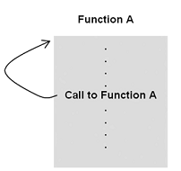
What Is a Recursive Function?
A recursive function is often defined as “a function that calls itself.”

Slide 28
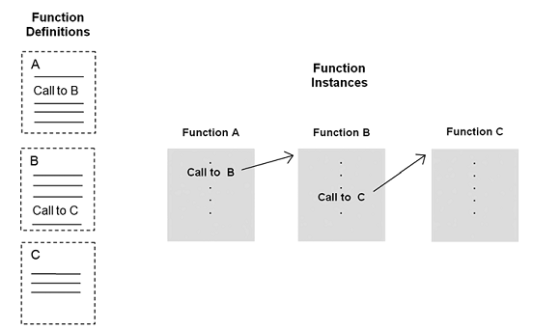
General mechanism of non-recursive function

Slide 29
Recursive function execution instances
Execution of a series of recursive function instances is similar to the execution of series of non-recursive instances, except that the execution instances are “clones” of each other (that is, of the same function definition).

Slide 30
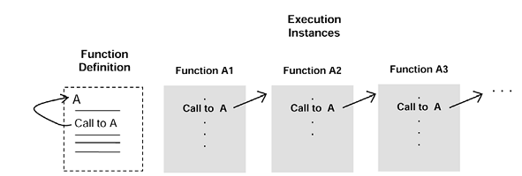

Slide 31
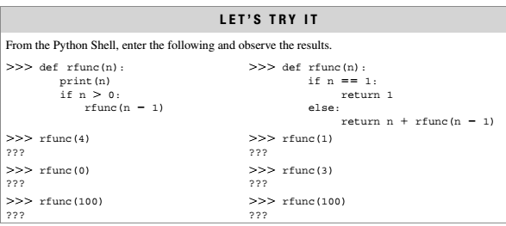

Slide 32
Example: Factorial
Problem:
The factorial function is an often-used example of the use of recursion. The computation of the factorial of 4 is given as,
factorial(4) = 4 * 3 * 2* 1= 24
In general, the computation of the factorial of any (positive, nonzero) integer n is,
factorial(n) = n . (n-1). (n-2) . . . 1
The one exception is the factorial of 0, defined to be 1.

Slide 33
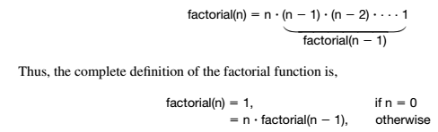
logic
The factorial of n can be defined as n times the factorial of n – 1

Slide 34
Example : Factorial
def factorial(n):
print("factorial has been called with n = " + n)
if n == 1:
return 1
else:
res = n * factorial(n-1)
print("intermediate result for ", n, " * factorial(" ,n-1, "): ",res)
return res
print(factorial(5))

Slide 35
Output
factorial has been called with n = 5
factorial has been called with n = 4
factorial has been called with n = 3
factorial has been called with n = 2
factorial has been called with n = 1
intermediate result for 2 * factorial( 1 ): 2
intermediate result for 3 * factorial( 2 ): 6
intermediate result for 4 * factorial( 3 ): 24
intermediate result for 5 * factorial( 4 ): 120
120

Slide 36
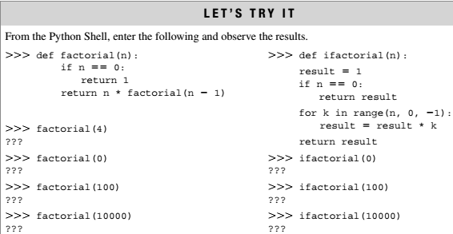

Slide 37
Example
Recursion Example
def tri_recursion(k): if(k>0): result = k+tri_recursion(k-1) print(result) else: result = 0 return result print("\n\nRecursion Example Results") tri_recursion(6)

Slide 38
In this example, tri_recursion() is a function that we have defined to call itself ("recurse"). We use the k variable as the data, which decrements (-1) every time we recurse. The recursion ends when the condition is not greater than 0 (i.e. when it is 0).
Output:
Recursion Example Results 1 3 6 10 15 21

Slide 39
Exercises
Compute area of circle using all possible function prototypes.
Compute Simple interest for given principle(P), number of years(N) and rate of interest(R). If R value is not given then consider R value as 10.5%. Use keyword arguments for the same.

