Slide 1
Class Average
Given marks secured in CSE1001 by the students in a class, design an algorithm and write a Python code to determine the class average. Print only two decimal digits in average

Slide 2
Class Average
Input | Processing | Output
Number of students in class, mark scored by each student | Determine total of marks secured by students Find average of marks | Class average of marks

Slide 3
Average marks scored by ‘N’ number of Students
Step 1: Start Step 2 : Read Number Of Students Step 3 : Initialize counter as 0 Step 4 : Input mark Step 5 : Add the mark with total Step 6 : Increment the counter by 1
Step 7: repeat Step 4 to Step 6 until counter less than number of students
Step 7: Divide the total by number of students and store it in average
Step 8: Display the average
Step 9: Stop

Slide 4
Test Cases
Input
5
90 85 70 50 60
Output
71.00
Processing Involved

Slide 5
Already Know
To read values from user
To check if a condition is satisfied
Print characters

Slide 6
Yet to learn
Repeatedly execute a set of statements

Slide 7
Need of iterative control
Repeated execution of set of statements
An iterative control statement is a control statement providing repeated execution of a set of instructions
Because of their repeated execution, iterative control structures are commonly referred to as “loops.”

Slide 8
While statement
Repeatedly executes a set of statements based on a provided Boolean expression (condition).
All iterative control needed in a program can be achieved by use of the while statement.

Slide 9
Syntax of While in Python
Initialization
while condition:
Statement
Inc/Dec

Slide 10
Alternate Syntax
while test: # Loop test
statements # Loop body
else: # Optional else
statements
# Run if didn't exit loop with break

Slide 11
Example
Print i as long as i is less than 6:
i = 1 while i < 6: print(i) i += 1
C:\Users\My Name>python demo_while.py 1 2 3 4 5

Slide 12
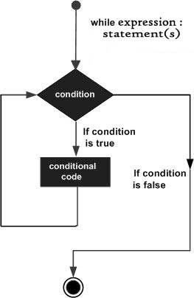
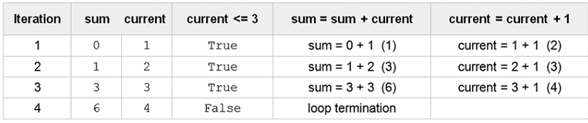
Example use
Sum of first ‘n’ numbers
sum =0
current =1
n=3
while current <= n:
sum=sum + current
current = current + 1

Slide 13
Print values from 0 to 9 in a line
a=0; b=10
while a < b: # One way to code counter loops print(a, end=' ')
a += 1 # Or, a = a + 1
Output:
0 1 2 3 4 5 6 7 8 9
Include end=‘ ‘ in print statement to suppress default move to new line

Slide 14
Break, continue, pass, and the Loop else
break Jumps out of the closest enclosing loop
continue Jumps to the top of the closest enclosing loop
pass Does nothing at all: it’s an empty statement placeholder
Loop else block Runs
if and only if the loop is exited normally (i.e., without hitting a break)

Slide 15
Break
With the break statement we can stop the loop even if the while condition is true:
Example
Exit the loop when i is 3:
i = 1 while i < 6: print(i) if i == 3: break i += 1

Slide 16
Output
1 2 3

Slide 17
Continue
With the continue statement we can stop the current iteration, and continue with the next:
Example
Continue to the next iteration if i is 3:
i = 0 while i < 6: i += 1 if i == 3: continue print(i)

Slide 18
Output
1 2 4 5 6
Number 3 is missing

Slide 19
Pass statement
pass is a null statement. The difference between a comment and pass statement in Python is that, while the interpreter ignores a comment entirely, pass is not ignored.
However, nothing happens when pass is executed. It results into no operation (NOP).

Slide 20
Suppose we have a loop or a function that is not implemented yet, but we want to implement it in the future.
They cannot have an empty body. The interpreter would complain. So, we use the pass statement to construct a body that does nothing.
Syntax: pass

Slide 21
i = 0 while i < 6: pass

Slide 22
Break statement
while True:
name = input('Enter name:')
if name == 'stop': break
age = input('Enter age: ')
print('Hello', name, '=>', int(age) ** 2)
Output:
Enter name:bob
Enter age: 40
Hello bob => 1600

Slide 23
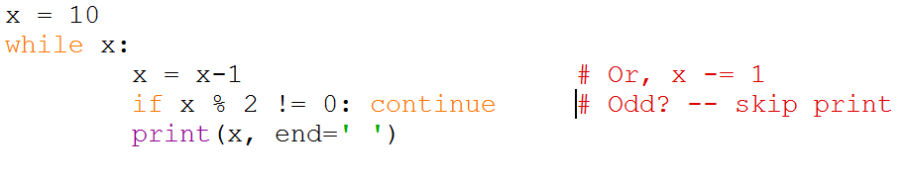
Print all even numbers less than 10 and greater than or equal to 0

Slide 24
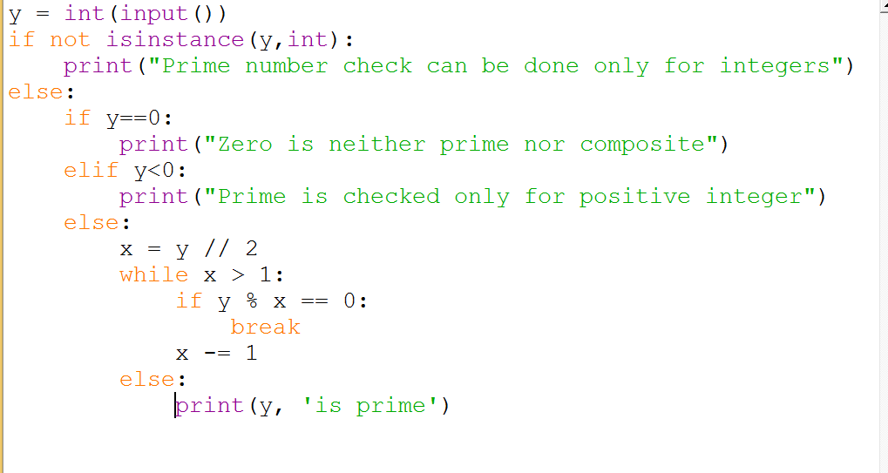
Check if a given number is Prime

Slide 25
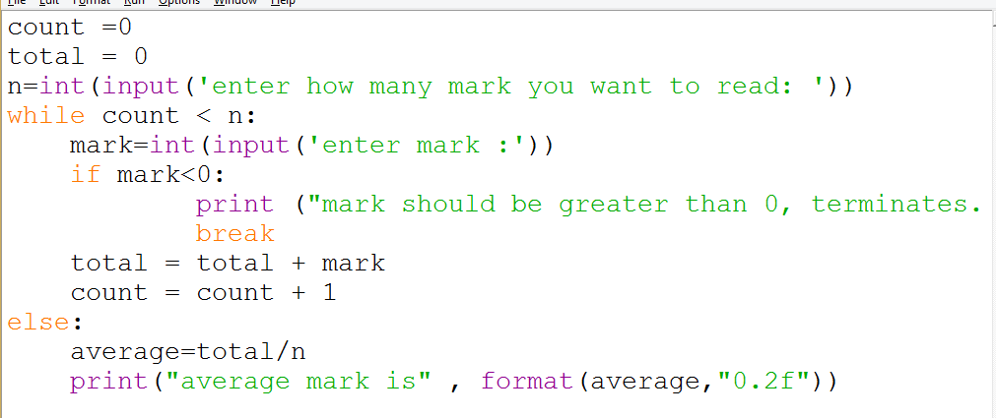
Class Average

Slide 26
Pattern Generation
Your teacher has given you the task to draw the structure of a staircase. Being an expert programmer, you decided to make a program for the same. You are given the height of the staircase. Given the height of the staircase, write a program to print a staircase as shown in the example. For example, Staircase of height 6:
#
##
###
####
#####
######
Boundary Conditions: height >0

Slide 27
Pattern Generation
Input | Processing | Output
Staircase height | Create steps one by one To create a step print character equal to length of step | Pattern

Slide 28
Pseudocode
READ staircase_height
if staircase_height > 0
x = 1
Repeat
y = 1
Repeat
print #
y = y + 1
Until y <= x
x = x + 1
Until x <= staircase_height
End if
Else
Print “Invalid input”

Slide 29
Test Cases
Input
3
Output
#
# #
# # #
Processing Involved
Print step by step

Slide 30
Test Cases
Input
-1
Output
Invalid input
Processing Involved
Boundary condition check fails

Slide 31
For iteration
In while loop, we cannot predict how many times the loop will repeat
The number of iterations depends on the input or until the conditional expression remains true
While loop is ideal when stop criteria is not explicit

Slide 32
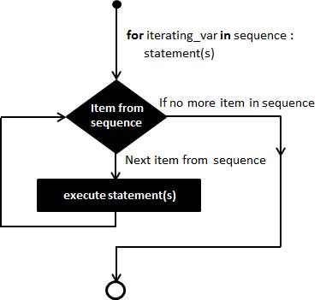
Control flow of for statement

Slide 33
Syntax of for Statement
for target in object:
# Assign object items to target
statements
if test: break # Exit loop now, skip else if test: continue # Go to top of loop now
else: statements # If we didn't hit a 'break’

Slide 34
For and Strings
for iterating_var in sequence or range:
statement(s)
Example:
for letter in 'Python':
print 'Current Letter :', letter

Slide 35
For and Strings
When the above code is executed:
Current Letter : P
Current Letter : y
Current Letter : t
Current Letter : h
Current Letter : o
Current Letter : n

Slide 36
Example
Print each fruit in a fruit list:
fruits = ["apple", "banana", "cherry"] for x in fruits: print(x)
Output:
apple banana cherry

Slide 37
Break in For Example
fruits = ["apple", "banana", "cherry"] for x in fruits: print(x) if x == "banana": break
Output:
apple banana

Slide 38
Break in For Example
fruits = ["apple", "banana", "cherry"] for x in fruits: if x == "banana": break print(x)
Output:
apple

Slide 39
Continue in FOR
continue statement we can stop the current iteration of the loop, and continue with the next.

Slide 40
Continue in FOR
fruits = ["apple", "banana", "cherry"] for x in fruits: if x == "banana": continue print(x)
Output:
apple cherry

Slide 41
For and Range
for n in range(1, 6):
print(n)
When the above code is executed:
1
2
3
4
5

Slide 42
range function call
Syntax - range( begin,end,step )
where
Begin - first value in the range; if omitted, then default value is 0
end - one past the last value in the range; end value may not be omitted
Step - amount to increment or decrement; if this parameter is omitted, it defaults to 1 and counts up by ones
begin, end, and step must all be integer values;
floating-point values and other types are not allowed

Slide 43
Example for Range
range(10) → 0,1,2,3,4,5,6,7,8,9
range(1, 10) → 1,2,3,4,5,6,7,8,9
range(1, 10, 2) → 1,3,5,7,9
range(10, 0, -1) → 10,9,8,7,6,5,4,3,2,1
range(10, 0, -2) → 10,8,6,4,2
range(2, 11, 2) → 2,4,6,8,10
range(-5, 5) → −5,−4,−3,−2,−1,0,1,2,3,4
range(1, 2) → 1
range(1, 1) → (empty)
range(1, -1) → (empty)
range(1, -1, -1) → 1,0
range(0) → (empty)

Slide 44
Print Even Numbers Using Range
>>> for i in range(2,10,2):
print(i)
Output:
2
4
6
8

Slide 45
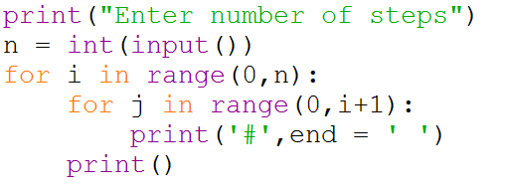

Slide 46
Else in For Loop
for x in range(6): print(x) else: print("Finally finished!")
Output:
0 1 2 3 4 5 Finally finished!

Slide 47
Nested Loops
adj = ["red", "big", "tasty"] fruits = ["apple", "banana", "cherry"] for x in adj: for y in fruits: print(x, y)

Slide 48
Output
red apple red banana red cherry big apple big banana big cherry tasty apple tasty banana tasty cherry

