Slide 1
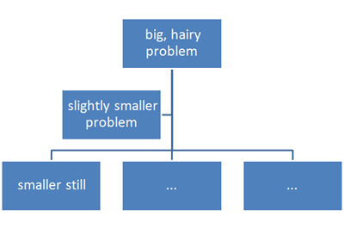
Functions

Slide 2
Keyword Arguments in Python
The functions we have looked at so far were called with a fixed number of positional arguments. A positional argument is an argument that is assigned to a particular parameter based on its position in the argument list, as illustrated below.

Slide 3


Slide 4
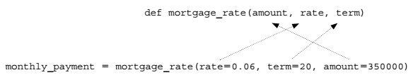
Keyword Arguments in Python Contd..
A keyword argument is an argument that is specified by parameter name, rather than as a positional argument as shown below

Slide 5
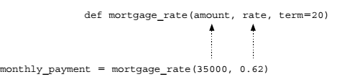
Default Arguments in Python
A default argument is an argument that can be optionally provided,
In this case, the third argument in calls to function mortgage_rate is optional. If omitted, parameter term will default to the value 20 (years) as shown. If, on the other hand, a third argument is provided, the value passed replaces the default parameter value.

Slide 6
Keyword and Default Examples
>>> def f(a, b, c):
print(a, b, c)
>>> f(1, 2, 3)
1 2 3
>>> f(c=3, b=2, a=1)
1 2 3
>>> f(1, c=3, b=2)
# a gets 1 by position, b and c passed by name 1 2 3

Slide 7
Defaults
>>> def f(a, b=2, c=3):
print(a, b, c)
# a required, b and c optional
>>> f(1) # Use defaults
1 2 3
>>> f(a=1)
1 2 3
>>> f(1, 4) # Override defaults
1 4 3
>>> f(1, 4, 5)
1 4 5

Slide 8
Defaults
>>> f(1, c=6) # Choose defaults
1 2 6
Combining keywords and defaults
def func(spam, eggs, toast=0, ham=0):
# First 2 required
print((spam, eggs, toast, ham))

Slide 9
Defaults
func(1, 2) # Output: (1, 2, 0, 0)
func(1, ham=1, eggs=0) # Output: (1, 0, 0, 1)
func(spam=1, eggs=0) # Output: (1, 0, 0, 0)
func(toast=1, eggs=2, spam=3)
# Output: (3, 2, 1, 0)
func(1, 2, 3, 4) # Output: (1, 2, 3, 4)

Slide 10
Arbitrary Arguments Examples
Use of ‘*’
collects unmatched positional arguments into a tuple:
>>> def f(*args):
print(args)

Slide 11
Arbitrary Arguments Examples
>>> f()
()
>>> f(1)
(1,)
>>> f(1, 2, 3, 4)
(1, 2, 3, 4)

Slide 12
Arbitrary Arguments Examples
** feature is similar, but it only works for keyword arguments—it collects them into a new dictionary
>>> def f(**args):
print(args)
>>> f()
{}
>>> f(a=1, b=2)
{'a': 1, 'b': 2}

Slide 13
Arbitrary Arguments Examples
>>> def f(a, *pargs, **kargs):
print(a, pargs, kargs)
>>> f(1, 2, 3, x=1, y=2)
1 (2, 3) {'y': 2, 'x': 1}

Slide 14
Calls: Unpacking arguments
>>> def func(a, b, c, d):
print(a, b, c, d)
>>> args = (1, 2)
>>>args += (3, 4)
>>> func(*args)
# Same as func(1, 2, 3, 4)
1 2 3 4

Slide 15
Calls: Unpacking arguments
>>> args = {'a': 1, 'b': 2, 'c': 3}
>>> args['d'] = 4
>>> func(**args)
# Same as func(a=1, b=2, c=3, d=4)
1 2 3 4

Slide 16
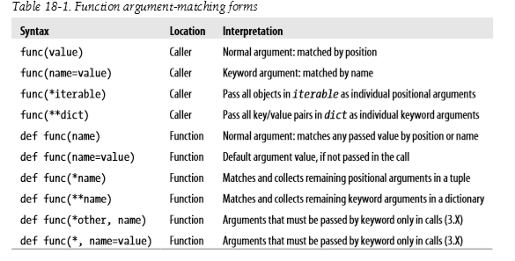

Slide 17
Different patterns in Algorithm

Slide 18
MOTIVATION-Recursion
Almost all computation involves the repetition of steps.
Iterative control statements, such as the for and while statements, provide one means of controlling the repeated execution of instructions.
Another way is by the use of recursion.

Slide 19
Recursive algorithms
In recursive problem solving, a problem is repeatedly broken down into similar sub problems, until the sub problems can be directly solved without further breakdown.

Slide 20
Recursive algorithms
Recursive algorithms ■ The functions computed by the algorithms are expressed in terms of itself ■ Example Task: Find the Factorial of a positive integer

Slide 21
Recursive algorithms
Algorithm:
Algorithm Factorial(n)
Begin if (n=1) than return 1 else return(n * Factorial(n-1)) End

Slide 22
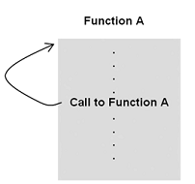
What Is a Recursive Function?
A recursive function is often defined as “a function that calls itself.”

Slide 23
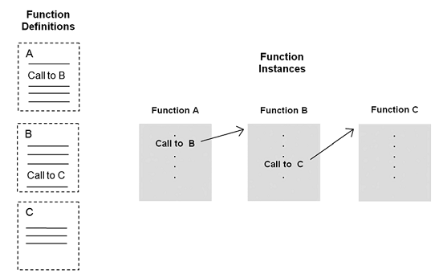
General mechanism of non-recursive function

Slide 24
Recursive function execution instances
Execution of a series of recursive function instances is similar to the execution of series of non-recursive instances, except that the execution instances are “clones” of each other (that is, of the same function definition).

Slide 25
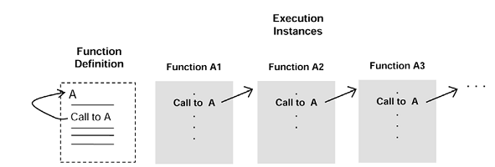

Slide 26
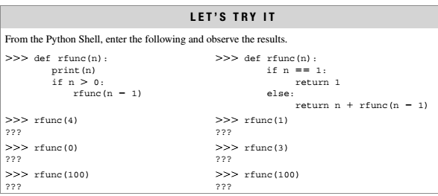

Slide 27
Example: Factorial
Problem:
The factorial function is an often-used example of the use of recursion. The computation of the factorial of 4 is given as,
factorial(4) = 4 * 3 * 2* 1= 24
In general, the computation of the factorial of any (positive, nonzero) integer n is,
factorial(n) = n . (n-1). (n-2) . . . 1
The one exception is the factorial of 0, defined to be 1.

Slide 28
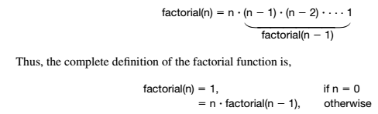
logic
The factorial of n can be defined as n times the factorial of n – 1

Slide 29

A Recursive Factorial Function Implementation
Input
Factorial(4)

Slide 30
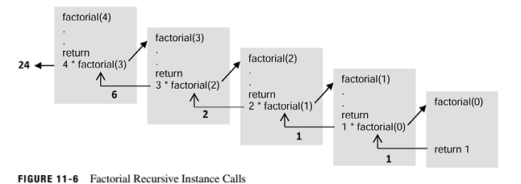
Factorial Recursive Instance Calls

Slide 31
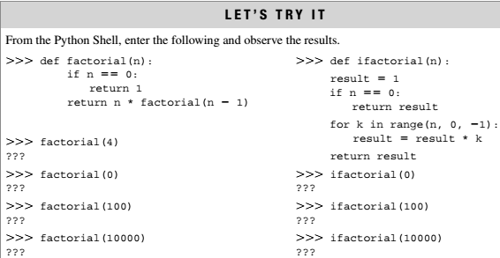

Slide 32
Command line arguments in Linux
command.py
import sys
print(len(sys.argv))
print(argv[0])
In terminal:
python command.py 2 3 4
3
command.py

Slide 33
Exercise 1
Ram is planning to give chocolates to two of his brother. He comes to a shop that has 'n' chocolates of type 1 and 'm' chocolates of type 2, and Ram wants to buy largest but equal number of both. Write a program to determine the number using recursive function.

