Slide 1
Pure Virtual Function
1

Slide 2
Runtime Polymorphism
Definition
Ability to take more than one form
An essential feature of an OO Language
It builds upon Inheritance
Allows run-time interpretation of object type for a given class hierarchy
Also Known as “Late Binding”
Implemented in C++ using virtual functions
2
Notes:
2

Slide 3
Dynamic Binding
Is the run-time determination of which function to call for a particular object of a derived class based on the type of the argument
Declaring a member function to be virtual instructs the compiler to generate code that guarantees dynamic binding
Dynamic binding requires pass-by-reference
3
Notes:
3

Slide 4
Whether constructors and destructors can be virtual??
Virtual constructors not allowed
But virtual destructors are allowed
Because when a pointer is deleted only the of the class type is called
Static binding is done
To do dynamic binding make destructors as virtual

Slide 5
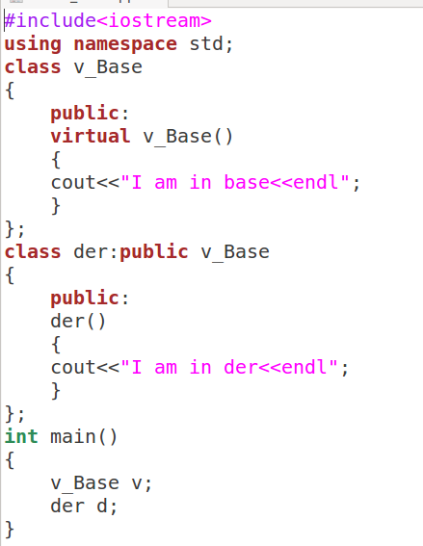

Slide 6
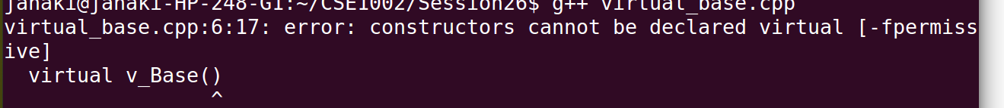

Slide 7
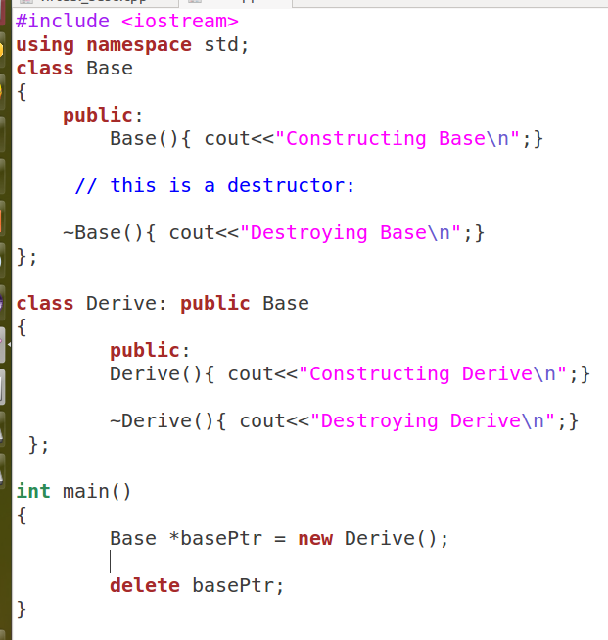

Slide 8
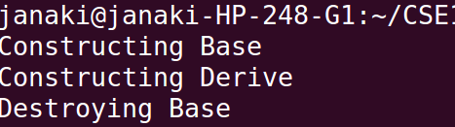

Slide 9
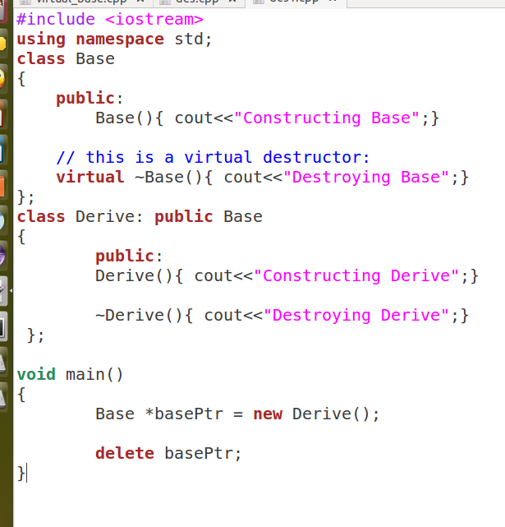

Slide 10
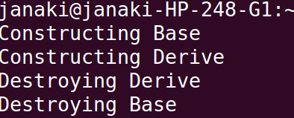

Slide 11
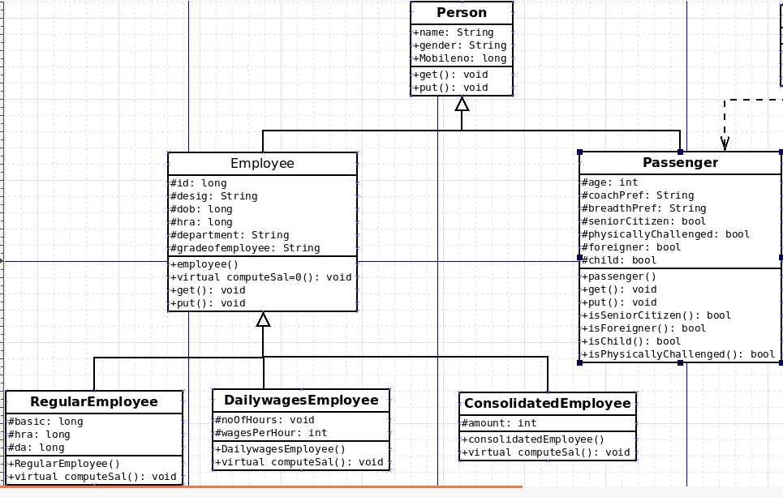

Slide 12
Employee Class
Different types of employees based on the way in which salary is calculated
All employees has salary but that cannot be determined in base class
Force any derived class to implement it
Make it as pure virtual functions

Slide 13
Pure Virtual Function
A pure virtual function is a function that has the notation "= 0" in the declaration of that function. Why we would want a pure virtual function and what a pure virtual function looks like is explored in more detail below.
Simple Example of a pure virtual function in C++
class SomeClass
{ public: virtual void pure_virtual() = 0; // a pure virtual function // note that there is no function body
};
13

Slide 14
The pure specifier
The "= 0" portion of a pure virtual function is also known as the pure specifier, because it’s what makes a pure virtual function “pure”.
Pure specifier appended to the end of the virtual function definition may look like the function is being assigned a value of 0, that is not true.
The notation "= 0" is just there to indicate that the virtual function is a pure virtual function, and that the function has no body or definition.
14

Slide 15
Abstract Classes
A class with one or more pure virtual functions is an Abstract Class
Objects of abstract class can’t be created
Abstract Class is a class which contains atl east one Pure Virtual function in it.
Abstract classes are used to provide an Interface for its sub classes.
Classes inheriting an Abstract Class must provide definition to the pure virtual function, otherwise they will also become abstract class.
But pointer of abstract class can hold address of derived class
15

Slide 16
Simple Example
Math Symbol Problem
Create an abstract class MathSymbol may provide a pure virtual function doOperation(), and create two more classes Plus and Minus implement doOperation() to provide concrete implementations of addition in Plus class and subtraction in Minus class.
16

Slide 17
Algorithm for Math Symbol Problem
Create Mathsymbol abstract class with doOperation() pure virtual function.
Create plus class derived from Mathsymbol.
Create minus class dervied from Mathsymbol.
Perform addition in plus class using doOperation() pure virtual function.
Perform subtraction in minus class using doOperation() pure virtual function.
Print each values in respective classes.
17

Slide 18
Implementation in C++
Already learnt creating classes
Learnt about Inheritance
Define Pure virtual function in Abstract(base) class.
Inherit virtual function for distinct operations.
Already learnt about how to display the output.
18

Slide 19
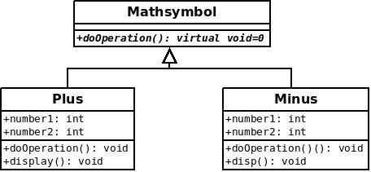
Class Diagram using Dia
19

Slide 20
Example
Some classes exist logically but not physically.
Example : Mathsymbol
Mathsymbol M;
Mathssymbol makes sense only as a base of some classes derived from it. Serves as a “category”
Hence instantiation of such a class must be prevented
class Mathsymbol //Abstract
{ public : //Pure virtual Function virtual void doOperation() = 0;
}
Mathsymbol M; // error : variable of an abstract class
20
Notes:
20

Slide 21
A pure virtual function not defined in the derived class remains a pure virtual function.
Hence derived class also becomes abstract
class Plus : public Mathsymbol{ //No doOperation() - Abstract public : void print(){ cout << “Doing Addition” << endl; }
class Minus : public Mathsymbol { public : void doOperation(){ // Override Mathsymbol:: doOperation() int a=10,b=5;
cout << “Subtration is = ” <<a-b<< endl; }
Minus m; // Valid
Plus p; // error : variable of an abstract class
21
Notes:
21

Slide 22
It is still possible to provide definition of a pure virtual function in the base class
The class still remains abstract and functions must be redefined in the derived classes, but a common piece of code can be kept there to facilitate reuse
In this case, they can not be declared inline
class Mathsymbol { //Abstract public : virtual void doOperation() = 0;
}; // OK, not defined inline
void Mathsymbol::doOperation(){ cout << “Arithmetic" << endl; }
class Minus : public Mathsymbol
{ public : void doOperation(){ Mathsymbol::doOperation(); //Reuse cout <<“Subtraction”<< endl; }
22
Notes:
22

Slide 23
Example: Pure Virtual Functions
class A {
public:
virtual void x() = 0;
virtual void y() = 0;
};
class B : public A {
public:
virtual void x();
};
class C : public B {
public:
virtual void y();
};
int main () {
A * ap = new C;
ap->x ();
ap->y ();
delete ap;
return 0;
};
A is an abstract (base) class
Similar to an interface in Java
Declares pure virtual functions (=0)
May also have non-virtual methods, as well as virtual methods that are not pure virtual
Derived classes override pure virtual methods
B overrides x(), C overrides y()
Can’t instantiate an abstract class
class that declares pure virtual functions
or inherits ones that are not overridden
A and B are abstract, can create a C
Can still have a pointer or reference to an abstract class type
Useful for polymorphism
23

Slide 24
Pure Virtual Functions: Summary
Pure virtual functions are useful because they make explicit the abstractness of a class
Tell both the user and the compiler how it was intended to be used
Note : It is a good idea to keep the common code as close as possible to the root of you hierarchy
24
Notes:
24

Slide 25
Difference b/w Virtual and Pure Virtual Function
A pure virtual function makes the class it is defined for abstract. Abstract classes cannot be instantiated. Derived classes need to override/implement all inherited pure virtual functions. If they do not, they too will become abstract. In C++, a class can define a pure virtual function that has an implementation.
25

