Slide 1
General form of a C program
Preprocessor directives
int main(void)
{
declarations;
statements;
}

Slide 2
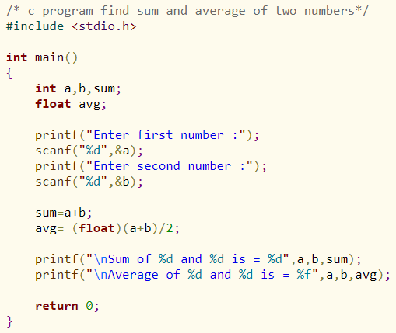
C-code

Slide 3
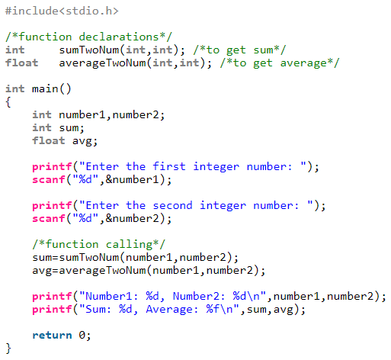
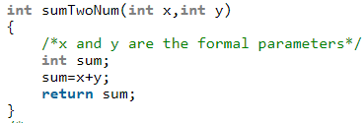
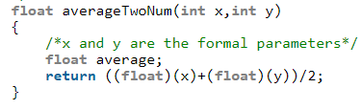

Slide 4
Pointer in c

Slide 5
Why Pointer?
Pointers provide direct access to memory
Reduces the execution time of the program
Pointers provide a way to return more than one value to the functions
Reduces the storage space and complexity of the program
Provides an alternate way to access array elements
Pointers can be used to pass information back and forth between the calling function and called function.
Used to change variables inside a function (reference parameters)
Pointers allows us to perform dynamic memory allocation and deallocation.
Pointers helps us to build complex data structures like linked list, stack, queues, trees, graphs etc.
Pointers allows us to resize the dynamically allocated memory block.
Addresses of objects can be extracted using pointers

Slide 6
Address in c
#include <stdio.h>
int main()
{
int var = 5;
printf("var: %d\n", var);
// Notice the use of ‘&’ before var
printf("address of var: %u", &var);
return 0;
}

Slide 7
Computer Memory
Each variable is assigned a memory slot (the size depends on the data type) and the variable’s data is stored there
Memory address:
1020
1024
1032
…
…
100
…
1024
…
a
Variable a’s value, i.e., 100, is
stored at memory location 1024
int a = 100;

Slide 8
Pointers
A pointer is a variable used to store the address of a memory cell or another variable.
We can use the pointer to reference this memory cell
Memory address:
1020
1024
1032
…
…
100
…
1024
…
integer
pointer

Slide 9
Pointer Variable
Declaration of Pointer variables
type* pointer_name;
//or
type *pointer_name;
where type is the type of data pointed to (e.g. int, char, double)
Examples:
int *n;
int **p; // pointer to pointer

Slide 10
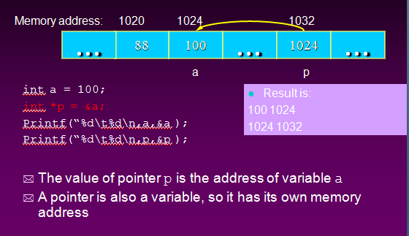
Pointer Variables

Slide 11
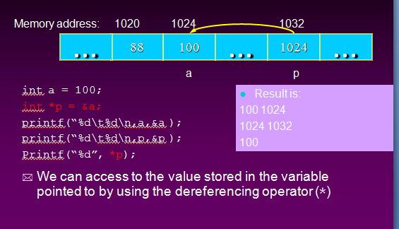
Dereferencing Operator *

Slide 12
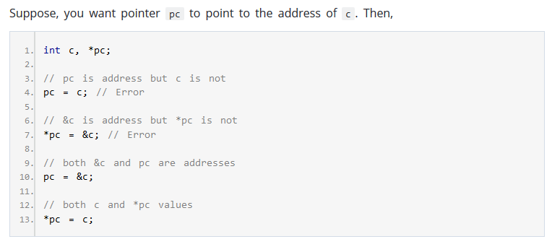
Common mistakes when working with pointers

Slide 13
Example – change data with variable and pointer
#include <stdio.h>
int main()
{
int* pc, c;
c = 22;
printf("Address of c: %u\n", &c);
printf("Value of c: %d\n\n", c); // 22
pc = &c;
printf("Address of pointer pc: %u\n", pc);
printf("Content of pointer pc: %d\n\n", *pc); // 22
c = 11;
printf("Address of pointer pc: %u\n", pc);
printf("Content of pointer pc: %d\n\n", *pc); // 11
*pc = 2;
printf("Address of c: %u\n", &c);
printf("Value of c: %d\n\n", c); // 2
return 0;
}

Slide 14
Another example
int main(){
int value1 = 5, value2 = 15;
int *p1, *p2;
p1 = &value1; // p1 = address of value1
p2 = &value2; // p2 = address of value2
*p1 = 10; // value pointed to by p1=10
*p2 = *p1; // value pointed to by p2= value
// pointed to by p1
p1 = p2; // p1 = p2 (pointer value copied)
*p1 = 20; // value pointed to by p1 = 20
printf("value1=%d \n vale2=%d", value1,value2);
return 0;
}

Slide 15
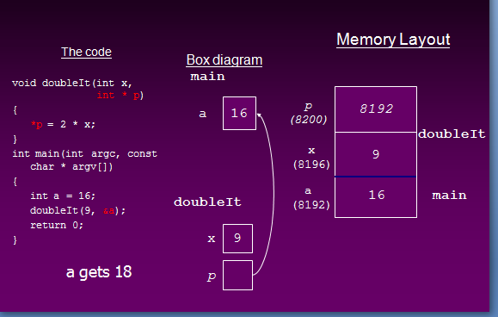
Pointer example with function

Slide 16
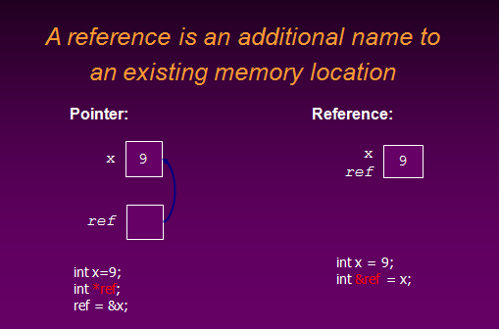
Reference Variable

Slide 17
Traditional Pointer usage
#include <stdio.h>
void IndirectSwap(char *Ptr1, char *Ptr2)
{
char temp = *Ptr1;
*Ptr1 = *Ptr2;
*Ptr2 = temp;
}
int main(){
char a = 'y'; char b = 'n';
IndirectSwap(&a, &b);
printf("a=%c\tb=%c",a,b);
return 0;
}

Slide 18
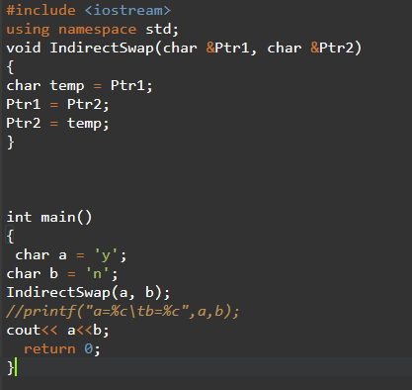
Pass by reference

Slide 19
C Pointer to array elements
#include <stdio.h>
const int MAX = 3;
int main () {
int var[] = {10, 100, 200};
int i, *ptr;
/* let us have array address in pointer */
ptr = var;
for ( i = 0; i < MAX; i++)
{
printf("Address of var[%d] = %x\n", i, ptr );
printf("Value of var[%d] = %d\n", i, *ptr );
/* move to the next location */
ptr++; }
return 0;
}

Slide 20
Another example
main() { int x[] = {1,2,3,4,5}; int *ptr,i ; ptr = x; for(i=0;i<5;i++) { printf("nAddress : %u",&x[i]); printf("nElement : %d",x[i]); printf("nElement : %u",*(x+i)); printf("nElement : %d",i[x]); printf("nElement : %d",*ptr); } }

Slide 21
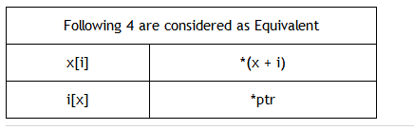
Note pointer array

Slide 22
Passing array to function using call by value method
#include <stdio.h>
void disp( char ch)
{
printf("%c ", ch);
}
int main()
{
char arr[] = {'a', 'b', 'c', 'd', 'e', 'f', 'g', 'h', 'i', 'j'};
for (int x=0; x<10; x++)
{
/* I’m passing each element one by one using subscript*/
disp (arr[x]);
}
return 0;
}

Slide 23
Passing array to function using call by reference
#include <stdio.h>
void disp( int *num)
{
printf("%d ", *num);
}
int main()
{
int arr[] = {1, 2, 3, 4, 5, 6, 7, 8, 9, 0};
for (int i=0; i<10; i++)
{
/* Passing addresses of array elements*/
disp (&arr[i]);
}
return 0;
}

Slide 24
How to pass an entire array to a function as an argument?
#include <stdio.h>
void myfuncn( int *var1, int var2)
{
/* The pointer var1 is pointing to the first element of
* the array and the var2 is the size of the array. In the
* loop we are incrementing pointer so that it points to
* the next element of the array on each increment. */
for(int x=0; x<var2; x++)
{
printf("Value of var_arr[%d] is: %d \n", x, *var1);
/*increment pointer for next element fetch*/
var1++;
}
}
int main()
{
int var_arr[] = {11, 22, 33, 44, 55, 66, 77};
myfuncn(var_arr, 7);
return 0;
}

Slide 25
Two dimensional array
#include <stdio.h>
const int n = 3;
void print(int arr[][n], int m)
{
int i, j;
for (i = 0; i < m; i++)
for (j = 0; j < n; j++)
printf("%d ", arr[i][j]);
}
int main()
{
int arr[][3] = {{1, 2, 3}, {4, 5, 6}, {7, 8, 9}};
print(arr, 3);
return 0;
}

Slide 26
Using single pointer
#include <stdio.h>
void print(int *arr, int m, int n)
{
int i, j;
for (i = 0; i < m; i++)
for (j = 0; j < n; j++)
printf("%d ", *((arr+i*n) + j));
}
int main()
{
int arr[][3] = {{1, 2, 3}, {4, 5, 6}, {7, 8, 9}};
int m = 3, n = 3;
print((int *)arr, m, n);
return 0;
}

Slide 27
Double pointer
#include <stdio.h>
// Same as "void print(int **arr, int m, int n)"
void print(int *arr[], int m, int n)
{
int i, j;
for (i = 0; i < m; i++)
for (j = 0; j < n; j++)
printf("%d ", *((arr+i*n) + j));
}
int main()
{
int arr[][3] = {{1, 2, 3}, {4, 5, 6}, {7, 8, 9}};
int m = 3;
int n = 3;
print((int **)arr, m, n);
return 0;
}

Slide 28
Dynamic memory allocation
malloc()
calloc()
free()
realloc()
Note : stdlib.h

Slide 29
C malloc() method
“malloc” or “memory allocation” method in C is used to dynamically allocate a single large block of memory with the specified size. It returns a pointer of type void which can be cast into a pointer of any form.
Syntax:
ptr = (cast-type*) malloc(byte-size)
For Example:
ptr = (int*) malloc(100 * sizeof(int));
Since the size of int is 4 bytes, this statement will allocate 400 bytes of memory. And, the pointer ptr holds the address of the first byte in the allocated memory.
If space is insufficient, allocation fails and returns a NULL pointer.

Slide 30
Example
#include <stdio.h> #include <stdlib.h> int main() { // This pointer will hold the // base address of the block created int* ptr; int n, i, sum = 0; // Get the number of elements for the array n = 5; printf("Enter number of elements: %d\n", n); // Dynamically allocate memory using malloc() ptr = (int*)malloc(n * sizeof(int)); // Check if the memory has been successfully // allocated by malloc or not | if (ptr == NULL) { printf("Memory not allocated.\n"); exit(0); } else { // Memory has been successfully allocated printf("Memory successfully allocated using malloc.\n"); // Get the elements of the array for (i = 0; i < n; ++i) { ptr[i] = i + 1; } // Print the elements of the array printf("The elements of the array are: "); for (i = 0; i < n; ++i) { printf("%d, ", ptr[i]); } } return 0; }

Slide 31
C calloc() method
“calloc” or “contiguous allocation” method in C is used to dynamically allocate the specified number of blocks of memory of the specified type. It initializes each block with a default value ‘0’.
Syntax:
ptr = (cast-type*)calloc(n, element-size);
For Example:
ptr = (float*) calloc(25, sizeof(float));
This statement allocates contiguous space in memory for 25 elements each with the size of the float.

Slide 32
Example
#include <stdio.h> #include <stdlib.h> int main() { int* ptr; int n, i, sum = 0; n = 5; printf(“Number of elements: %d\n", n); ptr = (int*)calloc(n, sizeof(int)); if (ptr == NULL) { printf("Memory not allocated.\n"); exit(0); } | else { printf("Memory successfully allocated using calloc.\n"); for (i = 0; i < n; ++i) { ptr[i] = i + 1; } printf("The elements of the array are: "); for (i = 0; i < n; ++i) { printf("%d, ", ptr[i]); } } return 0; }

Slide 33
free()
“free” method in C is used to dynamically de-allocate the memory. The memory allocated using functions malloc() and calloc() is not de-allocated on their own. Hence the free() method is used, whenever the dynamic memory allocation takes place. It helps to reduce wastage of memory by freeing it.
Syntax:
free(ptr);

Slide 34
Example
#include <stdio.h> #include <stdlib.h> int main() { // This pointer will hold the // base address of the block created int *ptr, *ptr1; int n, i, sum = 0; // Get the number of elements for the array n = 5; printf("Enter number of elements: %d\n", n); // Dynamically allocate memory using malloc() ptr = (int*)malloc(n * sizeof(int)); // Dynamically allocate memory using calloc() ptr1 = (int*)calloc(n, sizeof(int)); | printf("Memory successfully allocated using malloc.\n"); // Free the memory free(ptr); printf("Malloc Memory successfully freed.\n"); // Memory has been successfully allocated printf("\nMemory successfully allocated using calloc.\n"); // Free the memory free(ptr1); printf("Calloc Memory successfully freed.\n"); return 0; }

Slide 35
C realloc() method
“realloc” or “re-allocation” method in C is used to dynamically change the memory allocation of a previously allocated memory. In other words, if the memory previously allocated with the help of malloc or calloc is insufficient, realloc can be used to dynamically re-allocate memory.
Syntax:
ptr = realloc(ptr, newSize); where ptr is reallocated with new size 'newSize'.

Slide 36
Example
#include <stdio.h> #include <stdlib.h> int main() { // This pointer will hold the // base address of the block created int* ptr; int n, i, sum = 0; // Get the number of elements for the array n = 5; printf("Enter number of elements: %d\n", n); // Dynamically allocate memory using calloc() ptr = (int*)calloc(n, sizeof(int)); | printf("Memory successfully allocated using calloc.\n"); // Get the elements of the array for (i = 0; i < n; ++i) { ptr[i] = i + 1; } // Print the elements of the array printf("The elements of the array are: "); for (i = 0; i < n; ++i) { printf("%d, ", ptr[i]); } return 0; }

Slide 37
Example (cont…)
// Get the new size for the array n = 10; printf("\n\nEnter the new size of the array: %d\n", n); // Dynamically re-allocate memory using realloc() ptr = realloc(ptr, n * sizeof(int)); // Memory has been successfully allocated printf("Memory successfully re-allocated using realloc.\n"); // Get the new elements of the array for (i = 5; i < n; ++i) { ptr[i] = i + 1; } // Print the elements of the array printf("The elements of the array are: "); for (i = 0; i < n; ++i) { printf("%d, ", ptr[i]); } free(ptr); }

Slide 38
More Problem
https://www.techiedelight.com/pass-2d-array-function-parameter/

Slide 39
Draw backs of pointer
Uninitialized pointers might cause segmentation fault.
Dynamically allocated block needs to be freed explicitly. Otherwise, it would lead to memory leak.
Pointers are slower than normal variables.
Failed to protect memory addresses (locations) - Since pointer can access direct memory so memory cannot be protected.
If pointers are updated with incorrect values, it might lead to memory corruption.
Basically, pointer bugs are difficult to debug. Its programmers responsibility to use pointers effectively and correctly.

Slide 40
Key points to remember
Normal variable stores the value whereas pointer variable stores the address of the variable.
The content of the C pointer always be a whole number i.e. address.
Always C pointer is initialized to null, i.e. int *p = null.
The value of null pointer is 0.
& symbol is used to get the address of the variable.
* symbol is used to get the value of the variable that the pointer is pointing to.
If a pointer in C is assigned to NULL, it means it is pointing to nothing.
Two pointers can be subtracted to know how many elements are available between these two pointers.
The size of any pointer is 2 byte (for 16 bit compiler).

Slide 41
Exercise Problems
Write a program in C to add two numbers using pointers.
Write a program in C to add numbers using call by reference.
Write a program in C to find the maximum number between two numbers using a pointer.
Write a program in C to store n elements in an array and print the elements using pointer.
Write a program in C to print all permutations of a given string using pointers.

Slide 42
Write a program in C to find the largest element using Dynamic Memory Allocation.
Write a program in C to Calculate the length of the string using a pointer.
Write a program in C to sort an array using Pointer.
Write a program in C to compute the sum of all elements in an array using pointers.
Failed to protect memory addresses (locations) - Since pointer can access direct memory so memory cannot be protected.
Source :https://www.w3resource.com/c-programming-exercises/pointer/index.php

Slide 43
C program to declare memory for an integer variable dynamically.
C program to read and print name, where memory for variable should be declared at run time.
C program to find sum of array elements using Dynamic Memory Allocation.
Source : https://www.includehelp.com/c-programs/c-programs-pointers-solved-examples.aspx

Slide 44
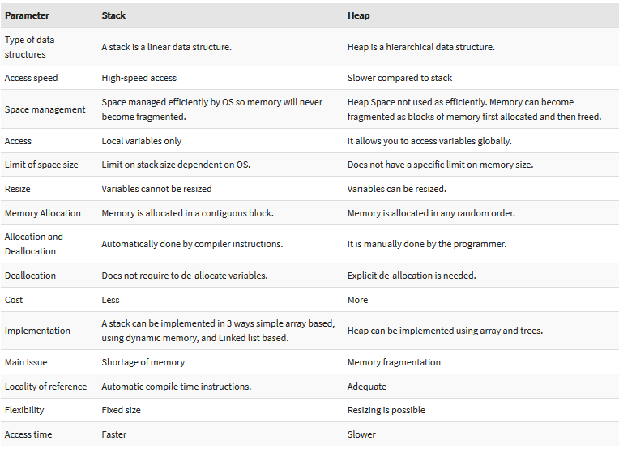
Stack vs Heap Storage

Slide 45
Stack allocation example 1
int main()
{
// All these variables get memory
// allocated on stack
int a;
int b[10];
int n = 20;
int c[n];
}

Slide 46
Stack allocation example 2
#include <stdio.h>
double multiplyByTwo (double input)
{
double twice = input * 2.0;
return twice;
}
int main (int argc, char *argv[])
{
int age = 30;
double salary = 12345.67;
double myList[3] = {1.2, 2.3, 3.4};
printf("double your salary is %.3f\n", multiplyByTwo(salary));
return 0;
}

Slide 47
Heap allocation example 1
int main () {
int *age = malloc(sizeof(int));
}

Slide 48
Heap allocation example 2
#include <stdio.h> #include <stdlib.h> double *multiplyByTwo (double *input) { double *twice = malloc(sizeof(double)); *twice = *input * 2.0; return twice; } int main (int argc, char *argv[]) { int *age = malloc(sizeof(int)); *age = 30; double *salary = malloc(sizeof(double)); *salary = 12345.67; double *myList = malloc(3 * sizeof(double)); | myList[0] = 1.2; myList[1] = 2.3; myList[2] = 3.4; double *twiceSalary = multiplyByTwo(salary); printf("double your salary is %.3f\n", *twiceSalary); free(age); free(salary); free(myList); free(twiceSalary); return 0; }

Slide 49
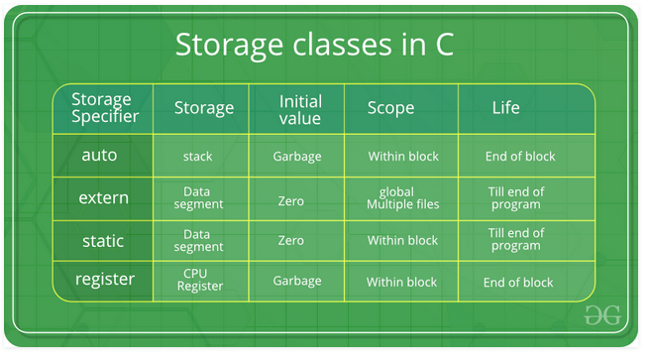
Storage class in c

Slide 50
Auto
This is the default storage class for all the variables declared inside a function or a block. Hence, the keyword auto is rarely used while writing programs in C language. Auto variables can be only accessed within the block/function they have been declared and not outside them (which defines their scope). Of course, these can be accessed within nested blocks within the parent block/function in which the auto variable was declared. However, they can be accessed outside their scope as well using the concept of pointers given here by pointing to the very exact memory location where the variables resides. They are assigned a garbage value by default whenever they are declared.

Slide 51
Auto example
int main()
{
// declaring an auto variable (simply
// writing "int a=32;" works as well)
auto int a = 32;
// printing the auto variable 'a'
printf("Value of the variable 'a'"
" declared as auto: %d\n", a);
}

Slide 52
register
This storage class declares register variables which have the same functionality as that of the auto variables. The only difference is that the compiler tries to store these variables in the register of the microprocessor if a free register is available. This makes the use of register variables to be much faster than that of the variables stored in the memory during the runtime of the program. If a free register is not available, these are then stored in the memory only. Usually few variables which are to be accessed very frequently in a program are declared with the register keyword which improves the running time of the program. An important and interesting point to be noted here is that we cannot obtain the address of a register variable using pointers.

Slide 53
Register example
int main()
{
// declaring an auto variable (simply
// writing "int a=32;" works as well)
register int a = 32;
// printing the auto variable 'a'
printf("Value of the variable 'a'"
" declared as auto: %d\n", a);
}

Slide 54
Static
This storage class is used to declare static variables which are popularly used while writing programs in C language. Static variables have a property of preserving their value even after they are out of their scope! Hence, static variables preserve the value of their last use in their scope. So we can say that they are initialized only once and exist till the termination of the program. Thus, no new memory is allocated because they are not re-declared. Their scope is local to the function to which they were defined. Global static variables can be accessed anywhere in the program. By default, they are assigned the value 0 by the compiler.

Slide 55
Static example
int main()
{
int i;
for (i = 1; i < 5; i++) {
// Declaring the static variable 'y'
static int y = 5;
// Declare a non-static variable 'p'
int p = 10;
// Incrementing the value of y and p by 1
y++;
p++;
// printing value of y at each iteration
printf("\nThe value of 'y', “ "declared as static, in %d “ "iteration is %d\n", i, y);
// printing value of p at each iteration
printf("The value of non-static variable 'p', “ “in %d iteration is %d\n", i, p);
}
}

Slide 56
extern
Extern storage class simply tells us that the variable is defined elsewhere and not within the same block where it is used. Basically, the value is assigned to it in a different block and this can be overwritten/changed in a different block as well. So an extern variable is nothing but a global variable initialized with a legal value where it is declared in order to be used elsewhere. It can be accessed within any function/block. Also, a normal global variable can be made extern as well by placing the ‘extern’ keyword before its declaration/definition in any function/block. This basically signifies that we are not initializing a new variable but instead we are using/accessing the global variable only. The main purpose of using extern variables is that they can be accessed between two different files which are part of a large program.

Slide 57
Extern example 1
First File: main.h #include <stdio.h> extern int i; | Second File: original.c #include <stdio.h> #include “main.h” main() { i=5; printf("value of the external integer is = %d\n", i); return 0; }

Slide 58
Extern example 2
#include <stdio.h>
extern int num1 = 1;
extern int num2 = 2;
int main()
{
int num1 = 3; int num2 = 4;
int add = num1 + num2;
printf("%d + %d = %d ", num1, num2, add);
return 0;
}

