Slide 1
SERVLETS

Slide 2
SERVLETS
Servlet can be described in many ways, depending on the context.
Servlet is a technology i.e. used to create web application.
Servlet is an API that provides many interfaces and classes including documentations.
Servlet is an interface that must be implemented for creating any servlet.
Servlet is a class that extend the capabilities of the servers and respond to the incoming request. It can respond to any type of requests.
Servlet is a web component that is deployed on the server to create dynamic web page.

Slide 3
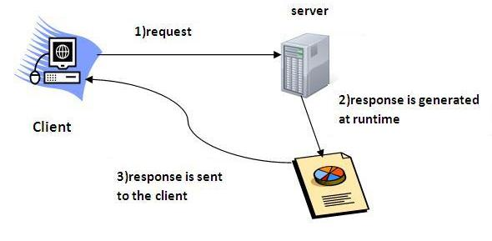

Slide 4
Benefits of servlets
Better performance: because it creates a thread for each request not process.
Portability: because it uses java language.
Robust: Servlets are managed by JVM so we don't need to worry about memory leak, garbage collection etc.
Secure: because it uses java language..

Slide 5
WEB TERMINOLOGY
Servlet Terminology | Description
Website: static vs dynamic | It is a collection of related web pages that may contain text, images, audio and video.
HTTP | It is the data communication protocol used to establish communication between client and server.
HTTP Requests | It is the request send by the computer to a web server that contains all sorts of potentially interesting information.
Get vs Post | It give the difference between GET and POST request.
Container | It is used in java for dynamically generate the web pages on the server side.
Server: Web vs Application | It is used to manage the network resources and for running the program or software that provides services.
Content Type | It is HTTP header that provides the description about what are you sending to the browser.

Slide 6
Servlet lifecycle
The web container maintains the life cycle of a servlet instance. Let's see the life cycle of the servlet:
Servlet class is loaded.
Servlet instance is created.
init method is invoked.
service method is invoked.
Destroy method is invoked.

Slide 7
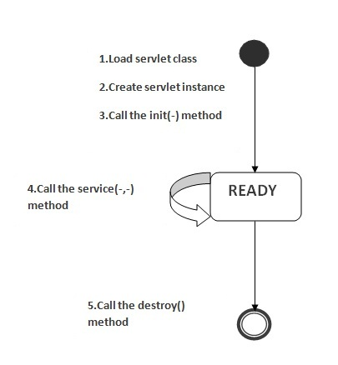
As displayed in the above diagram, there are three states of a servlet: new, ready and end. The servlet is in new state if servlet instance is created. After invoking the init() method, Servlet comes in the ready state. In the ready state, servlet performs all the tasks. When the web container invokes the destroy() method, it shifts to the end state.

Slide 8
contd…
1) Servlet class is loaded
The classloader is responsible to load the servlet class. The servlet class is loaded when the first request for the servlet is received by the web container.

Slide 9
2. Servlet instance is created
The web container creates the instance of a servlet after loading the servlet class. The servlet instance is created only once in the servlet life cycle.

Slide 10
init method is invoked
The web container calls the init method only once after creating the servlet instance. The init method is used to initialize the servlet. It is the life cycle method of the javax.servlet.Servlet interface. Syntax of the init method is given below:
public void init(ServletConfig config) throws ServletException

Slide 11
Service method is invoked
The web container calls the service method each time when request for the servlet is received. If servlet is not initialized, it follows the first three steps as described above then calls the service method.
If servlet is initialized, it calls the service method. Notice that servlet is initialized only once. The syntax of the service method of the Servlet interface is given below:
public void service(ServletRequest request, ServletResponse response) throws ServletException, IOException

Slide 12
destroy method
The web container calls the destroy method before removing the servlet instance from the service. It gives the servlet an opportunity to clean up any resource for example memory, thread etc. The syntax of the destroy method of the Servlet interface is given below:
public void destroy()

Slide 13
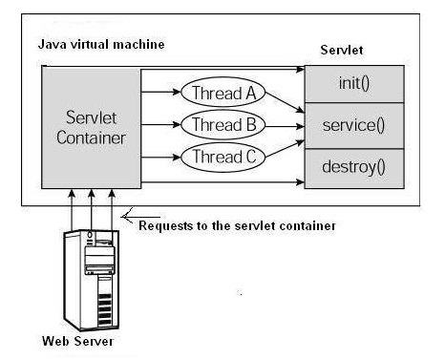
Servlet architecture

Slide 14
SERVLET API
The javax.servlet and javax.servlet.http packages represent interfaces and classes for servlet api.
The javax.servlet package contains many interfaces and classes that are used by the servlet or web container. These are not specific to any protocol.
The javax.servlet.http package contains interfaces and classes that are responsible for http requests only.

Slide 15
Interfaces in javax.servlet package
There are many interfaces in javax.servlet package. They are as follows:
Servlet
ServletRequest
ServletResponse
RequestDispatcher
ServletConfig
ServletContext
SingleThreadModel
Filter
FilterConfig
FilterChain
ServletRequestListener
ServletRequestAttributeListener
ServletContextListener
ServletContextAttributeListener

Slide 16
Servlet Interface
Servlet interface provides common behaviour to all the servlets.
Servlet interface needs to be implemented for creating any servlet (either directly or indirectly). It provides 3 life cycle methods that are used to initialize the servlet, to service the requests, and to destroy the servlet and 2 non-life cycle methods.
Methods of Servlet interface
There are 5 methods in Servlet interface. The init, service and destroy are the life cycle methods of servlet. These are invoked by the web container.

Slide 17
Method | Description
public void init(ServletConfig config) | initializes the servlet. It is the life cycle method of servlet and invoked by the web container only once.
public void service(ServletRequest request,ServletResponse response) | provides response for the incoming request. It is invoked at each request by the web container.
public void destroy() | is invoked only once and indicates that servlet is being destroyed.
public ServletConfig getServletConfig() | returns the object of ServletConfig.
public String getServletInfo() | returns information about servlet such as writer, copyright, version etc.

Slide 18
ServletRequest
ServletRequest Interface
An object of ServletRequest is used to provide the client request information to a servlet such as content type, content length, parameter names and values, header informations, attributes etc.

Slide 19
Method | Description
public String getParameter(String name) | is used to obtain the value of a parameter by name.
public String[] getParameterValues(String name) | returns an array of String containing all values of given parameter name. It is mainly used to obtain values of a Multi select list box.
java.util.Enumeration getParameterNames() | returns an enumeration of all of the request parameter names.
public int getContentLength() | Returns the size of the request entity data, or -1 if not known.
public String getCharacterEncoding() | Returns the character set encoding for the input of this request.
public String getContentType() | Returns the Internet Media Type of the request entity data, or null if not known.
public ServletInputStream getInputStream() throws IOException | Returns an input stream for reading binary data in the request body.
public abstract String getServerName() | Returns the host name of the server that received the request.
public int getServerPort() | Returns the port number on which this request was received.

Slide 20
ServletConfig Interface
An object of ServletConfig is created by the web container for each servlet. This object can be used to get configuration information from web.xml file.
If the configuration information is modified from the web.xml file, we don't need to change the servlet. So it is easier to manage the web application if any specific content is modified from time to time.
Advantage of ServletConfig
The core advantage of ServletConfig is that you don't need to edit the servlet file if information is modified from the web.xml file.

Slide 21
Methods of ServletConfig interface
public String getInitParameter(String name):Returns the parameter value for the specified parameter name.
public Enumeration getInitParameterNames():Returns an enumeration of all the initialization parameter names.
public String getServletName():Returns the name of the servlet.
public ServletContext getServletContext():Returns an object of ServletContext.
How to get the object of ServletConfig
getServletConfig() method of Servlet interface returns the object of ServletConfig.
Syntax of getServletConfig() method
public ServletConfig getServletConfig();

Slide 22
Example of getServletConfig() method
ServletConfig config=getServletConfig();
//Now we can call the methods of ServletConfig interface
Syntax to provide the initialization parameter for a servlet
The init-param sub-element of servlet is used to specify the initialization parameter for a servlet.
<web-app>
<servlet>
......
<init-param>
<param-name>parametername</param-name>
<param-value>parametervalue</param-value>
</init-param>
......
</servlet>
</web-app>

Slide 23
Servlet Context
An object of ServletContext is created by the web container at time of deploying the project. This object can be used to get configuration information from web.xml file. There is only one ServletContext object per web application.
If any information is shared to many servlet, it is better to provide it from the web.xml file using the <context-param> element.

Slide 24
Advantage of ServletContext
Easy to maintain if any information is shared to all the servlet, it is better to make it available for all the servlet. We provide this information from the web.xml file, so if the information is changed, we don't need to modify the servlet. Thus it removes maintenance problem.
Usage of ServletContext Interface
There can be a lot of usage of ServletContext object. Some of them are as follows:
The object of ServletContext provides an interface between the container and servlet.
The ServletContext object can be used to get configuration information from the web.xml file.
The ServletContext object can be used to set, get or remove attribute from the web.xml file.
The ServletContext object can be used to provide inter-application communication.

Slide 25
Commonly used methods of ServletContext interface
There is given some commonly used methods of ServletContext interface. public String getInitParameter(String name):Returns the parameter value for the specified parameter name. public Enumeration getInitParameterNames():Returns the names of the context's initialization parameters. public void setAttribute(String name,Object object):sets the given object in the application scope. public Object getAttribute(String name):Returns the attribute for the specified name. public Enumeration getInitParameterNames():Returns the names of the context's initialization parameters as an Enumeration of String objects. public void removeAttribute(String name):Removes the attribute with the given name from the servlet context.

Slide 26
How to get the object of ServletContext interface
getServletContext() method of ServletConfig interface returns the object of ServletContext.
getServletContext() method of GenericServlet class returns the object of ServletContext.
Syntax of getServletContext() method
public ServletContext getServletContext()

Slide 27
Example of getServletContext() method
//We can get the ServletContext object from ServletConfig object
ServletContext application=getServletConfig().getServletContext();
//Another convenient way to get the ServletContext object
ServletContext application=getServletContext();

Slide 28
Syntax to provide the initialization parameter in Context scope
The context-param element, subelement of web-app, is used to define the initialization parameter in the application scope. The param-name and param-value are the sub-elements of the context-param. The param-name element defines parameter name and and param-value defines its value. <web-app> ...... <context-param> <param-name>parametername</param-name> <param-value>parametervalue</param-value> </context-param> ...... </web-app>

Slide 29
Types of Servlet
Generic Servlet
javax.servlet (package)
extends javax.servlet.Servlet
service method
Http Servlet
javax.servlet.http (package)
extends javax.servlet.HttpServlet
doget(), doPost()….

Slide 30
Types of servlets (cont..)
Generic servlet
service(Request, Response) throws ServletException, IOException
HttpServlet
doGet(HttpServletRequest req, HttpServletResponse res)

