Slide 1



GRANDlib:
merged, cleaned, validated, beta-tested
Mauricio Bustamante
Niels Bohr Institute, University of Copenhagen
GRAND Weekly Meeting
October 1, 2026
Notes:
About 15 minutes. Four parts: the cleanup, input validation,
the beta test in three waves, and the timeline. One request:
access to the SPS data to test the aoi part of the code.

Slide 2
Since the last update
What
Status
Branches
All 40 branches decided; dev-next holds everything kept
done
Old PRs and issues
8 pull requests closed, 1 ported; 12 issues closed in triage, 7 fixed
done
Input validation
Bad input refused with a clear message: 50 of 60 cases, up from 7
merged, PR #179
Beta test
Two waves, 19 testers, 91 issues; all 11 Critical issues fixed
PR #208, CI green
2
Notes:
One minute. Each row is a part of the talk.

Slide 3
Cleaning up

Slide 4
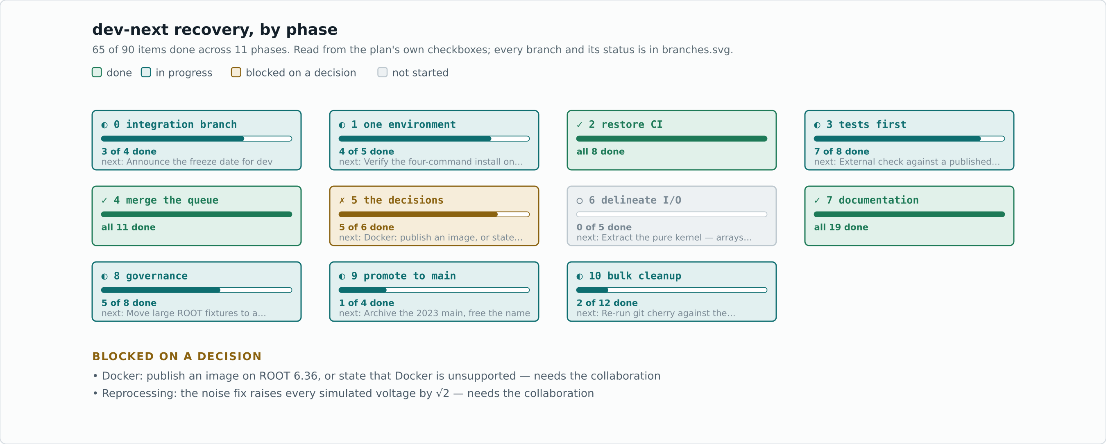
The recovery plan: 65 of 90 items done
Recovery plan: resources/dev/dev-next/ on dev-next
4
Notes:
Phases 2, 4 and 7 are done. Phase 5 waits on two collaboration decisions: Docker, and reprocessing.

Slide 5
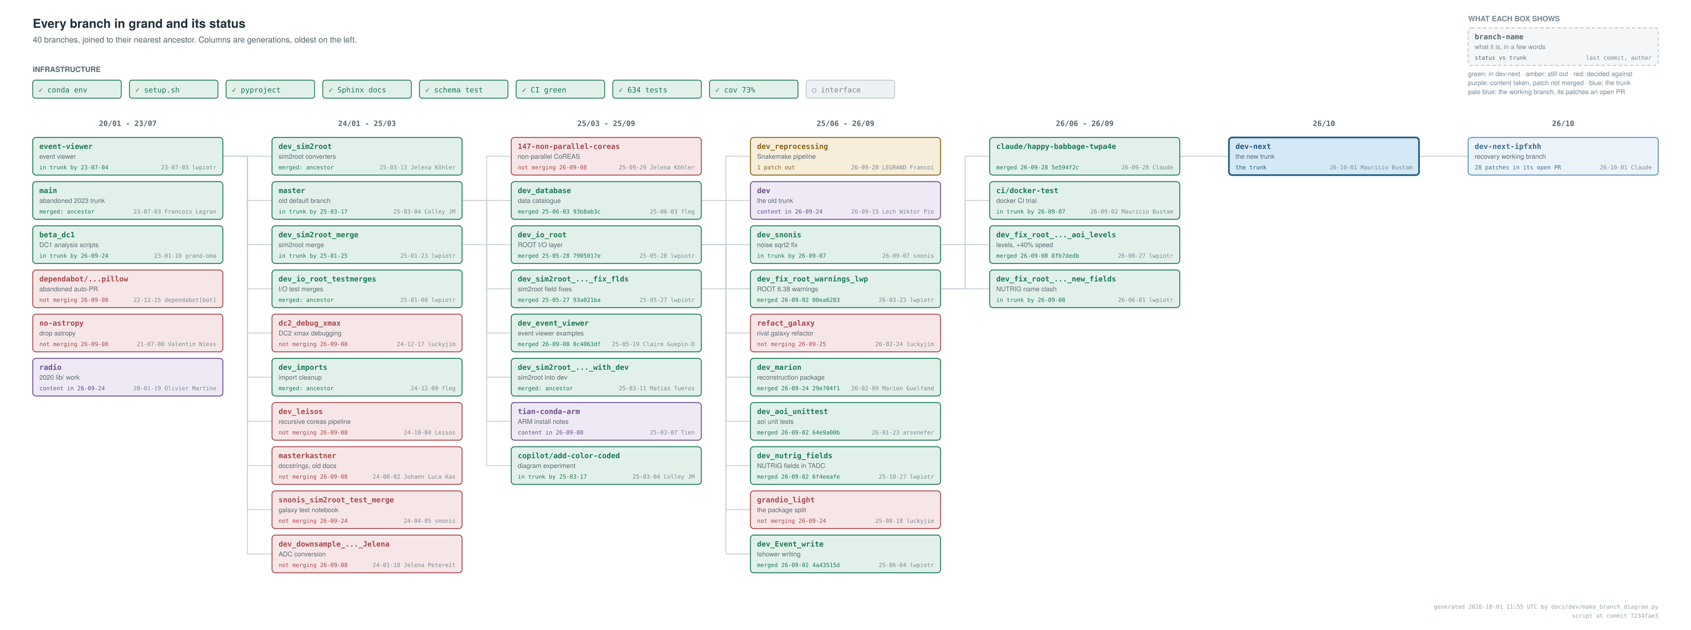
Every branch decided: 40 branches
Recovery plan: resources/dev/dev-next/ on dev-next
5
Notes:
Green: in dev-next. Red: decided against. Purple: content taken. Nothing deleted yet: archiving to tags waits for the software team.

Slide 6
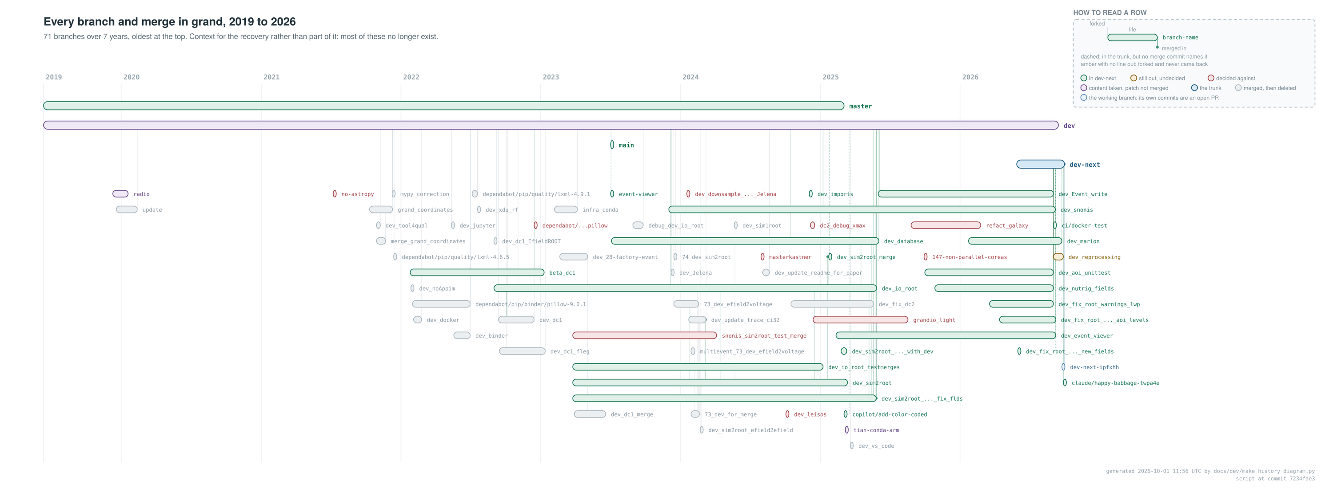
Seven years of branches, 2019 to 2026
Recovery plan: resources/dev/dev-next/ on dev-next
6
Notes:
Context only: most of these no longer exist.

Slide 7
Old pull requests and issues
Count
What happened
Pull requests
8 + 1
Closed: #9, #49, #52, #146, #149, #151, #153, #154. Ported by hand: #150 (Cramér–Rao bounds)
Old issues, triaged
12
Fixed (#95, #122, #123, #136); duplicate (#80, #84, #94, #99); not reproducible (#90, #92, #156); obsolete (#47)
Old issues, fixed
7
#71, #89, #91, #104 (Xmax, direction), #137, #139 (T1 trigger), #140 (reader)
Left for owners
4
#85, #121, #141, #142
Recovery plan: resources/dev/dev-next/ on dev-next
7

Slide 8
Input validation

Slide 9
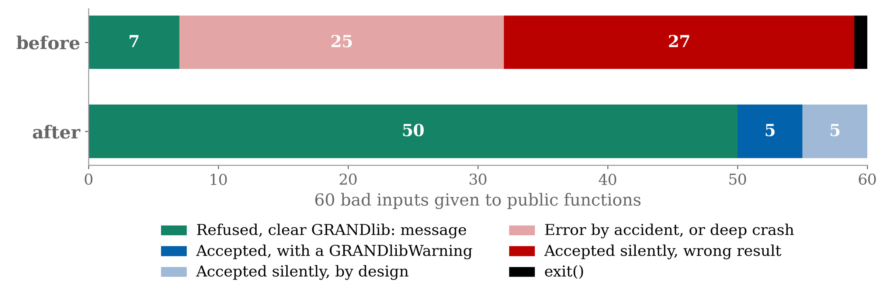
Bad input now stops with a clear message
60 bad inputs given to public functions: wrong type, range, shape or file. Before: 27 gave a wrong result silently. After: none do.
PR #179; Beta test: resources/dev/dev-next/beta-tests/TEST_PLAN.md, §4.1
9

Slide 10
The beta test

Slide 11
The beta test: three waves
Testers use GRANDlib as a newcomer, an expert or a pipeline user would, and report only.
Every report is reproduced before it becomes a GitHub issue, titled dev-next_beta-test: …, with its severity.
Fixes go into one pull request, one commit and one test each. A test must fail without its fix.
Wave
Testers
Looks for
Issues
1. Using it
11
Missing steps, wrong docs, brittle input
69
2. Checking it
8
Physics, docs, error handling, tests
22
3. Breaking it
5
Misuse, extremes, stress, unsafe input
next
Beta test: resources/dev/dev-next/beta-tests/TEST_PLAN.md
11
Notes:
Testers are AI agents, each in its own copy of the repository, on dev-next at 91d30a1b.

Slide 12
Wave 1: using it
Tester
Area
Issues
Critical
High
Beginners (×3)
Setup, the 12 notebooks, examples
14
–
2
Expert, dataio
Every tree, reader and writer
12
–
5
Expert, analysis
aoi, reconstruction, event viewer
7
1
3
Pipeline, ZHAireS
ZHAireS → rawroot → sim2root
8
1
3
Pipeline, CoREAS
CoREAS, e-field → voltage → ADC
9
4
2
Input fuzzers (×4)
Readers, scripts, damaged simulations
18
6
8
69 issues: 10 Critical, 22 High, 26 Medium, 11 Low. Most Critical ones were in the conversion chain.
Beta test: resources/dev/dev-next/beta-tests/TEST_PLAN.md
12
Notes:
Counts include 5 issues found before the wave, while double-checking the validation PR. An issue reported by two testers counts once.

Slide 13
Wave 2: checking it
Tester
Area
Issues
Critical
High
Physics (×2)
Coordinates, Xmax, signal chain, noise
7
1
2
Documentation (×2)
Docs, Handbook, READMEs, docstrings
4
–
1
Error handling
Silent failures, prints, asserts
3
–
2
Test suite
Coverage, deliberate bugs, weak tests
2
–
1
Input validation
Type, range, shape, units
6
–
3
Notebook prose
Every claim against its output
2
–
1
22 issues: 1 Critical, the EGM96 geoid upside down (−7.75 m at GP300 instead of −61.0 m). The test suite let 5 of 15 deliberate bugs through.
Beta test: resources/dev/dev-next/beta-tests/TEST_PLAN.md
13

Slide 14
Wave 3: breaking it
Breaker
Attack
Misuse
Methods in the wrong order; one object across files; events that do not exist
Numerical edges
Zenith 0° and 90°; NaN through a whole chain; one-antenna events
Scale and stress
Thousands of files; long traces; memory over long loops
Environment
Unset variables; missing packages; read-only or partial data
Unsafe input
File names that reach a shell; archive extraction
Starts once PR #208 is merged. A regression wave then re-runs the busiest testers on the fixed code.
Beta test: resources/dev/dev-next/beta-tests/TEST_PLAN.md
14

Slide 15
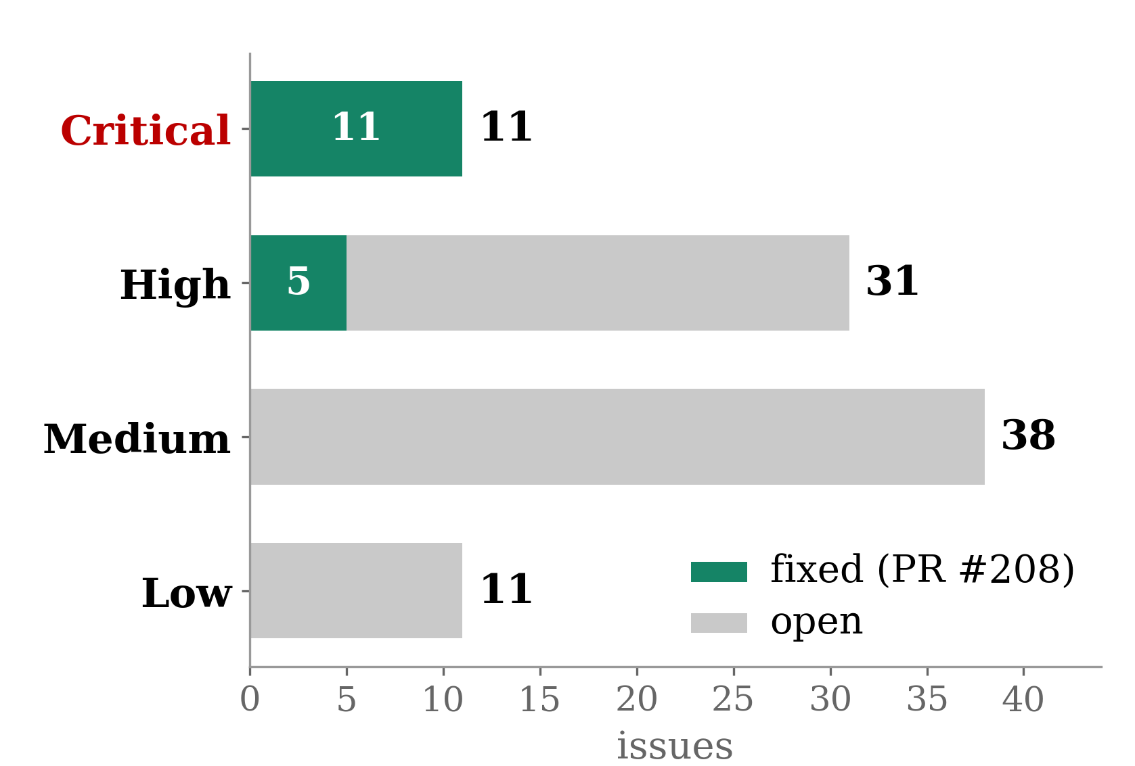
91 issues; every Critical one fixed
Severity
Issues
Fixed
Open
Critical
11
11
0
High
31
5
26
Medium
38
0
38
Low
11
0
11
Total
91
16
75
Critical: wrong physics or data, silently.
High: crashes, data loss, documented commands that fail.
Beta test: resources/dev/dev-next/beta-tests/TEST_PLAN.md. Fixed: in PR #208, not yet merged
15

Slide 16
The 11 Critical bugs, now fixed
Issue
Was wrong
Effect
#209
CoREAS azimuth mirrored
Wrong arrival direction
#220
sim2root antenna latitude and longitude
Off by up to 8 km
#227, #229
RF-chain options ignored; resampled rate lost
Wrong voltages and ADC rate
#228
Unknown CoREAS Xmax read as −1 cm
Voltages near 10⁻¹³ µV
#237
L0 e-field paired with an L1 run tree
Amplitudes doubled
#238, #247
A missing event or shower
Another event’s data
#242, #243
Damaged simulations accepted
Valid-looking files
#250
EGM96 geoid upside down
Heights off by 53 m at GP300
PR #208: one commit and one test each; CI green on ROOT 6.36 and 6.38
16
Notes:
Each gave a plausible wrong answer with exit code 0.

Slide 17
Still to fix
Area
Open High issues
Data loss
write() replaces trees; Event.write(overwrite=True); extract_events -ow; re-runs; get_files_from_db.py
Silent wrong results
DataDirectory drops files; event order; NaN in the ADC; geodetic heights west of Greenwich
Commands that fail
README quickstart; pipeline commands; docs examples; helper scripts
Crashes and hangs
close_files(); EventList options; the rf_chain error path
Next: the 26 High issues, data loss first. The 38 Medium and 11 Low are mostly docs and messages.
Beta test: resources/dev/dev-next/beta-tests/TEST_PLAN.md
17

Slide 18
What we need from you
Access to the GRAND data at CC-IN2P3 (SPS), to run the aoi part of GRANDlib on real events.
The aoi readers and the reconstruction scripts expect the data under /sps/grand/data/. So far they have been tested only on simulations and on the small files committed to the repository.
An account, or a few event files copied out, would be enough.
18
Notes:
This is the one request.

Slide 19
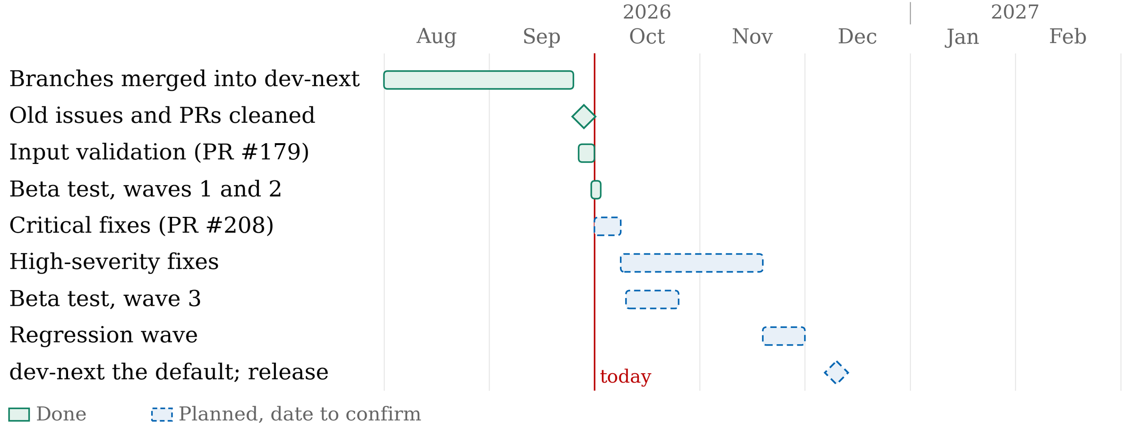
Timeline
Planned dates to confirm; the release waits for the software team’s green light
19
Notes:
Leave this up during questions.

