Slide 1
CSC 202 – Computer Programming II Structured Programming With JAVA
Oguche David e.
University of jos

Slide 2
Outline
Introduction
Unstructured Programming
Structured Programming
Installation of JAVA and Intellij IDEA
Selections in JAVA
Conclusion

Slide 3
Introduction
Java is an Object-Oriented Language
Android Mobile Apps, Desktop App, Web App
Designed by James Gosling
Developed by Sun Microsystems
(now owned by Oracle Corporation)
https://oracle.com/java/

Slide 4
Unstructured Programming
Unstructured Programming is an early form of programming where the solution for a given problem is written in a single continuous block of code.
Goto Statements “Spagetti Code”
Examples of languages that implement unstructured programming are:
Early versions of Visual Basic (MSX Basic, GW Basic)
Assembly Language

Slide 5
Structured Programming
Structured Programming is a programming paradigm which uses structured control flow constructs to break down a computer program into logical parts that are easier to understand and modify.
Structure Programming Theorem
Sequence, Selection, Iterations

Slide 6
Structured Programming
Some examples of programming languages that implement structured programming are:
C, C+, C++, C#, Java, Python

Slide 7
Installation of JAVA and Intellij IDEA
JAVA Installation
https://www.oracle.com/technetwork/java/javase/downloads/index-jsp-138363.html
DEMO

Slide 8
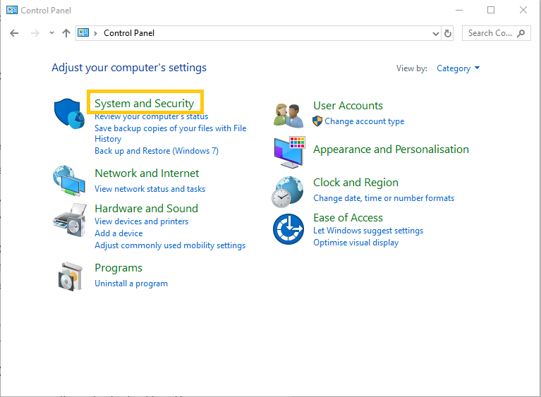

Slide 9
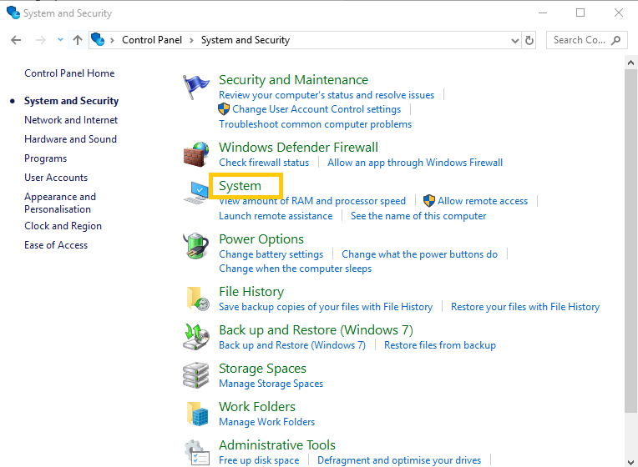

Slide 10
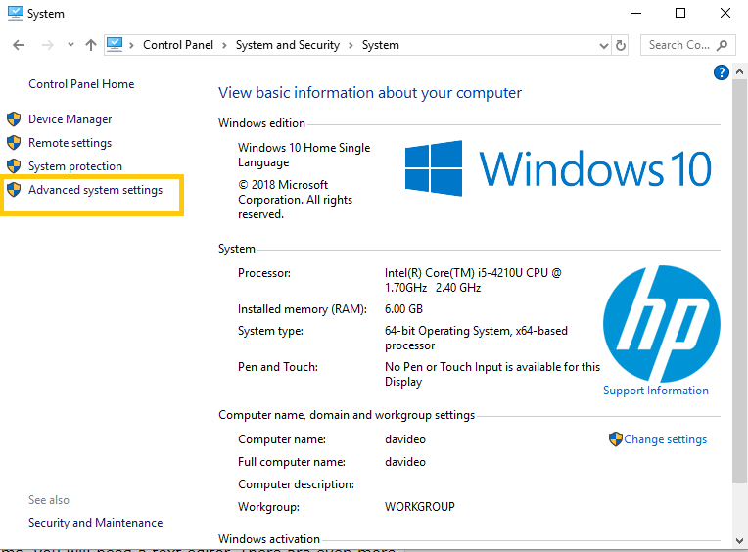

Slide 11
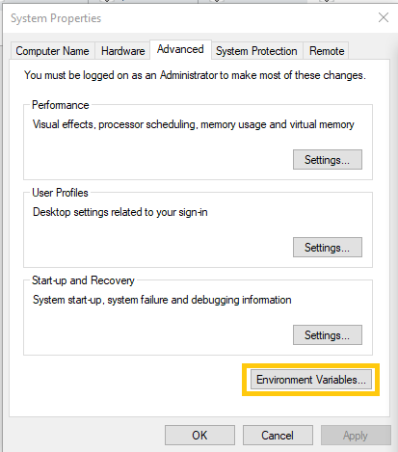

Slide 12
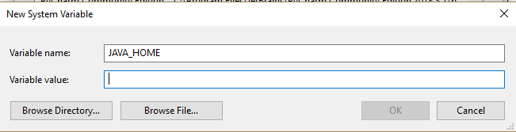

Slide 13
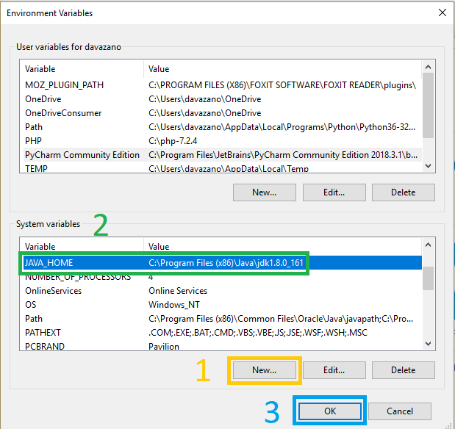

Slide 14
Installation of JAVA and Intellij IDEA
System requirements for Intellij IDEA
Microsoft Windows 10/8/7/Vista/2003/XP (incl.64-bit)
2 GB RAM minimum, 4 GB RAM recommended
1.5 GB hard disk space + at least 1 GB for caches
1024x768 minimum screen resolution

Slide 15
Demo
System.out.println("Hello World");
Primitive Data Types
Byte,
short,
int,
long,

Slide 16
Primitive Data Types
float,
double,
boolean,
char

Slide 17
Byte
Byte data type is an 8-bit signed two's complement integer
Range
-128 to 127
Default value is 0
Example: byte age = 99;

Slide 18
Short
Short data type is a 16-bit signed two's complement integer
Range
-32,768 (-2^15) to 32,767 (inclusive) (2^15 -1)
Default value is 0.
Example: short width = 10000;

Slide 19
Integer (int)
Int data type is a 32-bit signed two's complement integer.
Range:
- 2,147,483,648 (-2^31) to 2,147,483,647(inclusive) (2^31 -1)
The default value is 0
Example: int a = 100000, int b = -200000

Slide 20
Long
Long data type is a 64-bit signed two's complement integer
Range:
-9,223,372,036,854,775,808(-2^63) to 9,223,372,036,854,775,807 (inclusive)(2^63 -1)

Slide 21
Long
This type is used when a wider range than int is needed
Default value is 0L
Example: long a = 100000L, long b = -200000L

Slide 22
Float
Float is mainly used to save memory in large arrays of floating point numbers
Default value is 0.0f
Float data type is never used for precise values such as currency
Example: float f1 = 234.5f

Slide 23
Double
Double data type is a double-precision 64-bit IEEE 754 floating point
This data type is generally used as the default data type for decimal values, generally the default choice
Default value is 0.0d
Example: double d1 = 123.4

Slide 24
Boolean
boolean data type represents one bit of information
There are only two possible values:
true and false

Slide 25
Boolean
This data type is used for simple flags that track true/false conditions
Default value is false
Example: boolean one = true

Slide 26
Char
Char data type is a single 16-bit Unicode character
Range:
'\u0000' (or 0) to '\uffff' (or 65,535 inclusive)
Char data type is used to store any character
Example: char grade = 'A'

Slide 27
Variables
int age = 16;
double pi = 3.14;
char grade = ‘A’;

Slide 28
Demo
Operator | Name | Description | Example
+ | Addition | Adds values on either side of the operator. | A + B = 300
- | Subtraction | Subtracts right-hand operand from left-hand operand. | A - B = -100
* | Multiplication | Multiplies values on either side of the operator. | A * B = 2000
/ | Division | Divides left-hand operand by right-hand operand. | B / A = 2
% | Modulus | Divides left-hand operand by right-hand operand and returns remainder. | B % A = 0
++ | Increment | Increases the value of operand by 1. | ++B = 201
-- | Decrement | Decreases the value of operand by 1. | --B = 199
Basic Operators
Arithmetic Operators
A = 100
B = 200

Slide 29
String
is a sequence of characters
in Java we declare strings as objects (instance of String Class)
so a string data type is a reference/object data type

Slide 30
Examples of String
String message = "Welcome to CSC 202 Labs";
String Name = "Dave";

Slide 31
String Concatenation
"My name is ".concat("Adam");
"I am ".concat(String.valueOf(age)).concat("years old");
"My name is ".concat(Name);

Slide 32
Relational Operators (A = 100, B = 200)
Operator | Name | Description | Example
== | equal to | Checks if the values of two operands are equal or not, if yes then condition becomes true. | (A == B) is not true.
!= | not equal to | Checks if the values of two operands are equal or not, if values are not equal then condition becomes true. | (A != B) is true.
> | greater than | Checks if the value of left operand is greater than the value of right operand, if yes then condition becomes true. | (A > B) is not true.
< | less than | Checks if the value of left operand is less than the value of right operand, if yes then condition becomes true. | (A < B) is true.
>= | greater than or equal to | Checks if the value of left operand is greater than or equal to the value of right operand, if yes then condition becomes true. | (A >= B) is not true.
<= | less than or equal to | Checks if the value of left operand is less than or equal to the value of right operand, if yes then condition becomes true. | (A <= B) is true.

Slide 33
Selections in JAVA
In JAVA, selections are implemented using the keywords if, else if and else
Example:
If (age < 18) {
text.setText("Sorry, you are under the required age.");
}

Slide 34
Selections in JAVA
Example:
If (age < 18) {
text.setText("Sorry, you are under the required age.");
} else {
text.setText(“You have met the required age.");
}

Slide 35
Nested if statement
Example:
If (age < 18) {
if (region == “Plateau”) {
text.setText(“You are qualified to under go the screening for the Plateau Under 18 Football League.");
}
}

Slide 36
Switch statement
Example:
If (age < 18) {
if (region == “Plateau”) {
text.setText(“You are qualified to under go the screening for the Plateau Under 18 Football League.");
}
}

Slide 37
Switch case statement
Example:
switch(fruit) {
case “Mango” :
text.setText(“You selected Mango.");
break;
case “Orange”:
text.setText(“You selected Orange.");
break;
default : // Optional
text.setText(“I do not know this fruit.");
}

Slide 38
Logical Operators
Operator | Name | Description | Example
&& | logical and | Called Logical AND operator. If both the operands are non-zero, then the condition becomes true. | (A && B) is false
|| | logical or | Called Logical OR Operator. If any of the two operands are non-zero, then the condition becomes true. | (A || B) is true
! | logical not | Called Logical NOT Operator. Use to reverses the logical state of its operand. If a condition is true then Logical NOT operator will make false. | !(A && B) is true
boolean A = true;
boolean B = false;

Slide 39
if statement using Logical Operators
Example:
If (age < 18 && region == “Plateau”) {
text.setText(“You are qualified to under go the screening for the Plateau Under 18 Football League.");
}

Slide 40
if statement using Logical Operators
Example:
If (age < 18 || region == “Plateau”) {
text.setText(“You may enjoy the Plateau Under 18 Football League.");
}

Slide 41
Demo

Slide 42
Conclusion
JAVA is a Structural Programming Language and an Object Programming Language
JAVA uses the keywords if, else and switch, case for selections (conditions)
In JAVA we have
Primitive Data Types such as Byte, short, int, long, float, double, Boolean, char
And Reference/Object Data Types such as String

Slide 43
THANK YOU

