Slide 1
Chapter 5
Net Present Value and Other Investment Rules

Slide 2

Be able to compute payback and discounted payback and understand their shortcomings
Be able to compute the internal rate of return and profitability index, understanding the strengths and weaknesses of both approaches
Be able to compute net present value and understand why it is the best decision criterion
Copyright © 2016 McGraw-Hill Education. All rights reserved.
No reproduction or distribution without the prior written consent of McGraw-Hill Education.

Slide 3

5.1 Why Use Net Present Value?
5.2 The Payback Period Method
5.3 The Discounted Payback Period Method
5.4 The Internal Rate of Return
5.5 Problems with the IRR Approach
5.6 The Profitability Index
5.7 The Practice of Capital Budgeting
Copyright © 2016 McGraw-Hill Education. All rights reserved.
No reproduction or distribution without the prior written consent of McGraw-Hill Education.

Slide 4
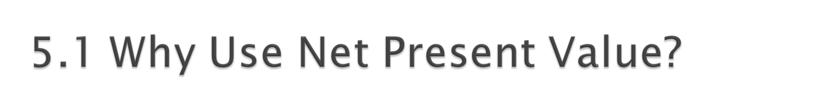
Accepting positive NPV projects benefits shareholders.
  NPV uses cash flows
  NPV uses all the cash flows of the project
  NPV discounts the cash flows properly
Copyright © 2016 McGraw-Hill Education. All rights reserved.
No reproduction or distribution without the prior written consent of McGraw-Hill Education.
Notes:
Note that the NPV recognizes the magnitude, risk, and timing of cash flows, which was an important description of why stock price maximization should be the primary corporate goal.

Slide 5

Net Present Value (NPV) =
Total PV of future CF’s + Initial Investment
Estimating NPV:
  1. Estimate future cash flows: how much? and when?
  2. Estimate discount rate
  3. Estimate initial costs
Minimum Acceptance Criteria: Accept if NPV > 0
Ranking Criteria: Choose the highest NPV
Copyright © 2016 McGraw-Hill Education. All rights reserved.
No reproduction or distribution without the prior written consent of McGraw-Hill Education.
Notes:
Note that although we add the initial investment, this value is a negative number.

Slide 6
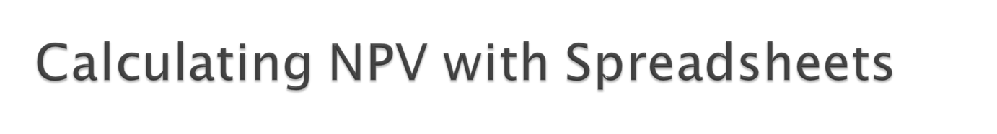

Spreadsheets are an excellent way to compute NPVs, especially when you have to compute the cash flows as well.
Using the NPV function:
  The first component is the required return entered as a decimal.
  The second component is the range of cash flows beginning with year 1.
  Add the initial investment after computing the NPV.
Copyright © 2016 McGraw-Hill Education. All rights reserved.
No reproduction or distribution without the prior written consent of McGraw-Hill Education.
Notes:
Click on the Excel icon to go to an embedded Excel worksheet that has example cash flows, along with the correct and incorrect ways to compute NPV. Click on the cell with the solution to show the students the difference in the formulas.
Again, note that when we add the initial investment, this is a negative number.

Slide 7

How long does it take the project to “pay back” its initial investment?
Payback Period = number of years to recover initial costs
Minimum Acceptance Criteria:
  Set by management
Ranking Criteria:
  Set by management
Copyright © 2016 McGraw-Hill Education. All rights reserved.
No reproduction or distribution without the prior written consent of McGraw-Hill Education.

Slide 8

Disadvantages:
  Ignores the time value of money
  Ignores cash flows after the payback period
  Biased against long-term projects
  Requires an arbitrary acceptance criteria
  A project accepted based on the payback criteria may not have a positive NPV
Advantages:
  Easy to understand
  Biased toward liquidity
Copyright © 2016 McGraw-Hill Education. All rights reserved.
No reproduction or distribution without the prior written consent of McGraw-Hill Education.
Notes:
Cash flows prior to the cutoff are implicitly discounted at a rate of zero, and cash flows after the cutoff are discounted using an infinite discount rate.

Slide 9
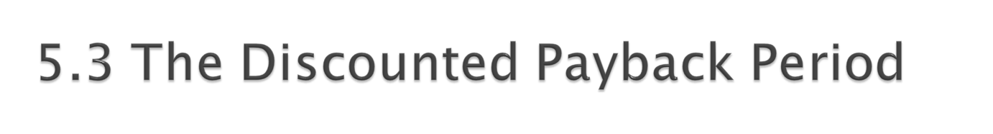
How long does it take the project to “pay back” its initial investment, taking the time value of money into account?
Decision rule: Accept the project if it pays back on a discounted basis within the specified time.
By the time you have discounted the cash flows, you might as well calculate the NPV.
Copyright © 2016 McGraw-Hill Education. All rights reserved.
No reproduction or distribution without the prior written consent of McGraw-Hill Education.
Notes:
Similar advantages and disadvantages as standard payback method, with the exception that cash flows prior to the cutoff are not discounted at zero.

Slide 10
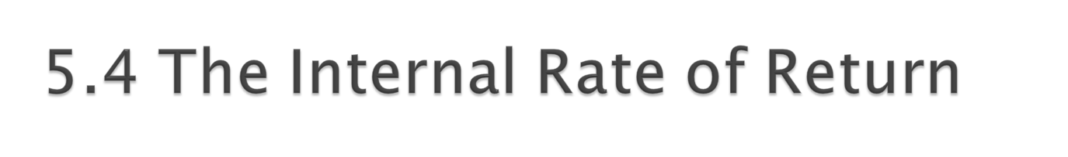
IRR: the discount rate that sets NPV to zero
Minimum Acceptance Criteria:
  Accept if the IRR exceeds the required return
Ranking Criteria:
  Select alternative with the highest IRR
Reinvestment assumption:
  All future cash flows are assumed to be reinvested at the IRR
Copyright © 2016 McGraw-Hill Education. All rights reserved.
No reproduction or distribution without the prior written consent of McGraw-Hill Education.

Slide 11
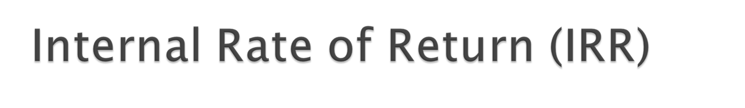
Disadvantages:
  Does not distinguish between investing and borrowing
  IRR may not exist, or there may be multiple IRRs
  Problems with mutually exclusive investments
Advantages:
  Easy to understand and communicate
Copyright © 2016 McGraw-Hill Education. All rights reserved.
No reproduction or distribution without the prior written consent of McGraw-Hill Education.

Slide 12

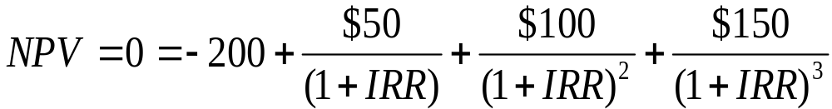
Consider the following project:
$50
$100
$150
0
1
2
3
-$200
The internal rate of return for this project is 19.44%
Copyright © 2016 McGraw-Hill Education. All rights reserved.
No reproduction or distribution without the prior written consent of McGraw-Hill Education.

Slide 13

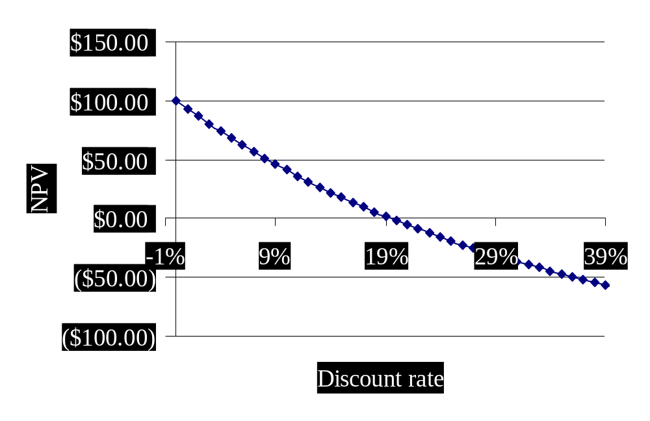
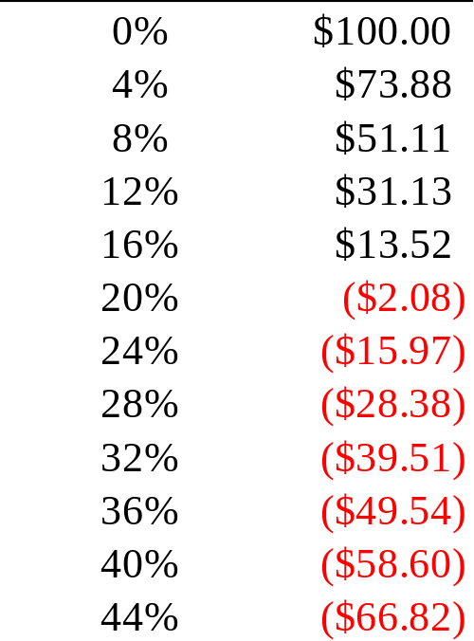
If we graph NPV versus the discount rate, we can see the IRR as the x-axis intercept.
IRR = 19.44%
Copyright © 2016 McGraw-Hill Education. All rights reserved.
No reproduction or distribution without the prior written consent of McGraw-Hill Education.

Slide 14
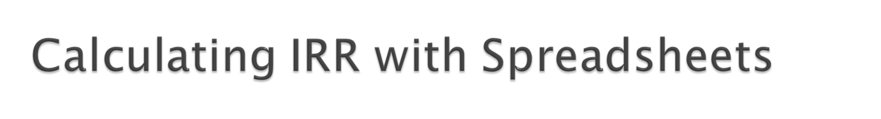

You start with the same cash flows as you did for the NPV.
You use the IRR function:
  You first enter your range of cash flows, beginning with the initial cash flow.
  You can enter a guess, but it is not necessary.
  The default format is a whole percent – you will normally want to increase the decimal places to at least two.
Copyright © 2016 McGraw-Hill Education. All rights reserved.
No reproduction or distribution without the prior written consent of McGraw-Hill Education.
Notes:
Click on the Excel icon to go to an embedded spreadsheet so that you can illustrate how to compute IRR on a spreadsheet.

Slide 15

Multiple IRRs
Are We Borrowing or Lending
The Scale Problem
The Timing Problem
Copyright © 2016 McGraw-Hill Education. All rights reserved.
No reproduction or distribution without the prior written consent of McGraw-Hill Education.

Slide 16
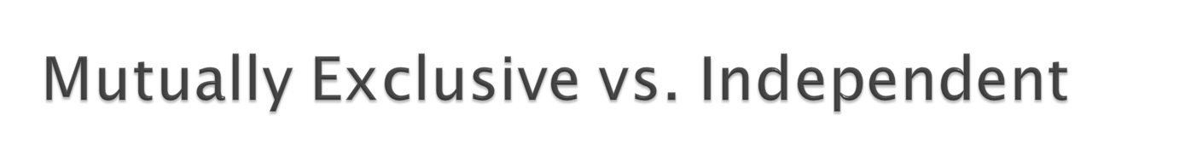
Mutually Exclusive Projects: only ONE of several potential projects can be chosen, e.g., acquiring an accounting system.
  RANK all alternatives, and select the best one.
Independent Projects: accepting or rejecting one project does not affect the decision of the other projects.
  Must exceed a MINIMUM acceptance criteria
Copyright © 2016 McGraw-Hill Education. All rights reserved.
No reproduction or distribution without the prior written consent of McGraw-Hill Education.

Slide 17

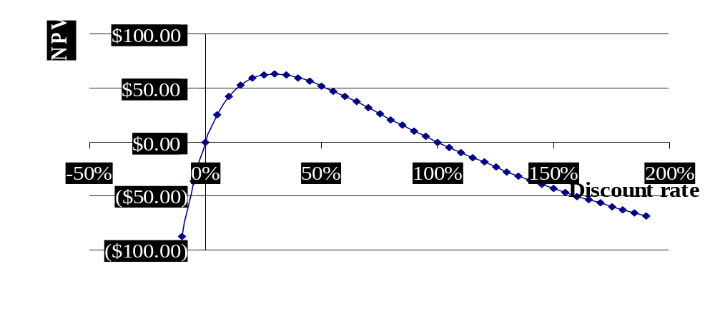
There are two IRRs for this project:
$200 $800
Which one should we use?
0 1 2 3
-$200
- $800
100% = IRR₂
0% = IRR₁
Copyright © 2016 McGraw-Hill Education. All rights reserved.
No reproduction or distribution without the prior written consent of McGraw-Hill Education.
Notes:
It is good to mention that the number of IRRs is equivalent to the number of sign changes in the cash flows.

Slide 18

Calculate the net present value of all cash outflows using the borrowing rate.
Calculate the net future value of all cash inflows using the investing rate.
Find the rate of return that equates these values.
Benefits: single answer and specific rates for borrowing and reinvestment
Copyright © 2016 McGraw-Hill Education. All rights reserved.
No reproduction or distribution without the prior written consent of McGraw-Hill Education.
Notes:
The alternative approach discussed in the text is to discount cash flows over a single period (or subset of time), then combine them as necessary to eliminate any sign differences. The approach presented in the slide is more generalized.

Slide 19

Would you rather make 100% or 50% on your investments?
What if the 100% return is on a $1 investment, while the 50% return is on a $1,000 investment?
Copyright © 2016 McGraw-Hill Education. All rights reserved.
No reproduction or distribution without the prior written consent of McGraw-Hill Education.

Slide 20

$10,000 $1,000 $1,000
Project A
0 1 2 3
-$10,000
$1,000 $1,000 $12,000
Project B
0 1 2 3
-$10,000
Copyright © 2016 McGraw-Hill Education. All rights reserved.
No reproduction or distribution without the prior written consent of McGraw-Hill Education.
Notes:
The preferred project in this case depends on the discount rate, not the IRR.

Slide 21

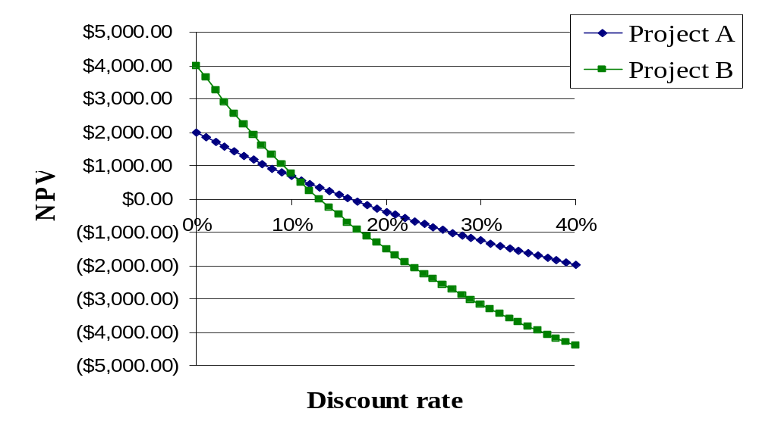
10.55% = crossover rate
12.94% = IRR_{B}
16.04% = IRR_{A}
Copyright © 2016 McGraw-Hill Education. All rights reserved.
No reproduction or distribution without the prior written consent of McGraw-Hill Education.
Notes:
The cross-over rate is the IRR of project A-B

Slide 22

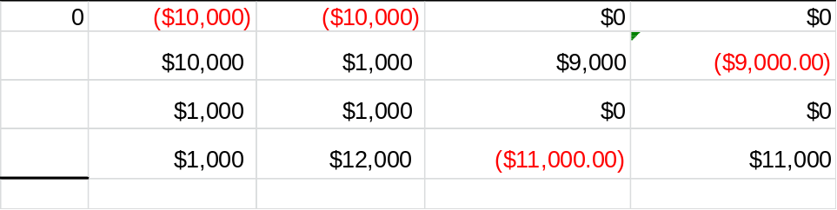
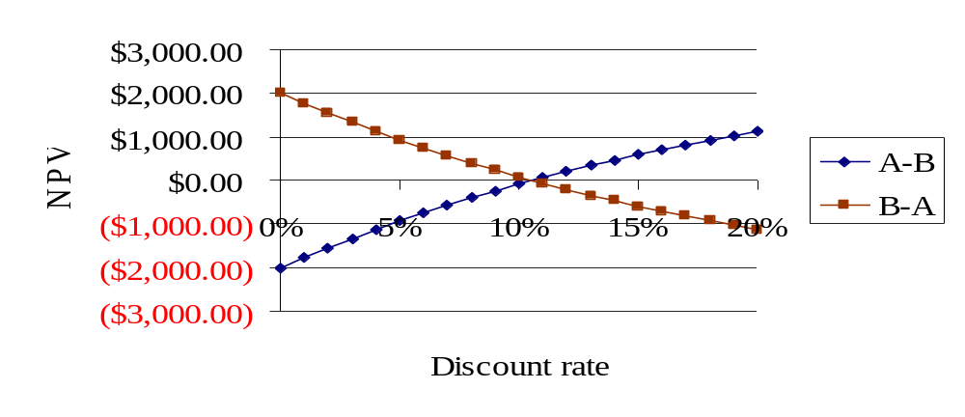
Compute the IRR for either project “A-B” or “B-A”
10.55% = IRR
Copyright © 2016 McGraw-Hill Education. All rights reserved.
No reproduction or distribution without the prior written consent of McGraw-Hill Education.

Slide 23

NPV and IRR will generally give the same decision.
Exceptions:
  Non-conventional cash flows – cash flow signs change more than once
  Mutually exclusive projects
    Initial investments are substantially different
    Timing of cash flows is substantially different
Copyright © 2016 McGraw-Hill Education. All rights reserved.
No reproduction or distribution without the prior written consent of McGraw-Hill Education.

Slide 24

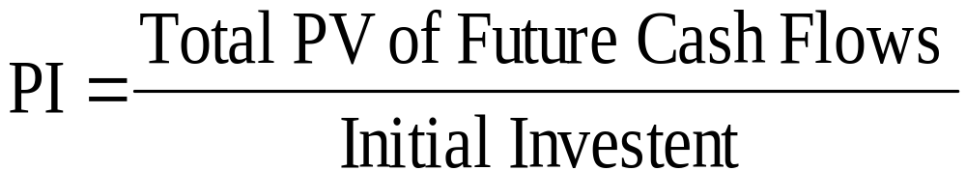
Minimum Acceptance Criteria:
  Accept if PI > 1
Ranking Criteria:
  Select alternative with highest PI
Copyright © 2016 McGraw-Hill Education. All rights reserved.
No reproduction or distribution without the prior written consent of McGraw-Hill Education.

Slide 25

Disadvantages:
  Problems with mutually exclusive investments
Advantages:
  May be useful when available investment funds are limited
  Easy to understand and communicate
  Correct decision when evaluating independent projects
Copyright © 2016 McGraw-Hill Education. All rights reserved.
No reproduction or distribution without the prior written consent of McGraw-Hill Education.

Slide 26
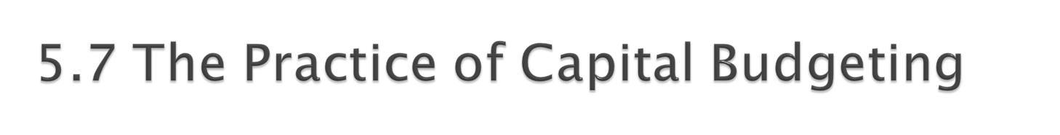
Varies by industry:
  Some firms may use payback, while others choose an alternative approach.
The most frequently used technique for large corporations is either IRR or NPV.
Copyright © 2016 McGraw-Hill Education. All rights reserved.
No reproduction or distribution without the prior written consent of McGraw-Hill Education.

Slide 27

Compute the IRR, NPV, PI, and payback period for the following two projects. Assume the required return is 10%.
Year Project A Project B
0 -$200 -$150
1 $200 $50
2 $800 $100
3 -$800 $150
Copyright © 2016 McGraw-Hill Education. All rights reserved.
No reproduction or distribution without the prior written consent of McGraw-Hill Education.

Slide 28
Project A Project B
CF₀ -$200.00 -$150.00
PV₀ of CF₁₋₃ $241.92 $240.80
NPV = $41.92 $90.80
IRR = 0%, 100% 36.19%
PI = 1.2096 1.6053
Copyright © 2016 McGraw-Hill Education. All rights reserved.
No reproduction or distribution without the prior written consent of McGraw-Hill Education.

Slide 29
Payback Period:
Project A Project B
Time CF Cum. CF CF Cum.CF
0 -200 -200 -150 -150
1 200 0 50 -100
2 800 800 100 0
3 -800 0 150 150
Payback period for project B = 2 years.
Payback period for project A = 1 or 3 years?
Copyright © 2016 McGraw-Hill Education. All rights reserved.
No reproduction or distribution without the prior written consent of McGraw-Hill Education.

Slide 30

Discount rate NPV for A NPV for B
-10% -87.52 234.77
0% 0.00 150.00 20% 59.26 47.92
40% 59.48 -8.60
60% 42.19 -43.07
80% 20.85 -65.64
100% 0.00 -81.25
120% -18.93 -92.52
Copyright © 2016 McGraw-Hill Education. All rights reserved.
No reproduction or distribution without the prior written consent of McGraw-Hill Education.

Slide 31

$400
NPV
$300
IRR ₁(A)
IRR ₂(A)
IRR (B)
$200
$100
$0
-15%
0%
15%
30%
45%
70%
100%
130%
160%
190%
($100)
($200)
Project A
Discount rates
Cross-over Rate
Project B
Copyright © 2016 McGraw-Hill Education. All rights reserved.
No reproduction or distribution without the prior written consent of McGraw-Hill Education.

Slide 32

Net present value
  Difference between market value and cost
  Accept the project if the NPV is positive
  Has no serious problems
  Preferred decision criterion
Internal rate of return
  Discount rate that makes NPV = 0
  Take the project if the IRR is greater than the required return
  Same decision as NPV with conventional cash flows
  IRR is unreliable with non-conventional cash flows or mutually exclusive projects
Profitability Index
  Benefit-cost ratio
  Take investment if PI > 1
  Cannot be used to rank mutually exclusive projects
  May be used to rank projects in the presence of capital rationing
Copyright © 2016 McGraw-Hill Education. All rights reserved.
No reproduction or distribution without the prior written consent of McGraw-Hill Education.

Slide 33

Payback period
  Length of time until initial investment is recovered
  Take the project if it pays back in some specified period
  Does not account for time value of money, and there is an arbitrary cutoff period
Discounted payback period
  Length of time until initial investment is recovered on a discounted basis
  Take the project if it pays back in some specified period
  There is an arbitrary cutoff period
Copyright © 2016 McGraw-Hill Education. All rights reserved.
No reproduction or distribution without the prior written consent of McGraw-Hill Education.

Slide 34

Consider an investment that costs $100,000 and has a cash inflow of $25,000 every year for 5 years. The required return is 9%, and payback cutoff is 4 years.
  What is the payback period?
  What is the discounted payback period?
  What is the NPV?
  What is the IRR?
  Should we accept the project?
What method should be the primary decision rule?
When is the IRR rule unreliable?
Copyright © 2016 McGraw-Hill Education. All rights reserved.
No reproduction or distribution without the prior written consent of McGraw-Hill Education.
Notes:
Payback period = 4 years
The project does not pay back on a discounted basis.
NPV = -2758.72
IRR = 7.93%

