Slide 1
Chapter 7
Risk Analysis, Real Options, and Capital Budgeting

Slide 2

Understand and be able to apply scenario and sensitivity analysis
Understand the various forms of break-even analysis
Understand Monte Carlo simulation
Understand the importance of real options in capital budgeting
Understand decision trees
Copyright © 2016 McGraw-Hill Education. All rights reserved.
No reproduction or distribution without the prior written consent of McGraw-Hill Education.

Slide 3

7.1 Sensitivity Analysis, Scenario Analysis, and Break-Even Analysis
7.2 Monte Carlo Simulation
7.3 Real Options
7.4 Decision Trees
Copyright © 2016 McGraw-Hill Education. All rights reserved.
No reproduction or distribution without the prior written consent of McGraw-Hill Education.

Slide 4
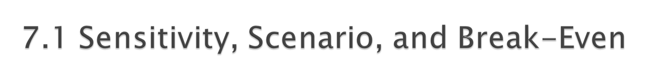
Each allows us to look behind the NPV number to see how stable our estimates are.
When working with spreadsheets, try to build your model so that you can adjust variables in a single cell and have the NPV calculations update accordingly.
Copyright © 2016 McGraw-Hill Education. All rights reserved.
No reproduction or distribution without the prior written consent of McGraw-Hill Education.

Slide 5

Stewart Pharmaceuticals Corporation is considering investing in the development of a drug that cures the common cold.
A corporate planning group, including representatives from production, marketing, and engineering, has recommended that the firm go ahead with the test and development phase.
This preliminary phase will last one year and cost $1 billion. Furthermore, the group believes that there is a 60% chance that tests will prove successful.
If the initial tests are successful, Stewart Pharmaceuticals can go ahead with full-scale production. This investment phase will cost $1.6 billion. Production will occur over the following 4 years.
Copyright © 2016 McGraw-Hill Education. All rights reserved.
No reproduction or distribution without the prior written consent of McGraw-Hill Education.

Slide 6
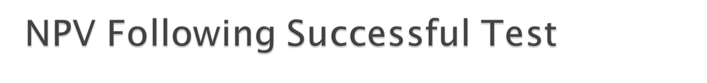
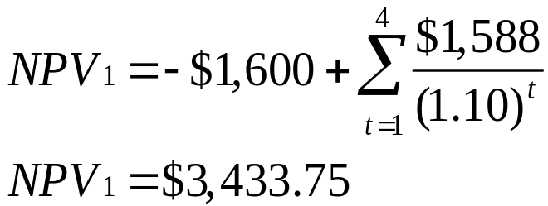
Investment | Year 1 | Years 2-5
Revenues |  | $7,000
Variable Costs |  | (3,000)
Fixed Costs |  | (1,800)
Depreciation |  | (400)
Pretax profit |  | $1,800
Tax (34%) |  | (612)
Net Profit |  | $1,188
Cash Flow | -$1,600 | $1,588
Note that the NPV is calculated as of date 1, the date at which the investment of $1,600 million is made. Later we bring this number back to date 0. Assume a cost of capital of 10%.
Copyright © 2016 McGraw-Hill Education. All rights reserved.
No reproduction or distribution without the prior written consent of McGraw-Hill Education.

Slide 7
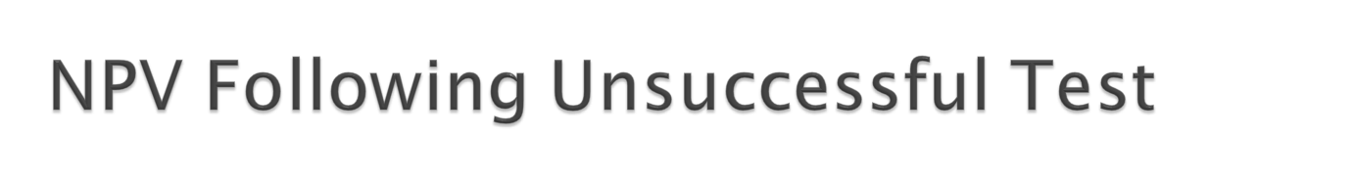
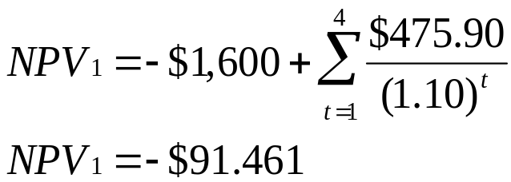
Investment | Year 1 | Years 2-5
Revenues |  | $4,050
Variable Costs |  | (1,735)
Fixed Costs |  | (1,800)
Depreciation |  | (400)
Pretax profit |  | $115
Tax (34%) |  | (39.10)
Net Profit |  | $75.90
Cash Flow | -$1,600 | $475.90
Note that the NPV is calculated as of date 1, the date at which the investment of $1,600 million is made. Later we bring this number back to date 0. Assume a cost of capital of 10%.
Copyright © 2016 McGraw-Hill Education. All rights reserved.
No reproduction or distribution without the prior written consent of McGraw-Hill Education.

Slide 8

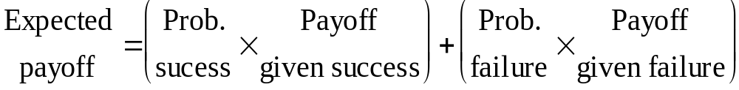
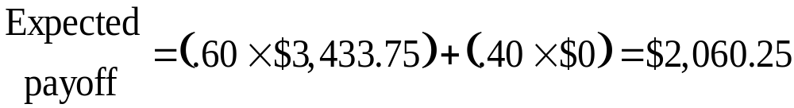
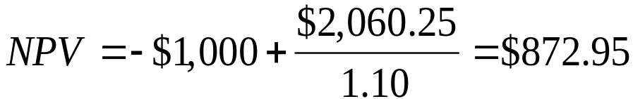
Let’s move back to the first stage, where the decision boils down to the simple question: should we invest?
The expected payoff evaluated at date 1 is:
The NPV evaluated at date 0 is:
So, we should test.
Copyright © 2016 McGraw-Hill Education. All rights reserved.
No reproduction or distribution without the prior written consent of McGraw-Hill Education.
Notes:
Note that we use the initial testing cost of $1 B, as the production costs were already applied in finding the payoffs.

Slide 9
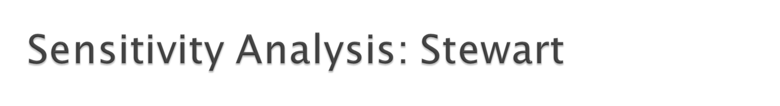
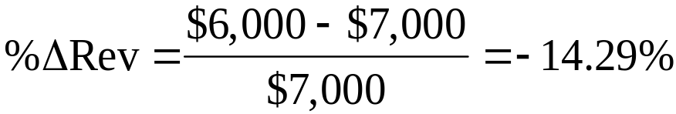
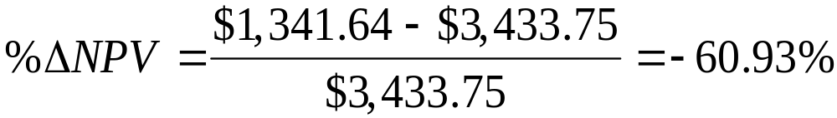
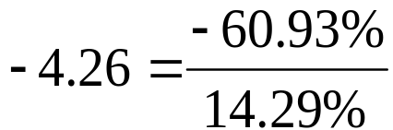
We can see that NPV is very sensitive to changes in revenues. In the Stewart Pharmaceuticals example, a 14% drop in revenue leads to a 61% drop in NPV.
For every 1% drop in revenue, we can expect roughly a 4.26% drop in NPV:
Copyright © 2016 McGraw-Hill Education. All rights reserved.
No reproduction or distribution without the prior written consent of McGraw-Hill Education.
Notes:
The calculations assume that revenues change as a result of a reduction in sales price; therefore, variable costs are unchanged. If revenue drops as a result of units, then the NPV is $2,239, which is a drop of 35%.

Slide 10

A variation on sensitivity analysis is scenario analysis.
For example, the following three scenarios could apply to Stewart Pharmaceuticals:
  The next few years each have heavy cold seasons, and sales exceed expectations, but labor costs skyrocket.
  The next few years are normal, and sales meet expectations.
  The next few years each have lighter than normal cold seasons, so sales fail to meet expectations.
Other scenarios could apply to FDA approval.
For each scenario, calculate the NPV.
Copyright © 2016 McGraw-Hill Education. All rights reserved.
No reproduction or distribution without the prior written consent of McGraw-Hill Education.
Notes:
Note the irony of scenario 1: our workers are too sick to make the medicine.
Scenario analysis is often commonly employed by identifying the best and worst possible cases of all variables.

Slide 11

Common tool for analyzing the relationship between sales volume and profitability
There are three common break-even measures
  Accounting break-even: sales volume at which net income = 0
  Cash break-even: sales volume at which operating cash flow = 0
  Financial break-even: sales volume at which net present value = 0
Copyright © 2016 McGraw-Hill Education. All rights reserved.
No reproduction or distribution without the prior written consent of McGraw-Hill Education.

Slide 12

Another way to examine variability in our forecasts is break-even analysis.
In the Stewart Pharmaceuticals example, we could be concerned with break-even revenue, break-even sales volume, or break-even price.
To find either, we start with the break-even operating cash flow.
Copyright © 2016 McGraw-Hill Education. All rights reserved.
No reproduction or distribution without the prior written consent of McGraw-Hill Education.

Slide 13
The project requires an investment of $1,600.
In order to cover our cost of capital (break even), the project needs to generate a cash flow of $504.75 each year for four years.
This is the project’s break-even operating cash flow, OCF_{BE}.
N
4
I/Y
10
PV
PV
1,600
PMT
− 504.75
FV
0
Copyright © 2016 McGraw-Hill Education. All rights reserved.
No reproduction or distribution without the prior written consent of McGraw-Hill Education.
Notes:
This example looks purely at the project once the decision to invest has been made, making the initial $1 B a sunk cost.
You may want to note that this is a similar process to finding a bid price in chapter 6.

Slide 14

Work backwards from OCF_{BE} to Break-Even Revenue
Revenue
$5,358.71
+ VC
Variable cost
$3,000
Fixed cost
$1,800
Depreciation
+D
$400
+FC
EBIT
$158.71
$104.75
Tax (34%)
0.66
$53.96
Net Income
$104.75
OCF =
$104.75 + $400
$504.75
Copyright © 2016 McGraw-Hill Education. All rights reserved.
No reproduction or distribution without the prior written consent of McGraw-Hill Education.

Slide 15

Now that we have break-even revenue of $5,358.71 million, we can calculate break-even price.
The original plan was to generate revenues of $7 billion by selling the cold cure at $10 per dose and selling 700 million doses per year,
We can reach break-even revenue with a price of only:
$5,358.71 million = 700 million × P_{BE}
$5,358.71
P_{BE}
=
= $7.66 / dose
700
Copyright © 2016 McGraw-Hill Education. All rights reserved.
No reproduction or distribution without the prior written consent of McGraw-Hill Education.

Slide 16

Monte Carlo simulation is a further attempt to model real-world uncertainty.
This approach takes its name from the famous European casino, because it analyzes projects the way one might evaluate gambling strategies.
Copyright © 2016 McGraw-Hill Education. All rights reserved.
No reproduction or distribution without the prior written consent of McGraw-Hill Education.

Slide 17

Imagine a serious blackjack player who wants to know if she should take the third card whenever her first two cards total sixteen.
  She could play thousands of hands for real money to find out.
  This could be hazardous to her wealth.
  Or, she could play thousands of practice hands.
Monte Carlo simulation of capital budgeting projects is in this spirit.
Copyright © 2016 McGraw-Hill Education. All rights reserved.
No reproduction or distribution without the prior written consent of McGraw-Hill Education.

Slide 18

Monte Carlo simulation of capital budgeting projects is often viewed as a step beyond either sensitivity analysis or scenario analysis.
Interactions between the variables are explicitly specified in Monte Carlo simulation; so, at least theoretically, this methodology provides a more complete analysis.
While the pharmaceutical industry has pioneered applications of this methodology, its use in other industries is far from widespread.
Copyright © 2016 McGraw-Hill Education. All rights reserved.
No reproduction or distribution without the prior written consent of McGraw-Hill Education.

Slide 19
Step 1: Specify the Basic Model
Step 2: Specify a Distribution for Each Variable in the Model
Step 3: The Computer Draws One Outcome
Step 4: Repeat the Procedure
Step 5: Calculate NPV
Copyright © 2016 McGraw-Hill Education. All rights reserved.
No reproduction or distribution without the prior written consent of McGraw-Hill Education.

Slide 20

One of the fundamental insights of modern finance theory is that options have value.
The phrase “We are out of options” is surely a sign of trouble.
Because corporations make decisions in a dynamic environment, they have options that should be considered in project valuation.
Copyright © 2016 McGraw-Hill Education. All rights reserved.
No reproduction or distribution without the prior written consent of McGraw-Hill Education.

Slide 21

The Option to Expand
  Has value if demand turns out to be higher than expected
The Option to Abandon
  Has value if demand turns out to be lower than expected
The Option to Delay
  Has value if the underlying variables are changing with a favorable trend
Copyright © 2016 McGraw-Hill Education. All rights reserved.
No reproduction or distribution without the prior written consent of McGraw-Hill Education.

Slide 22

We can calculate the market value of a project as the sum of the NPV of the project without options and the value of the managerial options implicit in the project.
M = NPV + Opt
A good example would be comparing the desirability of a specialized machine versus a more versatile machine. If they both cost about the same and last the same amount of time, the more versatile machine is more valuable because it comes with options.
Copyright © 2016 McGraw-Hill Education. All rights reserved.
No reproduction or distribution without the prior written consent of McGraw-Hill Education.

Slide 23

Suppose we are drilling an oil well. The drilling rig costs $300 today, and in one year the well is either a success or a failure.
The outcomes are equally likely. The discount rate is 10%.
The PV of the successful payoff at time one is $575.
The PV of the unsuccessful payoff at time one is $0.
Copyright © 2016 McGraw-Hill Education. All rights reserved.
No reproduction or distribution without the prior written consent of McGraw-Hill Education.

Slide 24

Traditional NPV analysis would indicate rejection of the project.
Expected Payoff
=
Prob. Success
Successful Payoff
Prob. Failure
Failure Payoff
×
+
×
Expected Payoff
= (0.50×$575) + (0.50×$0) = $287.50
$287.50
NPV =
–$300 +
= –$38.64
1.10
Copyright © 2016 McGraw-Hill Education. All rights reserved.
No reproduction or distribution without the prior written consent of McGraw-Hill Education.

Slide 25


However, traditional NPV analysis overlooks the option to abandon.
Success: PV = $500
Drill
Sit on rig; stare at empty hole: PV = $0.
Failure
Do not drill
Sell the rig; salvage value = $250
The firm has two decisions to make: drill or not, abandon or stay.
Copyright © 2016 McGraw-Hill Education. All rights reserved.
No reproduction or distribution without the prior written consent of McGraw-Hill Education.

Slide 26

When we include the value of the option to abandon, the drilling project should proceed:
Expected Payoff
=
Prob. Success
Successful Payoff
Prob. Failure
Failure Payoff
×
+
×
Expected Payoff
= (0.50×$575) + (0.50×$250) = $412.50
$412.50
NPV =
–$300 +
= $75.00
1.10
Copyright © 2016 McGraw-Hill Education. All rights reserved.
No reproduction or distribution without the prior written consent of McGraw-Hill Education.

Slide 27

Recall that we can calculate the market value of a project as the sum of the NPV of the project without options and the value of the managerial options implicit in the project.
M = NPV + Opt
$75.00 = –$38.64 + Opt
$75.00 + $38.64 = Opt
Opt = $113.64

Slide 28

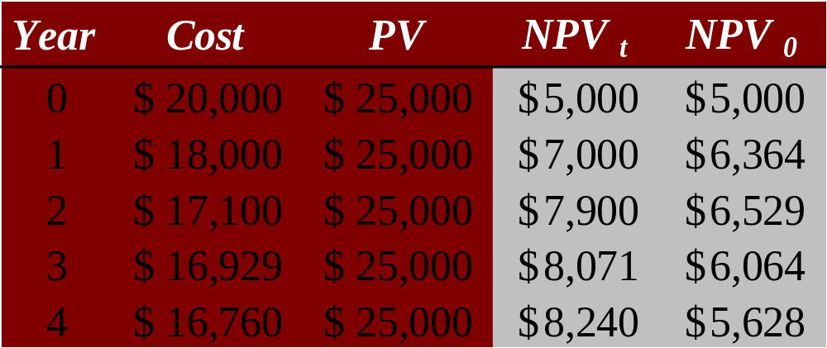
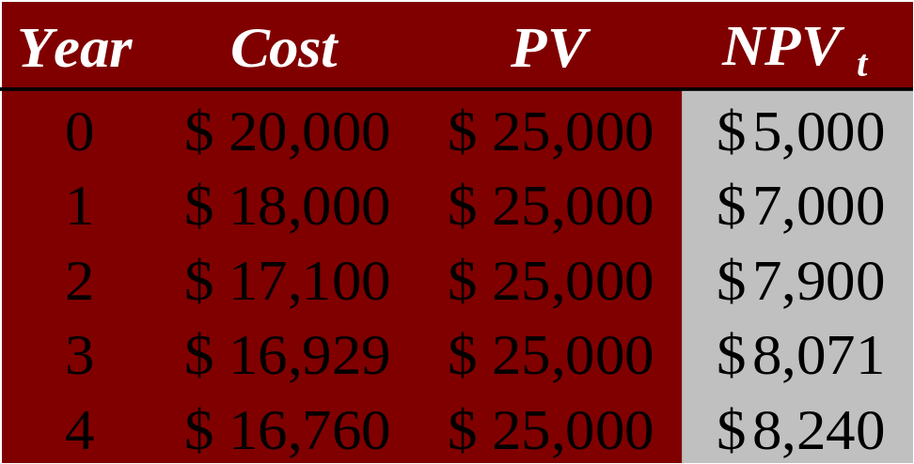
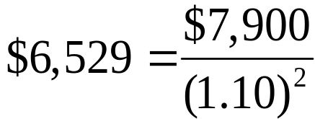
Consider the above project, which can be undertaken in any of the next 4 years. The discount rate is 10 percent. The present value of the benefits at the time the project is launched remains constant at $25,000, but since costs are declining, the NPV at the time of launch steadily rises.
The best time to launch the project is in year 2—this schedule yields the highest NPV when judged today.
Notes:
NPV₀ = NPV_{t} / (1.10)^{t}

Slide 29

Allow us to graphically represent the alternatives available to us in each period and the likely consequences of our actions
This graphical representation helps to identify the best course of action.
Copyright © 2016 McGraw-Hill Education. All rights reserved.
No reproduction or distribution without the prior written consent of McGraw-Hill Education.

Slide 30
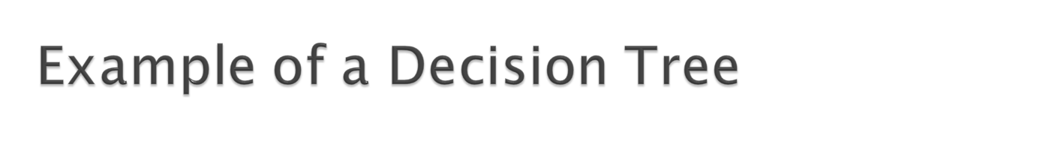
Squares represent decisions to be made.
Circles represent receipt of information, e.g., a test score.
“A”
Study finance
“B”
“C”
The lines leading away from the squares represent the alternatives.
Do not study
“D”
“F”

Slide 31

Invest
The firm has two decisions to make:
NPV = $3.4 b
To test or not to test.
Success
To invest or not to invest.
Do not invest
Test
NPV = $0
Failure
Do not test
Invest
NPV = –$91.46 m
Notes:
If you don’t invest, the NPV = 0, even if you test first, because the cost of testing becomes a sunk cost.
If you are so unwise as to invest in the face of a failed test, you incur lots of additional costs, but not much in the way of revenue, so you have a negative NPV as of date 1.
Referring back to slide 7 (Decision to Test) may help to clarify the application of decision trees.

Slide 32

What are sensitivity analysis, scenario analysis, break-even analysis, and simulation?
Why are these analyses important, and how should they be used?
How do real options affect the value of capital projects?
What information does a decision tree provide?
Copyright © 2016 McGraw-Hill Education. All rights reserved.
No reproduction or distribution without the prior written consent of McGraw-Hill Education.

