Slide 1
Chapter 9
Stock Valuation

Slide 2

Understand how stock prices depend on future dividends and dividend growth
Be able to compute stock prices using the dividend growth model
Understand valuation comparables
Understand the basics of the stock market
Copyright © 2016 McGraw-Hill Education. All rights reserved.
No reproduction or distribution without the prior written consent of McGraw-Hill Education.

Slide 3

9.1 The Present Value of Common Stocks
9.2 Estimates of Parameters in the Dividend Discount Model
9.3 Comparables
9.4 Valuing Stocks Using Free Cash Flows
9.5 The Stock Markets
Copyright © 2016 McGraw-Hill Education. All rights reserved.
No reproduction or distribution without the prior written consent of McGraw-Hill Education.

Slide 4
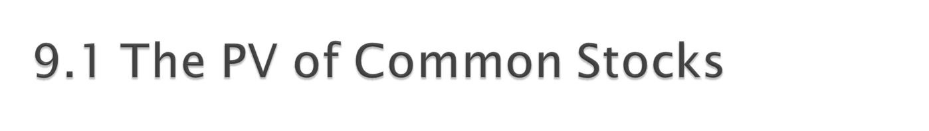
The value of any asset is the present value of its expected future cash flows.
Stock ownership produces cash flows from:
  Dividends
  Capital Gains
Valuation of Different Types of Stocks
  Zero Growth
  Constant Growth
  Differential Growth
Copyright © 2016 McGraw-Hill Education. All rights reserved.
No reproduction or distribution without the prior written consent of McGraw-Hill Education.

Slide 5

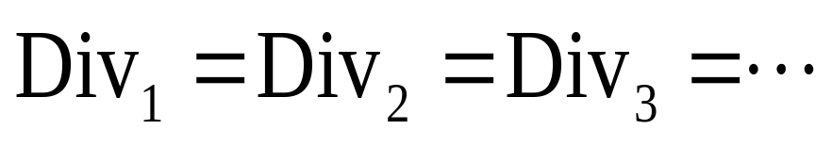
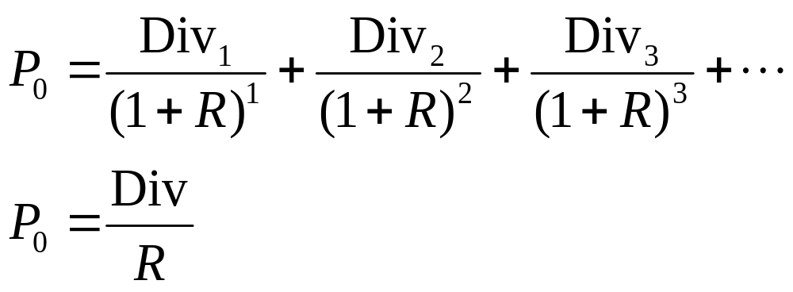
Assume that dividends will remain at the same level forever
Since future cash flows are constant, the value of a zero growth stock is the present value of a perpetuity:
Copyright © 2016 McGraw-Hill Education. All rights reserved.
No reproduction or distribution without the prior written consent of McGraw-Hill Education.

Slide 6

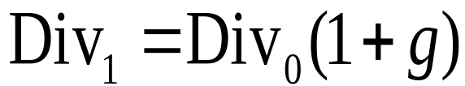
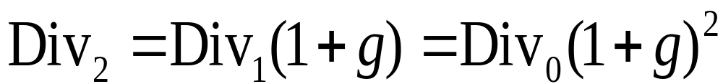
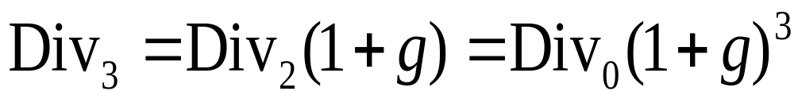
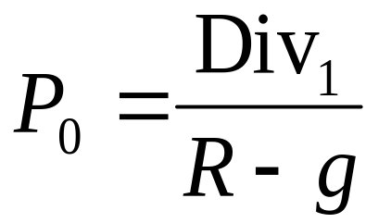
Assume that dividends will grow at a constant rate, g, forever, i.e.,
Since future cash flows grow at a constant rate forever, the value of a constant growth stock is the present value of a growing perpetuity:

Slide 7

Suppose Big D, Inc., just paid a dividend of $.50. It is expected to increase its dividend by 2% per year. If the market requires a return of 15% on assets of this risk level, how much should the stock be selling for?
P₀ = .50(1+.02) / (.15 - .02) = $3.92
Copyright © 2016 McGraw-Hill Education. All rights reserved.
No reproduction or distribution without the prior written consent of McGraw-Hill Education.
Notes:
The biggest mistake that students make with the DGM is using the incorrect dividend. Be sure to emphasize that we are finding a present value, so the dividend needed is the one that will be paid NEXT period, not the one that has already been paid.

Slide 8

Assume that dividends will grow at different rates in the foreseeable future and then will grow at a constant rate thereafter.
To value a Differential Growth Stock, we need to:
  Estimate future dividends in the foreseeable future.
  Estimate the future stock price when the stock becomes a Constant Growth Stock (case 2).
  Compute the total present value of the estimated future dividends and future stock price at the appropriate discount rate.
Copyright © 2016 McGraw-Hill Education. All rights reserved.
No reproduction or distribution without the prior written consent of McGraw-Hill Education.

Slide 9
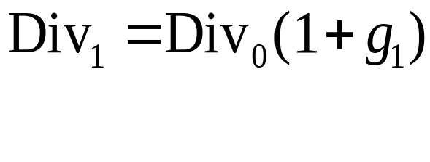
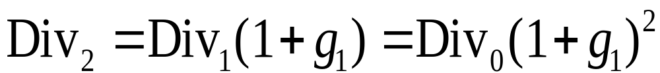
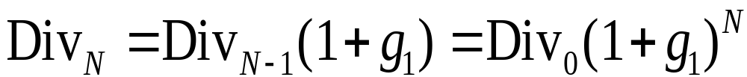
Assume that dividends will grow at rate g₁ for N years and grow at rate g₂ thereafter.
.
.
.
.
.
.
Copyright © 2016 McGraw-Hill Education. All rights reserved.
No reproduction or distribution without the prior written consent of McGraw-Hill Education.

Slide 10
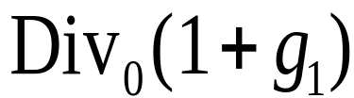
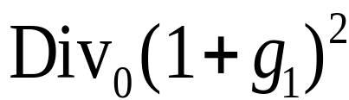
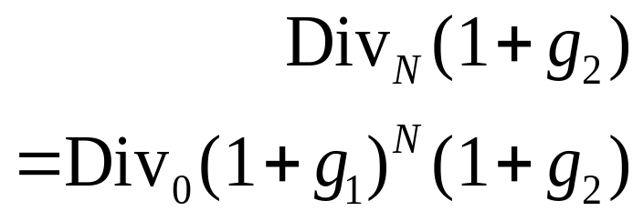
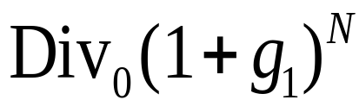
Dividends will grow at rate g₁ for N years and grow at rate g₂ thereafter
…
0 1 2
…
…
N N+1

Slide 11
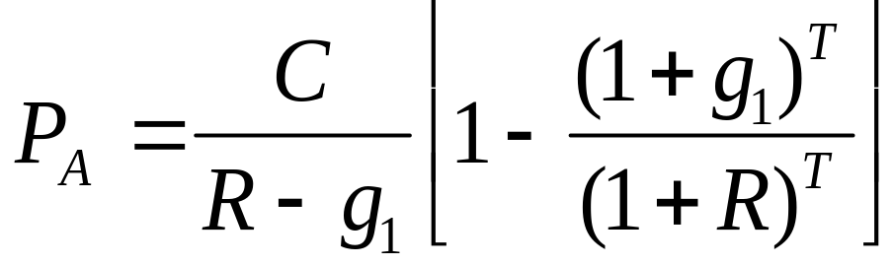
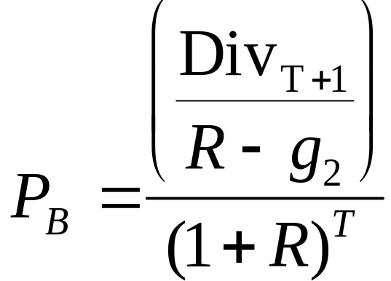
We can value this as the sum of:
a T-year annuity growing at rate g₁
plus the discounted value of a perpetuity growing at rate g₂ that starts in year T+1
Notes:
It may be good to point out that we have assumed the discount rate is constant; however, it could change across periods, or even across years.

Slide 12
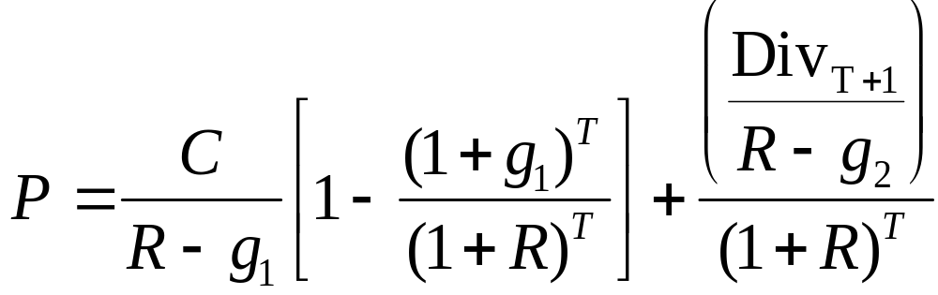
Consolidating gives:
Or, we can “cash flow” it out.
Copyright © 2016 McGraw-Hill Education. All rights reserved.
No reproduction or distribution without the prior written consent of McGraw-Hill Education.

Slide 13

A common stock just paid a dividend of $2. The dividend is expected to grow at 8% for 3 years, then it will grow at 4% in perpetuity.
What is the stock worth? The discount rate is 12%.
Copyright © 2016 McGraw-Hill Education. All rights reserved.
No reproduction or distribution without the prior written consent of McGraw-Hill Education.

Slide 14

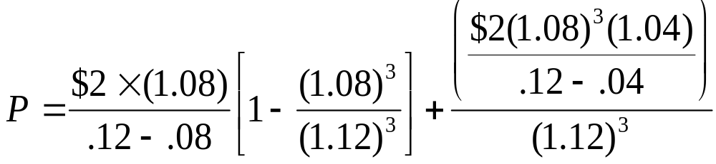
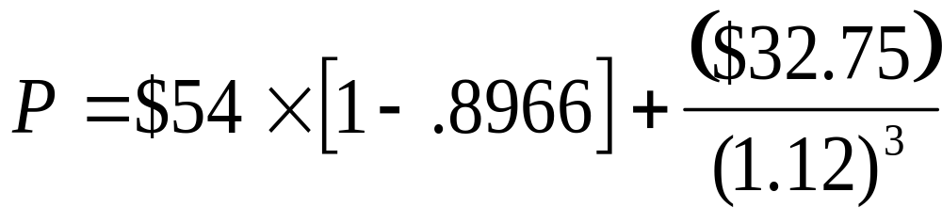
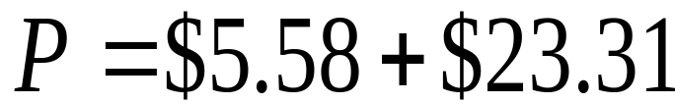
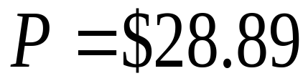
Copyright © 2016 McGraw-Hill Education. All rights reserved.
No reproduction or distribution without the prior written consent of McGraw-Hill Education.

Slide 15



…
0 1 2 3 4
The constant growth phase beginning in year 4 can be valued as a growing perpetuity at time 3.
0 1 2 3
Notes:
This type of problem generally separates the “A” students from the rest of the class.

Slide 16
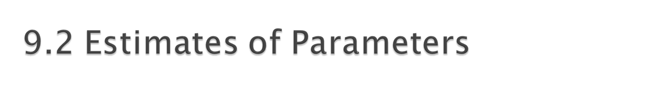
The value of a firm depends upon its growth rate, g, and its discount rate, R.
  Where does g come from?
  g = Retention ratio × Return on retained earnings
Copyright © 2016 McGraw-Hill Education. All rights reserved.
No reproduction or distribution without the prior written consent of McGraw-Hill Education.

Slide 17

The discount rate can be broken into two parts.
  The dividend yield
  The growth rate (in dividends)
In practice, there is a great deal of estimation error involved in estimating R.
Copyright © 2016 McGraw-Hill Education. All rights reserved.
No reproduction or distribution without the prior written consent of McGraw-Hill Education.

Slide 18

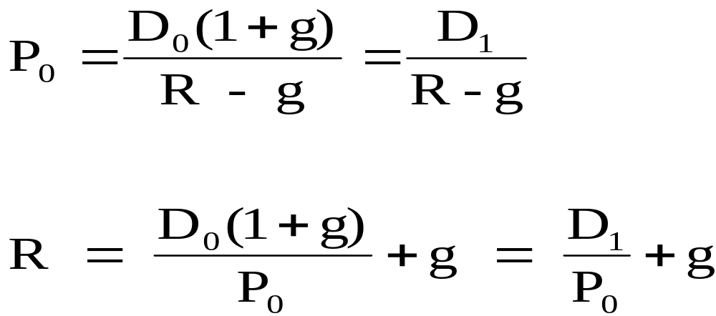
Start with the DGM:
Rearrange and solve for R:
Copyright © 2016 McGraw-Hill Education. All rights reserved.
No reproduction or distribution without the prior written consent of McGraw-Hill Education.
Notes:
Point out that D₁ / P₀ is the dividend yield and g is the capital gains yield.

Slide 19
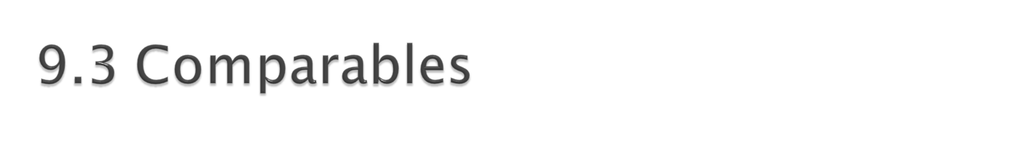
Comparables are used to value companies based primarily on multiples.
Common multiples include:
  Price-to-Earnings
  Enterprise Value Ratios
Copyright © 2016 McGraw-Hill Education. All rights reserved.
No reproduction or distribution without the prior written consent of McGraw-Hill Education.

Slide 20

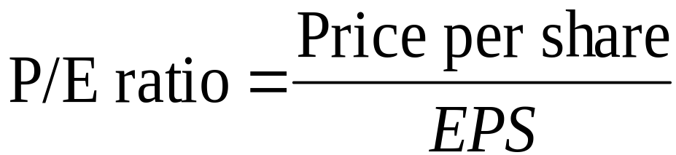
The price-earnings ratio is calculated as the current stock price divided by annual EPS.
  The Wall Street Journal uses last 4 quarter’s earnings
Copyright © 2016 McGraw-Hill Education. All rights reserved.
No reproduction or distribution without the prior written consent of McGraw-Hill Education.
Notes:
Other sources prefer to use forecasted earning (i.e., a forward PE) as opposed to trailing twelve months (TTM).

Slide 21

The PE ratio focuses on equity, but what if we want the value of the firm?
Use Enterprise Value:
  EV = market value of equity + market value of debt - cash
Like PE, we compare the value to a measure of earnings. From a firm level, this is EBITDA, or earnings before interest, taxes, depreciation, and amortization.
  EBITDA represents a measure of total firm cash flow
The Enterprise Value Ratio = EV / EBITDA
Copyright © 2016 McGraw-Hill Education. All rights reserved.
No reproduction or distribution without the prior written consent of McGraw-Hill Education.
Notes:
Accounting policies will also impact the PE ratio, as conservative policies are generally associated with higher PE ratios.

Slide 22
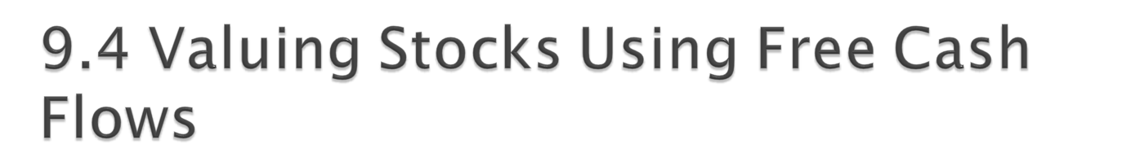
In Chapters 5 and 6 you learned that the value of a project (i.e., its NPV) was the discounted value of the cash flows it generates.
The firm is the consolidated present value of the cash flow from all of its projects.
Copyright © 2016 McGraw-Hill Education. All rights reserved.
No reproduction or distribution without the prior written consent of McGraw-Hill Education.

Slide 23
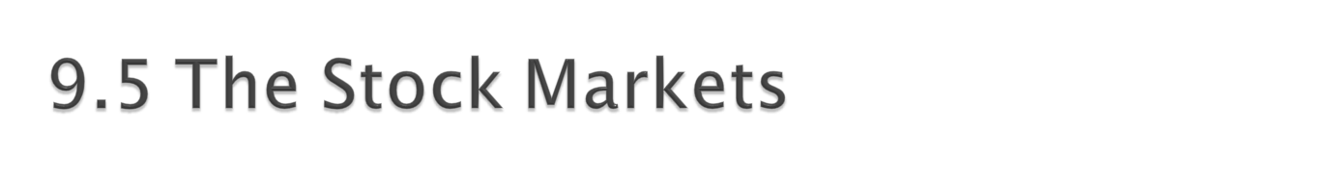
Dealers vs. Brokers
New York Stock Exchange (NYSE)
  Largest stock market in the world
  License Holders (formerly “Members”)
    Entitled to buy or sell on the exchange floor
  Operations
  Floor activity
Copyright © 2016 McGraw-Hill Education. All rights reserved.
No reproduction or distribution without the prior written consent of McGraw-Hill Education.
Notes:
Dealer: maintains an inventory and stands ready to trade at quoted bid (price at which they will buy) and ask (price at which they will sell) prices. Make their profit from the difference between the bid and ask prices, called the bid-ask spread. The smaller the spread, the more competition and the more liquid the stock. The move to decimalization allows for a smaller bid-ask spread.
Broker: a broker matches buyers and sellers. They perform the search function for a fee (commission). They do not hold an inventory of securities.
NYSE:
DMMs manage the order flow by keeping the limit order book. The limit order book lists the trades that investors have given to their brokers that include desired trading prices. The specialist is also a dealer that holds an inventory in their assigned stock, they post bid and ask prices and they are supposed to maintain an orderly market.
Other participants on the floor of the exchange include floor traders that own exchange seats, commission brokers and floor brokers.

Slide 24

Market orders:
  You specify ticker and quantity
  Immediate execution at best available price
    Market buy will be executed at lowest ask
    Market sell will be executed at highest bid
Limit orders:
  You specify ticker, quantity, and price
  The order will be executed only if trade can be made at the limit price or better
    Limit Buy can only be executed at limit price or lower
    Limit Sell can only be executed at limit price or higher
Copyright © 2016 McGraw-Hill Education. All rights reserved.
No reproduction or distribution without the prior written consent of McGraw-Hill Education.

Slide 25
The Stop price is the trigger or activation point.
  If the stop price is reached or passed, the order becomes a market order to be executed at the best available price.
  Risk: price suddenly plummets or rises and the execution price is much different than expected.
Copyright © 2016 McGraw-Hill Education. All rights reserved.
No reproduction or distribution without the prior written consent of McGraw-Hill Education.

Slide 26

Not a physical exchange – computer-based quotation system
Multiple market makers
Electronic Communications Networks
Three levels of information
  Level 1 – median quotes, registered representatives
  Level 2 – view quotes, brokers & dealers
  Level 3 – view and update quotes, dealers only
Large portion of technology stocks
Copyright © 2016 McGraw-Hill Education. All rights reserved.
No reproduction or distribution without the prior written consent of McGraw-Hill Education.
Notes:
Point out that the Nasdaq market site in Times Square is NOT an exchange. It is just offices and basically a place for reporters to report on what is happening with Nasdaq stocks.

Slide 27

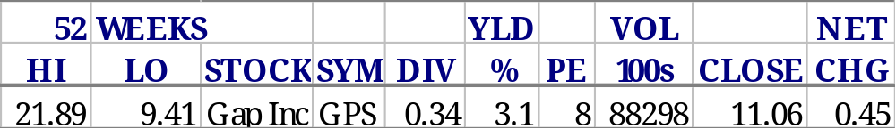
Gap pays a dividend of 34 cents/share.
Gap has been as high as $21.89 in the last year.
Gap ended trading at $11.06, which is up 45 cents from yesterday.
Given the current price, the dividend yield is 3.1%.
8,829,800 shares traded hands in the last day’s trading.
Gap has been as low as $9.41 in the last year.
Given the current price, the PE ratio is 8 times earnings.
Copyright © 2016 McGraw-Hill Education. All rights reserved.
No reproduction or distribution without the prior written consent of McGraw-Hill Education.

Slide 28

What determines the price of a share of stock?
What determines g and R in the DGM?
Discuss the importance of valuation ratios.
What are some of the major characteristics of NYSE and Nasdaq?
Copyright © 2016 McGraw-Hill Education. All rights reserved.
No reproduction or distribution without the prior written consent of McGraw-Hill Education.

