Slide 1
Chapter 13
Risk, Cost of Capital, and Valuation

Slide 2

13.1 The Cost of Equity Capital
13.2 Estimating the Cost of Equity Capital with the CAPM
13.3 The Dividend Discount Model Approach
13.4 Cost of Fixed Income Securities
13.5 The Weighted Average Cost of Capital
13.6 Valuation with R_{WACC}
Copyright © 2016 McGraw-Hill Education. All rights reserved.
No reproduction or distribution without the prior written consent of McGraw-Hill Education.

Slide 3

Earlier chapters on capital budgeting focused on the appropriate size and timing of cash flows.
This chapter discusses the appropriate discount rate when cash flows are risky.
Copyright © 2016 McGraw-Hill Education. All rights reserved.
No reproduction or distribution without the prior written consent of McGraw-Hill Education.
Notes:
The terms discount rate, required return, and cost of capital are all synonymous.

Slide 4

Shareholder invests in financial asset
Firm with
excess cash
Pay cash dividend
A firm with excess cash can either pay a dividend or make a capital investment
Shareholder’s Terminal Value
Invest in project
Because stockholders can reinvest the dividend in risky financial assets, the expected return on a capital-budgeting project should be at least as great as the expected return on a financial asset of comparable risk.
Notes:
Therefore, the discount rate of a project should be the expected return on a financial asset of comparable risk.

Slide 5

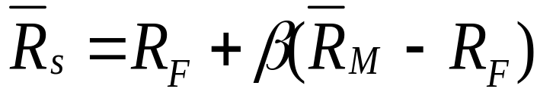

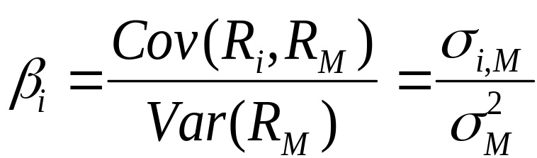
From the firm’s perspective, the expected return is the Cost of Equity Capital:
To estimate a firm’s cost of equity capital, we need to know three things:
The risk-free rate, R_{F}
The market risk premium,
The company beta,

Slide 6

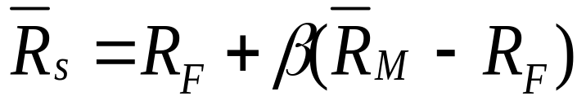
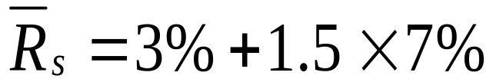
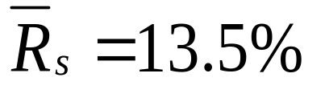
Suppose the stock of Stansfield Enterprises, a publisher of PowerPoint presentations, has a beta of 1.5. The firm is 100% equity financed.
Assume a risk-free rate of 3% and a market risk premium of 7%.
What is the appropriate discount rate for an expansion of this firm?
Notes:
You may want to note that this example assumes expansion into projects that are similar to the existing nature of the business. Also, point out that the firm is all equity, thus its discount rate is the cost of equity.

Slide 7

Suppose Stansfield Enterprises is evaluating the following independent projects. Each costs $100 and lasts one year.
Project
Project β
Project’s Estimated Cash Flows Next Year
IRR
NPV at 13.5%
A
1.5
$125
25%
$10.13
B
1.5
$113.5
13.5%
$0
C
1.5
$105
5%
-$7.49
Copyright © 2016 McGraw-Hill Education. All rights reserved.
No reproduction or distribution without the prior written consent of McGraw-Hill Education.

Slide 8


Good project
A
Project
IRR
30%
B
C
Bad project
5%
Firm’s risk (beta)
2.5
An all-equity firm should accept projects whose IRRs exceed the cost of equity capital and reject projects whose IRRs fall short of the cost of capital.
Copyright © 2016 McGraw-Hill Education. All rights reserved.
No reproduction or distribution without the prior written consent of McGraw-Hill Education.
Notes:
This, again, assumes independent projects. This is a good point at which to review the relation between IRR and NPV.

Slide 9
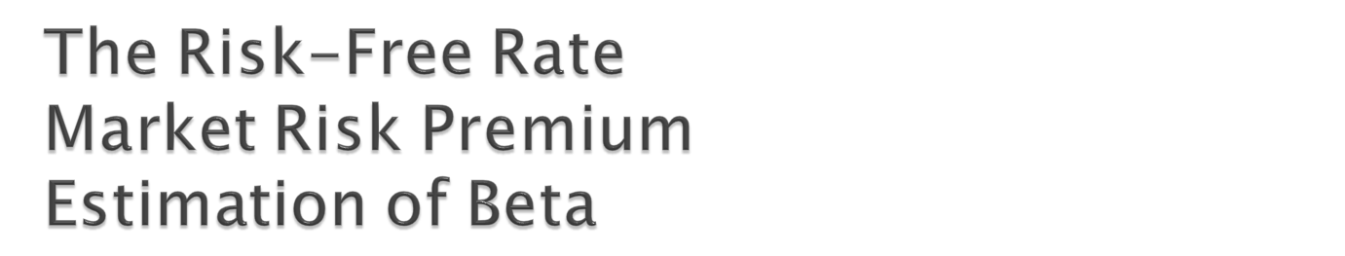
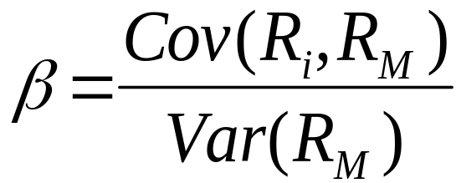
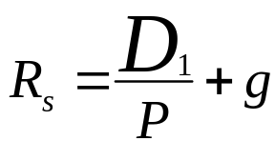
Treasury securities are close proxies for the risk-free rate.
Method 1: Use historical data
Method 2: Use the Dividend Discount Model
  Market data and analyst forecasts can be used to implement the DDM approach on a market-wide basis
Copyright © 2016 McGraw-Hill Education. All rights reserved.
No reproduction or distribution without the prior written consent of McGraw-Hill Education.
Notes:
This approach follows Ibbotson.

Slide 10


The DDM is an alternative to the CAPM for calculating a firm’s cost of equity.
The DDM and CAPM are internally consistent, but academics generally favor the CAPM and companies seem to use the CAPM more consistently.
  The CAPM explicitly adjusts for risk and it can be used on companies that do not pay dividends.
Copyright © 2016 McGraw-Hill Education. All rights reserved.
No reproduction or distribution without the prior written consent of McGraw-Hill Education.
Notes:
Note that even if a firm pays no dividend, there is still a cost to equity, as investors expect to receive future payouts (i.e., the growth). Further, investors also face opportunity costs for investing in one firm versus another, implying that dividend yield is only a piece of the whole issue.

Slide 11


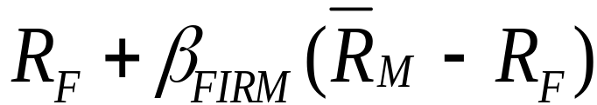
Project IRR
The SML can tell us why:
Incorrectly accepted negative NPV projects
Hurdle rate
Incorrectly rejected positive NPV projects
r_{f}
Firm’s risk (beta)
β_{FIRM}
Copyright © 2016 McGraw-Hill Education. All rights reserved.
No reproduction or distribution without the prior written consent of McGraw-Hill Education.
Notes:
To estimate the cost of capital for a division, a “pure play” approach could be used, although finding exactly similar firms may be difficult, particularly considering underlying financial and operational structure.

Slide 12
Capital Budgeting & Project Risk
Suppose the Conglomerate Company has a cost of capital, based on the CAPM, of 11.1%. The risk-free rate is 2%, the market risk premium is 7%, and the firm’s beta is 1.3.
11.1% = 2% + 1.3 × 7%
This is a breakdown of the company’s investment projects:
1/3 Automotive Retailer β = 2.0
1/3 Computer Hard Drive Manufacturer β = 1.3
1/3 Electric Utility β = 0.6
average β of assets = 1.3
When evaluating a new electrical generation investment, which cost of capital should be used?
Notes:
17

Slide 13
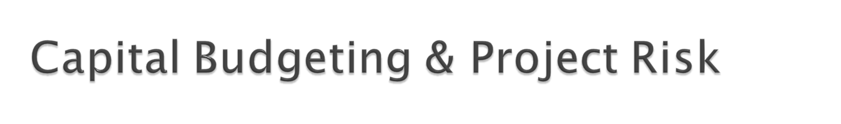
SML
16.0%
Investments in hard drives or auto retailing should have higher discount rates.
11.1%
Project IRR
6.2%
Project’s risk (β)
0.6
1.3
2.0
R = 2% + 0.6×(7% ) = 6.2%
6.2% reflects the opportunity cost of capital on an investment in electrical generation, given the unique risk of the project.

Slide 14
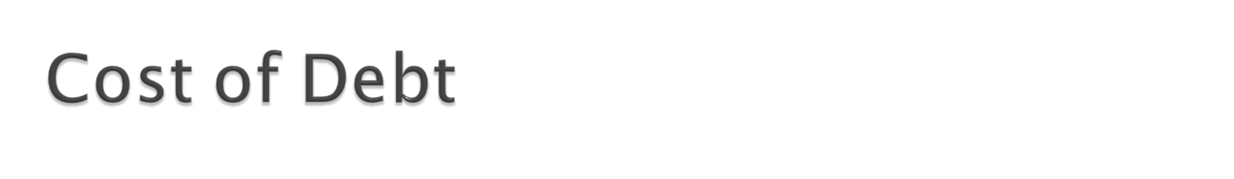
Interest rate required on new debt issuance (i.e., yield to maturity on outstanding debt)
Adjust for the tax deductibility of interest expense
Copyright © 2016 McGraw-Hill Education. All rights reserved.
No reproduction or distribution without the prior written consent of McGraw-Hill Education.

Slide 15
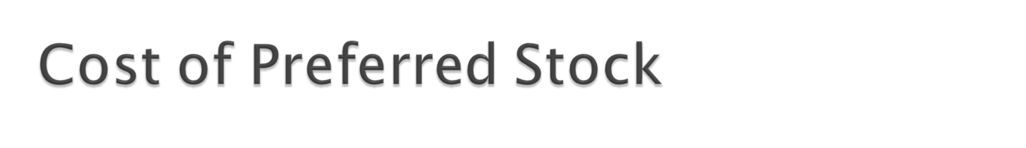
Preferred stock is a perpetuity, so its price is equal to the coupon paid divided by the current required return.
Rearranging, the cost of preferred stock is:
  R_{P} = C / PV
Copyright © 2016 McGraw-Hill Education. All rights reserved.
No reproduction or distribution without the prior written consent of McGraw-Hill Education.
Notes:
There is no tax adjustment because dividends are not tax deductible.

Slide 16
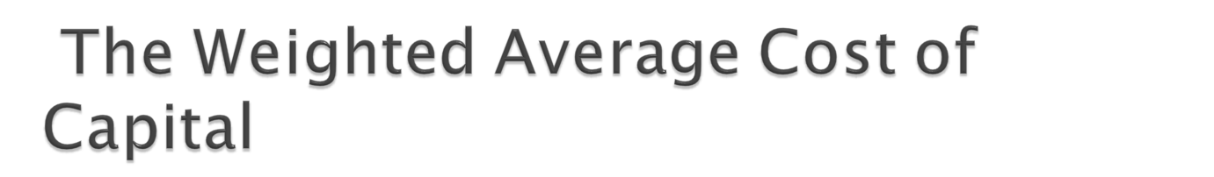
The Weighted Average Cost of Capital is given by:
Equity
Debt
R_{WACC} =
× R_{Equity} +
× R_{Debt} ×(1 – T_{C})
Equity + Debt
Equity + Debt
S
B
R_{WACC} =
× R_{S} +
× R_{B} ×(1 – T_{C})
S + B
S + B
Because interest expense is tax-deductible, we multiply the last term by (1 – T_{C}).
Copyright © 2016 McGraw-Hill Education. All rights reserved.
No reproduction or distribution without the prior written consent of McGraw-Hill Education.
Notes:
With preferred stock:
WACC = (S/(B+P+S))R_{S} + (P/(B+P+S))R_{P} + (B/(B+P+S))R_{D}(1-T_{C})

Slide 17

The value of the firm is the present value of expected future (distributable) cash flow discounted at the WACC
To find equity value, subtract the value of the debt from the firm value
Copyright © 2016 McGraw-Hill Education. All rights reserved.
No reproduction or distribution without the prior written consent of McGraw-Hill Education.

Slide 18

First, we estimate the cost of equity and the cost of debt.
  We estimate an equity beta to estimate the cost of equity.
  We can often estimate the cost of debt by observing the YTM of the firm’s debt.
Second, we determine the WACC by weighting these two costs appropriately.
Copyright © 2016 McGraw-Hill Education. All rights reserved.
No reproduction or distribution without the prior written consent of McGraw-Hill Education.

Slide 19

The industry average beta is 0.82, the risk free rate is 2%, and the market risk premium is 7%.
Thus, the cost of equity capital is:
R_{S} = R_{F} + β_{i} × ( R_{M} – R_{F})
= 2% + 0.82×7%
= 7.74%
Copyright © 2016 McGraw-Hill Education. All rights reserved.
No reproduction or distribution without the prior written consent of McGraw-Hill Education.

Slide 20

The yield on the company’s debt is 5%, and the firm has a 35% marginal tax rate.
The debt to value ratio is 32%
S
B
R_{WACC} =
× R_{S} +
× R_{B} ×(1 – T_{C})
S + B
S + B
= 0.68 × 7.74% + 0.32 × 5% × (1 – 0.35)
= 6.30%
6.30% is International’s cost of capital (i.e., WACC). It should be used to discount any project where one believes that the project’s risk is equal to the risk of the firm as a whole and the project has the same leverage as the firm as a whole.

Slide 21

Flotation costs represent the expenses incurred upon the issue, or float, of new bonds or stocks.
These are incremental cash flows of the project, which typically reduce the NPV since they increase the initial project cost (i.e., CF₀).
Amount Raised = Necessary Proceeds / (1-% flotation cost)
The % flotation cost is a weighted average based on the average cost of issuance for each funding source and the firm’s target capital structure:
f_{A} = (E/V)* f_{E} + (D/V)* f_{D}
Copyright © 2016 McGraw-Hill Education. All rights reserved.
No reproduction or distribution without the prior written consent of McGraw-Hill Education.

