Slide 1
Chapter 12
Capital Budgeting and Estimating Cash Flows
© 2001 Prentice-Hall, Inc.
Fundamentals of Financial Management, 11/e
Created by: Gregory A. Kuhlemeyer, Ph.D.
Carroll College, Waukesha, WI

Slide 2
Capital Budgeting and Estimating Cash Flows
  The Capital Budgeting Process
  Generating Investment Project Proposals
  Estimating Project “After-Tax Incremental Operating Cash Flows”

Slide 3
What is
Capital Budgeting?
The process of identifying, analyzing, and selecting investment projects whose returns (cash flows) are expected to extend beyond one year.

Slide 4
The Capital Budgeting Process
Generate investment proposals consistent with the firm’s strategic objectives.
Estimate after-tax incremental operating cash flows for the investment projects.
Evaluate project incremental cash flows.

Slide 5
The Capital Budgeting Process
Select projects based on a value-maximizing acceptance criterion.
Reevaluate implemented investment projects continually and perform postaudits for completed projects.

Slide 6
Classification of Investment Project Proposals
1. New products or expansion of existing products
2. Replacement of existing equipment or buildings
3. Research and development
4. Exploration
5. Other (e.g., safety or pollution related)

Slide 7
Screening Proposals and Decision Making
1. Section Chiefs
2. Plant Managers
3. VP for Operations
4. Capital Expenditures Committee
5. President
6. Board of Directors
Advancement
to the next
level depends
on cost
and strategic
importance.

Slide 8
Estimating After-Tax Incremental Cash Flows
Basic characteristics of relevant project flows
  Cash (not accounting income) flows
  Operating (not financing) flows
  After-tax flows
  Incremental flows

Slide 9
Estimating After-Tax Incremental Cash Flows
Principles that must be adhered to in the estimation
  Ignore sunk costs
  Include opportunity costs
  Include project-driven changes in working capital net of spontaneous changes in current liabilities
  Include effects of inflation

Slide 10
Tax Considerations and Depreciation
Depreciation represents the systematic allocation of the cost of a capital asset over a period of time for financial reporting purposes, tax purposes, or both.
Generally, profitable firms prefer to use an accelerated method for tax reporting purposes (MACRS).

Slide 11
Depreciation and the MACRS Method
Everything else equal, the greater the depreciation charges, the lower the taxes paid by the firm.
Depreciation is a noncash expense.
Assets are depreciated (MACRS) on one of eight different property classes.
Generally, the half-year convention is used for MACRS.

Slide 12
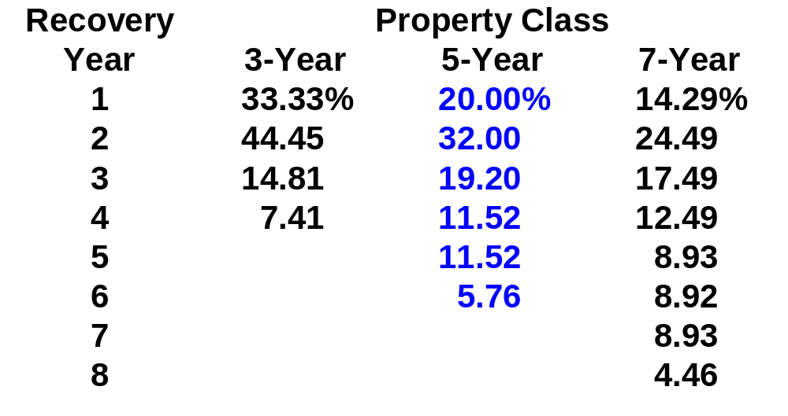
MACRS Sample Schedule

Slide 13
Depreciable Basis
In tax accounting, the fully installed cost of an asset. This is the amount that, by law, may be written off over time for tax purposes.
Depreciable Basis =
Cost of Asset + Capitalized Expenditures

Slide 14
Capitalized Expenditures
Capitalized Expenditures are expenditures that may provide benefits into the future and therefore are treated as capital outlays and not as expenses of the period in which they were incurred.
Examples: Shipping and installation

Slide 15
Sale or Disposal of a Depreciable Asset
Generally, the sale of a “capital asset” (as defined by the IRS) generates a capital gain (asset sells for more than book value) or capital loss (asset sells for less than book value).
Often historically, capital gains income has received more favorable U.S. tax treatment than operating income.

Slide 16
Corporate Capital Gains / Losses
Currently, capital gains are taxed at ordinary income tax rates for corporations, or a maximum 35%.
Capital losses are deductible only against capital gains.

Slide 17
Calculating the Incremental Cash Flows
Initial cash outflow -- the initial net cash investment.
Interim incremental net cash flows -- those net cash flows occurring after the initial cash investment but not including the final period’s cash flow.
Terminal-year incremental net cash flows -- the final period’s net cash flow.

Slide 18
Initial Cash Outflow
a) Cost of “new” assets
b) + Capitalized expenditures
c) + (-) Increased (decreased) NWC
d) - Net proceeds from sale of “old” asset(s) if replacement
e) + (-) Taxes (savings) due to the sale of “old” asset(s) if replacement
f) = Initial cash outflow

Slide 19
Incremental Cash Flows
a) Net incr. (decr.) in operating revenue less (plus) any net incr. (decr.) in operating expenses, excluding depr.
b) - (+) Net incr. (decr.) in tax depreciation
c) = Net change in income before taxes
d) - (+) Net incr. (decr.) in taxes
e) = Net change in income after taxes
f) + (-) Net incr. (decr.) in tax depr. charges
g) = Incremental net cash flow for period

Slide 20
Terminal-Year Incremental Cash Flows
a) Calculate the incremental net cash flow for the terminal period
b) + (-) Salvage value (disposal/reclamation costs) of any sold or disposed assets
c) - (+) Taxes (tax savings) due to asset sale or disposal of “new” assets
d) + (-) Decreased (increased) level of “net” working capital
e) = Terminal year incremental net cash flow

Slide 21
Example of an Asset Expansion Project
Basket Wonders (BW) is considering the purchase of a new basket weaving machine. The machine will cost $50,000 plus $20,000 for shipping and installation and falls under the 3-year MACRS class. NWC will rise by $5,000. Lisa Miller forecasts that revenues will increase by $110,000 for each of the next 4 years and will then be sold (scrapped) for $10,000 at the end of the fourth year, when the project ends. Operating costs will rise by $70,000 for each of the next four years. BW is in the 40% tax bracket.

Slide 22
Initial Cash Outflow
a) $50,000
b) + 20,000
c) + 5,000
d) - 0 (not a replacement)
e) + (-) 0 (not a replacement)
f) = $75,000*
* Note that we have calculated this value as a “positive” because it is a cash OUTFLOW (negative).

Slide 23
Incremental Cash Flows
Year 1 Year 2 Year 3 Year 4
a) $40,000 $40,000 $40,000 $40,000
b) - 23,331 31,115 10,367 5,187
c) = $16,669 $ 8,885 $29,633 $34,813
d) - 6,668 3,554 11,853 13,925
e) = $10,001 $ 5,331 $17,780 $20,888
f) + 23,331 31,115 10,367 5,187
g) = $33,332 $36,446 $28,147 $26,075

Slide 24
Terminal-Year Incremental Cash Flows
a) $26,075 The incremental cash flow from the previous slide in Year 4.
b) + 10,000 Salvage Value.
c) - 4,000 .40*($10,000 - 0) Note, the asset is fully depreciated at the end of Year 4.
d) + 5,000 NWC - Project ends.
e) = $37,075 Terminal-year incremental cash flow.

Slide 25
Summary of Project Net Cash Flows
Asset Expansion
Year 0 Year 1 Year 2 Year 3 Year 4
-$75,000* $33,332 $36,446 $28,147 $37,075
* Notice again that this value is a negative cash flow as we calculated it as the initial cash OUTFLOW in slide 12-18.

Slide 26
Example of an Asset Replacement Project
Let us assume that previous asset expansion project is actually an asset replacement project. The original basis of the machine was $30,000 and depreciated using straight-line over five years ($6,000 per year). The machine has two years of depreciation and four years of useful life remain-ing. BW can sell the current machine for $6,000. The new machine will not increase revenues (remain at $110,000) but it decreases operating expenses by $10,000 per year (old = $80,000). NWC will rise to $10,000 from $5,000 (old).

Slide 27
Initial Cash Outflow
a) $50,000
b) + 20,000
c) + 5,000
d) - 6,000 (sale of “old” asset)
e) - 2,400 <----
f) = $66,600
(tax savings from
loss on sale of
“old” asset)

Slide 28
Calculation of the Change in Depreciation
Year 1 Year 2 Year 3 Year 4
a) $23,331 $31,115 $10,367 $ 5,187
b) - 6,000 6,000 0 0
c) = $17,331 $25,115 $10,367 $ 5,187
a) Represent the depreciation on the “new” project.
b) Represent the remaining depreciation on the “old” project.
c) Net change in tax depreciation charges.

Slide 29
Incremental Cash Flows
Year 1 Year 2 Year 3 Year 4
a) $10,000 $10,000 $10,000 $10,000
b) - 17,331 25,115 10,367 5,187
c) = $ -7,331 -$15,115 $ -367 $ 4,813
d) - -2,932 -6,046 -147 1,925
e) = $ -4,399 $ -9,069 $ -220 $ 2,888
f) + 17,331 25,115 10,367 5,187
g) = $12,932 $16,046 $10,147 $ 8,075

Slide 30
Terminal-Year Incremental Cash Flows
a) $ 8,075 The incremental cash flow from the previous slide in Year 4.
b) + 10,000 Salvage Value.
c) - 4,000 (.40)*($10,000 - 0). Note, the asset is fully depreciated at the end of Year 4.
d) + 5,000 Return of “added” NWC.
e) = $19,075 Terminal-year incremental cash flow.

Slide 31
Summary of Project Net Cash Flows
Asset Expansion
Year 0 Year 1 Year 2 Year 3 Year 4
-$75,000 $33,332 $36,446 $28,147 $37,075
Asset Replacement
Year 0 Year 1 Year 2 Year 3 Year 4
-$66,600 $12,933 $16,046 $10,147 $19,075

