Slide 1
Classifying Imagenette with a small bottleneck network
Elias DeVoe
University of Wisconsin, Madison​
Wisconsin Institute for Discovery

Slide 2
Overview
Background on the datasets
Training details
Evaluating predictions
Transfer learning

Slide 3
Imagenette and Imagewoof: full-size subsets of Imagenet
Imagenette
Imagewoof
13395 full size (469 × 387) images from Imagenet
Split into 10 ~equally sized categories
tench
English springer
cassette player
chain saw
church
French horn
garbage truck
gas pump
golf ball
parachute
Like Imagenette , 12955 images, only dog breeds
Australian terrier
Border terrier
Samoyed
Beagle
Shih-Tzu
English foxhound
Rhodesian ridgeback
Dingo
Golden retriever
Old English sheepdog
Source: https://github.com/fastai/imagenette

Slide 4

Data storage and loading
Tuning
Training
Train (70%)
Train only on training data
Test on last 15%
- Class 1
.
.
.
- Class 10
Validation (15%)
class ImagenetteDataloader(Dataset)
@ parameter “folds”: if > 0, how many folds to split into for cross-validation
@ parameter “i”: which fold to evaluate on
@ parameter “mode”:
- if “train” or “val” and “folds” > 0:
- Combine train and val, split into k folds, evaluate on fold ”i”
- otherwise, follow path to specified data directory
code/dataloader.py

Slide 5
Overview
Background on the datasets
Training details
Evaluating predictions
Transfer learning

Slide 6
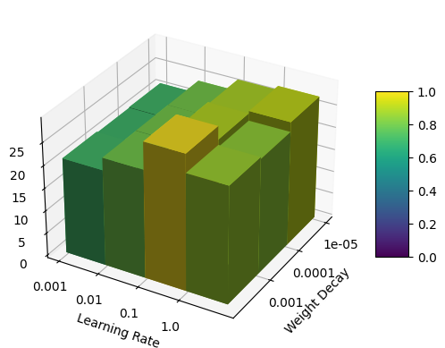
Hyperparameter Tuning
Best model from lr = 0.1, weight decay = 1e-4
5 – fold cross validation:
For each combination of hyperparameters, average validation from a model trained/evaluated on different subsets of the training data
Bar height and color correspond to validation accuracy
code/vis_cross_validation.py

Slide 7
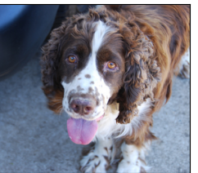
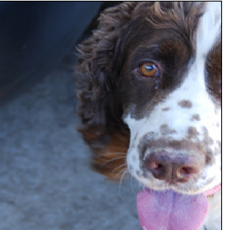
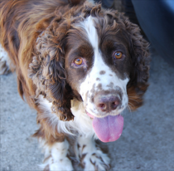
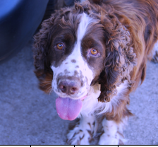
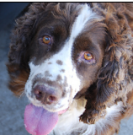
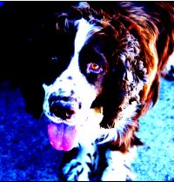
Data augmentation by composing image transforms
Randomly apply:
Resize
Crop
Horizontal flip
Recolor
In-frame rotation (no black corners)
Normalize
code/transforms.py

Slide 8
BottleneckNet
1x conv block
3x conv block
Each conv block consists of:
1x1 conv to expand feature dimension
Batchnorm
3x3 conv to learn features
Batchnorm
1x1 conv to expand feature dimension
Batchnorm + ReLu + residual connection
3x conv block
7x7 conv
Global Avg Pool +
Fully Connected Layer
Max-pool
Max-pool
Max-pool
Max-pool
3 -> 64
64 -> 128
128 -> 256
256 -> 512
code/models.py

Slide 9
Training Details
90 epochs
Batch size 256
Linear ramp from initial learning rate
Cross entropy loss

Slide 10
Overview
Background on the datasets
Training details
Evaluating predictions
Transfer learning

Slide 11
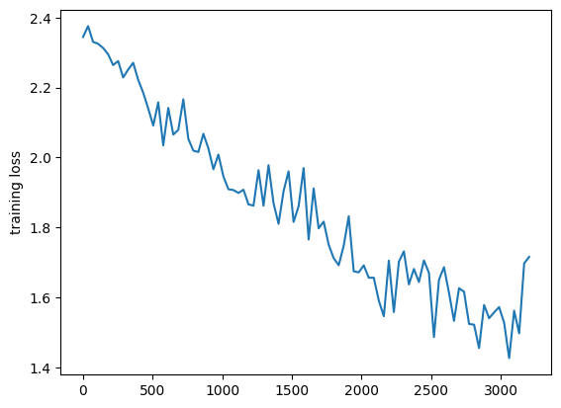
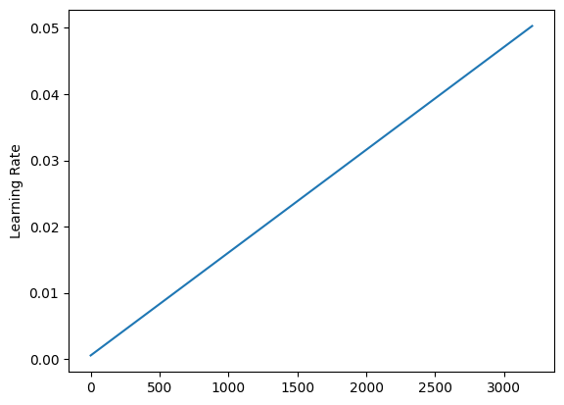
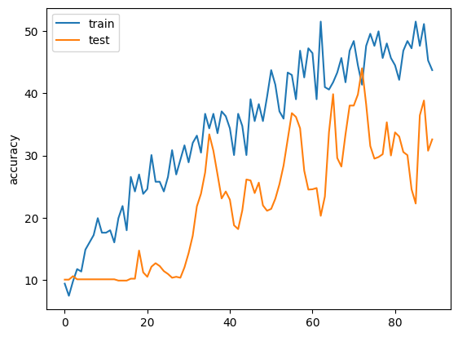
Training dynamics suggest further hyperparameter tuning could lead to easy performance improvements
Training Loss
Learning Rate
Accuracy
Epoch 35
code/vis_best_model.py

Slide 12
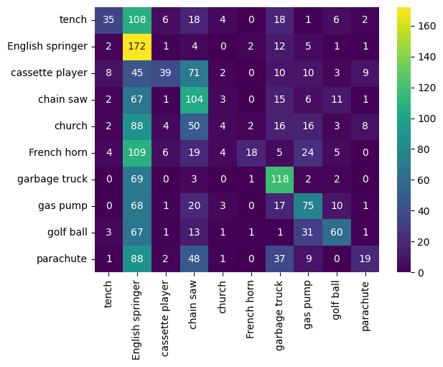
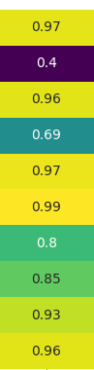
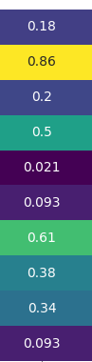
The model mistakes everything for English Springers
Specificity
Sensitivity
True class
0.852
0.326
Predicted class
code/vis_best_model.py

Slide 13
Overview
Background on the datasets
Training details
Evaluating predictions
Transfer learning

Slide 14
Approach to fine-tuning for Imagewoof
Using the best model trained on Imagenette:
Replace the classification head with a randomly initialized fully connected layer
Freeze gradients in all other layers
Train 8 epochs with same learning rate
Unfreeze earlier layers
Train 52 epochs with 1/5th learning rate
Compare to “vanilla” model trained only on Imagewoof

Slide 15
Fine tuning leads to significant improvement over vanilla classifier
Final validation accuracy
Vanilla: 24%
Fine Tuned: 30%
code/fine_tune.py

Slide 16
Next Steps
More robust hyperparameter tuning strategy
Deeper models

Slide 17
Thank You!

