Slide 1

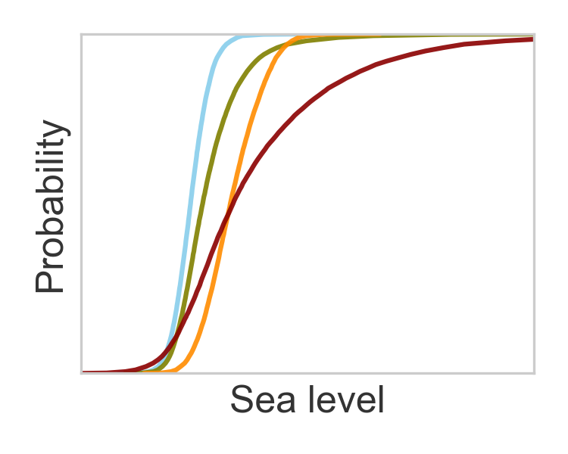
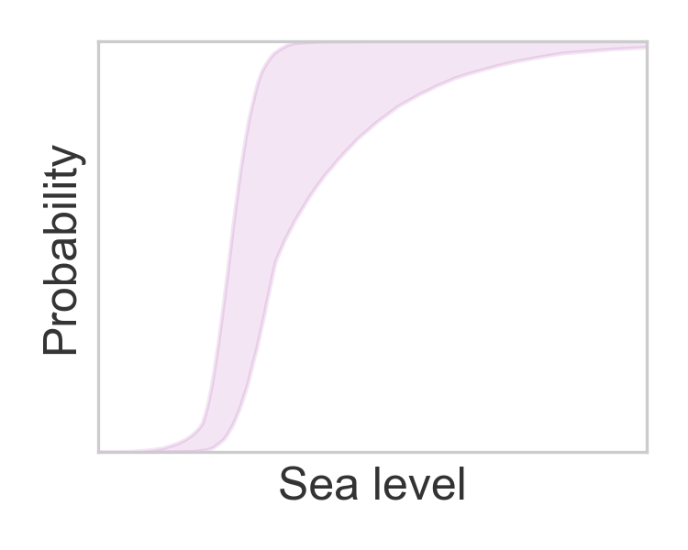
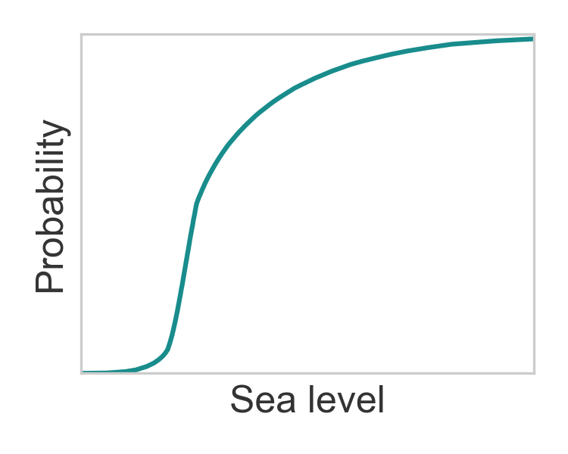
Expert judgment
Probabilistic projections
Alternative workflows provide alternative estimates of scientific uncertainty
Experts develop
models & methods
Experts select workflows
to include in the p-box
The p-box quantifies workflow ambiguity
Experts assess the strengths
of alternative workflows
The fusion is a best estimate of scientific uncertainty

