Slide 1
Green Manufacturing
By Nabh Choudhary
Green manufacturing is a method for manufacturing that minimizes waste and pollution. These goals are often achieved through product and process design.
Recent Industrial Initiative:
Climate Savers Computing Initiative:
CSCI is an effort to reduce the electric power consumption of PCs in active and inactive states. The CSCI provides a catalog of green products from its member organizations and information for reducing PC power consumption. It
was started on 2007.
2. Green Computing Impact Organization Inc.: GCIO is
a nonprofit organization dedicated to assisting the end users of computing products in being environmentally responsible. This mission is accomplished through educational events, cooperative programs and subsidized auditing services.

Slide 2
3.Green Electronics Council: The Green Electronics Council offers the Electronic Products Environmental Assessment Tool (EPEAT) to assist in the purchase of "green" computing systems. The Council evaluates
computing equipment on 28 criteria that measure a product’s efficiency and sustainability attributes.
4. The Green Grid: It is a global consortium dedicated to advancing energy efficiency in data centers and business computing ecosystems. It was founded in February 2007 by several key companies in the industry AMD, APC, Dell, HP, IBM, Intel, Microsoft, Rackable Systems, SprayCool, Sun Microsystems and VMware.

Slide 3
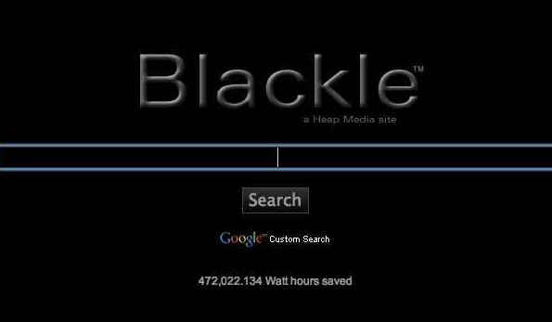
Recent Implementation In Green Computing:
1. Blackle:
Blackle is a website powered by Google custom search and created by Heap Media , which aims to save energy by displaying a black background and using grayish-white font color for search results.

Slide 4

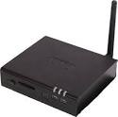
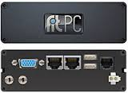
2.Zonbu Computers:
Zonbu is a technology company that markets a computing platform which combines a web-centric service, a small form factor PC and an open source based software architecture.
3. Fit-PC:
The fit-PC is a small, light, fan-less nettop computer manufactured by the Isreli company CompuLab.
The deviceis power-efficient (fit-PC 1 was about 5 W) and therefore considered to be a green computing project, capable of using open-source software and creating minimal electronic waste.

Slide 5
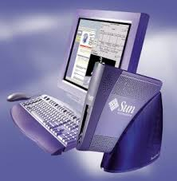

4. SunRay Thin Client:
The Sun Ray from Oracle is a stateless thin client solution aimed at corporate environments, originally introduced by Sun Microsystems in September 1999 and discontinued by Oracle in 2014.It featured a smart card reader and several models featured an integrated flat panel display.

