Slide 1
Messaging with Spring-Integration

Slide 2
Agenda
Use cases
Channels and Endpoints
What was this all about?
Introducing Spring Integration!
Spring Integration Channels
Spring Integration Endpoints
Integration with External Systems

Slide 3
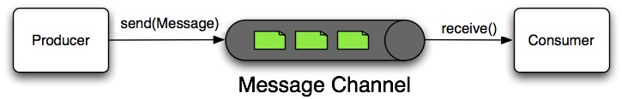
Pipes-and-Filters
Filter
Pipe
Filter
The Message Channel decouples the messaging components,
and also provides a convenient point for interception and monitoring of Messages.

Slide 4
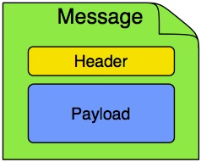

Message
In Spring Integration, a Message is a generic wrapper for any Java object combined with metadata used by the framework while handling that object

Slide 5



Point-to-Point
Producer
Message
Channel
Consumer
With a Point-to-Point channel,
at most one consumer can receive each Message sent to the channel.

Slide 6





Publish / Subscribe
Publisher
Message
Subscribable Channel
Publish/Subscribe channels will attempt
to broadcast each Message to all of its subscribers
Subscribers

Slide 7
Endpoint
Endpoint
Consumer
A Message Endpoint represents the "filter" of a pipes-and-filters architecture.
The endpoint's primary role is to connect application code to the messaging framework,
and to do so in a non-invasive manner.

Slide 8
Endpoints
Transformer
Filter
Router
Splitter
Aggregator
Service Activator
Channel Adapter

Slide 9
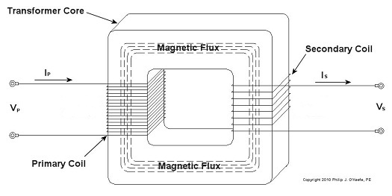

Transformer
XML
JSON
Is responsible for converting a Message's content or structure and returning the modified Message.
The most common type of transformer is one that converts the payload of the Message from one format to another (e.g. from XML Document to JSON).
May be used to add, remove, or modify the Message's header values.

Slide 10

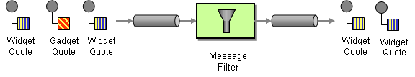
Filter
Determines whether a Message should be passed to an output channel at all.
Often used in conjunction with a Publish Subscribe channel, where multiple consumers may receive the same Message and use the filter to narrow down the set of Messages to be processed based on some criteria.

Slide 11


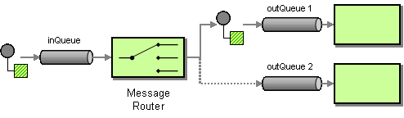
Router
Responsible for deciding what channel or channels should receive the Message next
Often used as a dynamic alternative to a statically configured output channel
Provides a proactive alternative to the reactive Message Filters used by multiple subscribers

Slide 12
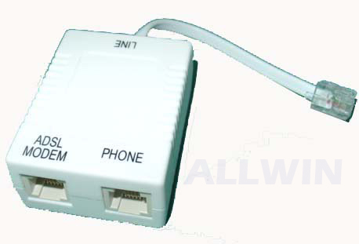

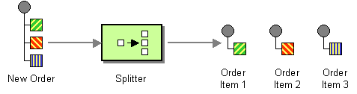
Splitter
Splits received Message into multiple Messages, and then sends each of those to its output channel.
Typically used for dividing a "composite" payload object into a group of Messages containing the sub-divided payloads

Slide 13
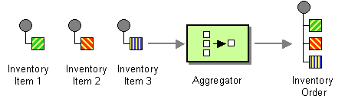
Aggregator
A mirror-image of the Splitter
Receives multiple Messages and combines them into a single Message
Technically, is more complex than a Splitter, because it is required to maintain state (the Messages to-be-aggregated)

Slide 14


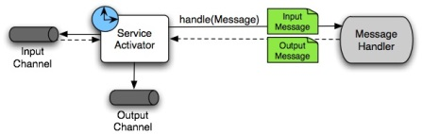
Service Activator
A generic endpoint for connecting a service instance to the messaging system
The input Message Channel must be configured
If the service method to be invoked is capable of returning a value, an output Message Channel may also be provided.

Slide 15


Channel Adapter
Inbound
Outbound
An endpoint that connects a Message Channel to some other system or transport
May be either inbound or outbound
Typically, will do some mapping between the Message and whatever object or resource is received-from or sent-to the other system (File, HTTP Request, JMS Message, etc)

Slide 16
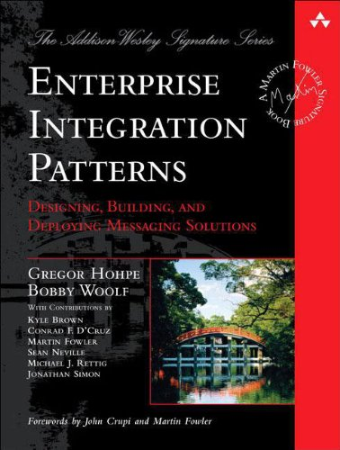
What was this all about?
Enterprise application integration (EAI) is the use of software and computer systems architectural principles to integrate a set of enterprise computer applications.
Spring Integration is a framework for EAI that provides reusable functions that are essential in messaging, or event-driven architectures.

Slide 17
Spring Integration
Provides an extension of the Spring programming model to support the well-known Enterprise Integration Patterns
Enables lightweight messaging within Spring-based applications
Supports integration with external systems via declarative adapters
Provides a higher-level of abstraction over Spring's support for remoting, messaging, and scheduling

Slide 18
Goals
Spring Integration is motivated by the following goals:
Provide a simple model for implementing complex enterprise integration solutions.
Facilitate asynchronous, message-driven behavior within a Spring-based application.
Promote intuitive, incremental adoption for existing Spring users.

Slide 19
Principles
Spring Integration is guided by the following principles:
Components should be loosely coupled for modularity and testability.
The framework should enforce separation of concerns between business logic and integration logic.
Extension points should be abstract in nature but within well-defined boundaries to promote reuse and portability.

Slide 20
Message Channels
public interface MessageChannel {
boolean send(Message message);
boolean send(Message message, long timeout);
}
public interface PollableChannel extends MessageChannel {
Message<?> receive();
Message<?> receive(long timeout);
}
public interface SubscribableChannel extends MessageChannel {
boolean subscribe(MessageHandler handler);
boolean unsubscribe(MessageHandler handler);
}

Slide 21
Message Channel implementations
DirectChannel - has point-to-point semantics but implements the SubscribableChannel interface. - The default channel type within Spring Integration. - Enables a single thread to perform the operations on "both sides" of the channel. <int:channel id = "exampleChannel"/> <int:channel id = "stringOrNumberChannel" datatype = "java.lang.String,java.lang.Number"/>
ExecutorChannel - like DirectChannel, but delegates to an instance of TaskExecutor to perform the dispatch <int:channel id = "executorChannel"> <int:dispatcher task-executor = "someExecutor"/> </int:channel>

Slide 22
Message Channel implementations
PublishSubscribeChannel - broadcasts any Message sent to it to all of its subscribed handlers. <int:publish-subscribe-channel id = "exampleChannel"/>
QueueChannel - wraps a FIFO queue, has point-to-point semantics. <int:channel id = "queueChannel"> <queue/> </int:channel>

Slide 23
Message Channel implementations
PriorityChannel - allows for messages to be ordered within the channel based upon a priority. <int:channel id = "priorityChannel" datatype = "example.Widget"> <int:priority-queue comparator = "widgetComparator" capacity = "10"/> </int:channel>
RendezvouzChannel - a "direct-handoff" scenario where a sender will block until another party invokes the channel's receive() method <int:channel id = "rendezvousChannel"/> <int:rendezvous-queue/> </int:channel>

Slide 24
Channel Interceptors
public interface ChannelInterceptor {
Message<?> preSend (Message<?> message, MessageChannel channel);
void postSend (Message<?> message, MessageChannel channel, boolean sent);
boolean preReceive (MessageChannel channel);
Message<?> postReceive(Message<?> message, MessageChannel channel);
}
<int:channel id = "exampleChannel"> <int:interceptors> <ref bean = "trafficMonitoringInterceptor"/> </int:interceptors> </int:channel> <int:channel-interceptor ref = "myInterceptor" pattern = "input*, bar*, foo" order = "3"/> <bean id = "myInterceptor" class = "foo.barSampleInterceptor"/>

Slide 25
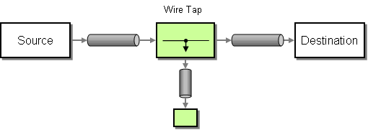

Wire Tap
Consumes messages off the input channel and publishes the unmodified message to both output channels. <int:channel id = "in"> <int:interceptors> <int:wire-tap channel = "logger"/> </int:interceptors> </int:channel> <int:logging-channel-adapter id = "logger" level="DEBUG"/>

Slide 26
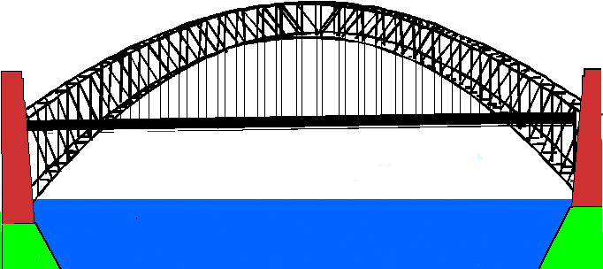
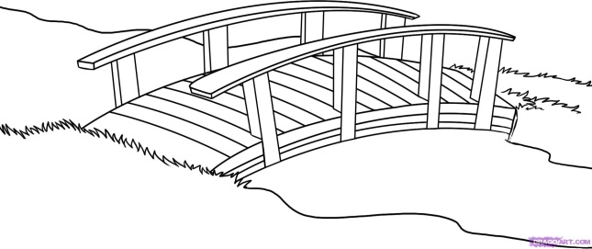
Messaging Bridge
Connects two Message Channels or Channel Adapters
Another valid use for a Messaging Bridge is to connect two different systems
<int:bridge input-channel = "input" output-channel = "output"/>
<int:bridge input-channel = "pollable" output-channel = "subscribable">
<int:poller max-messages-per-poll = "10" fixed-rate = "5000"/>
</int:bridge>

Slide 27
So how to implement endpoints with Spring Integration?
Transformer
Filter
Router
Splitter
Aggregator
Service Activator
Channel Adapter

Slide 28
Transformer
<int:transformer id = "testTransformer" ref = "testTransformerBean" input-channel = "inChannel" method = "transform" output-channel = "outChannel"/> <beans:bean id = "testTransformerBean" class = "org.foo.TestTransformer" /> Out of the box: <int:object-to-string-transformer input-channel="in" output-channel="out"/>
Serialization / Deserialization:
<int:payload-serializing-transformer input-channel = "objectsIn" output-channel = "bytesOut"/> <int:payload-deserializing-transformer input-channel= "bytesIn" output-channel = "objectsOut"/>
JSON (with Jackson ObjectMapper) :
<int:object-to-json-transformer input-channel = "objectMapperInput"/>
<int:json-to-object-transformer input-channel = "objectMapperInput" type = "foo.MyDomainObject" object-mapper = "customObjectMapper"/>

Slide 29
Filter
public interface MessageSelector { boolean accept ( Message<?> message ); }
<int:filter input-channel = "input" ref = "selector" output-channel = "output"/>
<bean id = "selector" class = "example.MessageSelectorImpl"/> <int:filter input-channel = "input" output-channel = "output" ref = "exampleObject" method = "someBooleanReturningMethod"/>
<bean id = "exampleObject" class = "example.SomeObject"/>

Slide 30
Router
<int:payload-type-router input-channel = "routingChannel">
<int:mapping type = "java.lang.String" channel = "stringChannel" />
<int:mapping type = "java.lang.Integer" channel = "integerChannel" />
</int:payload-type-router>
<int:header-value-router input-channel = "routingChannel" header-name = “routeHeader">
<int:mapping value = "someHeaderValue" channel = "channelA" />
<int:mapping value = "someOtherHeaderValue" channel = "channelB" />
</int:header-value-router>
<int:router method = "someMethod" input-channel = "input" default-output-channel = "defaultOutput">
<beans:bean class = "org.foo.MyCustomRouter"/>
</int:router>

Slide 31
Splitter
<int:channel id = "inputChannel"/>
<int:splitter id = "splitter" ref = "splitterBean" method = "split" input-channel = "inputChannel" output-channel = "outputChannel" />
<int:channel id = "outputChannel"/>
<beans:bean id = "splitterBean" class = "sample.PojoSplitter"/>

Slide 32
Aggregator
public class Waiter {
...
@Aggregator public Delivery aggregatingMethod(List<OrderItem> items) { ... }
@ReleaseStrategy public boolean releaseChecker(List<Message<?>> messages) { ... }
@CorrelationStrategy public String correlateBy(OrderItem item) { ... }
}
<aggregator input-channel = "input" output-channel = "output“ ref = “waiter” />

Slide 33
Service Activator
<int:service-activator input-channel = "exampleChannel" output-channel = "replyChannel“ ref = “activatedPojo" method = “activatedMethod"/>

Slide 34
Channel Adapter
An "inbound-channel-adapter" element can invoke any method on a Spring-managed Object and send a non-null return value to a MessageChannel after converting it to a Message.
<int:inbound-channel-adapter ref = "source" method = “poll" channel = "channel1"> <int:poller fixed-rate="5000"/> </int:inbound-channel-adapter> <beans:bean id=“source" class="org.Foo"/>
An "outbound-channel-adapter" element can connect a MessageChannel to any POJO consumer method that should be invoked with the payload of Messages sent to that channel.
<int:outbound-channel-adapter channel = "channel1" ref = "target" method = "handle"/> <beans:bean id = "target" class = "org.Foo"/>

Slide 35
Message Handler Chain
Can be configured as a single Message Endpoint while actually delegating to a chain of other handlers, such as Filters, Transformers, Splitters, and so on.
<int:chain input-channel = "input" output-channel = "output">
<int:filter ref = "someSelector" throw-exception-on-rejection = "true"/>
<int:header-enricher>
<int:header name = "foo" value = "bar"/>
</int:header-enricher>
<int:service-activator ref = "someService" method = "someMethod"/>
</int:chain>

Slide 36
Integration with External Systems
Spring Integration provides a number of endpoints used to interface with external systems, file systems etc.
AMQP (RabbitMQ)
Spring ApplicationEvents
Feed (RSS, ATOM, …)
File
FTP
GemFire
HTTP
JDBC
JMS
JMX
JPA (Hibernate, OpenJPA, …)
Mail
MongoDB
MQTT
Redis
Resource
RMI
SFTP
Stream
Syslog
TCP
Twitter
UDP
Web Services
XMPP

Slide 37
Interesting Facts
Spring Integration 4.1.0 was released on 11 Nov 2014 (introducing WebSocket support, more EIP patterns implemented and other improvements)
On Nov 12, 2014, DZone research recognized Spring Integration as the leader of the ESB / Integration framework space, leading with 42% market share

Slide 38
Questions?

Slide 39
Useful Links:
http://www.eaipatterns.com/toc.html - Enterprise Integration Patterns
http://projects.spring.io/spring-integration/ - Spring Integration home page
http://docs.spring.io/spring-integration/docs/4.1.0.RELEASE/reference/html/index.html - Spring Integration Reference Manual

