Slide 1


When Camel Smiles
Orest Ivasiv

Slide 2
Agenda
Integration concept
Camel Intro
Sample route
Camel community

Slide 3
What is Apache Camel?
Apache Camel ™ is a versatile open-source integration framework based on known Enterprise Integration Patterns.
Is not ESB (Servicemix, Mule)
Is not Message Broker (ActiveMQ, RabbitMQ)
Is not a runtime container (see Tomcat)
FTW?

Slide 4
Distributed Applications vs. Integration
Enterprise integration—how to integrate independent applications so that they can work together.
An enterprise application often incorporates an n-tier architecture enabling it to be distributed across several computers.
Q: Why is an n-tier architecture considered application distribution and not application integration?
the communicating parts are tightly coupled
communication between tiers tends to be synchronous
Communication between tiers tends to be synchronous
Notes:
http://www.eaipatterns.com/Introduction.html
Distributed Applications vs. Integration
This book is about enterprise integration—how to integrate independent applications so that they can work together. An enterprise application often incorporates an n-tier architecture (a more sophisticated version of a client/server architecture) enabling it to be distributed across several computers. Even though this results in processes on different machines communicating with each other, this is application distribution, not application integration.
Why is an n-tier architecture considered application distribution and not application integration? First, the communicating parts are tightly coupled—they dependent directly on each other, so that one tier cannot function without the others. Second, communication between tiers tends to be synchronous. Third, an application (n-tier or atomic) tends to have human users that will only accept rapid system response.
In contrast, integrated applications are independent applications that can each run by itself, but coordinate with each other in a loosely coupled way. This enables each application to focus on one comprehensive set of functionality and yet delegate to other applications for related functionality. Integrated applications communicating asynchronously don’t have to wait for a response; they can proceed without a response or perform other tasks concurrently until the response is available. Integrated applications tend to have a broad time constraint, such that they can work on other tasks until a result becomes available, and therefore are more patient than most human users waiting real-time for a result.

Slide 5
Complexity of Integration
Integration Suite
Enterprise Service Bus
Integration Framework
No Tool
Low
High
Custom integration
Connectivity
Routing
Transformation
Integration
Tooling
Monitoring
Support
Business Process Management
Big Data / MDM
Registry / Repository
Rule Engine
“You Name It”
Notes:
http://www.kai-waehner.de/blog/2011/06/02/when-to-use-apache-camel/
http://www.slideshare.net/KaiWaehner/spoilt-for-choice-how-to-choose-the
If you have to integrate just one or two technologies, e.g. reading a file or sending a JMS message, it is probably much easier and faster to use some well known libraries such as Apache Commons IO or Spring JmsTemplate. But please do always use these helper classes, pure File or JMS integration with try-catch-error is soooo ugly!

Slide 6
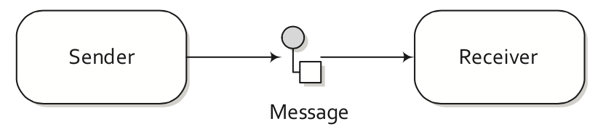
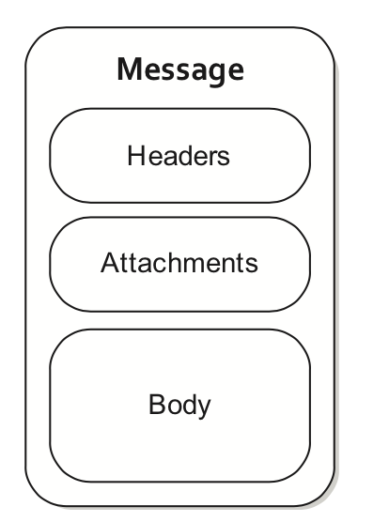
Message
Notes:
$ ls -d */ | wc -l
187

Slide 7
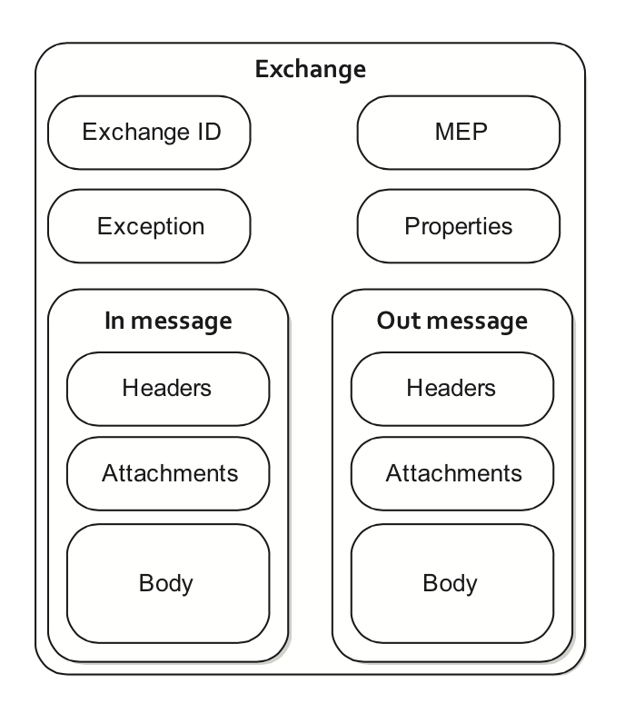
Exchange
Notes:
MEPs are used to differentiate between one-way and request-response messaging styles. The Camel exchange holds a pattern property that can be either

Slide 8
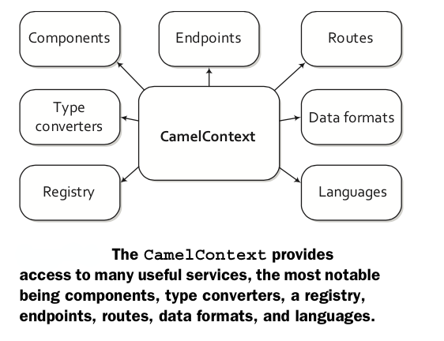
CamelContext
Notes:
From book “Camel in Action”

Slide 9
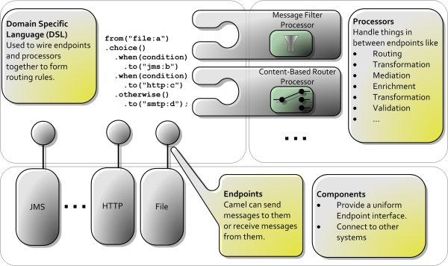
Camel Architecture

Slide 10
Component Categories
General use
Direct, seda, file, bean, log, timer
Search, big data, cashing
Lucene, solr, elasticsearch
Hdfs, s3, mongodb
Ehcache, hazelcast
Management
Jmx, ldap, splunk, zookeeper
Integration
http, servlet, cxf, jms
protocols
Mina, netty, pop3, imap

Slide 11
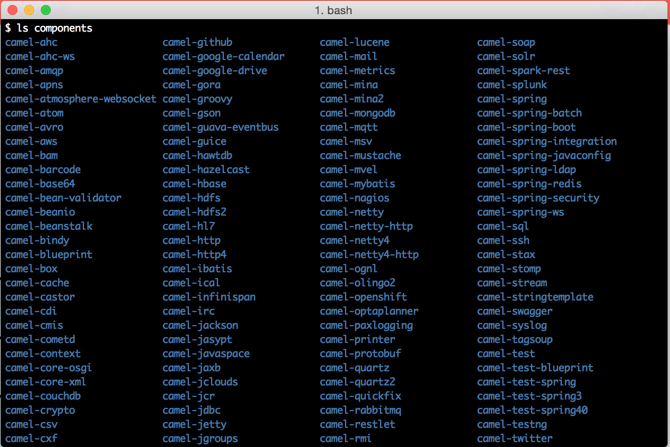
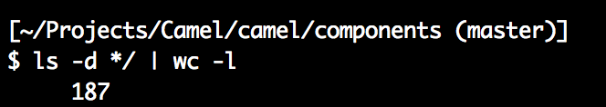
ls camel/components

Slide 12
How to use a component
You found a component… now what?
Review the spec page, samples, unit tests
Include camel-[component] jar in your project
Add dependency to your pom.xml
w/o maven (gradle) just add your jars to your classpath
Create a basic unit test
Copy/paste from component test
Sanity test your setup
Validate desired config option
Integrate your component with your app
Is you CamelContent setup?
Is your RouteBuilder wired in?
Notes:
http://www.consulting-notes.com/2014/06/apachecon-2014-presentation-apache.html#comment-form

Slide 13
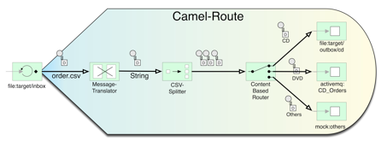
Sample Route

Slide 14
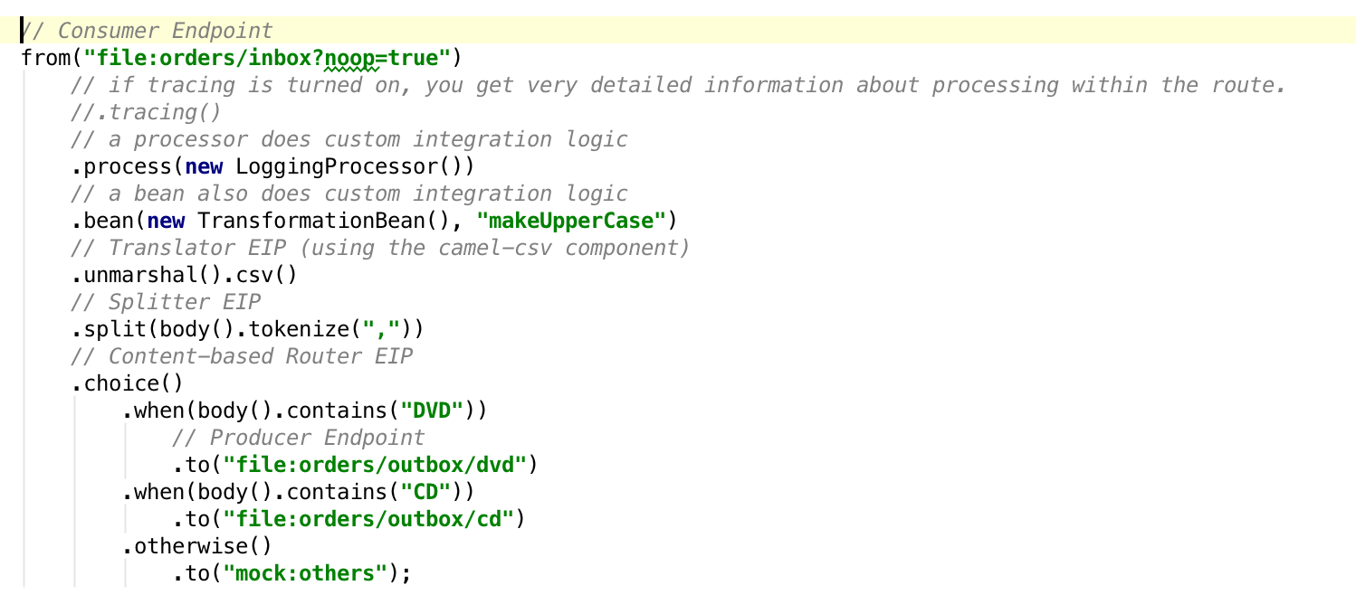
Sample Route (cont.)

Slide 15
Top Camel contributors
$ git shortlog -ns
8095 Claus Ibsen
2853 Willem Ning Jiang
1385 James Strachan
930 Willem Jiang
757 Hadrian Zbarcea
648 Babak Vahdat
487 Christian Mueller
478 Jonathan Anstey
196 cmueller
194 Hiram R. Chirino
143 Christian Schneider
139 Henryk Konsek
136 Daniel Kulp
130 Moulliard Charles
108 Gert Vanthienen
100 Dhiraj Bokde

Slide 16

Camel initial commit
Author: James Strachan <jstrachan@apache.org> 2007-03-19 12:54:57
`
Apache ActiveMQ
Apache Camel
Apache ServiceMix
Groovy programming language

Slide 17
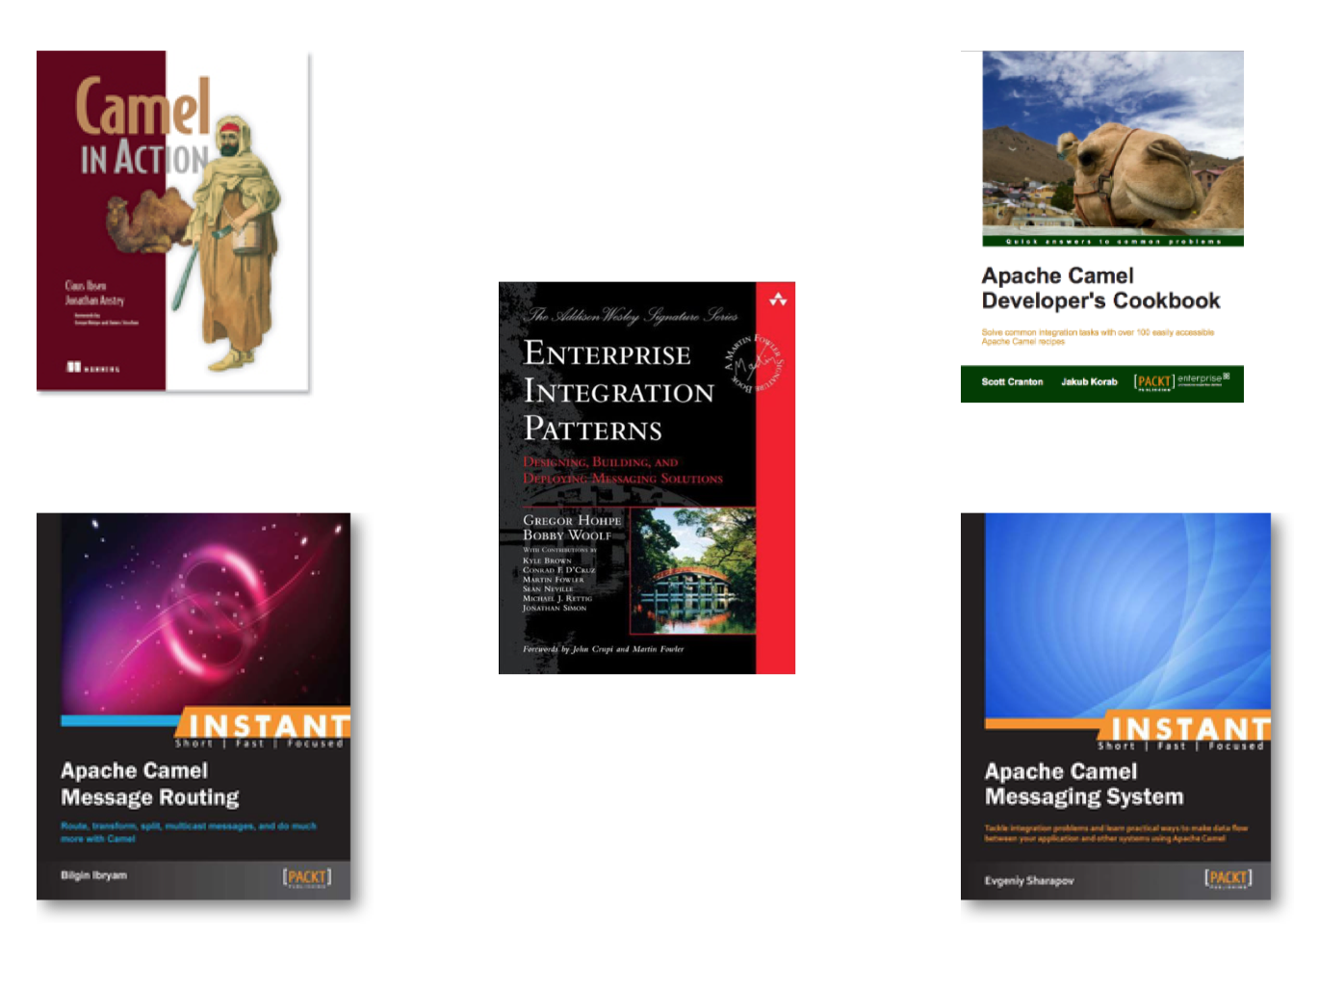
Books
Notes:
http://camel.apache.org/books.html
Camel in Action
Apache Camel Developer's Cookbook
Instant Apache Camel Message Routing
Instant Apache Camel Messaging System
Enterprise Integration Patterns
Apache Camel Developer's Cookbook by Scott Cranton and Jakub Korab (Packt Publishing, December 2013)
Instant Apache Camel Messaging System by Evgeniy Sharapov (Packt Publishing, September 2013)
Instant Apache Camel Message Routing by Bilgin Ibryam (Packt Publishing, August 2013)
Camel in Action by Claus Ibsen and Jonathan Anstey (Manning, December 2010)
Enterprise Integration Patterns by Gregor Hohpe and Bobby Woolf (Addison Wesley, October 2003)

Slide 18
Conferences
Camel One 2011-2013 (http://camelone.org)
DevNation 2014 (http://www.devnation.org)

Slide 19
Q&A

