Slide 1
SOLR open source enterprise search platform based on Apache Lucene
Arsen Miemietov amiem@softserveinc.com

Slide 2
Project
Client: Calavista (Austin, Texas)
Project Name: 1XTRM
Scope: Intellectual Property (IP) Exchange
Key point: Matching IP with Potential Buyers
Time Allocated: ~ 2 years
Spent: ~ 4 months (research, proof-of-concept)
Former project: VIPEX (IPZONE) for AMEX

Slide 3
Intellectual Property (Asset)
IP: (Patents, Trade Marks, Software, etc)
Tynax (www.tynax.com)
iBridge (www.ibridgenetwork.org)
Yet2 (www.yet2.com)
Landon IP (www.landon-ip.com)
TechTransferOnline (www.techtransferonline.com)
Life Sciences Link (www.lifescienceslink.org)
FlintBox, InnoGet, ICAP Patent Brokerage
Patents (~10.000.000 from USPTO) United States Patent and Trademark Office
…

Slide 4
Potential Buyers
Target Audience
F500 (Fortune 500)
Forbes Global 2000
Top Universities
Non Practicing Entities (NPE)
~ 30.000 companies (Fluid Innovation)
~ 300.000 companies (Fluid Innovation v2)

Slide 5
Input Data
Bulk Import (XLS, CSV, XML, JSON files)
Provided by Client
Obtained by scraping web
Web Harvesting (Scraping)
Part of development (tynax.com, ip.com) Implemented JavaScript scraper ~ DOM parser/analyzer ~ HTML5 LocalStorage (SQLite)
Sync from 1XTRM DB
One-way sync data from MS SQL Server
DataImportHandler (near future)

Slide 6
Matching using Apache Solr
Features
Servlet
Web Administration Interface
XML/HTTP, JSON Interfaces
Faceting
Schema to define types and fields
Highlighting
Caching
Index Replication (Master / Slaves)
Pluggable
Java 5

Slide 7
SOLR Architecture
Request Handlers
Response Writers
Update Handlers
/admin
/select
/spell
XML
Binary
JSON
XML
CSV
binary
Extracting Request
Handler (PDF/WORD)
Search Components
Schema
Update Processors
Query
Highlighting
Signature
Spelling
Statistics
Logging
Faceting
Debug
Indexing
More like this
Clustering
Apache Tika
Query Parsing
Config
Distributed Search
Data Import Handler (SQL/RSS)
Analysis
Faceting
Filtering
Search
Caching
High-lighting
Index Replication
Apache Lucene
Core Search
IndexReader/Searcher
Indexing
IndexWriter
Text Analysis

Slide 8
Matching using Apache Solr
Feed with data
Flattened version
Mainly CSV and JSON
Logical structure
Index is collection of documents
Documents are a collection of fields
Fields are the content
Stored – Stored verbatim for retrieval with results
Indexed – Tokenized and made searchable
Indexed terms stored in inverted index

Slide 9
Indexing
…
#0
Software Distribution Solution
software
0
distribution
0
#1
Digital Management Solution
solution
0, 1
digital
1, 2
#2
management
1, 2
Digital Rights Management
rights
2
…
Extract tokens from text (tokenizer)
Whitespace
Hyphens
Manipulate or modify tokens (token filter)
Stemming
Removal
Tokenizer / Token Filter chains are called analyzers

Slide 10
Analyzer
A thermotolerant and high acetic acid-producing Acetobacter
WhitespaceTokenizer
A | thermotolerant | and | high | acetic | acid-producing | Acetobacter
WordDelimiterFilter
A | thermotolerant | and | high | acetic | acid-producing | acid | producing | Acetobacter
LowerCaseFilter
a | thermotolerant | and | high | acetic | acid-producing | acid | producing | acetobacter
SynonymFilter
a | thermotolerant | and | high | acetic | acid-producing | acid | acerbic | sulfurous | acidic | biting | producing | acetobacter
StopFilter
thermotolerant | acetic | acid-producing | acid | acerbic | sulfurous | acidic | biting | producing | acetobacter
SnowballPorterFilter
thermotoler | acet | acid-produc | acid | acerb | sulfur | acid | bite | produc | acetobact
RemoveDuplicatesTokenFilter
thermotoler | acet | acid-produc | acid | acerb | sulfur | bite | produc | acetobact

Slide 11
Searching
Query types
Term
Phrase (“bad wolf”)
Proximity (“quick fox”~4)
Prefix (pla?e, practic*)
Fuzzy (edit distance) (planting~0.75)
Range (date:[NOW/DAY-7DAYS TO NOW], author: {king TO mason})
May have different analyzers for indexing and searching on each field

Slide 12
Index vs Query analyzers
Document Analysis (Indexing)
Query Analysis
PowerShot SD 500
power-shot sd500
WhitespaceTokenizer
WhitespaceTokenizer
PowerShot
SD
500
power-shot
sd500
WordDelimiterFilter catenateWords=1
WordDelimiterFilter catenateWords=0
Power
Shot
PowerShot
SD
500
power
shot
sd
500
LowercaseFilter
LowercaseFilter
power
shot
powershot
sd
500
power
shot
sd
500
A Match!

Slide 13
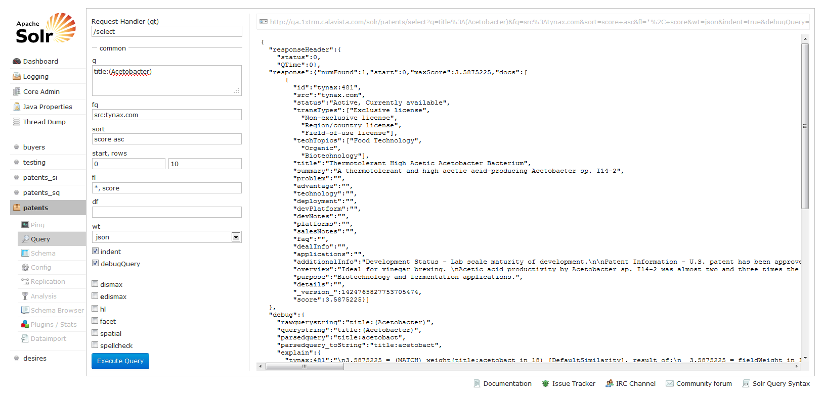
Solr UI

Slide 14
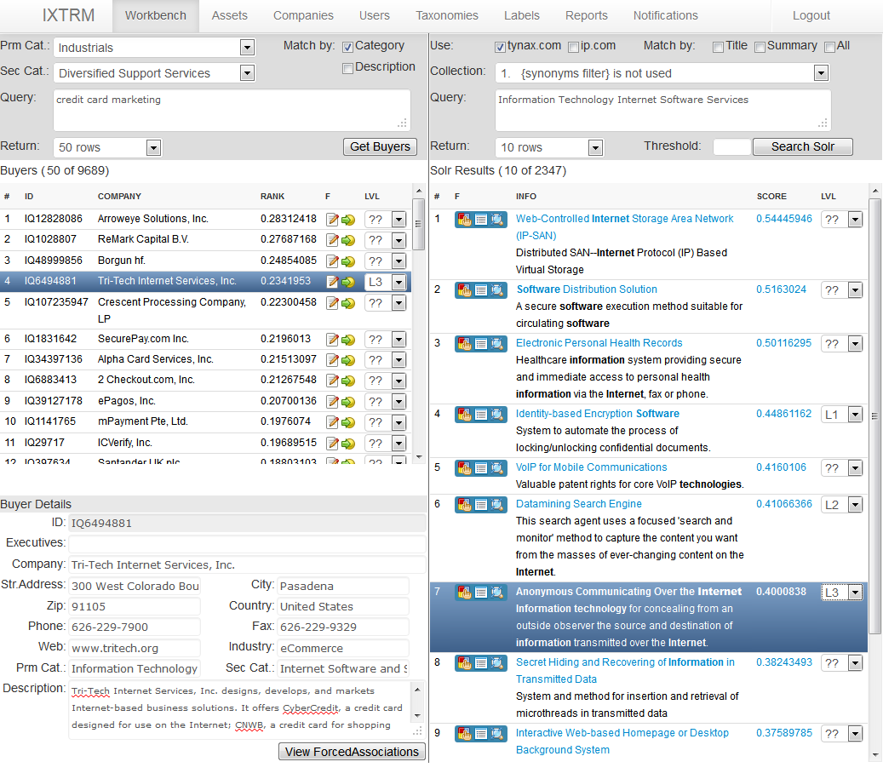
Result

Slide 15
Thanks
Sources
http://lucene.apache.org/
http://lucene.apache.org/solr/
http://people.apache.org/~yonik/presentations/
Live project
http://qa.1xtrm.calavista.com/solr
http://qa.1xtrm.calavista.com/ixtrm
Q & A

