Slide 1
Experience everywhere. Project driving tips.
by Bogdan Grynko

Slide 2
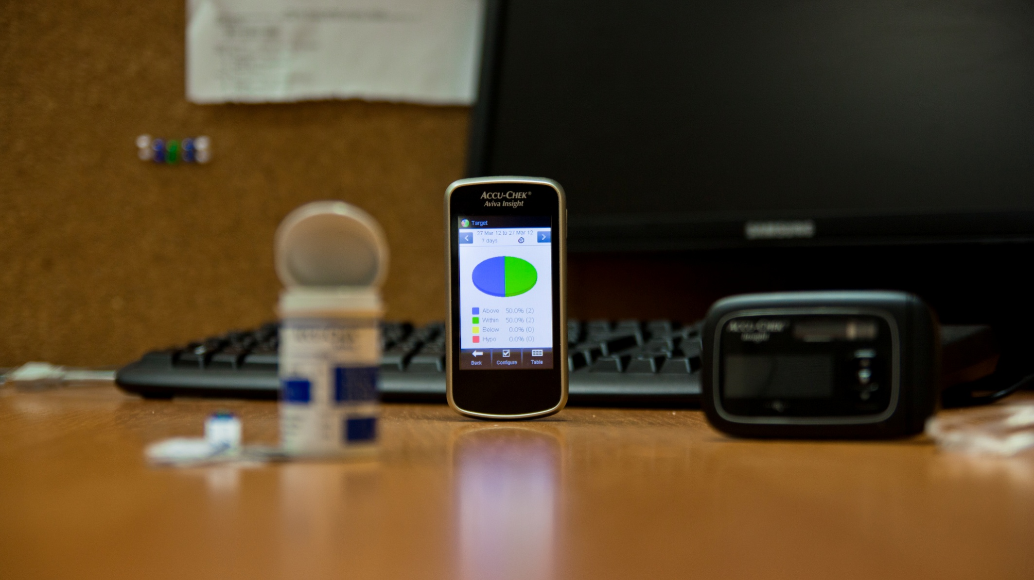
Calypso project
Meter
Pump
allows you to perform blood analysis;
Windows CE 6.0 R3 on board
Calypso application as firmware;
equipped with touch screen;
supports PC connection through USB;
performs main calculations;
contains insulin charge;
provides consumer with calculated doze of insulin;
Calypso application firmware for Pump;
synchronized with BG Meter through Bluetooth interface;

Slide 3
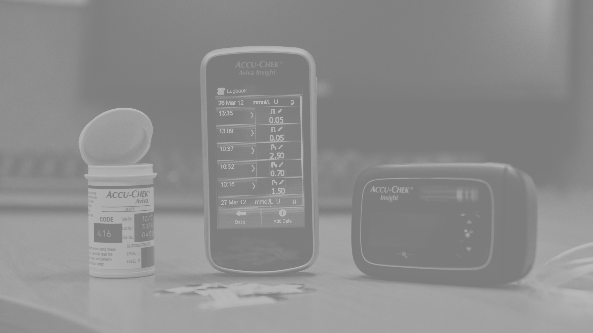



Technologies
20 team members
consumables;
should be used to make a blood analysis;

Slide 4
PM and TL were changed simultaneously
challenges:
new key people for client
new key people for team
lots of information needs to be learned
solutions:
do not break down what works well

Slide 5
Quick project growth
challenges:
in short period of time amount of people was doubled
most of new people were trainees
senior staff performance degradation
team performance degradation
solutions:
“How to start” doc was created
trainees were assigned to mature senior staff (3 to 1)
transparency in a question who are experts

Slide 6
Two rooms of one project
challenges:
bad information sharing
slow speed of experience growth
two parts start becoming mental separated
solutions:
PM located in one part TL in another
rooms were joined

Slide 7
Scrum implementation
challenges:
lots of RI tasks
client and client of client were not included in Scrum
on hold tasks
solutions:
kanban table
daily status
possible alternatives:
dedicated team members for argent tasks
Scrum for the rest of team.

Slide 8
Not top technologies
challenges:
Team members want to use top technologies
solutions:
work with objections with each team member
finding challengeable tasks in project
Win8
RAM

Slide 9
Inconvenient stakeholder on client side
challenges:
one TL on client side in not mature enough
senior PL on client side cannot solve situation
solutions:
attempt to go to confrontation failed
to be a good partner and be an expert in adjacent areas. As a result to get more work and get influence on decisions.

Slide 10
The end
THANK YOU!!!

