Slide 1
2014 How to manage your boss
Sergii Zabigaylo
September 25, 2014

Slide 2
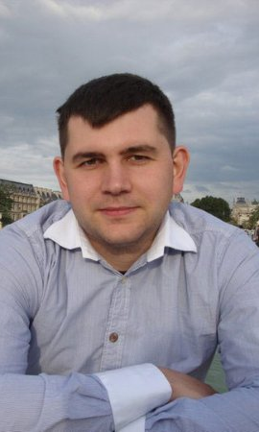
How to manage your Leader
Sergii Zabigaylo
HealthCare-B Program Manager at SoftServe.
Email: sergiy.zabigaylo@gmail.com
Skype: serge.zab
Linkedin: ua.linkedin.com/in/sergezab/
Facebook: https://www.facebook.com/serge.zab
active member of SoftServe PMO community
expert on both theoretical and practical aspects of project management
PMs’ coach
fan of GTD, TOC and Lean Kaizen.

Slide 3
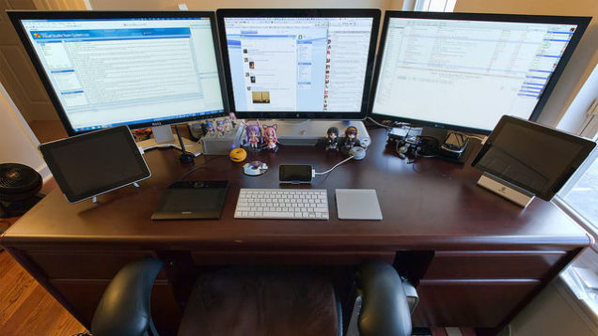
How to request second monitor?
Notes:
http://adizes.info/index.php/Тесты/paei.html

Slide 4
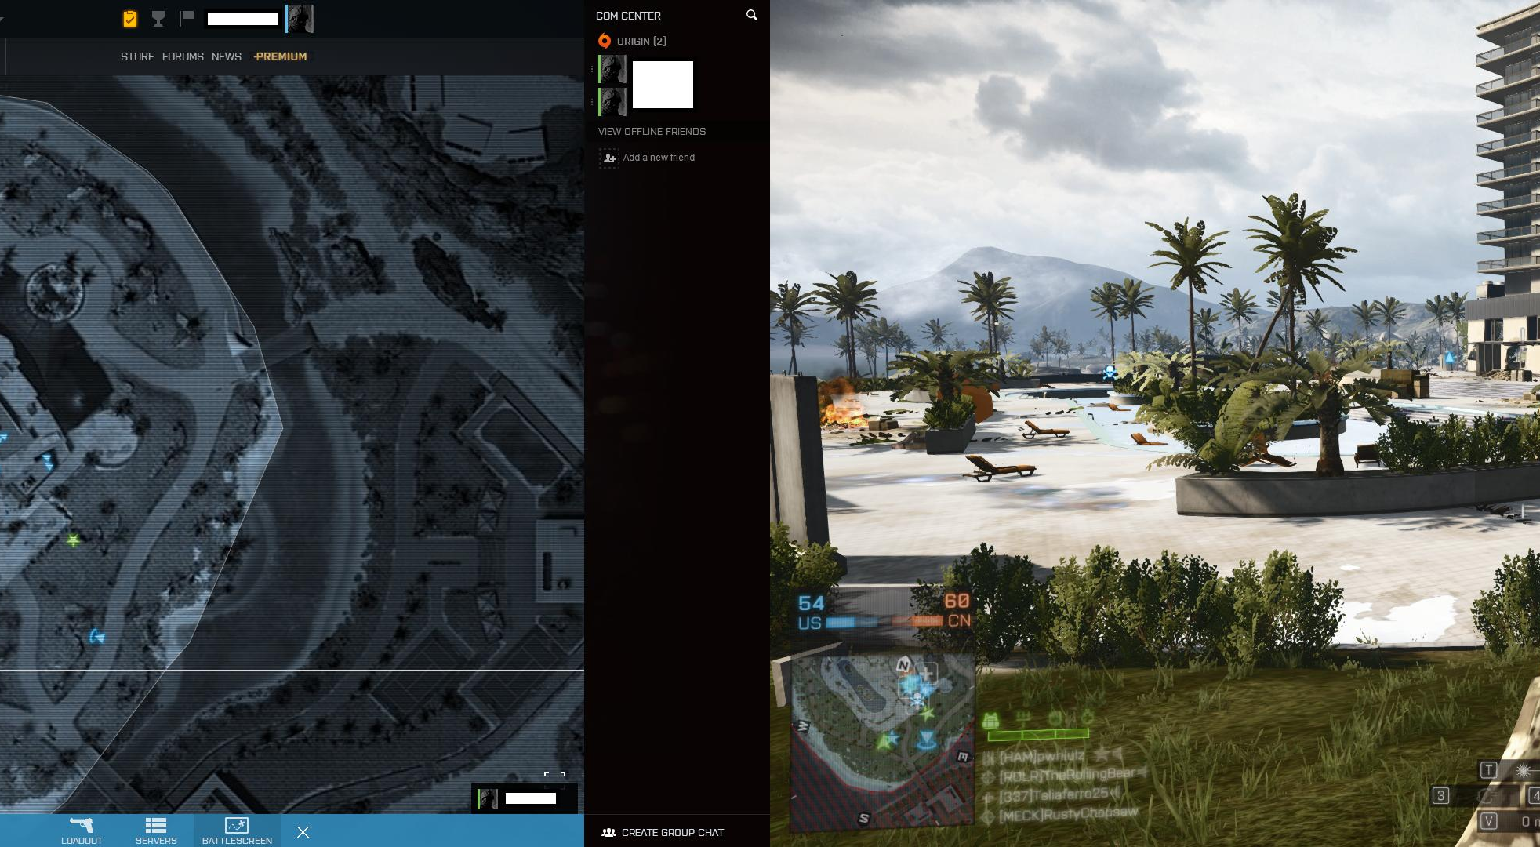
Do Developers Really Need a Second Monitor?
Notes:
http://adizes.info/index.php/Тесты/paei.html

Slide 5
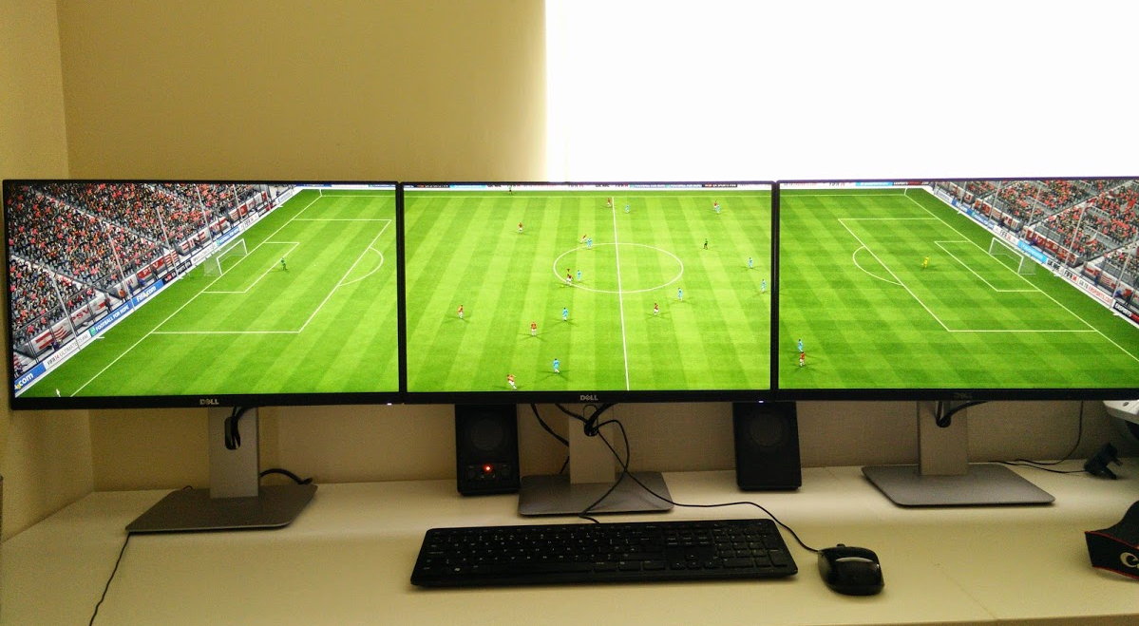
Do Developers Really Need a Second Monitor?
Notes:
http://adizes.info/index.php/Тесты/paei.html

Slide 6
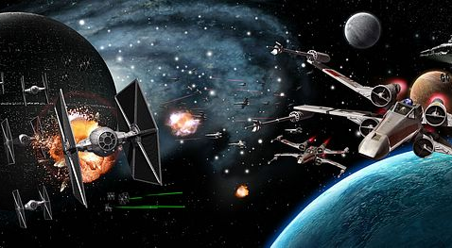
How to request second monitor?
Notes:
http://adizes.info/index.php/Тесты/paei.html

Slide 7
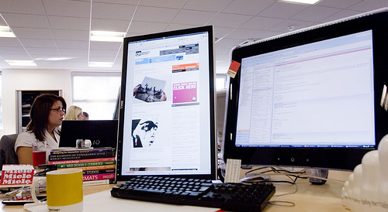
Yes!
A second monitor can help you gain up to 50% in productivity!!!
Notes:
Microsoft's Research Center's findings indicate that users can improve productivity by 9 to 50% by adding another monitor to their computing environment (depending on the type of task). Other studies cited in the New York Times suggest 20% to 30% productivity boosts.

Slide 8
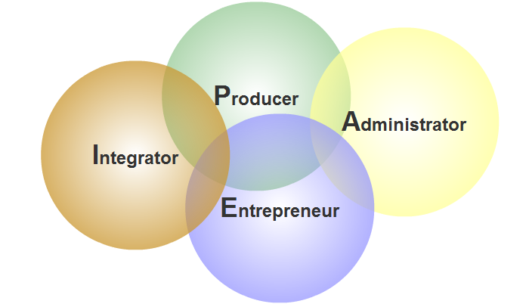
PAEI Management Roles (Adizes)

Slide 9
Manager types by Adizes
Результаты
Эффективность
Производитель
Администратор
Краткосрочная
(P)
(A)
Перспектива
Предприниматель
Интегратор
(E)
(I)
Долгосрочная

Slide 10
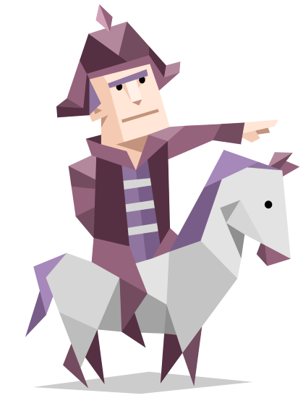
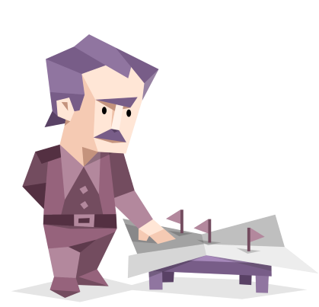
Производитель - Producer
Strengths
High energy, active people
Strong will
Like to be busy all the time
Interests are overwhelmingly concrete
Love to attain tangible results, and to attain them often
Prefers no to talk about solutions but implement them.
Weaknesses
Dislike fussy details, ambiguous situations or abstract considerations
little patience with future-oriented tasks and wild brainstorming
feeling that the rapid attainment of concrete results justifies the suspension of other concerns
May be unpleasant for the others
Notes:
Producers are high energy, active people. They like to be busy all the time, and their interests are overwhelmingly concrete. They love to attain tangible results, and to attain them often. They feel highly rewarded every time they can declare a task complete. Producers dislike fussy details, ambiguous situations or abstract considerations. They have little patience with future-oriented tasks and wild brainstorming. They are much more interested in getting a task done than they are in ensuring that their colleagues are happy with the way it got done. They will denigrate these kinds of interpersonal concerns, feeling that the rapid attainment of concrete results justifies the suspension of other concerns. This can make them unpleasant to be around at times, but they are responsible for driving many organizational achievements. Producers help us stop talking about solutions
and start implementing on them.

Slide 11
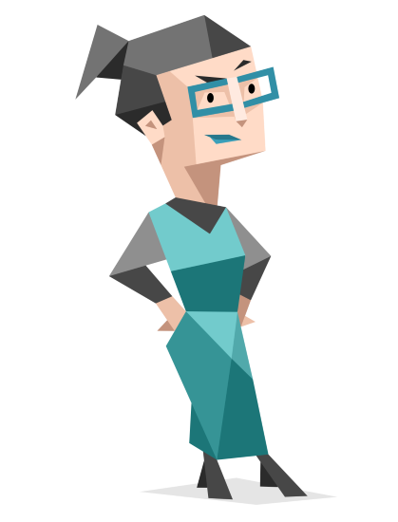

Administrators
Strengths
Quiet, cautious people
Need to know what process or procedure we are planning to use before they can join in on the action
Slow and careful in decision-making
Track each detail to make certain it is handled properly
Stability and order to collective activities
Weaknesses
Uncomfortable with ambiguity or uncertainty
Made uneasy by unstructured environments, spontaneity and improvisation
Unplanned activities feel distressingly chaotic to them.
Less concerned with what we should do
Notes:
Administrators are quiet, cautious people who are less concerned with what we should do than how we should do it. They need to know what process or procedure we are planning to use before they can join in on the action. They are extremely uncomfortable with ambiguity or uncertainty, and they are made uneasy by unstructured environments and by group reliance on spontaneity and improvisation. Unplanned activities feel distressingly chaotic to them. Administrators prefer to construct a system of routines and conventions for ongoing activities, so they can be conducted in the smoothest and least disruptive manner possible. In organizational contexts, they bring stability and order to collective activities. They are slow and careful in decision-making because they track each detail to make certain it is handled properly. They also weigh the impact of any proposed changes on the entire stabilizing network of rules that they maintain. They may say “no” to new proposals as a reflex, in order to slow things down so they can think through the proposal and deliver a revised opinion once they have worked through their concerns. Administrators may see Producers as sloppy loose canons wreaking havoc upon organizational operations. Producers may see
Administrators as fussy obstructionists.

Slide 12


Entrepreneurs
Strengths
Dreamers
Talkative, Charismatic, Proactive
Their excitement is highly infectious
They love being at the center of attention
Not interested in the results we are attaining today, and would rather focus on bigger potential achievements in the future
Energized by novel challenges
Weaknesses
Feel stifled by the demands of ongoing activities
Flamboyant, expressive and very easily bored
Come up with several very different grand future schemes every few minutes, when inspired.
Track activities at a very high level of abstraction
Can be easily dismissed from organization
Notes:
Именно E руководит организацией, когда той приходится иметь дело с меняющимися реалиями. На мой взгляд, подходящая метафора для E-функции — это «способность видеть сквозь туман». Нетворческий человек ждет, пока туман рассеется, взойдет солнце и все станет ясно. Тогда он скажет: «Ну вот, так я и думал!» Он не добавляет к увиденному никакой информации и ничего не созидает, в то время как творческая личность заполняет пустоты в информационном тумане с помощью воображения.

Slide 13

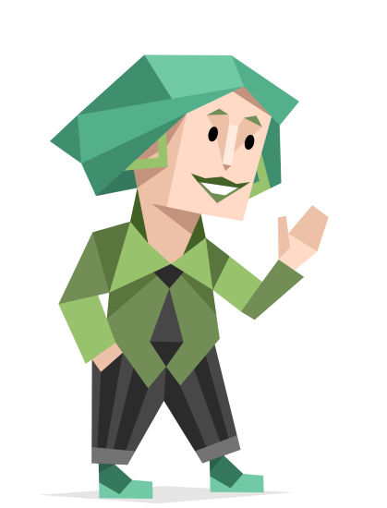
Integrators
Strengths
Team-builders
manage the interpersonal, interdepartmental, supplier and client relationships
attend to peoples’ needs, views, motivators, complaints and conflicts to foster a constructive working environment
help people focus on shared goals
focus on people
focused on the organization itself as the Team
Weaknesses
Less concerned about formal roles and titles
May be slow with task execution

Slide 14

Yes”, “No”, “Maybe” - 1
(Е) Entrepreneur
Yes = maybe (“Hmm, why not?”)
No = no
(А) Administrator
No = maybe (You may come one more time and try to persuade)
Yes = yes
Notes:
PAei

Slide 15
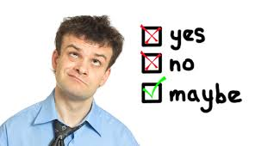
Yes”, “No”, “Maybe” - 1
(Р) Producer
Yes = yes
No = no
(І) Integrator
No = maybe
Yes = maybe
Notes:
PAei

Slide 16
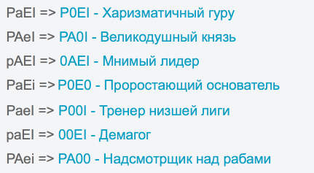
Personalities

Slide 17

Practice - PAEI
What type does this boss have?
What symptoms have you used?
PAei – Насмотрщик над рабами
Notes:
PAei – Насмотрщик над рабами

Slide 18

Practice - PAEI
What type does this boss have?
What symptoms have you used?
paEI – Великодушный князь
Notes:
paEI – Великодушный князь

Slide 19

Practice - PAEI
What type does this boss have?
What symptoms have you used?

Slide 20
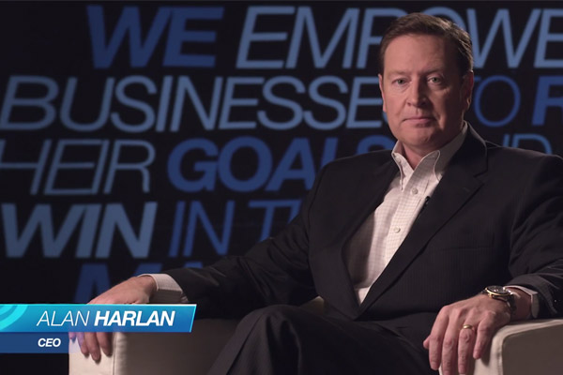
Practice - PAEI
What type does this boss have?
What symptoms have you used?
PaEI – Харизматичний гуру
Notes:
PaEI – Харизматичний гуру

Slide 21
Useful Links
JOB FUNCTION / POSITION | SUGGESTED PAEI PROFILE
Accountant | pAEi
MIS / IT Manager | pAEi
Chief Executive Officer | paEI or PaEi or PAei
Sales Manager | PaeI or PAei
Credit Controller | pAEi
HR Manager | paEI
R&D / Marketing Manager | PaEi
Production Manager | PAei
Project Manager | PAei
Treasurer / Corporate fin | PaEi
Trainer | pAEi
Personnel Manager | PAei or pAeI
Warehouse or Store | PAei
Chief Operating Officer | PaEi or PAei
Customer Service Manager / Executives | pAeI or pAEi
Quality Assurance | pAEi
Sales Engineers | PaeI or PAei
Internal Auditor | pAEi
Operations Manager | PAei
Project Site Manager | PAei
Production Planner | pAEi
Purchasing Manager | PaEi or PAei

Slide 22
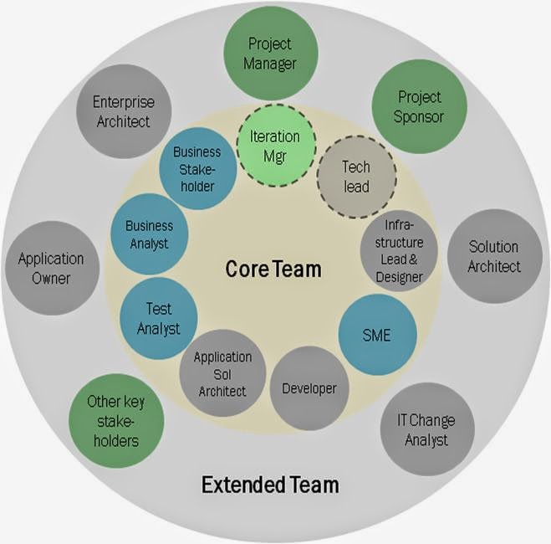
Dream Team

Slide 23
10 Stages of the Organization Lifecycle
$
pAeI
PAei
pA_I
PaE_
_A_I
P_E_
t

Slide 24
Useful Links
http://intjforum.com/index.php
http://www.16personalities.com/free-personality-test
http://adizes.me/paei_test/
http://paei.vistage.com.my/app/webroot/files/PAEI%20Explanatory.pdf
http://www.adizes.com

Slide 25
Thank You!
Sergii Zabigaylo
HealthCare-B Program Manager at SoftServe.
Email: sergiy.zabigaylo@gmail.com
Skype: serge.zab
Linkedin: ua.linkedin.com/in/sergezab/
Facebook: https://www.facebook.com/serge.zab

Slide 26
Thank You

