Slide 1
Using C#/.Net Controversial Topics & Common Mistakes

Slide 2
Stack Managed Heap (soh, loh) Heap

Slide 3
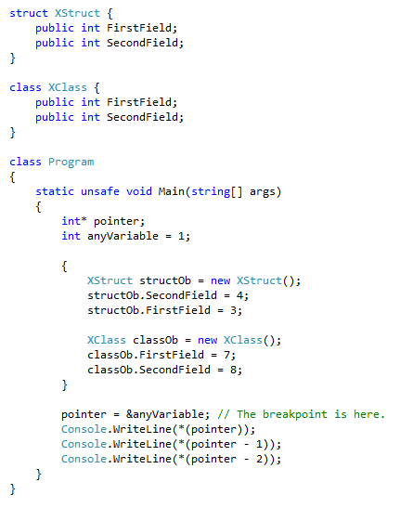

Slide 4
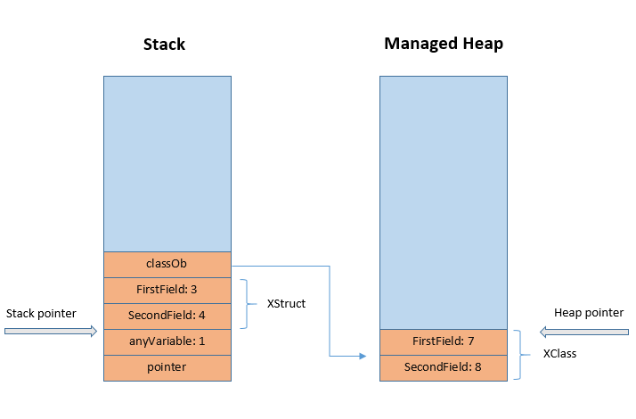

Slide 5
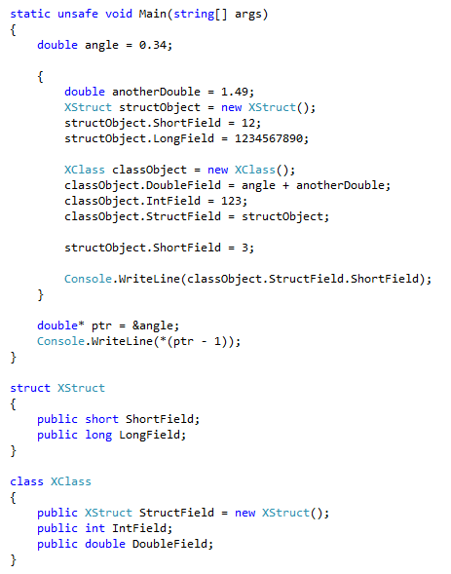

Slide 6
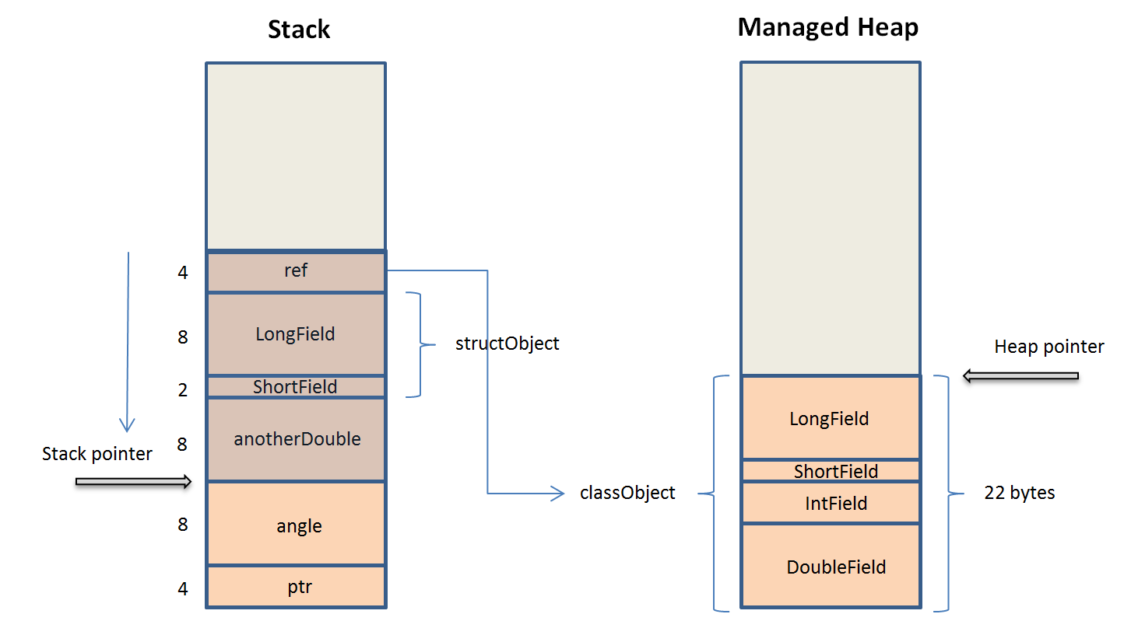
Memory

Slide 7
Struct or Class?

Slide 8
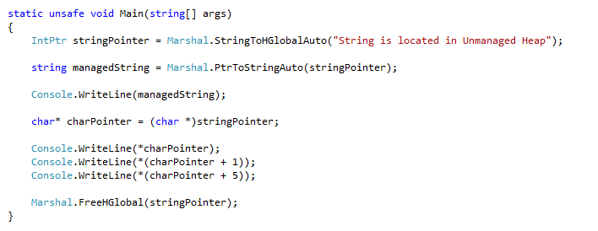
Unmanaged Heap

Slide 9
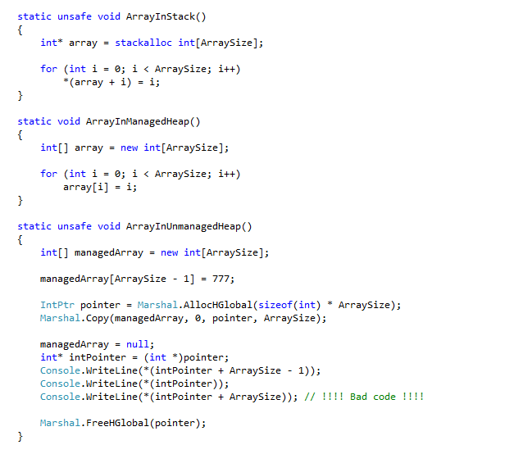
Where to locate an array?

Slide 10

How to change stack size?

Slide 11
Desired improvements
Compact LOHeap
GarbageCollector in background
Just-In-Time compiling in background
All these features are part of
.Net 4.5.0 - 4.5.2

Slide 12
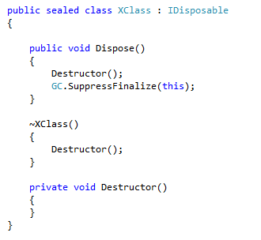
IDisposable

Slide 13
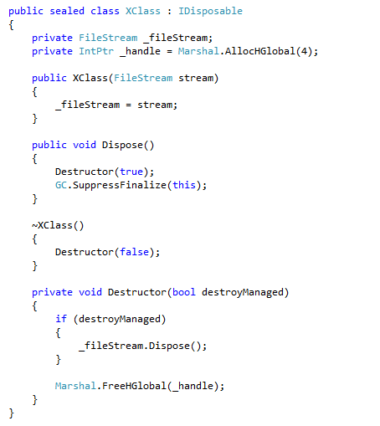

Slide 14
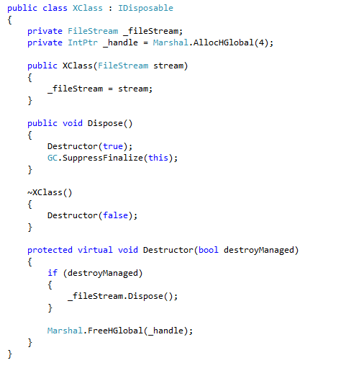
NVI & IDisposable

Slide 15
How to create thread?
Thread
ThreadPool
Task
Delegate.BeginInvoke()
async await
System.Timer
Etc…

Slide 16
class System.Threading.Thread
We use it only:
If you need a task to have a particular priority.
If you have a task that might run a long time.
If you need to place threads into a single-threaded apartment. [STAThread]
if you should use a dedicated thread to abort that thread, suspend it, or discover it by name.

Slide 17
Async methods
IAsyncResult - the legacy model.
This model is no longer recommended for new development.
We should use async await method.

Slide 18
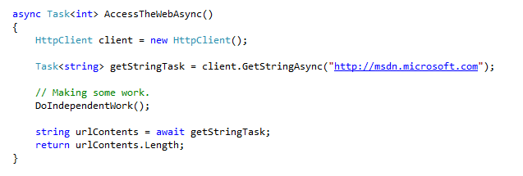
Async programming

Slide 19
Multithreading guidelines
Don't use Thread.Abort() to terminate other threads.
Don't use Thread.Suspend(), Thread.Resume().
Don't use lock(this).
If you are not sure the Monitor.Exit() will be called, then use Mutex.

Slide 20
Strong name
Weakly and strongly named assembly
“Assembly, Version=1.0.0.1, Culture=neutral, PublicKeyToken=f1cb1c59fa003011“
Tampering

Slide 21
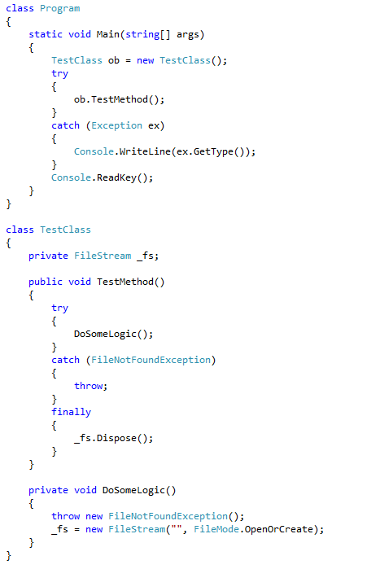
Exception handling

Slide 22
C# - new syntactic sugar
Var
Anonymous methods
Extension methods

Slide 23
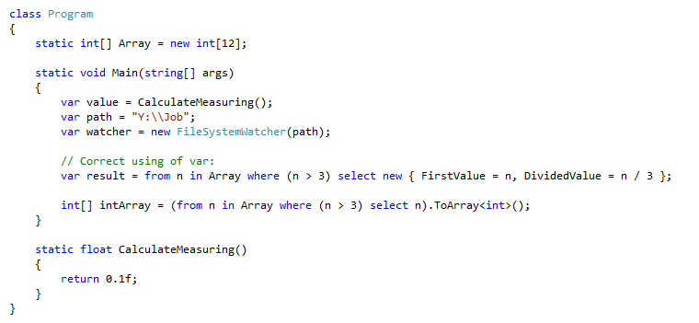
Using of Var

Slide 24

Anonymous Method

Slide 25
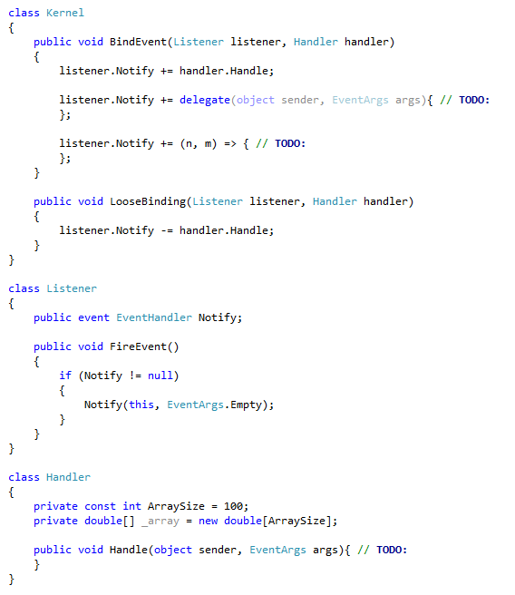
Delegates

Slide 26
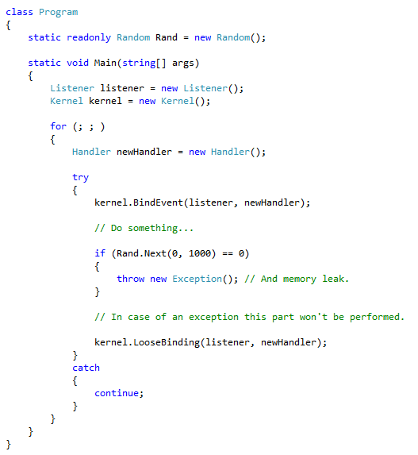
Delegates and memory leak

Slide 27
.Net’s .module
csc /t:module MyModule.cs
csc /t:exe /addmodule:MyModule.netmodule Main.cs

Slide 28
Using of MSSql
Store procedures
Triggers
Functions
Views
Indexes

