Slide 1
Storm use case Streams

Slide 2
Agenda
Storm – short intro
Application goal
Application design
Pay attention to…

Slide 3
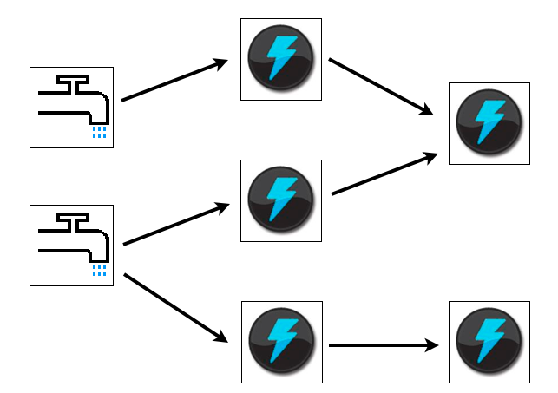
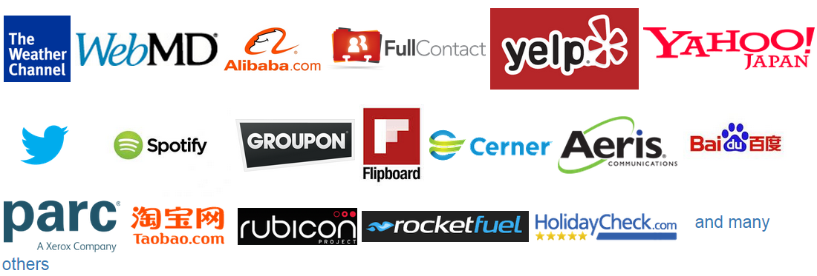
Storm
If there is a need of:
Hadoop of real time
Fault-tolerant (and no data loss)
Scalable
Code your logic, not a framework

Slide 4
Application goal
Insurance company works with healthcare provider network
Notify doctor when patient fills a prescription in a pharmacy
Monitor late refills, unrefills
Notify doctor for emergency events (Emergency room)
Ability to monitor and delegate events for a patient
Work under high load
Scalability
Guaranteed event processing

Slide 5
Why Storm?
App requirements:
Process events in real time: <5s delay
Tight event throughput: ~100k/min
Guaranteed data processing
Scalability out of the box

Slide 6
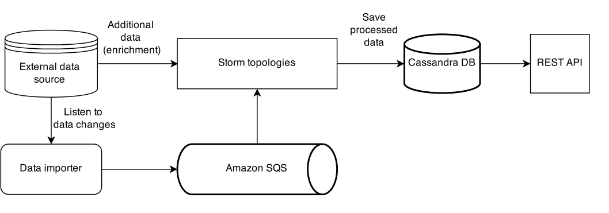
Application Design: Overview

Slide 7
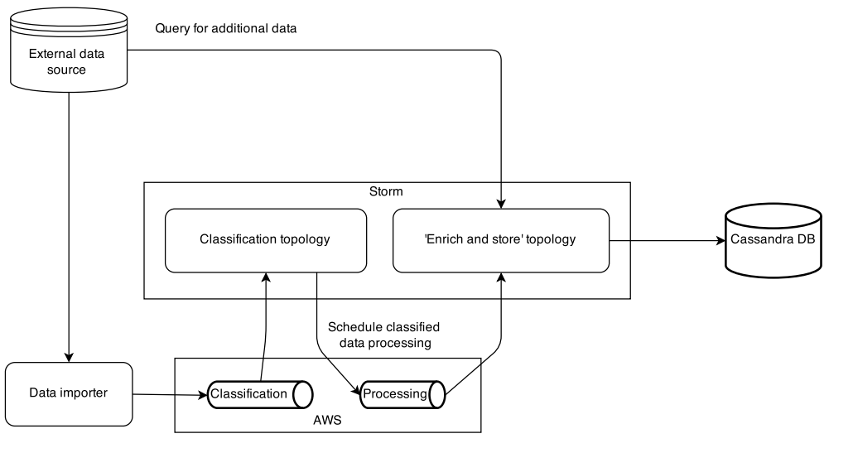
Application Design: Topologies interaction

Slide 8
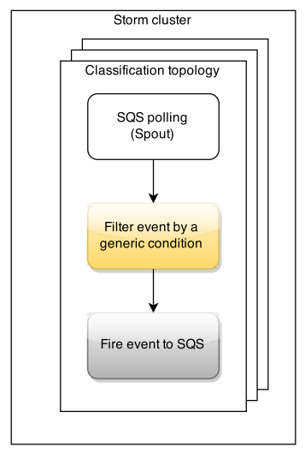
Application Design: Topology example

Slide 9
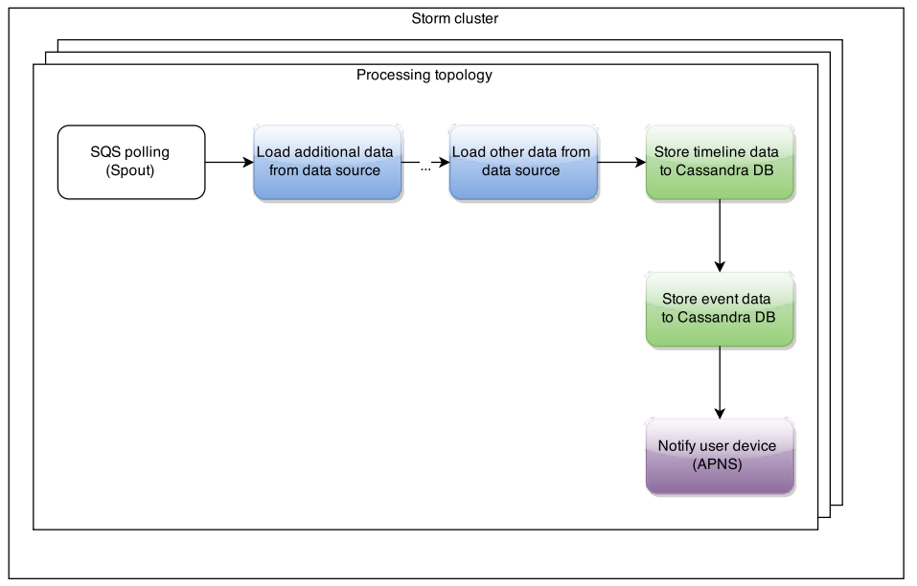
Application Design: Topology example

Slide 10
Pay attention
Error handling
Transactional processing
Joining streams
Java 6
Infrastructure investment
Dependencies to external services
Notes:
Error handling (process entry again later, fail entry, fail worker)
Transactional processing (i.e. problems with processed more than once)
Joining streams (merging two streams - parallel processing)
Java 6 – not guaranteed to work with other versions
Infrastructure investment (manage nodes – DevOps scripts, support)
Dependencies to external services (throughput depends on weak points)

Slide 11
Questions?

