Slide 1
Hierarchical Queries in ORACLE
Created by Iryna Khomutova
2013

Slide 2
Agenda
Purpose of Hierarchical Queries
Who is my manager?
CONNECT BY PRIOR in Oracle
Hierarchical query Pseudo-columns
SYS_CONNECT_BY_PATH
Simulation of CONNECT BY PRIOR in SQL SERVER, IBM DB2, PostgreSQL

Slide 3

Purpose of Hierarchical Queries
A relational database does not store data in a hierarchical way. Then how do I get the data in a hierarchical manner?
A hierarchy is built upon a parent-child relationship within the same table or view.
Hierarchical query is one of the very first features of the Oracle Database and was introduced more than twenty years ago!

Slide 4

Who is my manager?

Slide 5
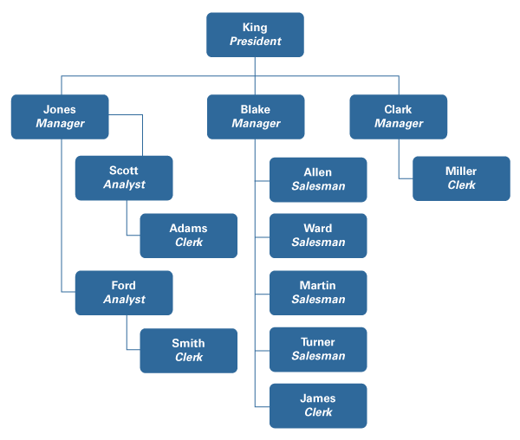

Employee hierarchical diagram

Slide 6
EMP table structure
EMPNO | ENAME | JOB | MGR | HIREDATE
7369 | SMITH | CLERK | 7902 | 17-Dec-80
7499 | ALLEN | SALESMAN | 7698 | 20-Feb-81
7521 | WARD | SALESMAN | 7698 | 22-Feb-81
7566 | JONES | MANAGER | 7839 | 2-Apr-81
7654 | MARTIN | SALESMAN | 7698 | 28-Sep-81
7698 | BLAKE | MANAGER | 7839 | 1-May-81
7782 | CLARK | MANAGER | 7839 | 9-Jun-81
7788 | SCOTT | ANALYST | 7566 | 19-Apr-87
7839 | KING | PRESIDENT |  | 17-Nov-81
7844 | TURNER | SALESMAN | 7698 | 8-Sep-81
7876 | ADAMS | CLERK | 7788 | 23-May-87
7900 | JAMES | CLERK | 7698 | 3-Dec-81
7902 | FORD | ANALYST | 7566 | 3-Dec-81
7934 | MILLER | CLERK | 7782 | 23-Jan-82

Slide 7
CONNECT BY … = PRIOR
SELECT ename, job, empno, mgr
FROM emp
CONNECT BY NOCYCLE mgr = PRIOR empno
START WITH mgr IS NULL
START WITH – specifies the root rows of the hierarchy or in other words, where to start parsing from. This clause is necessary for true hierarchical queries
CONNECT BY PRIOR – this explains the relationship between the parent and the child.
NOCYCLE - instructs Oracle Database to return rows from a query even if a CONNECT BY LOOP exists in the data.
However, when the query is run, the result still looks like a flat table in no apparent order:
ENAME JOB EMPNO MGR
---------- --------- ---------- ----------
KING PRESIDENT 7839
JONES MANAGER 7566 7839
SCOTT ANALYST 7788 7566
ADAMS CLERK 7876 7788
FORD ANALYST 7902 7566
SMITH CLERK 7369 7902
...

Slide 8
Hierarchical query Pseudo-columns
The new hierarchical query pseudo-columns are valid only in hierarchical queries. The specific hierarchical query pseudo-columns are:
LEVEL - returns 1 for a root row, 2 for a child of a root, and so on.
CONNECT_BY_ISCYCLE - returns 1 if the current row has a child which is also its ancestor. Otherwise it returns 0. NOCYCLE enables Oracle to return the results of a query that would otherwise fail because of a CONNECT BY loop in the data
CONNECT_BY_ISLEAF - returns 1 if the current row is a leaf of the tree defined by the CONNECT BY condition. Otherwise it returns 0
CONNECT_BY_ROOT - returns the column value using data from the root row (‘KING’)

Slide 9
SYS_CONNECT_BY_PATH and pseudo-columns using
SELECT ename "Employee", CONNECT_BY_ISLEAF "IsLeaf", CONNECT_BY_ISCYCLE "IsCycle",
LPAD(' ', 2 * LEVEL - 1) || SYS_CONNECT_BY_PATH(ename, '/') "Path"
FROM emp
CONNECT BY NOCYCLE PRIOR empno = mgr
START WITH mgr IS NULL
ORDER SIBLINGS BY ename
Employee IsLeaf IsCycle Path
------------ --------- --------- -----------------------------------------
KING 0 0 /KING
BLAKE 0 0 /KING/BLAKE
ALLEN 1 0 /KING/BLAKE/ALLEN
JAMES 1 0 /KING/BLAKE/JAMES
MARTIN 1 0 /KING/BLAKE/MARTIN
TURNER 1 0 /KING/BLAKE/TURNER
WARD 1 0 /KING/BLAKE/WARD
CLARK 0 0 /KING/CLARK
MILLER 1 0 /KING/CLARK/MILLER
JONES 0 0 /KING/JONES
FORD 0 0 /KING/JONES/FORD
SMITH 1 0 /KING/JONES/FORD/SMITH
SCOTT 0 0 /KING/JONES/SCOTT
ADAMS 1 0 /KING/JONES/SCOTT/ADAMS

Slide 10
Simulation of CONNECT BY PRIOR in SQL SERVER, IBM DB2, PostgreSQL
The perfectly equivalent solution is instead a recursive query:
WITH hierarchy (empno, ename) AS
(SELECT empno, ename
FROM emp
WHERE ename = ‘KING’
UNION ALL
SELECT nplus1.empno, nplus1.ename
FROM emp as emp1, hierarchy
WHERE hierarchy.empno = emp1.mgr)
SELECT ename FROM hierarchy

Slide 11

Questions

