Slide 1
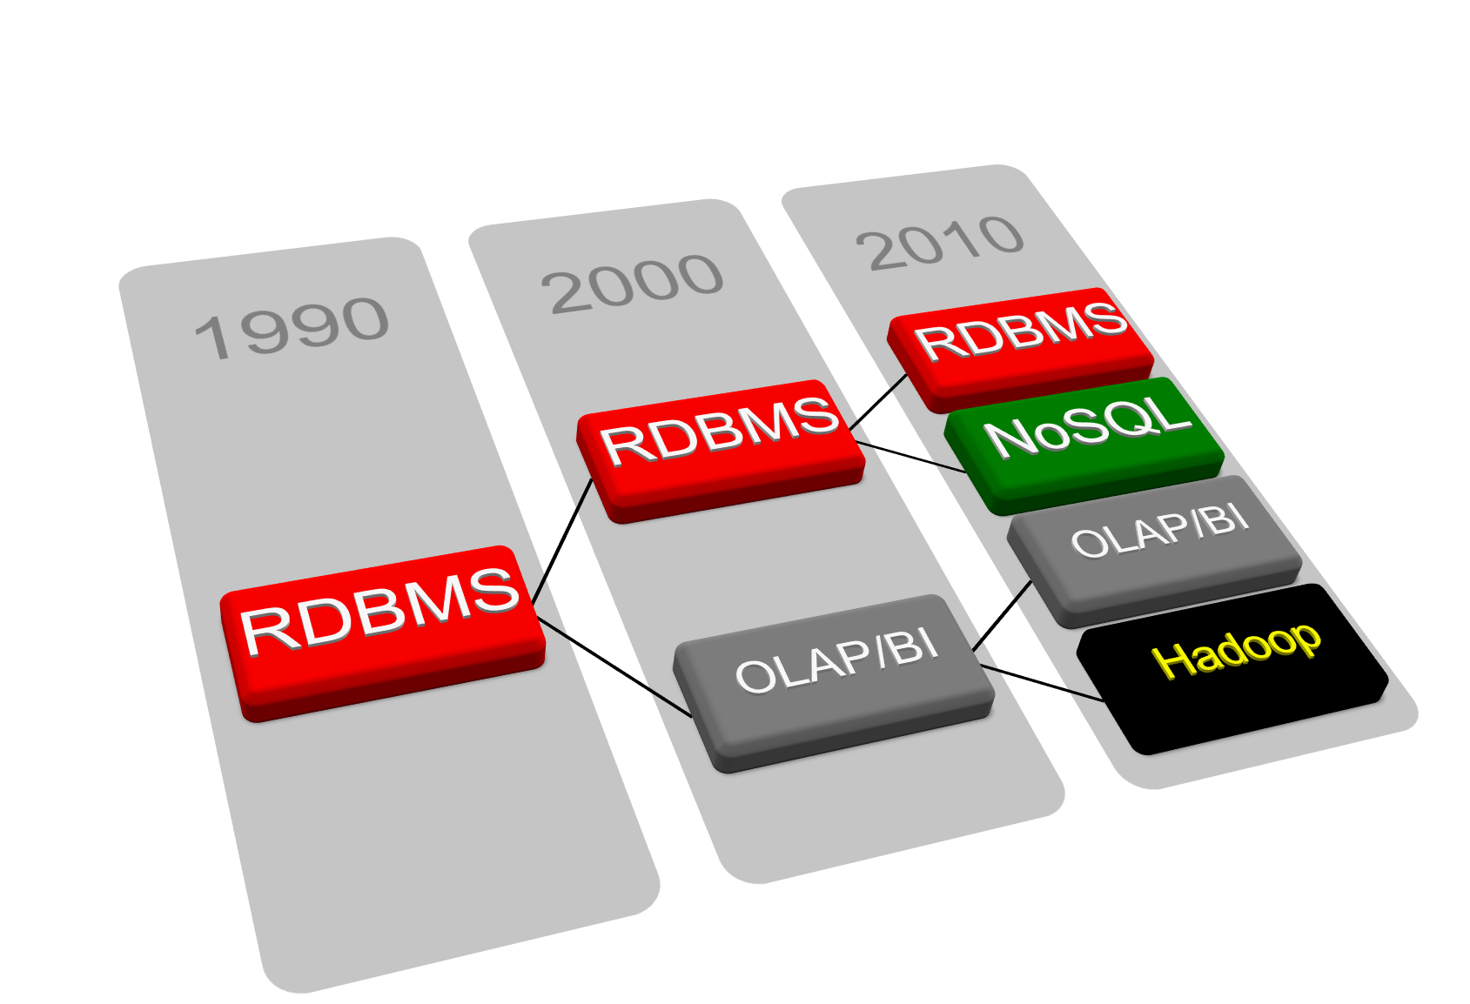
Introduction to MongoDB
Write your first NoSQL blog
by Maksym Palamarenko

Slide 2
Document database
Not best for PDF or DOC files
A document is an associative array
Document == JSON
Document == PHP Array
Document == Python Dict
Document == Ruby Hash
etc.

Slide 3
Some facts
Programmed in C++
Open Source (available on GitHub)
GNU AGPL licensed
Runs on Linux, MacOS, Windows, ...
Developed by 10gen (http://www.10gen.com/)
Professional Support
First Class Documentation

Slide 4
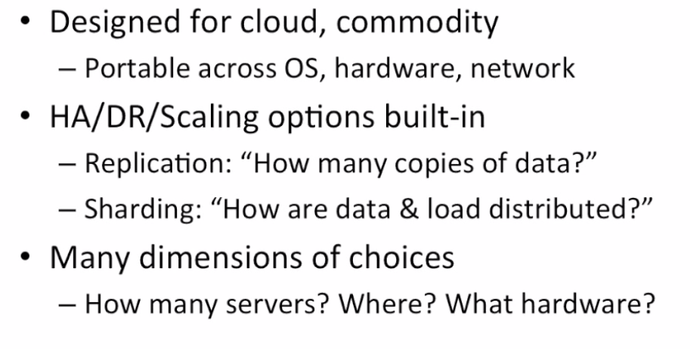
MongoDB flexibility

Slide 5
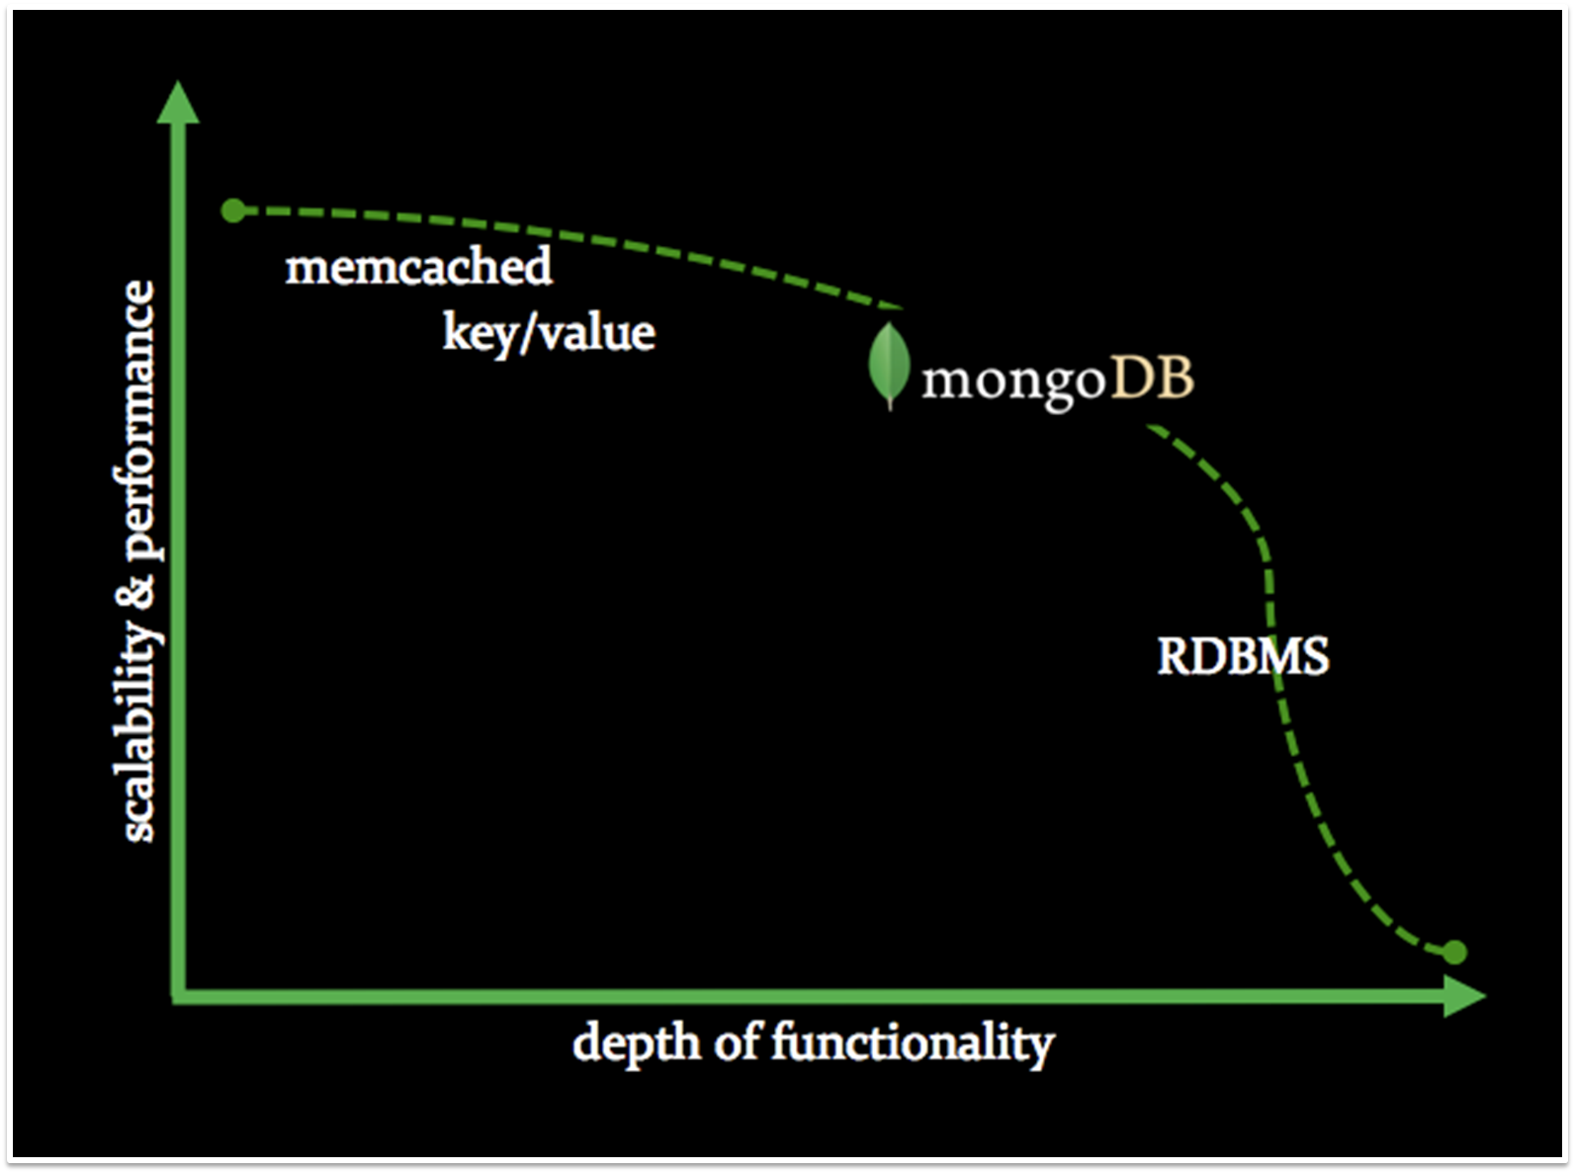
MongoDB landscape

Slide 6
Full Featured
Ad hoc queries
Real time aggregation
Rich query capabilities
Strongly consistent
Geospatial features
Support for most programming languages
Flexible schema

Slide 7
More details
Scaling out (horizontally) is easier than scaling up (vertically)
Data files are Memory mapped (Memory is managed by OS)
Writes are "fire-and-forget" by default (safe-mode=off)
Store and marshal BSON (binary JSON)
A lot of work is delegated to Clients (drivers)

Slide 8
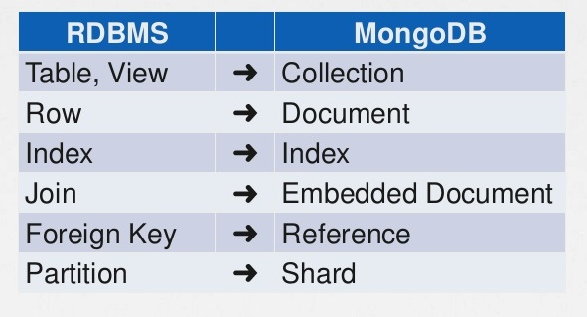
Terminology

Slide 9
Entities of our blogging system
Users (post authors)
Posts
Comments
Tags

Slide 10
Relational design
In RDBMS we would start
by doing
schema design

Slide 11
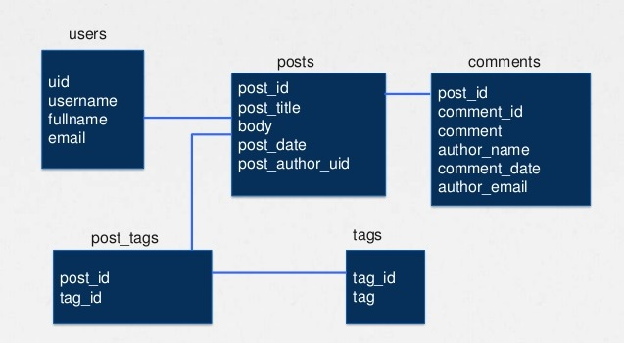
Typical relational ERD

Slide 12
MongoDB Design approach
In a MongoDB based application we start building…
and let the schema evolve!

Slide 13
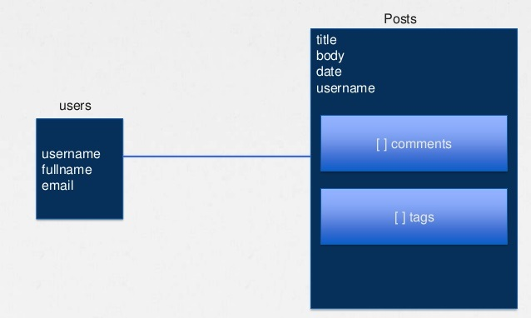
MongoDB ERD

Slide 14
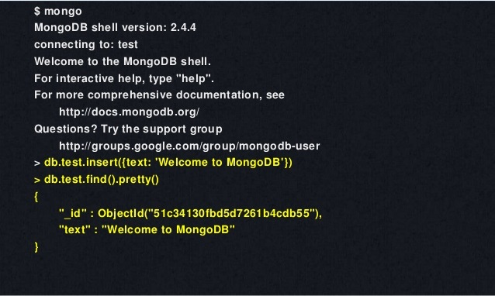
Using the shell

Slide 15
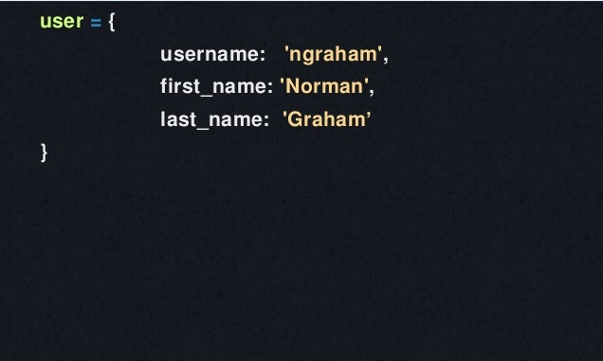
Everything starts with an object

Slide 16
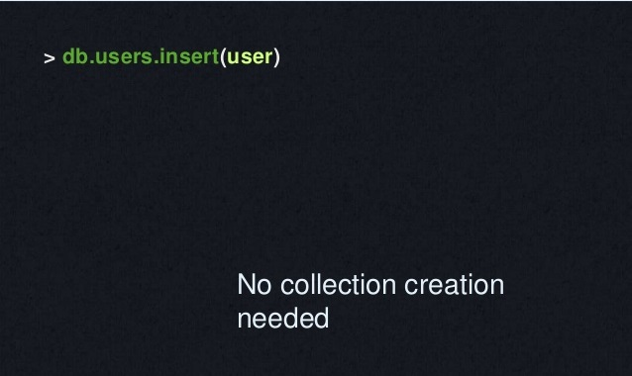
Insert a record

Slide 17
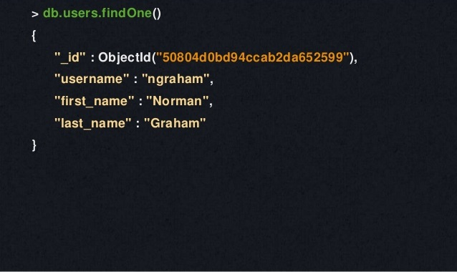
Querying for a user

Slide 18
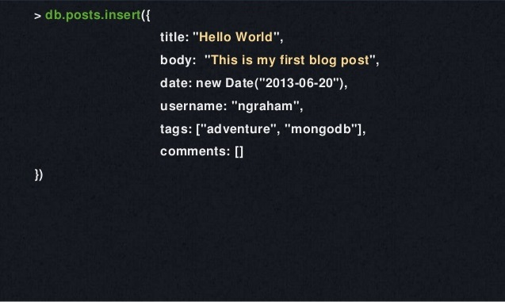
Creating a blog post

Slide 19
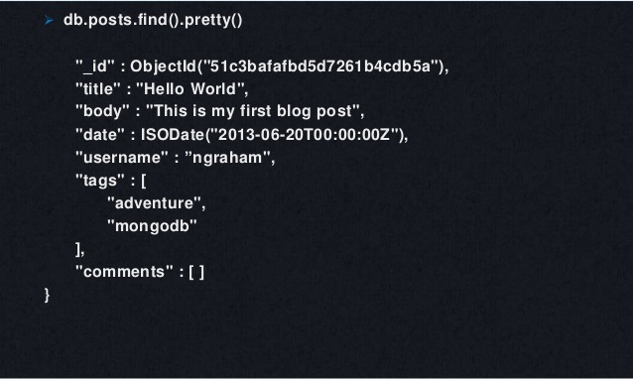
Finding the Post

Slide 20
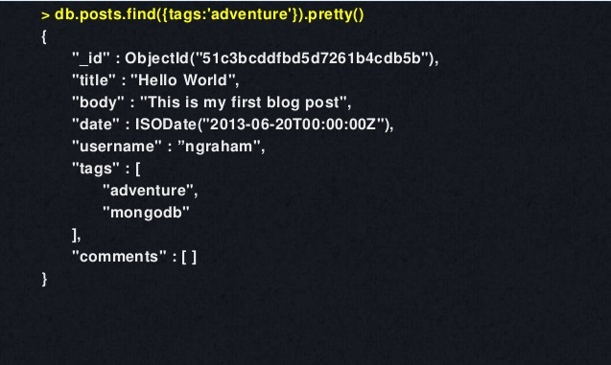
Querying an Array

Slide 21
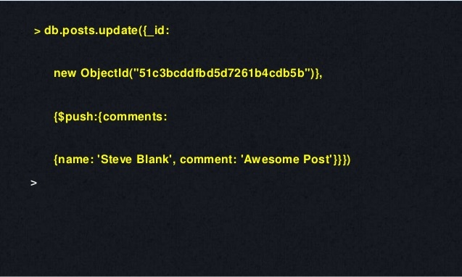
Using Update to Add a Comment

Slide 22
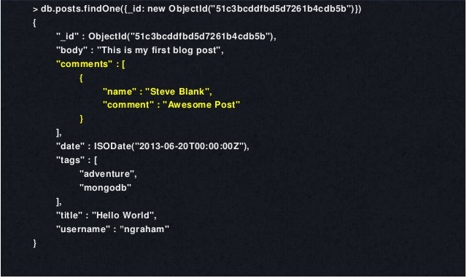
Post with Comment Attached

Slide 23
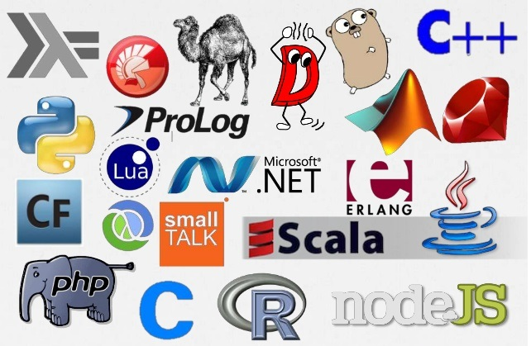
Supported languages

Slide 24
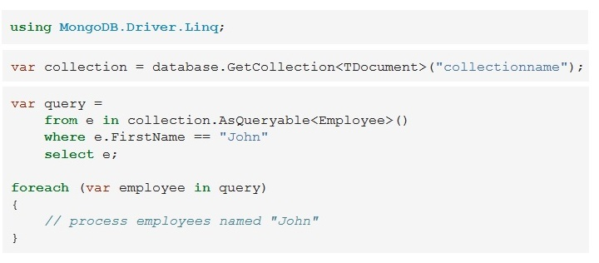
Accessing through LINQ

Slide 25
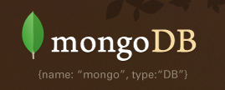
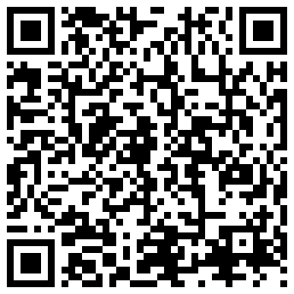
Questions?

