Slide 1

The Agile database migration framework
by Vitalii Bashun

Slide 2

Let me introduce myself :)
Vitalii Bashun
What makes me the one who I am
IT
Continuous education
Sport
People around

Slide 3



What I’m talking about
- We have FlyWay!
- … Fly Away? DB tool? ….

Slide 4
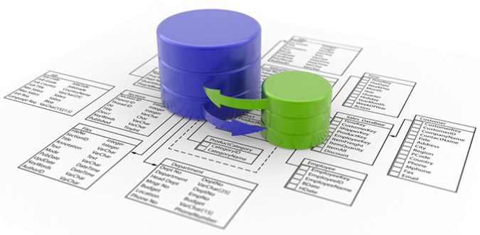
So what’s the problem
and why we need any migration tools

Slide 5

Lets start a project

Slide 6

Lets start a project

Slide 7
Lets start a project
RockStar Soft

Slide 8

Lets start a project
RockStar Soft
RockStar DB

Slide 9

Development
Vasya Dev
Taras Dev

Slide 10
Development
Vasya Dev
Continuous integration
Taras Dev

Slide 11
Development
Vasya Dev
Continuous integration
Test
Taras Dev

Slide 12
Development
Vasya Dev
Continuous integration
Test
Production
Taras Dev

Slide 13
Development
Production
Vasya Dev
Continuous integration
Production
Test
Production
Taras Dev
Production
Production

Slide 14
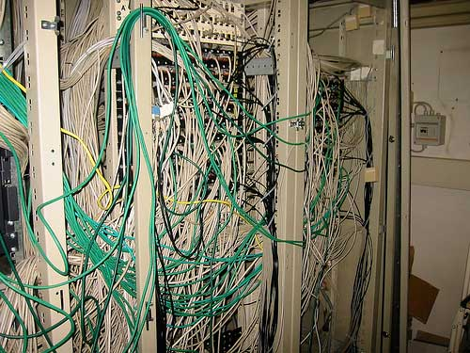

Slide 15
Production

Slide 16
Production
?

Slide 17
Production
What state is the database in on this machine?
?

Slide 18
Production
What state is the database in on this machine?
Has update-to-version-N script already been applied or not?
?

Slide 19
Production
What state is the database in on this machine?
Has update-to-version-N script already been applied or not?
Has the quick fix in production been applied in test afterwards?
?

Slide 20
Production
What state is the database in on this machine?
Has update-to-version-N script already been applied or not?
Has the quick fix in production been applied in test afterwards?
How do you set up a new database instance?
?

Slide 21
Production
?
How can we handle that?

Slide 22

Possible solutions:
1. Manual DB management
( + )
Do not need any additional environment
( - )
Will become your nightmare in middle-large projects

Slide 23
Possible solutions:
2. Writing “change scripts”
DECLARE @current_version INTEGER
SET @current_version = (SELECT current_version FROM db_version)
IF(@current_version < 187)
BEGIN
// changes in db
// ………
UPDATE db_version
SET current_version = 187
END
( + )
Can store changes separately and versioned
( - )
Need additional system to run appropriately
It’s a powerful bug source

Slide 24

Possible solutions:
2. Writing “change scripts”
DECLARE @current_version INTEGER
SET @current_version = (SELECT current_version FROM db_version)
IF(@current_version < 187)
BEGIN
// changes in db
// ………
UPDATE db_version
SET current_version = 187
END
( + )
Can store changes separately and versioned
( - )
Need additional system to run appropriately
It’s a powerful bug source

Slide 25




Possible solutions:
3. Using special migration tools
( + )
Reach function set
Automatic migrations
Speed and stability
( - )
Sometimes complexity
MIGRATEdb
migrate4j
c5-db-migration
mybatis
dbdeploy.com
tacitknowledge/autopatch

Slide 26
FlyWay: How it works

Slide 27
FlyWay: How it works
RockStar Soft

Slide 28

FlyWay: How it works
RockStar Soft

Slide 29


FlyWay: How it works
RockStar Soft

Slide 30
FlyWay: How it works
RockStar Soft
DECLARE @current_version INTEGER
SET @current_version = (SELECT current_version FROM db_version)
IF(@current_version < 187)
BEGIN
// changes in db
// ………
UPDATE db_version
SET current_version = 187
END

Slide 31
FlyWay: How it works
RockStar Soft
DECLARE @current_version INTEGER
SET @current_version = (SELECT current_version FROM db_version)
IF(@current_version < 187)
BEGIN
// changes in db
// ………
UPDATE db_version
SET current_version = 187
END

Slide 32
FlyWay: How it works
RockStar Soft
RockStar DB
Empty

Slide 33

FlyWay: How it works
RockStar Soft
RockStar DB
Empty
Migrate

Slide 34

FlyWay: How it works
RockStar Soft
RockStar DB
Version 1
Migrate

Slide 35

FlyWay: How it works
RockStar Soft
RockStar DB
Version 2
Migrate

Slide 36
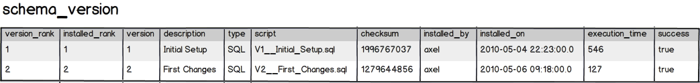
FlyWay: How it works
RockStar Soft
RockStar DB
Version 2
Migrate

Slide 37

FlyWay: How it works
RockStar Soft
RockStar DB
Version 2
Pending

Slide 38


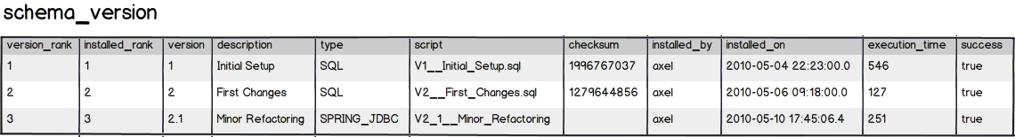
FlyWay: How it works
RockStar Soft
RockStar DB
Version 2.1
Migrate

Slide 39
FlyWay: How it can be used

Slide 40

FlyWay: How it can be used
Maven Plugin

Slide 41

FlyWay: How it can be used
Maven Plugin
Command-line Tool

Slide 42
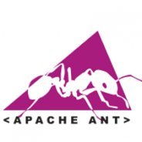
FlyWay: How it can be used
Maven Plugin
Command-line Tool
Ant Tasks

Slide 43
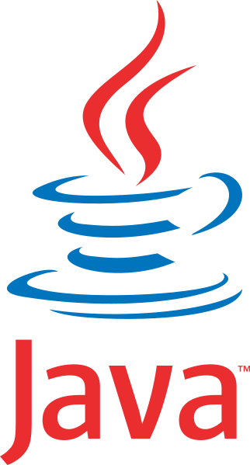
FlyWay: How it can be used
Maven Plugin
Command-line Tool
Ant Tasks
Java API

Slide 44

FlyWay: How it can be used
Maven Plugin
Command-line Tool
Ant Tasks
Java API
Gradle Plugin

Slide 45
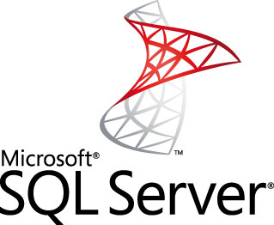



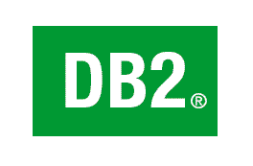


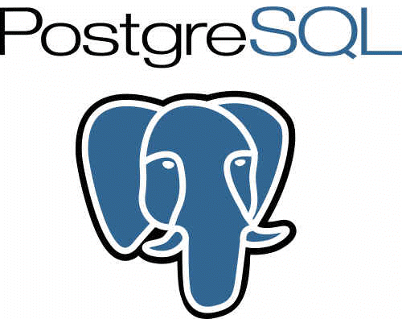


FlyWay: DB supported

Slide 46
FlyWay: What it can’t do
It doesn’t make your DB immortal (you still have to make backups)
It doesn’t make reverse engineering
No XML migrations
Doesn’t allow changes outside the FlyWay

Slide 47
FlyWay: Advantages
Multi source, multi schema, multi server, multi profile
Both data and schema changes
Placeholders support ( ${PARAM} )
Blocking migrations if there were errors in previous attempts

Slide 48


