Slide 1
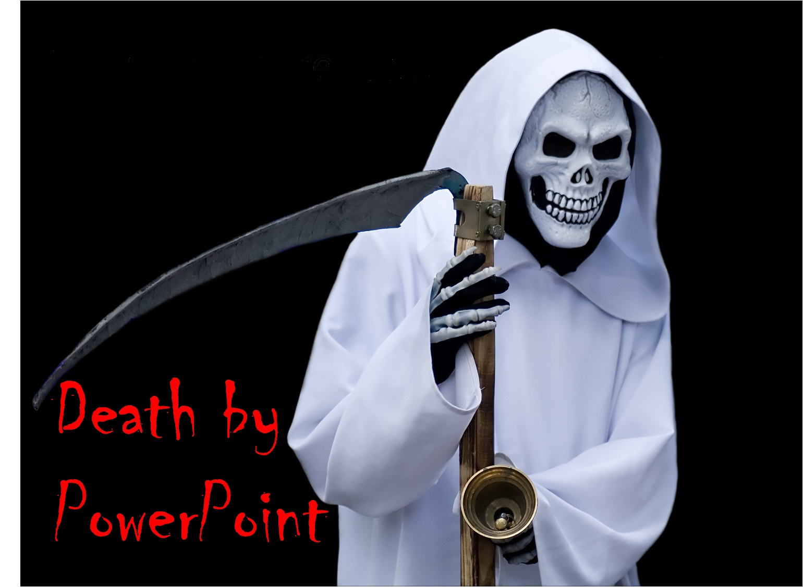
Khrystyna Paprotska,
Pacemaker, Dnipro 2013

Slide 2


Slide 3
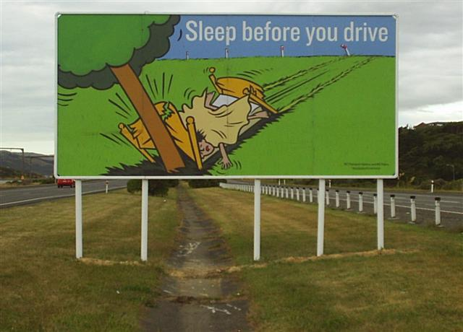
3 seconds message

Slide 4

THIS IS NOT A SLIDE

Slide 5


DOCUMENT
SLIDE

Slide 6
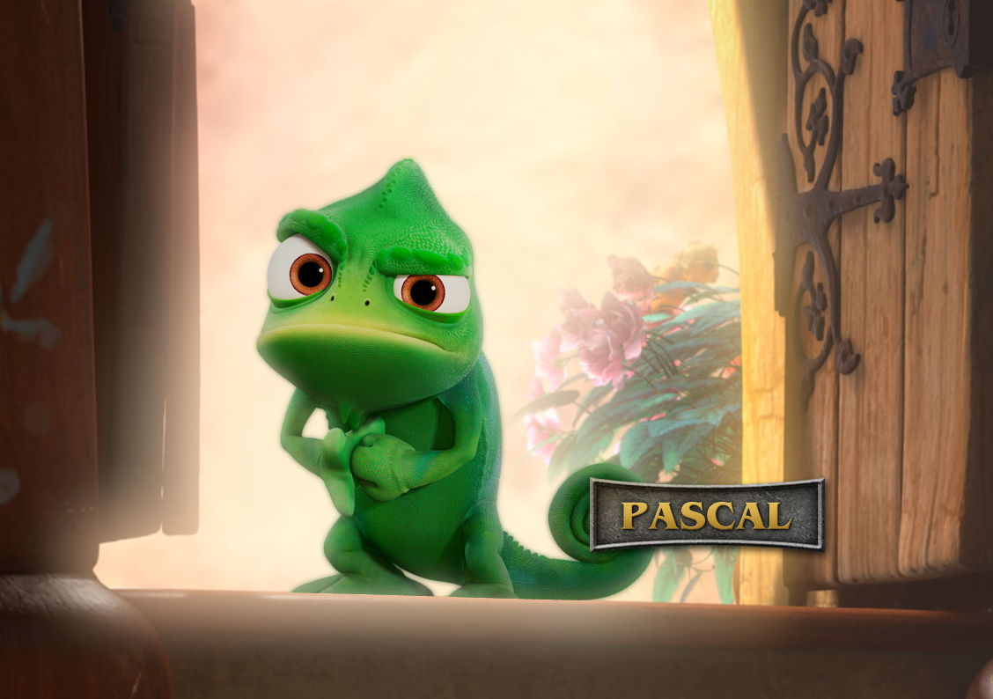
USE IMAGES

Slide 7

Notes:
SHOW IDEA NOT SLIDE

Slide 8


How?

Slide 9

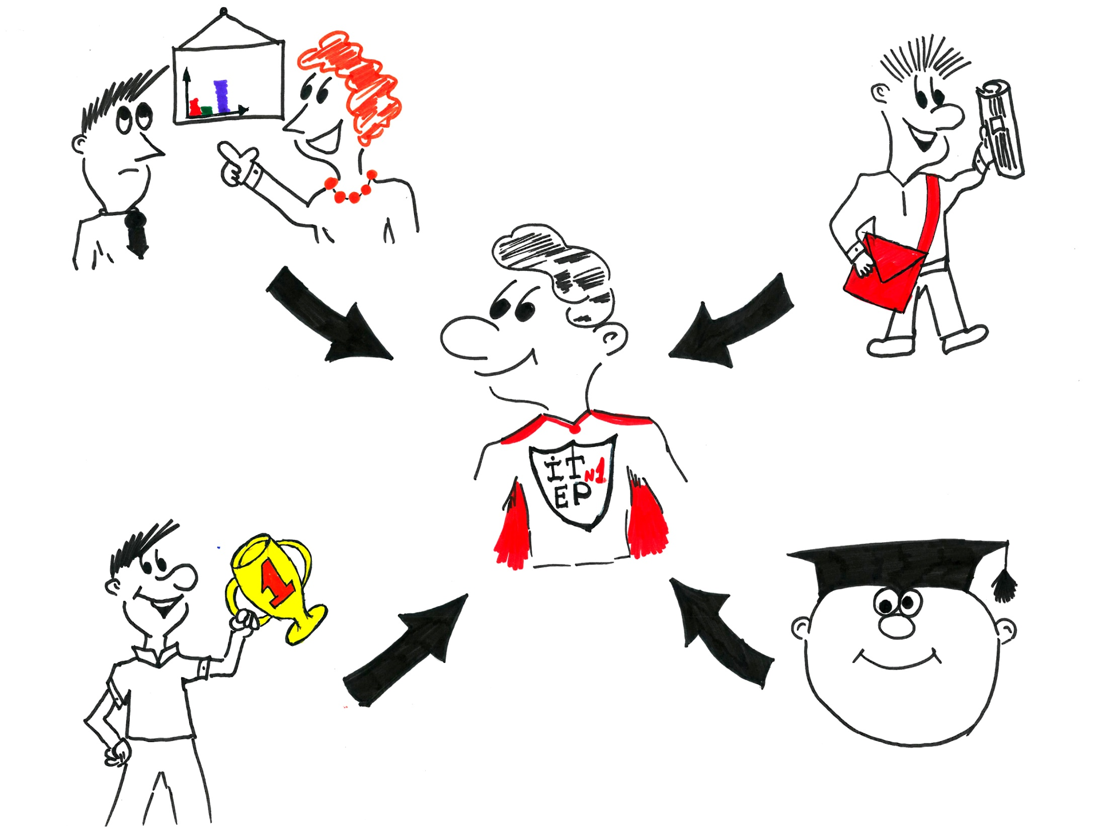
Where?
$

Slide 10
Default type is wrong
Letter is a spirit
Comic Sans

Slide 11
Verdana
Tahoma
Trebuchet
Arial

Slide 12

symbols
Mико

Slide 13
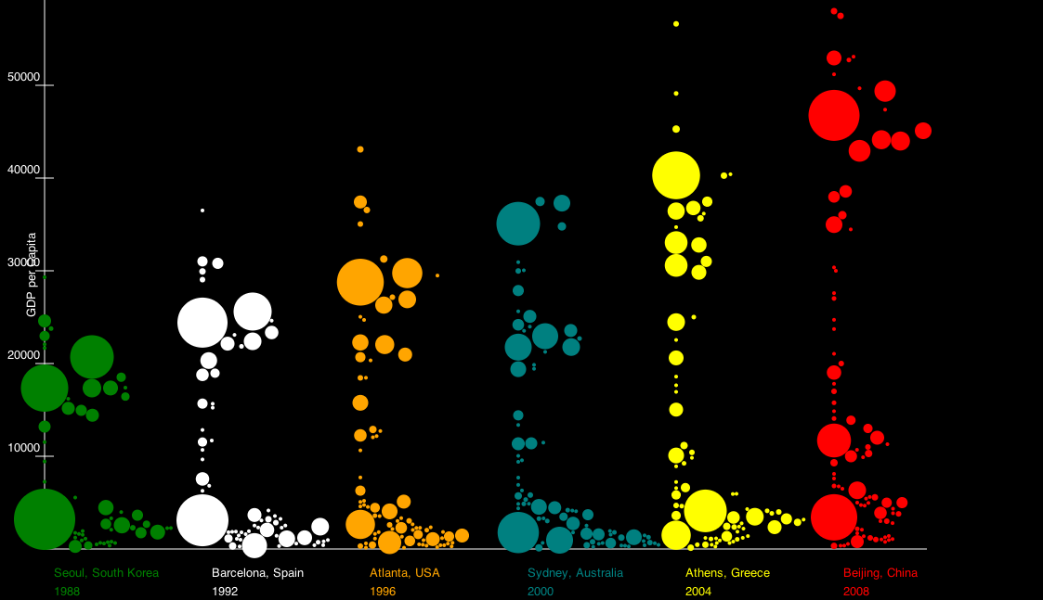
Beautiful information

Slide 14
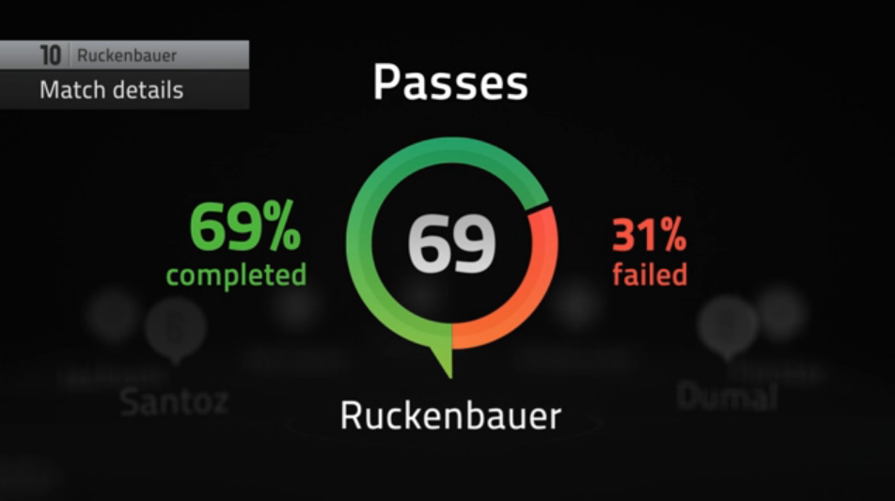

Slide 15
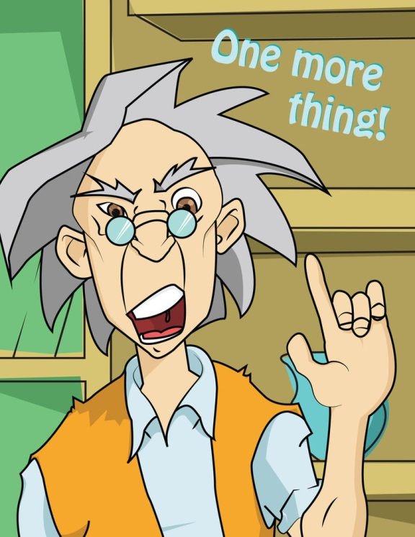

Slide 16


