Slide 1
Multi-tenancy Implementation with Spring and JPA2
Hibernate based solution
Ruslan Danilin
April 2013

Slide 2
Agenda
What is multi-tenancy
What problems this approach solves
Economic Considerations of this approach
Pros & Cons
Security & Extensibility patterns
What we may do with Hibernate
Code & hacks

Slide 3
What is Multi-tenancy?
The term multi-tenancy in general is applied to software development architecture in which a single running instance of an application simultaneously serves multiple clients (tenants).
This is highly common in SaaS solutions.

Slide 4
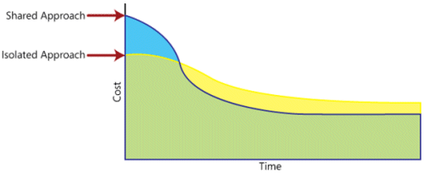
Economic Considerations
relative complexity of developing a multi-tenant architecture results in higher initial costs

Slide 5

Multi-tenant data approaches
Separate database
Separate schema
Shared scheme (discriminator based data)
Note
Each approach has pros and cons as well as specific techniques and considerations.

Slide 6
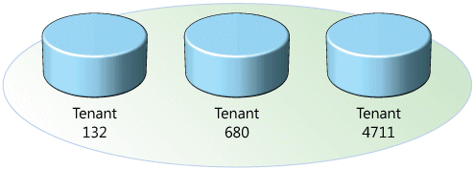
Separate database
Each tenant's data is kept in a physically separate database instance.
A general application approach here would be to define a JDBC Connection pool per-tenant and to select the pool to use based on the “tenant identifier” associated with the currently logged in user.

Slide 7
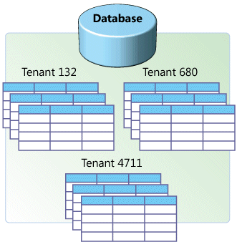
Separate Schema
Each tenant's data is kept in a distinct database schema on a single database instance.

Slide 8
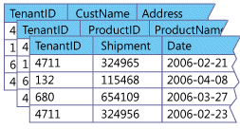




Shared Scheme (discriminator based)
All data is kept in a single database schema. The data for each tenant is partitioned by the use of partition value or discriminator. The complexity of this discriminator might range from a simple column value to a complex SQL formula.

Slide 9
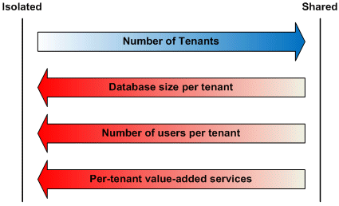
Tenant Considerations

Slide 10
Security Patterns
Filtering: Using an intermediary layer between a tenant and a data source that acts like a sieve, making it appear to the tenant as though its data is the only data in the database.
Permissions: Using access control lists (ACLs) to determine who can access data in the application and what they can do with it.
Encryption: Obscuring every tenant's critical data so that it will remain inaccessible to unauthorized parties even if they come into possession of it.

Slide 11
Security Considerations
Integrate Jasypt with Hibernate
Combine with Spring Security ACL
Check entity for tenant violation during post processing

Slide 12
Extensibility Patterns
Preallocated Fields
Name-Value Pairs
Custom Columns
Custom Column with XML or JSON data

Slide 13
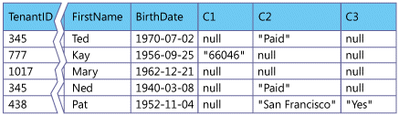
Extensibility Patterns
Preallocated Fields

Slide 14
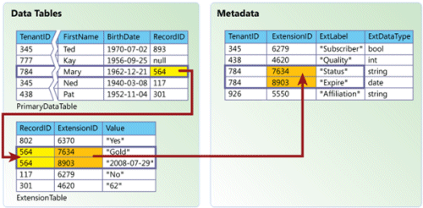
Extensibility Patterns
Name-Value Pairs

Slide 15
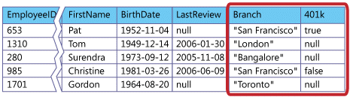
Extensibility Patterns
Custom Columns

Slide 16
Extensibility Patterns
Custom Column with XML or JSON
structured XML entities (XQuery, IBM DB2 pureXML, etc)
JSON data (PostgreSQL 9.3 json_* functions)

Slide 17
Backup & Restore / Data Audit
Issues with restoring data for Shared Scheme
Consistency problem
High load during restoring data
Ways to provide auditable solutions:
DB layer (based on Triggers)
App layer (@Audit / Hibernate Envers)

Slide 18
Implement MT with Hibernate for separate DATABASE or SCHEMA
hibernate.multiTenancy = DATABASE
MultiTenantConnectionProvider hibernate.multi_tenant_connection_provider
CurrentTenantIdentifierResolver
hibernate.tenant_identifier_resolver

Slide 19
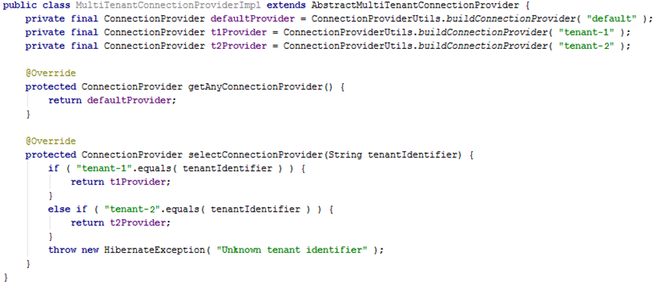
MultiTenantConnectionProvider

Slide 20
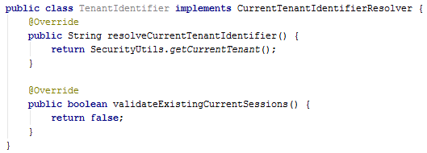
CurrentTenantIdentifierResolver

Slide 21
Implement MT with Hibernate for Shared Scheme approach
Shared Scheme (discriminator based data) model currently not supported in Hibernate and should be implemented in version 4.3 or 5.0
It’s possible to simulate it via Hibernate Filters and customization of HibernatePersistence class

Slide 22
Hibernate Filters
Hibernate filter is approach to handling data with "visibility" rules. A Hibernate filter is a global, named, parameterized filter that can be enabled or disabled for a particular Hibernate session

Slide 23
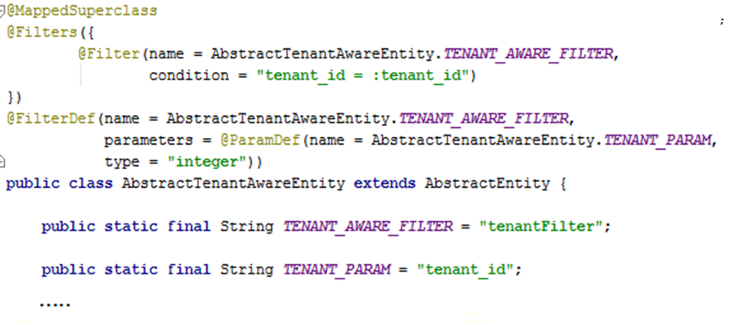
Entity with Filter

Slide 24
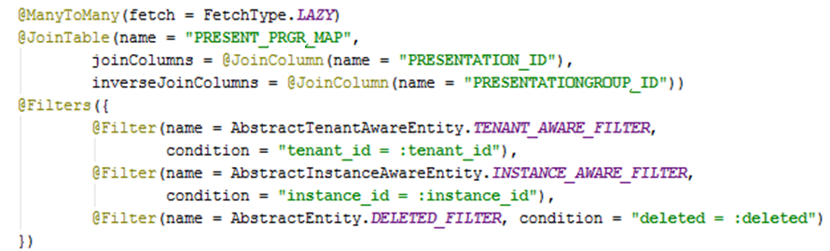
Filtering Collections
Filtered collections should be Sets

Slide 25
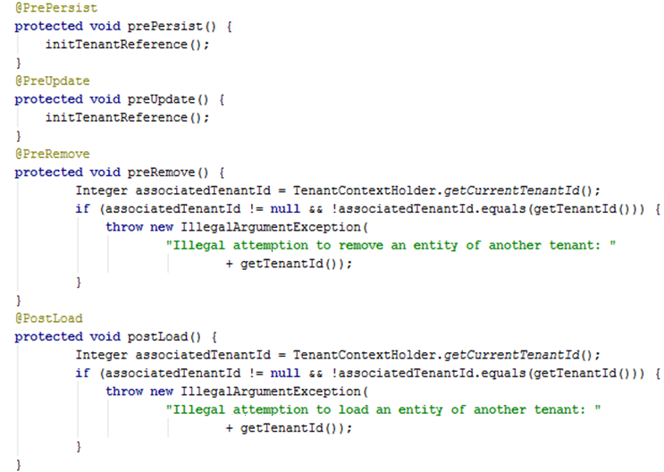
@PrePersist, @PreUpdate, @PreRemove, @PostLoad

Slide 26
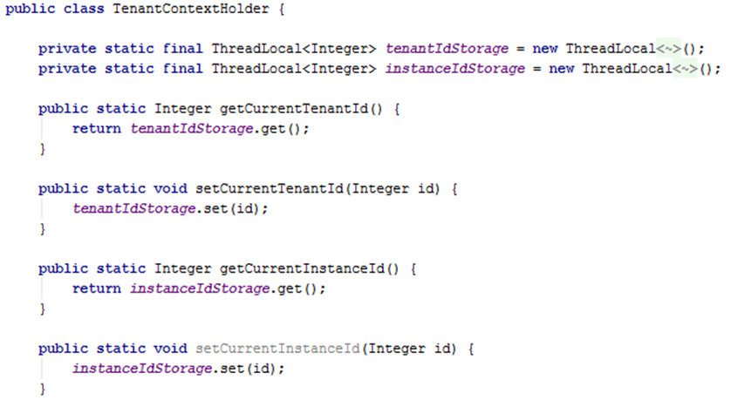
TenantConextHolder

Slide 27
ThreadLocal
Thread-local variables differ from their normal counterparts in that each thread that accesses one (via its get or set method) has its own, independently initialized copy of the variable.

Slide 28
Hibernate Session
Filters should be enabled per every Hibernate Session for correct data isolation
OSIV is anti-pattern

Slide 29
OpenSessionInView anti-pattern
Increased transaction time
Completely defeats layered architecture

Slide 30
Solution
Custom MultiTenantHibernatePersistence bean should be implemented in order to wrap EntityManagerFactory with dynamic proxy that intercepts all method calls made to it. Interception of createEntityManager method allows to access every new EntityManager and enable filter on its session with identifiers gotten from TenantContextHolder

Slide 31
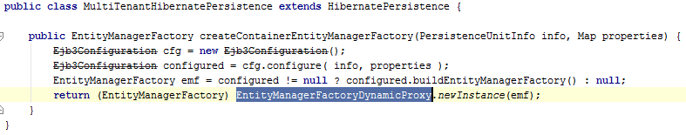
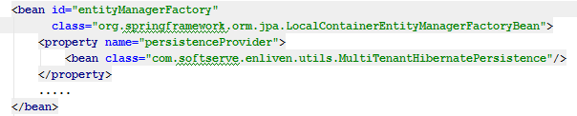
MultiTenantHibernatePersistence
Spring Context Configuration:

Slide 32
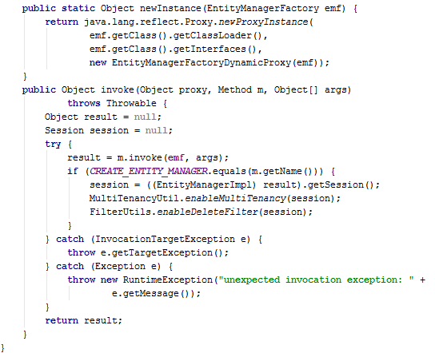
Dynamic Proxy

Slide 33
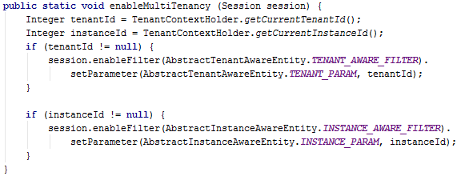

Enabling Filters
via MultiTenancyUtil class
via EntityManager.getDelegate()

Slide 34
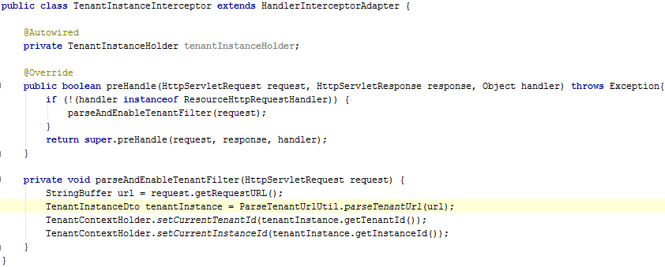

Identifying Tenants via URLs
http://tenant.com/instance/api/someservice/
Spring Dispatcher Servlet Context:

Slide 35
Future
JPA 2.1 (JavaEE 7) specification will include multi-tenancy
Hibernate 4.3 / Hibernate 5.0 should implement JPA 2.1 specification

Slide 36
Resources
Multi-Tenant Data Architecture
http://msdn.microsoft.com/en-us/library/aa479086.aspx
Hibernate Multi-tenancy Support
http://docs.jboss.org/hibernate/orm/4.2/devguide/en-US/html/ch16.html
Hibernate Filters
http://docs.jboss.org/hibernate/orm/4.2/manual/en-US/html_single/#filters
JSSDK 2.0 Docs
https://confluence.softserveinc.com/display/MIPDev/JSSDK+2.0

Slide 37
Q&A section
Thank you!

