Slide 1


Cloud Security
vs. Security in the Cloud
main attack scenarios and security issues
Nazar Tymoshyk Ph.D, Security Consultant at R&D Team
Bohdan Serednytskyi, Security Engineer at R&D Team
Notes:
In 2009, the European Network and Information Security Agency published a report titled Cloud Computing Security Risk Assessment. While the report lauded the benefits of cloud computing, including some of the security benefits, it does address the threat presented by employees of the cloud provider.

Slide 2
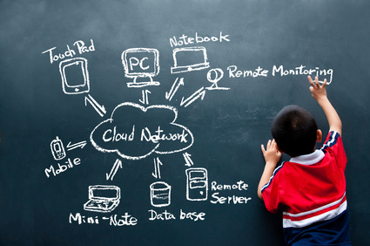
We use clouds everywhere
Notes:
According to Gartner, by 2012, 20% of businesses will adopt cloud services and own no IT assets. Goal of the project is to maintain a list of top 10 security risks faced with the Cloud* Computing and SaaS Models. List will be maintained by input from community, security experts and security incidences at cloud/SaaS providers.
Most of the risks are based on the assumption that Cloud is a public or a hybrid cloud
Mobile backups to Google cloud (now Google know everything about you ☺)
Mobile backups with iCloud (Apple too)
Dropbox (use Amazon S3)
Amazon S3 as corporate backup

Slide 3

Most of Developers and CEOs/CIOs think that cloud management looks like this:

Slide 4
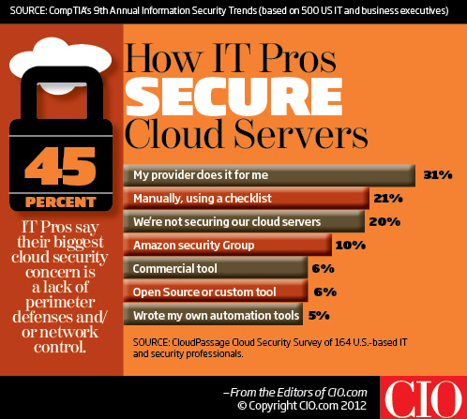

Slide 5
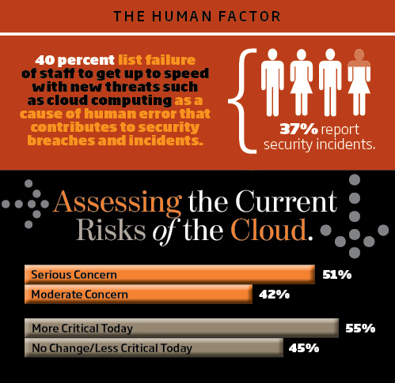

Slide 6

If hacker gets access to one node of cloud cluster – they may get access to whole infrastructure
Notes:
German security researcher Thomas Roth earlier this year showed how tapping the EC2 service allowed him to crack Wi-Fi passwords in a fraction of the time and for a fraction of the cost of using his own computing gear. For about $1.68, he used special “Cluster GPU Instances” of the Amazon cloud to carry out brute-force cracks that allowed him to access a WPA-PSK protected network in about 20 minutes.
And in late 2009, a ZeuS-based banking trojan used the popular Amazon service as a command and control channel that issued software updates and malicious instructions to PCs that were infected by the malware.
In both cases, those tapping the Amazon cloud did so as paid customers.
A top Sony executive recently implicated the Anonymous hacker collective in the PSN attack but has so far provided no convincing evidence to support that claim. The attack, which penetrated core parts of the gaming network, was used to steal passwords, names, addresses, ages, email addresses and other data associated with 77 million accounts

Slide 7
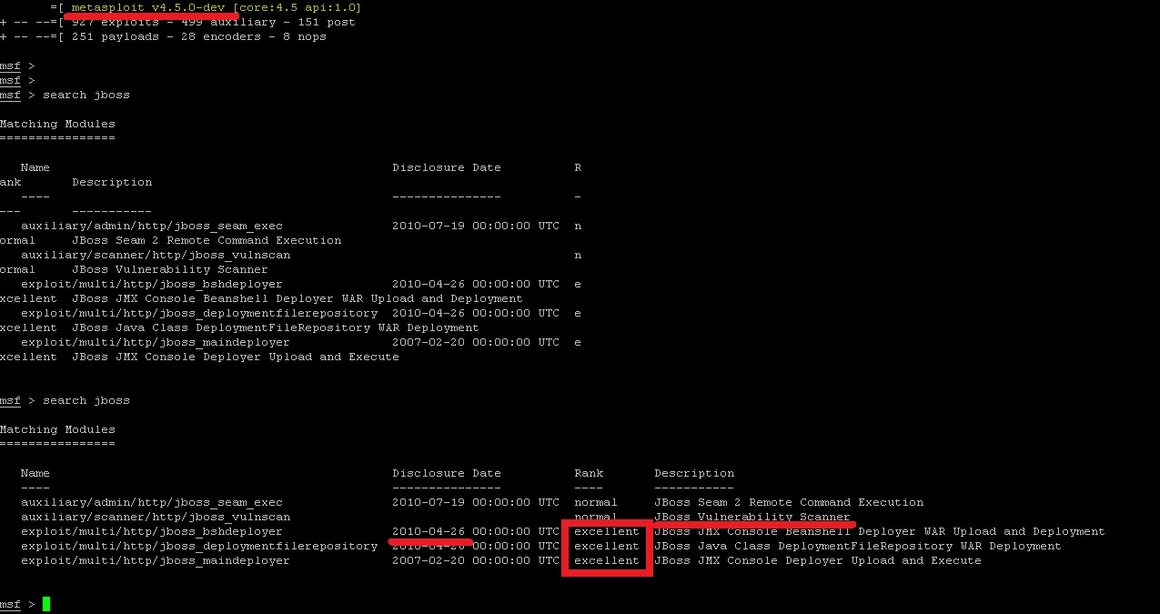
Classical Hack

Slide 8

Cloud vs. Premise
Hypervisors, VLANs, Firewalls,
IDS, IPS, WAF
No difference
For Hackers and Penetration testers

Slide 9

OWASP Top 10 Cloud Risks That Will Keep You Awake at Night
R1: Accountability & Data Risk
R2: User Identity Federation
R3: Regulatory Compliance
R4: Business Continuity & Resiliency
R5: User Privacy & Secondary Usage of Data
R6: Service & Data Integration
R7: Multi-tenancy & Physical Security
R8: Incidence Analysis & Forensics
R9: Infrastructure Security
R10: Non-production Environnent exposure

Slide 10

Our most dangerous
attack
vectors

Slide 11
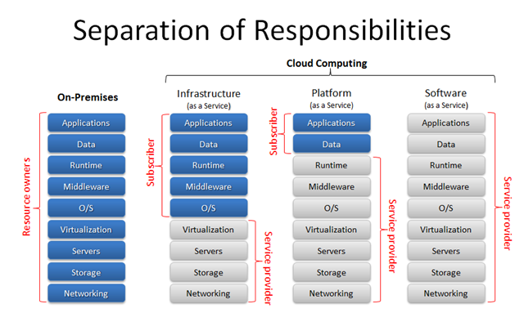
HOW PRODUCT OWNERS SEE
Security level: Max
Security level: unknown

Slide 12




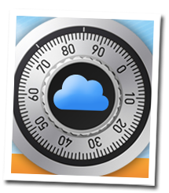
Risks: Islands of User Identities
Security Risks
1.Managing Identities across multiple providers
2.Less control over user lifecycle (off-boarding)
3.User experience
Notes:
Mitigations
1.Federated Identity
2.Oauth for backend integrations
3.Tighter user provisioning controls

Slide 13

Critical IaaS/PaaS issues
Old software versions (kernel, ftp, web-server, cross server communication)
Self signed certificates, UNSECURE CERTIFICATE STORAGE
Configuration stealing
Firewall misconfiguration

Slide 14

(SaaS)
Vulnerabilities in cloud application
(hardcoded passwords, XSS, SQLi, XSRF)
Server misconfiguration (default passwords, web-configs, unneeded extensions, control panels)

Slide 15
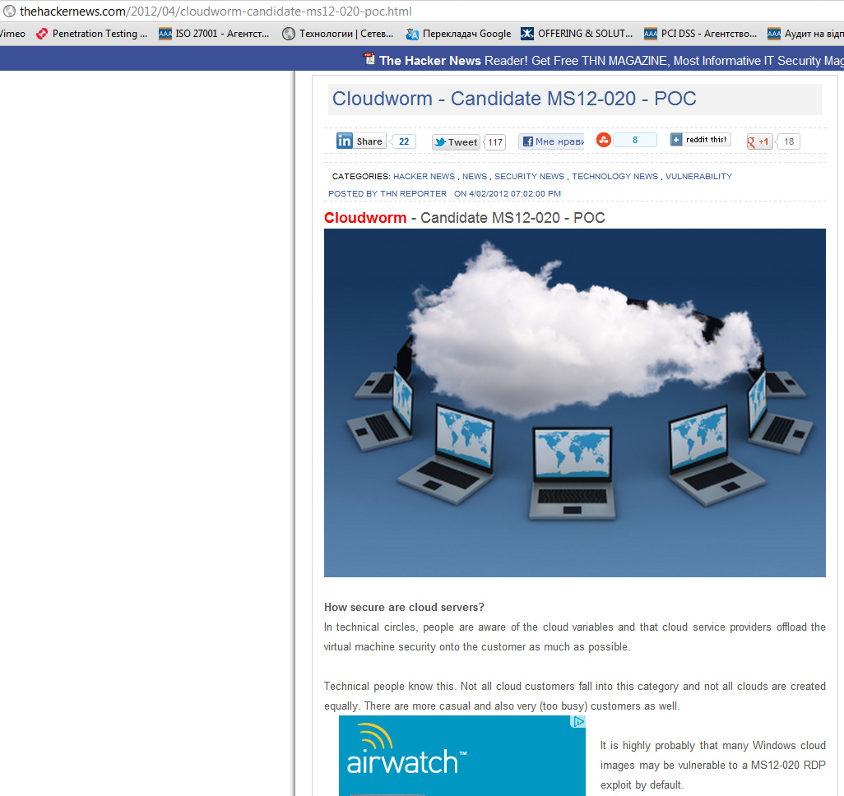
Cloud Worm, what could be more dangerous?
Notes:
http://thehackernews.com/2012/04/cloudworm-candidate-ms12-020-poc.html
New research using the nmap nse script "rdp-ms12-020.nse" developed by @ea_foundation shows that all Rackspace Windows cloud images are vulnerable by default. And on AWS EC2 any existing, unpatched Windows AMIs or EBS images (pre 2012.03.13) that are booted with the AWS Management Console default firewall ruleset are vulnerable as well.
A Cloudworm
Although cloud service providers have taken some steps to mitigate MS12-020, it is nowhere near enough to protect customers.
This is due to the fact that both cloud service providers, AWS EC2 and Rackspace have vulnerable by default security settings.
AWS EC2 have a global allow RDP (port 3389) as a default rule for all customers using the AWS Management Console to launch EC2 instances.
Rackspace have an unsecured "servicenet" (unfirewalled LAN) on all their cloud servers.
Experienced users may not be off the hook either. Booting older Windows cloud images will leave the server vulnerable until the user has patched and rebooted their cloud server, unless they have a sensible RDP ruleset and have secured any "open" network interfaces.

Slide 16

Top 5 Critical issues with Amazon Cloud
AWS images with rootkits and backdoors
Default/weak passwords
Weak/Test environments
Absence of Automatic patch management for cloud member?
All internal communication is trusted, you just need to get inside trough bug in code or deployment

Slide 17

Is it possible to investigate incident?
In really big infrastructure it’s very hard
Most SaaS vendors do not provide the level of audit logs necessary to recover from a serious security breach
CLOUD FORENSICS
Notes:
What do I need to know?
Who logged in?
When?
From where?
What administrative actions were taken?
What documents/data was accessed?

Slide 18

Our approach is based on:
Cloud Security Alliance Audit, Assertion, Assessment, and Assurance guidance
NIST SP 800-144 Guidelines on Security and Privacy in Public Cloud
OWASP Application Verification Standard
OWASP Cloud
PenTest Standard
CWE/SANS Top
NIST Guideline on Website Security Testing
NIST SP 800-42 Guideline on Network Security Testing
NIST SP 800-115 Technical Guide to Information Security Testing and Assessment
ISO/IEC 27002 International Standard
Web Application Security Consortium WASC-TCv2
Information Systems Security Assessment Framework (OISSG)
The Open Source Security Methodology Manual (OSSTMM)

Slide 19

SoftServe recommendations:
Provide assessment of existing situation
Find gaps and recommendation
Design procedures and policies
Attach high-qualified IT-consultants to help developers to understand all design and deployment issues
Conduct independent and objective security audit on annual base

Slide 20
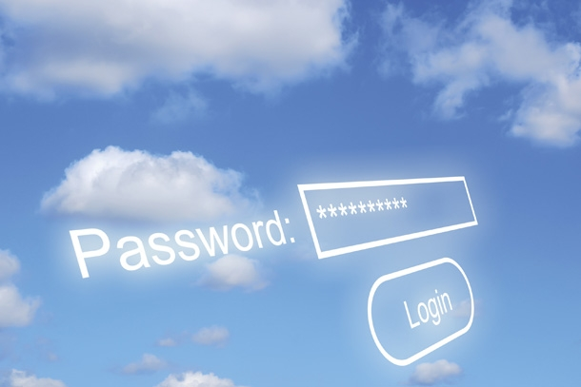
SoftServe recommendations:
Use alternative credscheme (token, cert)
Completely control password policies
Implement internal password reset
Perform anomaly detection on login attempts
Place the portal behind VPN
Access control
Endpoint management

Slide 21

Why take back authentication?
Assign responsible person to monitor logs, performance, security
Use multi-factor authentication and linking
Use security notification
Security practices should be regularly reviewed and updated when necessary

Slide 22

Questions?
Thank you for your attention!

