Slide 1
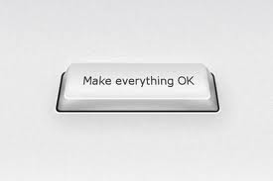
How to

Slide 2

Zen-management

Slide 3
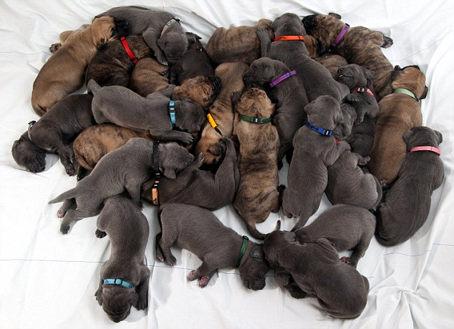
Team is getting bigger

Slide 4

Ordinary morning

Slide 5
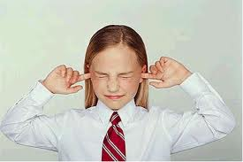
First thought

Slide 6



Results

Slide 7

First thought

Slide 8
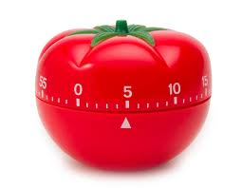
Second try

Slide 9
Second try

Slide 10

Multitasking

Slide 11
Multitasking

Slide 12


Success at last

Slide 13


