Slide 1
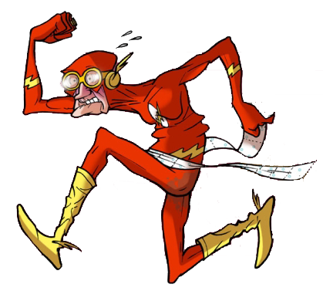
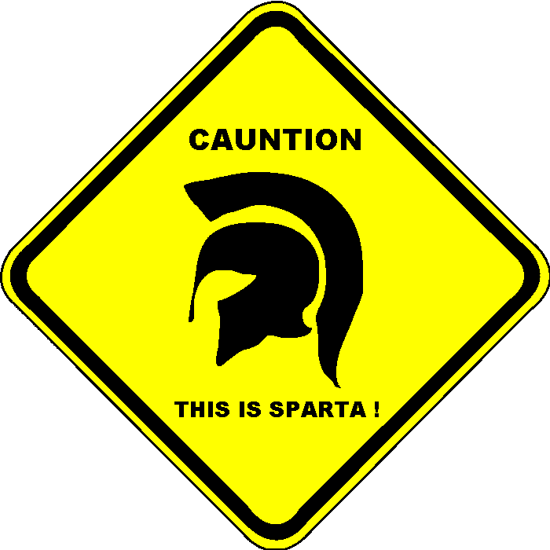
Adventures of Java developer in Ruby world
by Orest Ivasiv
@halyph

Slide 2
WARNING!
A Presentation is NOT a Documentation!

Slide 3
Agenda
Background
Project issues and language choice
Ruby History
“Trololo”
Ruby Ecosystem review
Notes:
Issues with Ruby ecosystem.
Is Ruby really cross platform?
Pitfalls with the Ruby language.
Packaging and application distribution, pros&cons.
Ruby CLI application facilities.
Project based experience.

Slide 4

Background
My experience: 5+ years in industry
Java is my primary language
1st ruby experience – 05/2007
08/2012 real Ruby project
Language agnostic, only pragmatic choices
Co-organizer of

Slide 5
Project requirements
Scripting language
Easy to learn
Simple distribution model
Language Community
Local community size
Ecosystem

Slide 6
Language Matrix
 | Java | Python | Ruby | Groovy | Perl
Well adopted | + | + | + | - | -
Cross-platform | + | + | +/- | + | +
Easy Maintainable | + | + | + | + | -
Huge community | + | +/- | + | +/- | -
Nice to start app from scratch | - | + | + | + | -
Lots of third-party libs | + | + | + | +/- | +
Speed of execution | + | + | +/- | - | +
Application distribution model and dependency issues | + | +/- | +/- | + | +/-
Runtime environment setup | + | +/- | +/- | +/- | +/-
My Language sympathy | Native | - exp | + exp | +/- | Hate it

Slide 7
History
Smalltalk
Perl
Ruby
Java
C#
1983
1989
1993
1995
2000
Lisp
1958

Slide 8
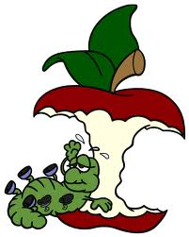
Ruby History
02/24/1993 - Pre-history age. Without code
12/21/1995 - Ruby is in public. V.0.95
12/25/1996 - Ruby 1.0 released
10/27/1999 - the first Ruby book
xx/07/2004 - DHH first released Ruby on Rails
xx/12/2005 - version 1 of Ruby on Rails was released
xx/10/2007 - bundle/ship RoR w/ OS X Leopard
Notes:
See http://blog.nicksieger.com/articles/2006/10/20/rubyconf-history-of-ruby
http://gunnertech.com/2011/11/ruby-on-rails-history-a-look-back/
27 October 1999: Matz and Keiju’s book is published, the first Ruby book

Slide 9
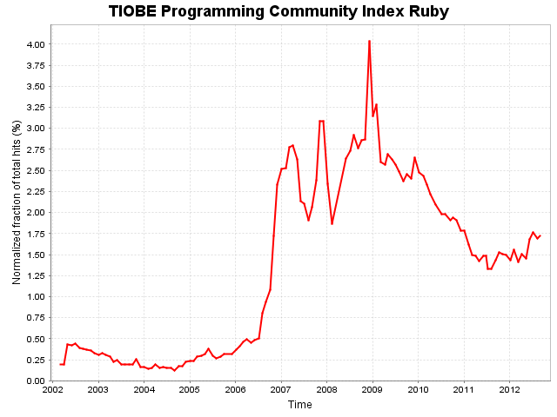
Ruby History
Notes:
See http://blog.nicksieger.com/articles/2006/10/20/rubyconf-history-of-ruby
http://gunnertech.com/2011/11/ruby-on-rails-history-a-look-back/
27 October 1999: Matz and Keiju’s book is published, the first Ruby book

Slide 10


Slide 11

Ruby trolls on early days
September 20, 2007
here is a list of the top 10 reasons that anything (and probably everything) related to Java sucks ass in comparison to Ruby and Rails.
... Fuck compilers ... Java Programmers are Morons ... they all suck ass ... Jimmy Gosling? Hahahahahahahaha...
Notes:
http://www.javalobby.org/java/forums/t101687.html
->
http://www.jroller.com/obie/entry/top_10_reasons_why_java
1) Java has a compiler
Ruby does not. That's great! Fuck compilers and their false sense of security. Too often is bad code checked in or even deployed to production, simply because it compiled. No such luxury in the Ruby world.
2) Java framework authors are not application developers
Prime example: the JBoss guys, who are paid handsomely to work on framework code all day. Sure, they're exposed to real application development, but they don't do it themselves. As a result, none of their handiwork is extracted from actual working codebases. Which is a shame, because if it were extracted from actual working codebases then it might actually not suck.
All Rails core and plugin contributors of significance are fulltime application developers, starting at the top with DHH himself and the Rails core team. Day in and day out we write applications in Ruby and extract the useful bits out for other Rails developers to make use of via gems and plugins.
3) Most Java Programmers are Morons
This has to do with the number of people in the world that describe themselves as Java programmers and work at day jobs doing Java programming. What are there, like 2 million of them? More? So it's just a numbers thing, really. There just aren't that many good programmers overall in the world -- and most them wouldn't be caught dead doing Java.
4) Java is too Fragmented
Java has a gazillion open-source frameworks and they all suck ass. So what do Java teams do to cope? Cobble those suck-ass frameworks together into custom layered homebrews that are nothing more than exponential explosions of sheer, despicable suck-assiness.
In stark contrast, in the Ruby world, we only have Rails. All Rails projects are structured the same way and follow the same conventions. That's a good thing, since it means that Rails developers can move across projects with relative ease.
5) Java is Too Slow
Ha. This is one of my favorite reasons, for the bloody irony of it. You see, Java isn't actually slow. Everyone reading this knows that it got plenty fast over the last five years or so. Nevertheless, 90% of the world that knows of Java thinks that it is slow, because of its association with crappy slow Java applets and crappy slow Java loading screens on mobile devices.
Ruby *is* slow, compared to Java, and yet it is fast enough. Amazing, isn't it.
6) Java doesn't have blocks and closures
Do I really need to rehash this reason? No. I don't think so.
7) Java has Integrated Development Environments (IDEs)
Closely related to Reason #3 Most Java Programmers are morons. Everyone knows that the best programmers use Vim and Emacs. Then come the TextMate users. If you need to use an IDE then you suck, period.
8) Java has good debugging support
Java has great and powerful debugging (which is very necessary since most Java code sucks so much ass). Ruby has ridiculously pitiful debugging support, which means our code actually needs to be well-tested and readable.
9) Java Makes a Lot of Money for Vendors
This is potentially the most subtle of all of the reasons on the list. Basically, the integrity of most anything having to do with Java is corrupted by the way that it is inextricably linked to a web of intrigue involving money, big vendors and bullshit enterprise politics and pandering. Ruby doesn't make major money for anyone except Pragmatic Dave.
10) Java does not have DHH
In the words of my inimitable friend Zed Shaw, "If DHH ain't doing it, you don't fucking do it. (Seems every time some clever fellow gets into trouble it's because of that.)"
Who does Java have? Jimmy Gosling? Hahahahahahahaha...

Slide 12

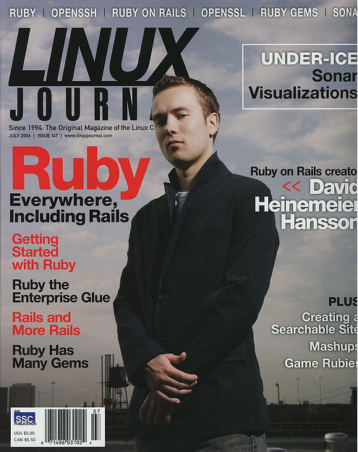
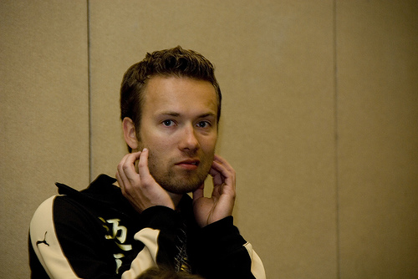
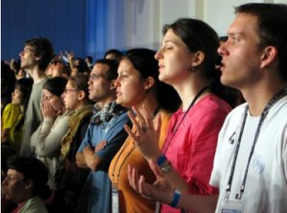
Ruby trolls on early days
DHH

Slide 13
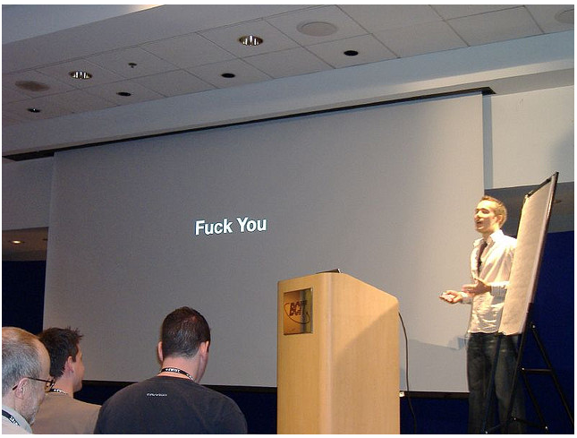
Ruby trolls on early days
Maybe "Fuck You" means something different in Copenhagen? ☺

Slide 14
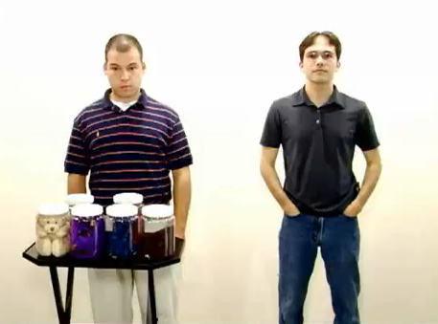
Ruby trolls on early days
May 13, 2007
Ruby on Rails vs Java
Ruby on Rails vs PHP
Ruby on Rails vs .NET
Notes:
May 13, 2007
http://www.youtube.com/watch?v=PQbuyKUaKFo

Slide 15

Ruby implementations
Which to pick ?
Ruby 1.8, MRI
Ruby 1.9, YARV
JRuby
Rubinius
IronRuby
MacRuby

Slide 16
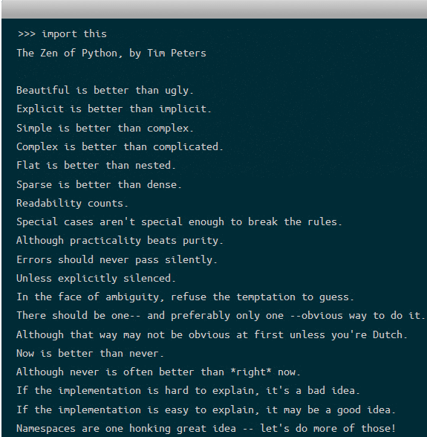
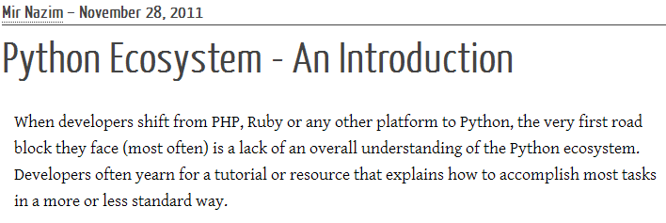
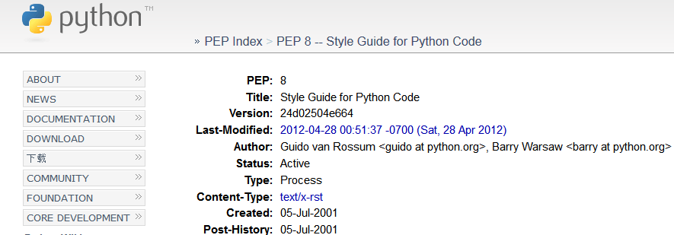
Python Community

Slide 17
Java Culture
Enterprise
Big company
Big departments

Slide 18
Ruby Culture
=
Start-Up Culture
Just the get App running
Notes:
“ J a v a P r o g r a m m e r s a r e w r i t i n g s t r a n g e R u b y C o d e . ”

Slide 19


How to find non-crappy Gem?

Slide 20
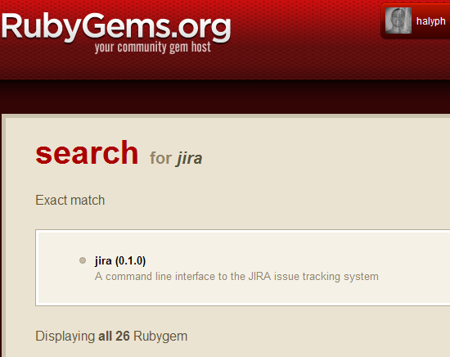
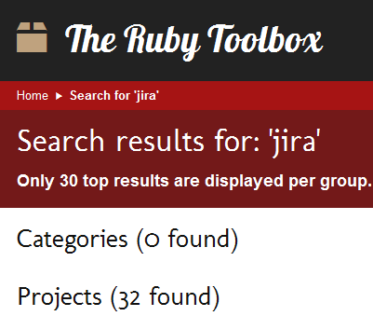
How to find non-crappy Gem?

Slide 21
How to find non-crappy Gem?
Evaluate gem
Documentation
Source code
Open/Closed issues
Gems Dependency
Curation of maintainer
Tests

Slide 22
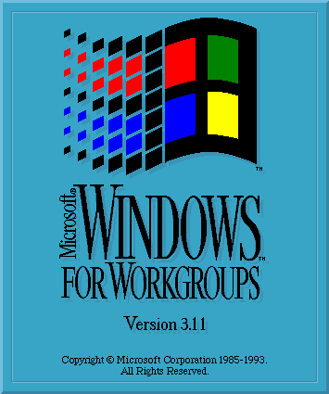
:Ruby => *nix

Slide 23
Implement Ruby Gem
Ruby Style Guide
Follow the better practices

Slide 24
Implement Ruby Gem
How to write own gem?
When is it necessary?
How to start? FTW?
Find the mentor
Pick proper test framework
Pick the bootstrap tools

Slide 25
Tools & Gems
Git
Gem
Bundler
Rake
Rspec
irb
Ri
Rdoc, TomDoc, YARD
Thor
Maven

Slide 26
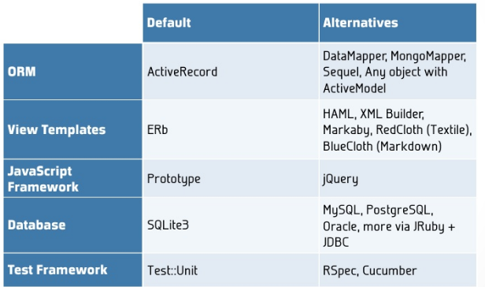
Tools & Gems

Slide 27



IDE vs. Text Editor

Slide 28

Debug Ruby Code
Ruby-debug
Pry
RubyMine debugger

Slide 29

Ruby Testing
Test::Unit
minitest
Rspec
Cucumber
…
Tons of other gems
Which to pick ?

Slide 30
Language Features
Namespaces
Mixin
Code organization
Duck typing
Open Classes
Blocks

Slide 31
Ruby Community
Social Coding - GitHub
Screencasts
Podcasts
Conferences
Tons of Books

Slide 32
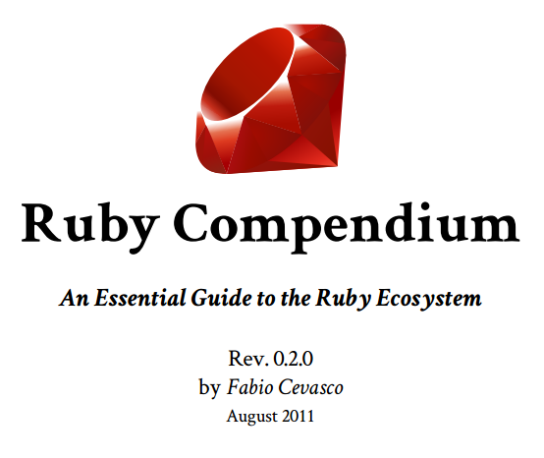
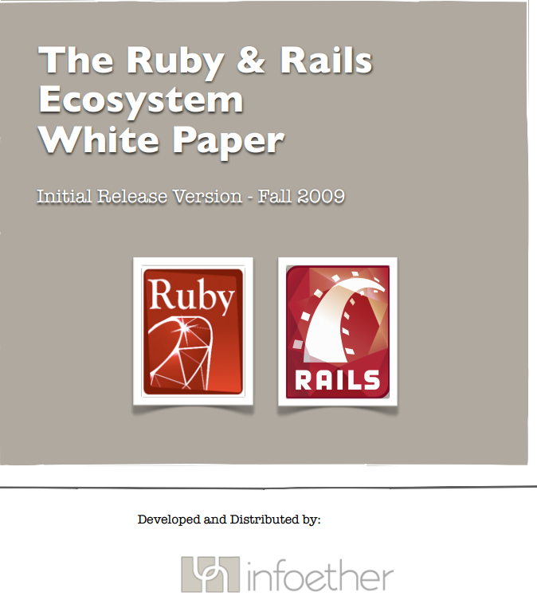
Ruby Ecosystem
Notes:
https://github.com/h3rald/ruby-compendium
http://infoether.com/ruby-and-rails-whitepaper

Slide 33

Any Questions?
Notes:
Як я обирав Рубі для поточного пректу. Показати матрицю
Які основні критерії були? РЕСТ АПІ, кросс платформеність
Чому не Пайтон?
Проблеми з ДжДК, креші, бандлер

