Slide 1
Clojure. Uncommon view at multithreading

Slide 2


Concurrency issues
Race conditions
Deadlocks (livelocks)
Locks and performance penalty

Slide 3

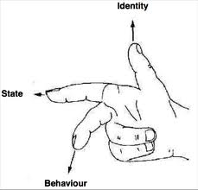
Clojure answer
Immutability
Functional language
Well defined API to work with shared state

Slide 4
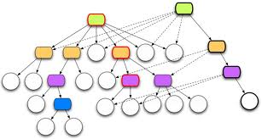
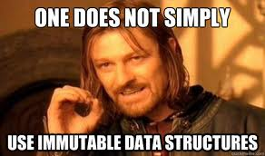
Immutability
No state and No mutation in place
No locks required
No complexity coming from locks implementation

Slide 5
Immutability (under the hood)
Shared immutable persistent data types

Slide 6

The real world is not a pure function
References (identities) point at different values at different points of time

Slide 7

Identity vs Value
Identity points to a value
Identity can change over time (point to a different value)
Identity change is transactional (no way to ignore that)

Slide 8
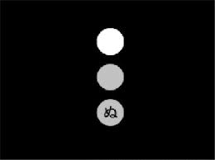
Atoms
Atoms – mutable shared storage changed synchronously and sequentially.
(def a (atom 1))
(swap! a inc)

Slide 9

Refs
Refs – mutable shared storage called Software Transactional Memory (STM). All the changes are done within transaction
(def location (ref "Chicago"))
(def salary (ref 30000))
(dosync
(ref-set location "San Francisco")
(alter salary (partial + 15000)))

Slide 10

Agents
Agents –mutable shared storage changed asynchronously, but sequentially.

Slide 11

Vars
Vars – mutable local thread storage (thread isolation)

Slide 12

Questions?

Slide 13
Useful links
www.clojure.org
InfoQ: Are We There Yet?
InfoQ: Perception and Action: An Introduction to Clojure's Time Model
Time, identity, and transition in Clojure « goodmike blogs here

