Slide 1
Emotional Intelligence
Vadim Mateushev

Slide 2

Agenda
Personal Efficiency
Types of Intelligence
Emotional Intelligence (EQ)
EQ: Advantages
EQ and Efficiency
EQ components:
Self-awareness
Self-control
Social keenness
Relationship management
Summary
Literature

Slide 3


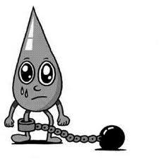
Personal Efficiency
Performance =
potential –
restrictions

Slide 4
Types of Intelligence
Understanding of others
EI
AI
Analysis and forecast
Relationship
PI
Influence
Planning
Organization of group activity

Slide 5
Emotional Intelligence
MYSELF
OTHERS
SELF-AWARENESS
SOCIAL KEENNESS
COMPREHENSION OF
comprehension of other people and situations
comprehension of own feelings
SELF-CONTROL
RELATIONSHIP MANAGEMENT
ACTIONS DIRECTED ON
manage own feelings
social skills

Slide 6
EQ: Advantages
People with high level of EQ:
build more stable interpersonal relationships
can motivate better themselves and other
more active, innovative and creative
more efficient leaders
work better under stress
cope with changes better
in harmony with themselves

Slide 7
EQ and Efficiency
Emotional resources of the organization
People have emotions
Emotional relationship between people
Emotions give energy, information, value and motive to do or not to do something

Slide 8
Emotional Intelligence
 | MYSELF | OTHERS
COMPREHENSION OF | SELF-AWARENESS comprehension of own feelings | SOCIAL KEENNESS comprehension of other people and situations
ACTIONS DIRECTED ON | SELF-CONTROL manage own feelings | RELATIONSHIP MANAGEMENT social skills

Slide 9


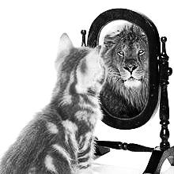
EQ: Self-awareness
Emotional self-awareness
Precise self-rating
Self-confidence

Slide 10
Emotional self-awareness

Slide 11

Emotions
Anger

Slide 12

Emotions
Fear

Slide 13

Emotions
Sadness

Slide 14

Emotions
Joy

Slide 15

Emotions
Interest

Slide 16
Emotions: spectrum
Interest
Curiosity
Surprise
Inspiration
Appetence
…
Joy
Love
Pleasure
Pride
Complacency
…
Anger
Fury
Irritation
Disgust
Envy
…
Fear
Excitement
Shame
Confusion
Awkwardness
…
Sadness
Melancholy
Oppression
Despond
Sorrow
…

Slide 17
Emotions: efficiency and activation
Efficiency
Interest
Joy
Fury
Fear
Sadness
Activation

Slide 18
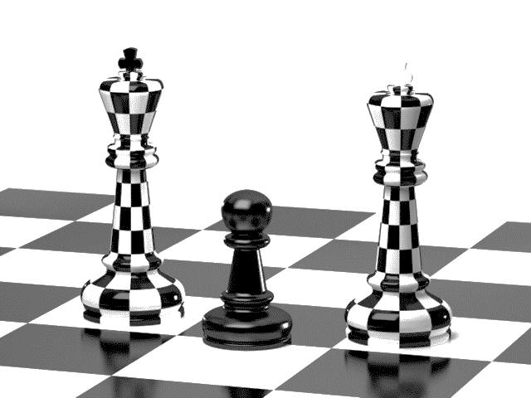
Precise self-rating

Slide 19
Self-confidence

Slide 20
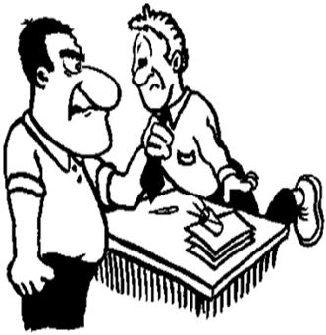
Behavior Models
Aggressive
Passive

Slide 21

Behavior Models
Assertiveness

Slide 22
Emotional Intelligence
 | MYSELF | OTHERS
COMPREHENSION OF | SELF-AWARENESS comprehension of own feelings | SOCIAL KEENNESS comprehension of other people and situations
ACTIONS DIRECTED ON | SELF-CONTROL manage own feelings | RELATIONSHIP MANAGEMENT social skills

Slide 23
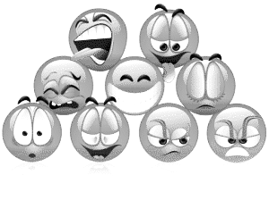

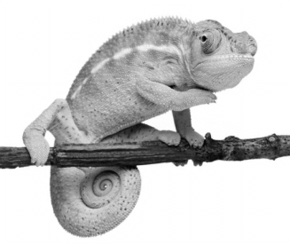
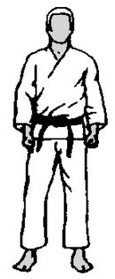
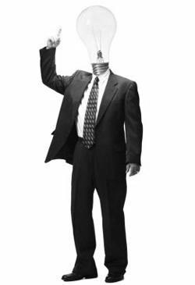
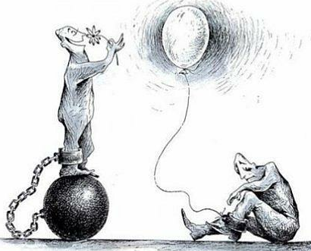
EQ: Self-Control
Emotions control
Openness
Adaptability
Will to win
Initiative
Optimism

Slide 24
Three ways how to manage own emotions
Discharge of emotions
Dissociation
Talk about feelings

Slide 25
Emotional Intelligence
 | MYSELF | OTHERS
COMPREHENSION OF | SELF-AWARENESS comprehension of own feelings | SOCIAL KENNESS comprehension of other people and situations
ACTIONS DIRECTED ON | SELF-CONTROL manage own feelings | RELATIONSHIP MANAGEMENT social skills

Slide 26
EQ: Social Keenness
Empathy
Business awareness
Attentiveness
Auxiliary skills:
Active listening
Understanding of nonverbal communication
Adaptation to a wide emotions spectrum

Slide 27
Emotional Intelligence
 | MYSELF | OTHERS
COMPREHENSION OF | SELF-AWARENESS comprehension of own feelings | SOCIAL KEENNESS comprehension of other people and situations
ACTIONS DIRECTED ON | SELF-CONTROL manage own feelings | RELATIONSHIP MANAGEMENT social skills

Slide 28
EQ: Relationship management
Inspiration
Influence
Assistance in self-improvement
Assistance in changes
Conflict management
Strengthening of personal relationships
Teamwork and cooperation

Slide 29
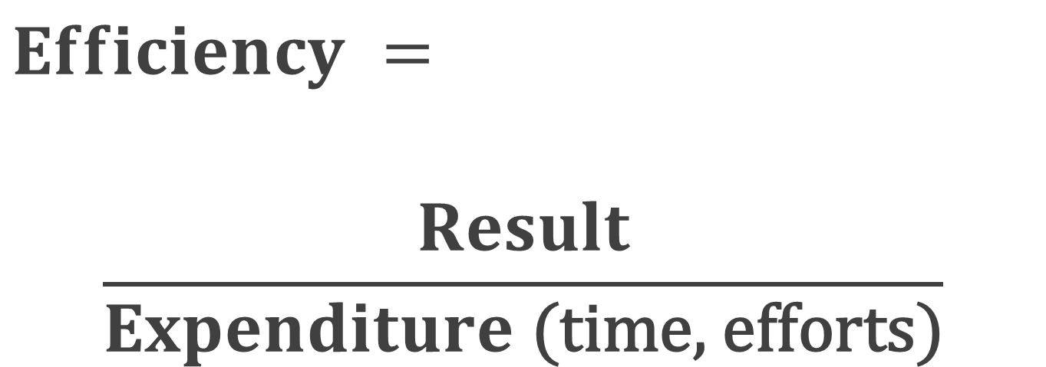
Summary
$$Efficiency =$$
$$\frac{Result}{Expenditure\text{ (}\text{time}\text{, }\text{efforts}\text{)}}$$

Slide 30
Summary
Develop abilities
Pertinent usage
Improving the competence
…
Master technologies

Slide 31


Slide 32
Thank you

Slide 33


Literature

Slide 34
Contacts
Europe Headquarters
52 V. Velykoho Str.
Lviv 79053, Ukraine
Tel: +380-32-240-9090 Fax: +380-32-240-9080
E-mail: info@softserveinc.com
Website: www.softserveinc.com
US Headquarters
12800 University Drive, Suite 250 Fort Myers, FL 33907, USA
Tel: 239-690-3111 Fax: 239-690-3116
Thank You!
Copyright © 2012 SoftServe, Inc.

