Slide 1



Slide 2
var me = {
name: ‘Evgen A. Epanchin’,
company: ‘SoftServe’,
sbu: ‘B-Pro’,
title: ‘Web UI Developer’,
email: ‘yyepanch@softserveinc.com’
};

Slide 3

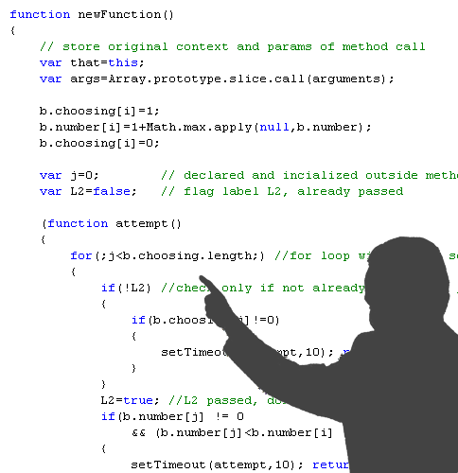
MAIN GOALS OF CODE REVIEW
Improve skills
Increase code quality

Slide 4


CODE REVIEW TYPES
Formal code review
Lightweight code review

Slide 5
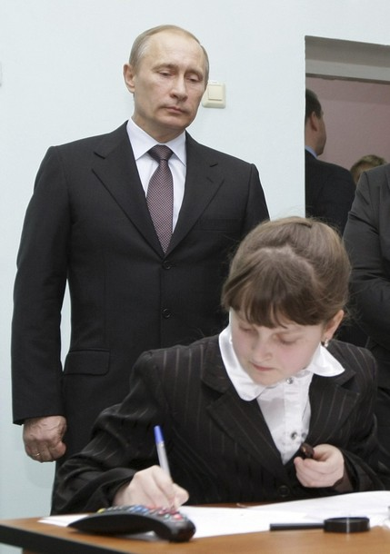
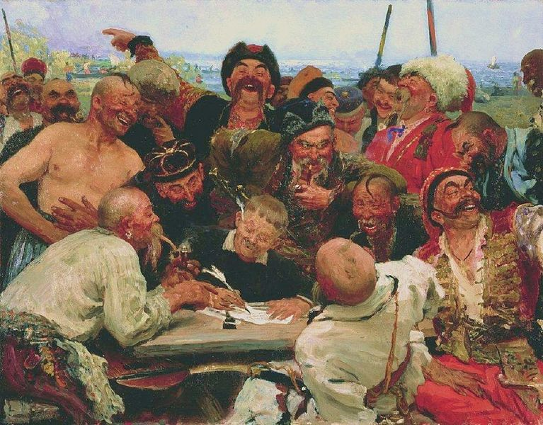
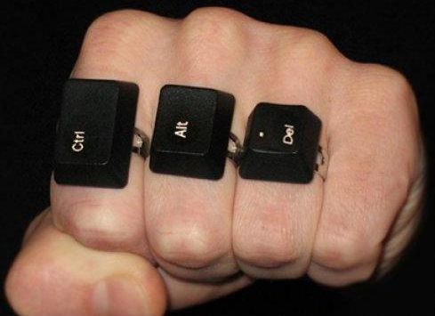
LIGHTWEIGHT CODE REVIEW
Over-the-shoulder
Email pass-around
Tool-assisted
Pair Programming

Slide 6

CODE REVIEW TOOLS
Rietveld
Review Board
CodeStriker
Groogle
Malevich
FishEye+Crucible
…

Slide 7
FISHEYE+CRUCIBLE CAPABILITIES
Web-based
Different VCS support
JIRA integration
Snippet reviews
Review Coverage Statistics
Notifications and reminders
Dashboards & Reports

Slide 8
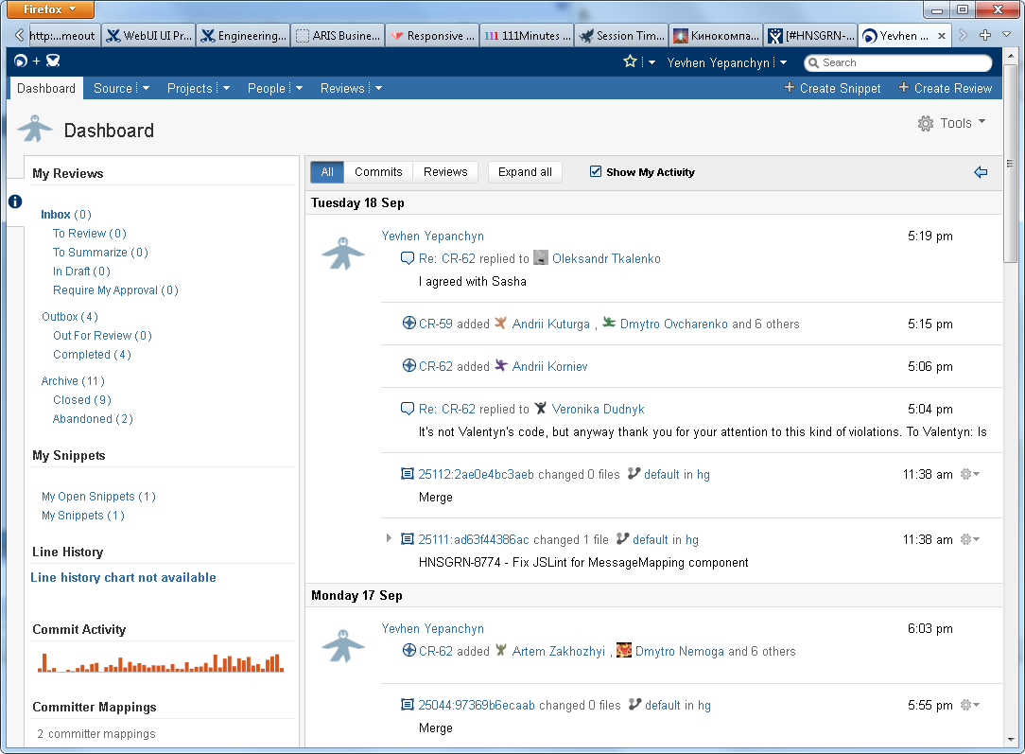
DASHBOARD

Slide 9
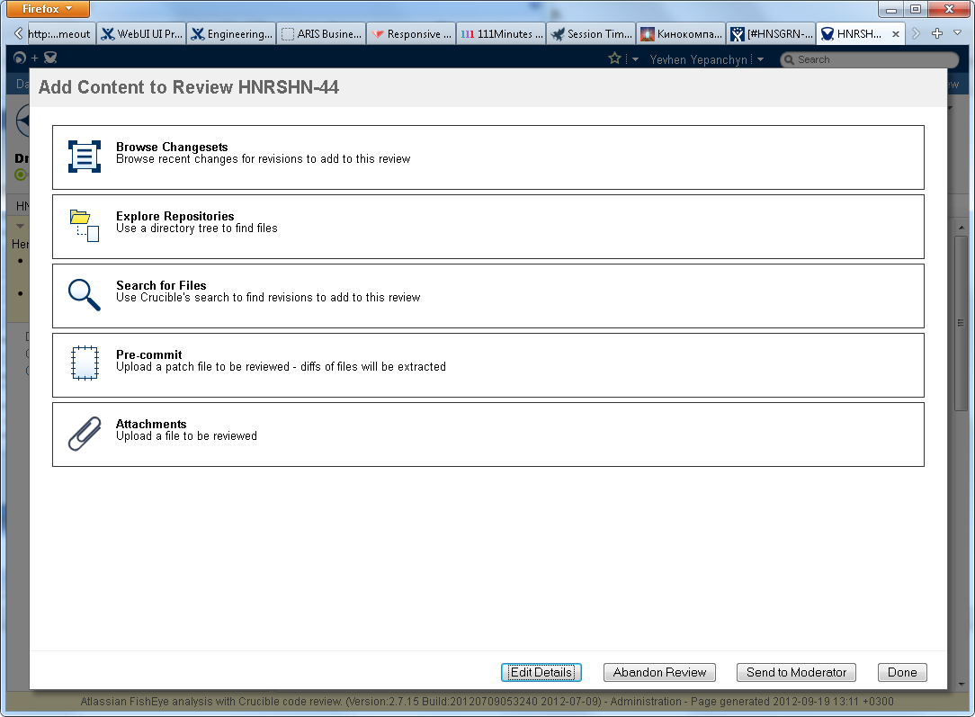
CREATE REVIEW: CHOOSE CONTENT

Slide 10
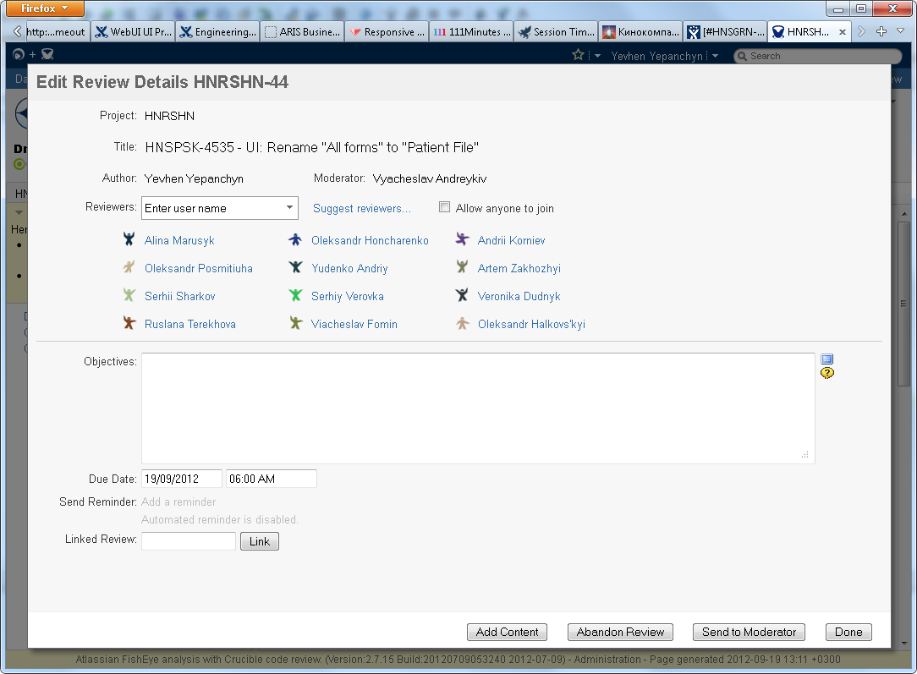
CREATE REVIEW: ADD PARTICIPANTS

Slide 11
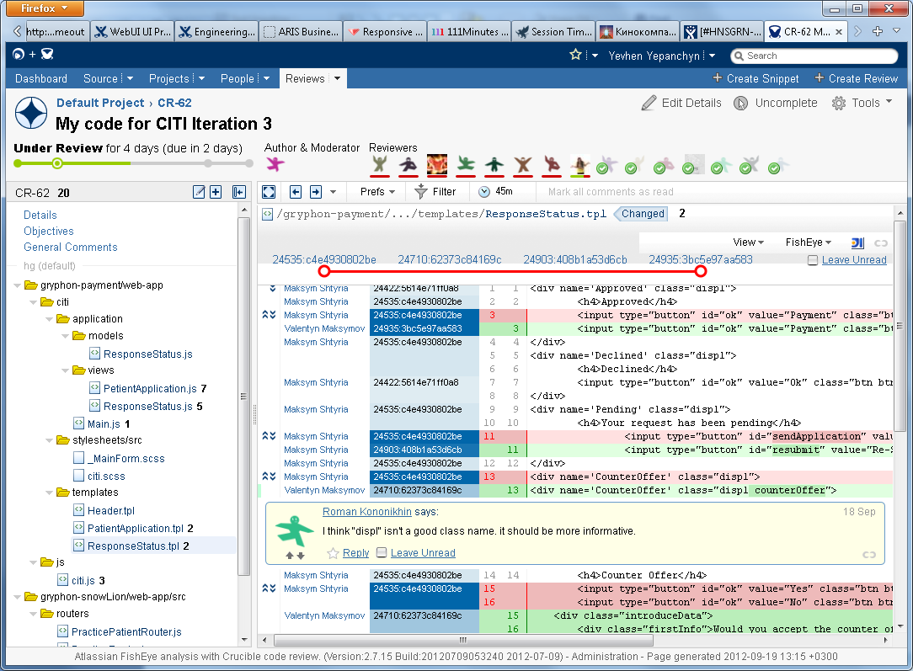
REVIEW PROCESS

Slide 12
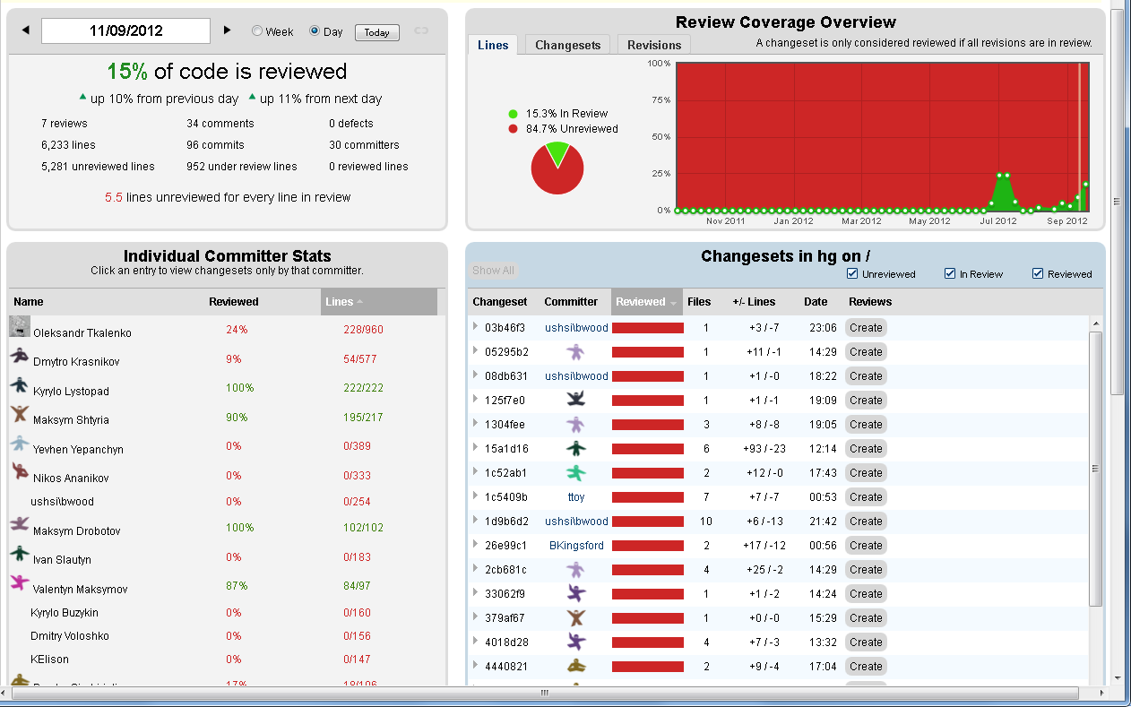
REVIEW COVERAGE STATISTICS

Slide 13
SOFTSERVE CRUCIBLE
test-server: vmsfisheye.softserveinc.com
stage-server: vmsfisheye2.softserveinc.com

Slide 14
QUESTIONS?

Slide 15
THANK YOU

