Slide 1



Create web app with AngularJS, Grails and MongoDB in 1 hour!
Yuriy Chulovskyy
yuriy.chulovskyy@gmail.com
friend7_chat

Slide 2

Inspired by

Slide 3

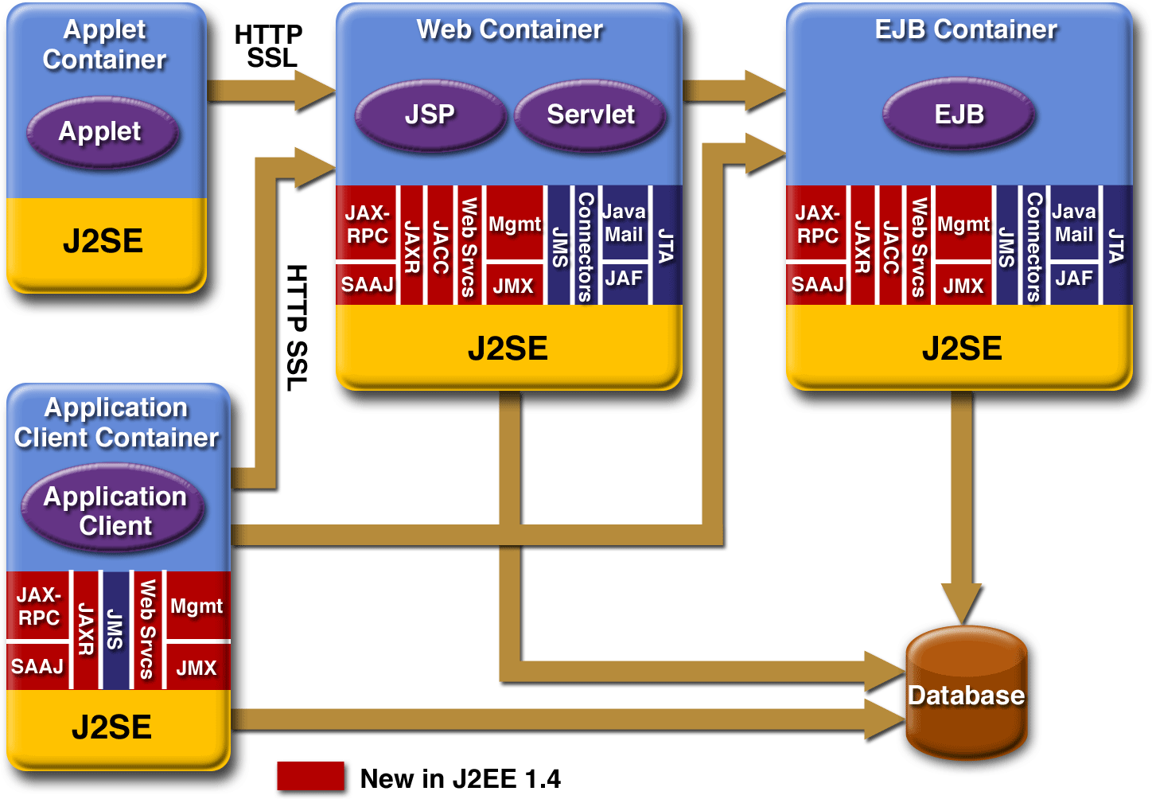
Enterprise architecture

Slide 4

Try something new!

Slide 5
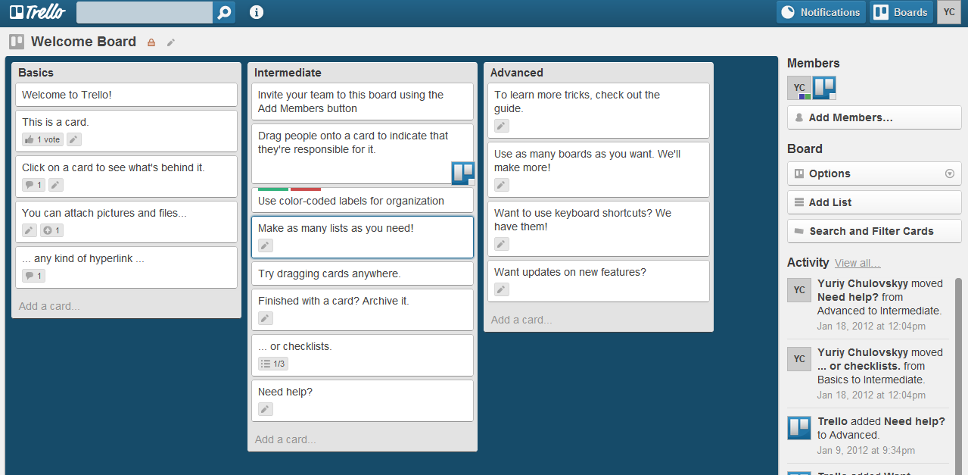
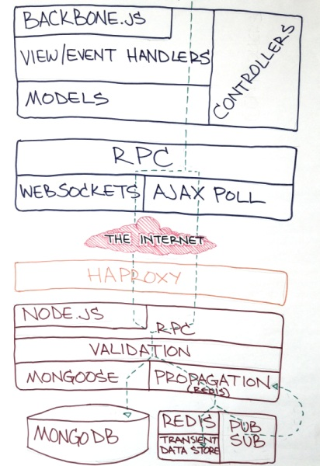

How cool guys do this? (trello.com)

Slide 6

Is it hard? Ask smart people!

Slide 7
Whine –> Result!
Fed up with or afraid of:
DB schema, normalization, joins -> MongoDB
ORM and persistence layer -> MongoDB + JSON
Heavy logic at backend -> REST + Smart UI
Java -> Groovy/Grails
Javascript –> AngularJS
UI design –> Twitter Bootstrap

Slide 8
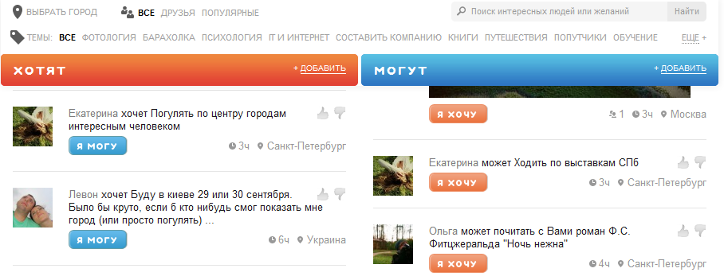
DrugDrugu.ru

Slide 9
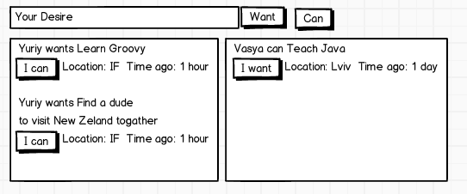
Main page

Slide 10
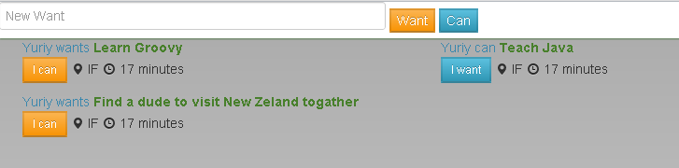
Main page

Slide 11
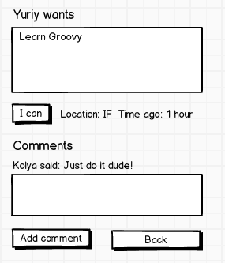
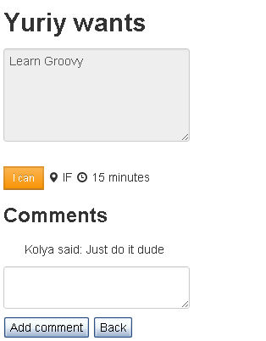
Details page

Slide 12





Links
http://www.mongodb.org/
http://grails.org/
http://angularjs.org/
http://twitter.github.com/bootstrap/
https://github.com/ychulovskyy/desires

Slide 13

Questions?
Thank You!

