Slide 1
Dmytro Tarasenko April 2012
Scalable JavaScript
Applications

Slide 2
Agenda
JavaScript trend
OOP in JavaScript
MVC
Application entities
MVC Example
Layers
Best practices

Slide 3
JS Trend: Languages evolution
OOP
C++, Java, C#, Python
Structured C, Pascal, Algol, Ada
Assemblers
Machine code

Slide 4
JS Trend: JavaScript evolution
Big frameworks
Dojo, ExtJs, jQuery, YUI
Small libraries Backbone, Midori, MochiKit
Self created libraries
DOM, BOM oriented

Slide 5
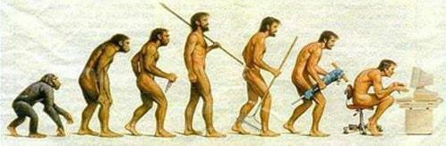
JS Trend: Big applications
Why JS environment has been changing?
Because of big WEB applications

Slide 6
OOP: Abstraction
Single page application
Classes, modules, layers
HTML, CSS, DOM and BOM abstraction

Slide 7
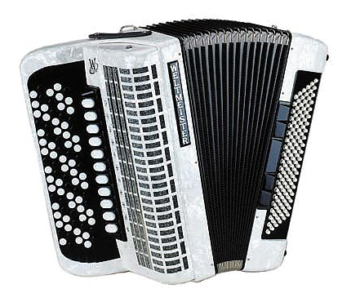
OOP: Classes
name extension constructor configuration mixins requires publics/privates statics
Come
JavaScript Expert

Slide 8
OOP: Class definition
Ext.define('MyClass', {
extend : 'MyBaseClass',
requires: 'MyClass2', method : Ext.emptyFn,
statics : {
prop: 123,
func: Ext.emptyFn
}
});
Come
JavaScript Expert

Slide 9
OOP: Class usage
var mc = Ext.create('MyClass');
mc.methodFromMyBaseClass(); mc.method();
MyClass.func(); // static function
MyClass.prop; // 123
Come
JavaScript Expert

Slide 10

MVC

Slide 11

MVC: Model
Data container;
CRUD operations;
Only data related logic;
Uses alone and in stores;
Controlled by a controller

Slide 12

MVC: View
Data representation
Validations
View logic
Stand alone widgets
Controlled by controller

Slide 13

MVC: Controller

Slide 14
Application entities
App
Reader
Writer
Locale
MVC
Static Data
Store
Utils
Mixins
Config

Slide 15
Application entities: Reader
Converts server data to JSON
Preprocesses data
Decodes data
Used in models and stores
App
Reader
Writer
Locale
MVC
Static Data
Store
Utils
Mixins
Config

Slide 16
Application entities: Writer
Converts data from JSON to server format
Postprocesses data
Encodes data
Used in models and stores
App
Reader
Writer
Locale
MVC
Static Data
Store
Utils
Mixins
Config

Slide 17
Application entities: Locale
English to Russian translation
Loads and stores language database
__(‘String’) method
Used everywhere
App
Reader
Writer
Locale
MVC
Static Data
Store
Utils
Mixins
Config

Slide 18
Application entities: MVC
App
Reader
Writer
Locale
MVC
Static Data
Store
Utils
Mixins
Config
Model View Controller pattern

Slide 19
Application entities: Static Data
App
Reader
Writer
Locale
MVC
Static Data
Store
Utils
Mixins
Config
Splits data and logic
Used in stores, templates, ...

Slide 20
Application entities: Store
Stores array of models
Filterable
Sortable
CRUD operations
Usage: Grids, Lists, Trees, …
App
Reader
Writer
Locale
MVC
Static Data
Store
Utils
Mixins
Config

Slide 21
Application entities: Utils
Shared functions
Shared properties
Shared classes
Constants
Used everywhere
App
Reader
Writer
Locale
MVC
Static Data
Store
Utils
Mixins
Config

Slide 22
Application entities: Mixins
App
Reader
Writer
Locale
MVC
Static Data
Store
Utils
Mixins
Config
Multiple inheritance emulation
Similar to class
Used in other classes

Slide 23
Application entities: Configuration
App
Reader
Writer
Locale
MVC
Static Data
Store
Utils
Mixins
Config
Affects the entire application
Contains shared options
Used in classes

Slide 24
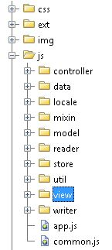
Application entities: File structure

Slide 25
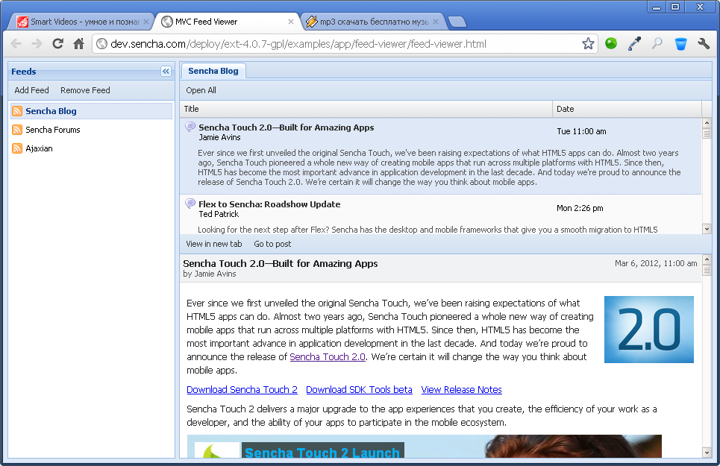
MVC Example

Slide 26
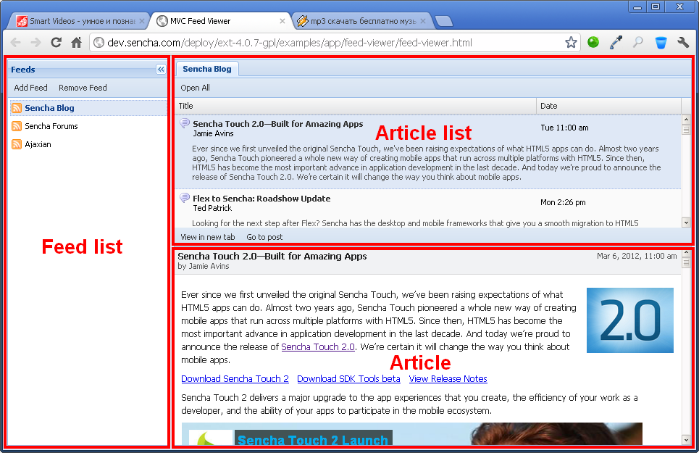
MVC Example

Slide 27
MVC Example: Views
FeedList
ArticleList
ArticlePreview

Slide 28
MVC Example: Controllers
Feed
Article

Slide 29
MVC Example: Models
Feed
Article

Slide 30
MVC Example: Stores
Feed
Article

Slide 31
MVC Example: FeedList view
Ext.define('FV.view.FeedList', {
extend: 'Ext.panel.Panel',
alias : 'widget.feedlist',
initComponent: function() {
this.items = [{
xtype: 'dataview',
store: this.store
}];
this.callParent(arguments);
}
});

Slide 32
MVC Example: Feed controller
Ext.define('FV.controller.Feed', {
extend: 'Ext.app.Controller',
stores: ['FV.store.Article'],
models: ['FV.model.Feed'],
init: function() {
this.control({
'feedlist dataview': {
selectionchange: this.loadFeed
}
});
},
loadFeed: function(selModel, selected) {
var store = this.getArticlesStore();
var feed = selected[0];
store.load({params: {feed: feed.get('url')}});
}
});

Slide 33
MVC Example: Feed model
Ext.define('FV.model.Feed', {
extend: 'Ext.data.Model',
fields: [
{name: 'url', type: 'string'},
{name: 'name', type: 'string'}
]
});

Slide 34
MVC Example: Feed store
Ext.define('FV.store.Feed', { extend: 'Ext.data.Store', model : 'FV.model.Feed', data : [ {name: 'Sencha Blog', url: '…'}, {name: 'Sencha Forums', url: '…'}, {name: 'Ajaxian', url: '…'} ]
});

Slide 35
Layers
Concrete app
(App NS)
Reusable layer
(XXX NS)
Base library
(Ext NS)
Browser
(window NS)

Slide 36
Scalable consists of…
OOP (architecture and design patterns)
Program entities (store, reader, writer,…)
Class loose coupling
Module based architecture

Slide 37
Best practices
Documented code conventions
MVC
Class loose coupling
Code Repository (SVN, Git)
Code review
Every day refactoring
Architect
Project knowledge sharing (dashboard)

Slide 38
Questions
?

