Slide 1
Javascript Application Architecture
by Volodymyr Pavlyuk
April 2012

Slide 2
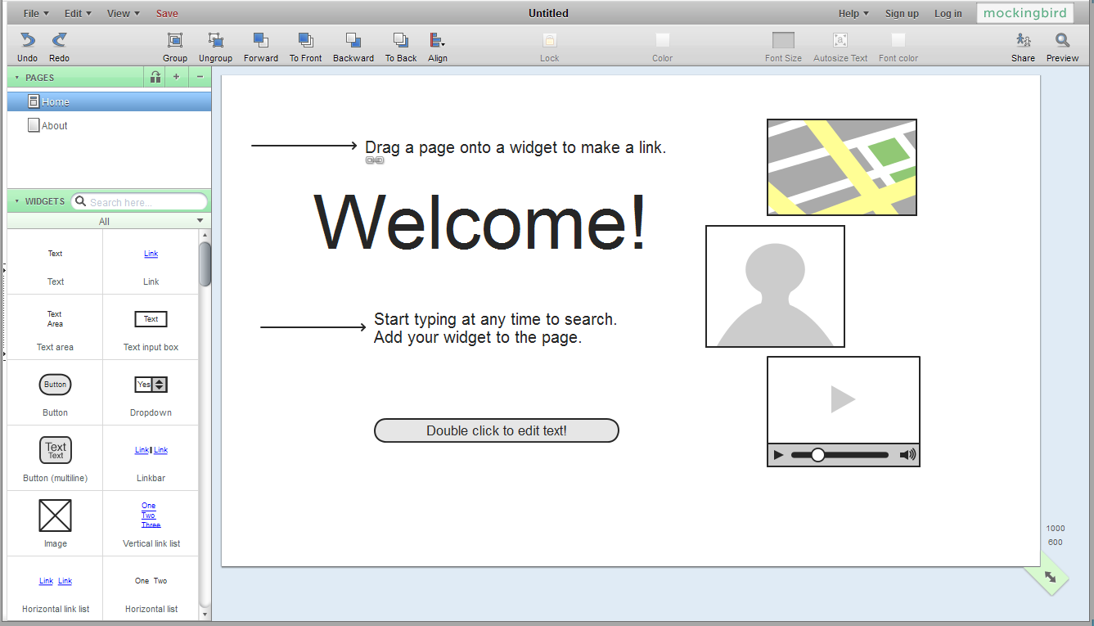
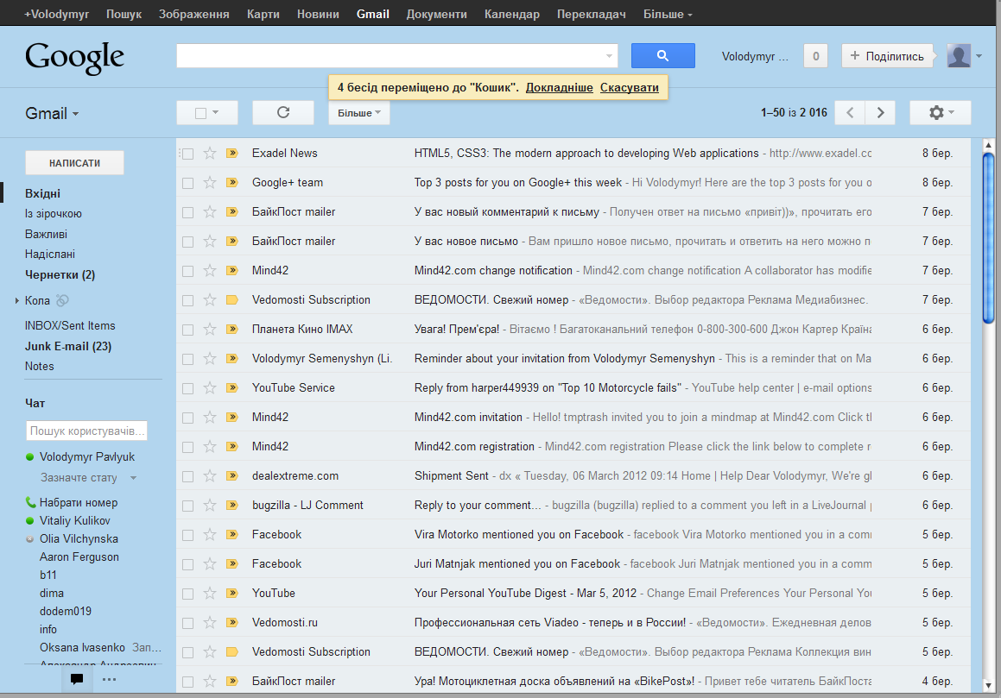
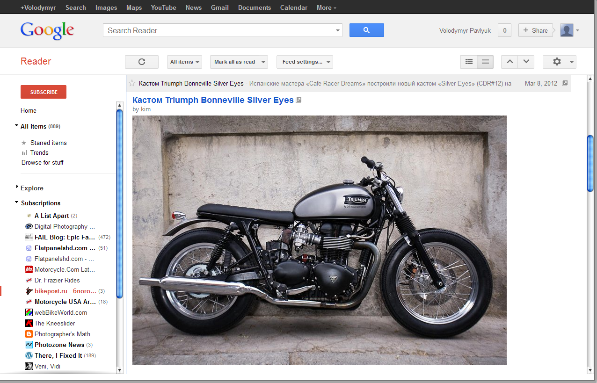
What is Javascript Application?

Slide 3
What is Javascript Application?
― Large scale application (500 classes)
― Single page application
― Background communication with server

Slide 4
What is wrong with JS Applications?
― Browser as application platform
― HTML/CSS/DOM – they just suck
― Javascript is like a kid

Slide 5
Browser as an application platform
― They were not designed for this
― There are a lot of them
― They are different
― They are buggy
― But there is hope – new browsers are getting better

Slide 6
HTML/CSS/DOM
― HTML is just a markup language
― CSS stands for “Crappy Style Sheets”
― DOM implementation is ugly
― HTML5 isn’t a solution

Slide 7
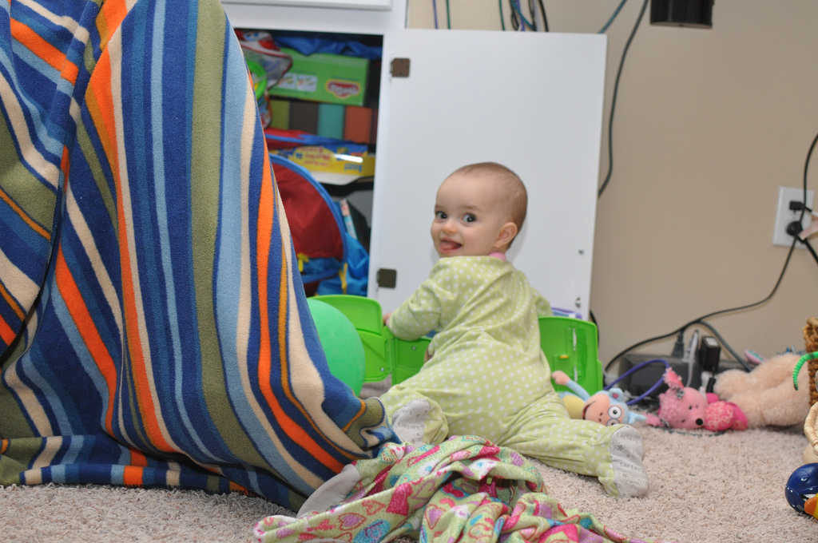
Javascript is like a kid – need to look after it

Slide 8
Javascript isn’t made for this
― No package mechanism
― Everything is in global namespace
― OOP is primitive
― Tooling still sucks

Slide 9
Everybody puts a layer on top
― GWT uses Java-to-Javascript translation
― Cappuchino uses Objective-J
― Everybody else uses (different) meta object systems written in Javascript

Slide 10
Solution?
Yes, Abstraction.

Slide 11
Desktop like web applications need desktop abstractions
DOM Nodes
CSS
Browser Bugs
Widgets
Layout Manager
Themes

Slide 12
HTML/DOM mess
<a href="http://www.javascript-coder.com/" onMouseOver="return changeImage()“ onMouseOut= "return changeImageBack()“ onMouseDown="return handleMDown()"onMouseUp="return handleMUp()">
<img name="jsbutton" src="buyit15.jpg" width="110" height="28" border="0"
alt="javascript button"></a>
<script language="JavaScript">
upImage = new Image();
upImage.src = "buyit15u.jpg";
downImage = new Image();
downImage.src = "buyit15d.jpg"
normalImage = new Image();
normalImage.src = "buyit15.jpg";
function changeImage()
{
document.images["jsbutton"].src= upImage.src;
return true;
}
function changeImageBack()
{
document.images["jsbutton"].src = normalImage.src;
return true;
}
function handleMDown()
{
document.images["jsbutton"].src = downImage.src;
return true;
}
function handleMUp()
{
changeImage();
return true;
}
</script>

Slide 13
Desktop Style Development
var button = new App.widget.Button({
label: ‘Nice Button’,
bgImage: ‘button.png’,
onClick: function(event) {
console.log(this.label +
‘clicked!’);
},
…
});

Slide 14
Isn’t that what Javascript libraries do?

Slide 15
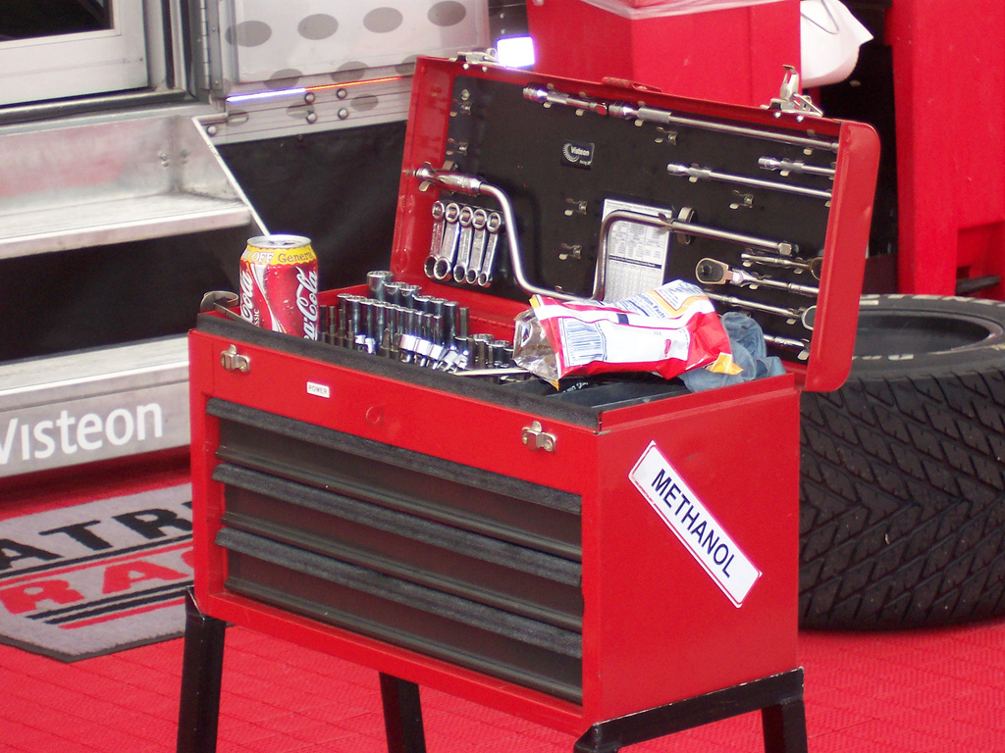
Javascript library is like a toolbox. You can build a lot of things using tools.

Slide 16
Business Logic
Application
Custom Widgets
Framework
Base Widgets
UI Core
(Rendering engine)
Normalizarion Layer
Javascript OOP

Slide 17
Widgets must support:
― Localization and internationalization
― Theming

Slide 18
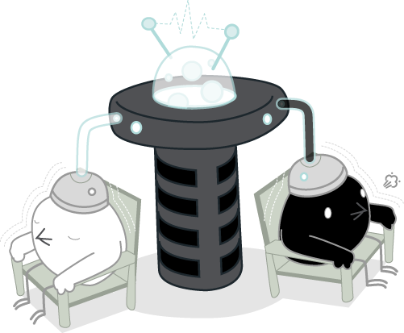
Components must be loosely coupled
This allows you to make changes to one component without affecting others

Slide 19
Loose coupling
var foo = new App.widget.Foo(),
bar = new App.widget.Bar();
…
foo.subscribe('hello', function(e) {
console.log(e.target.name + ' says "Hello!"');
});
bar.dispatch('hello');

Slide 20
Code organizing tips
― One class per file
― Name classes according to purpose
― Namespaces by screen/purpose

Slide 21
Summary
― Good abstractions
― Theming
― Loose coupling
― Internationalization
― Clean code

Slide 22
Finally you may ask question.

