Slide 1
Who is connected? Mobile Backend as a Service!
by Serhii Borysov
7/5/2014

Slide 2
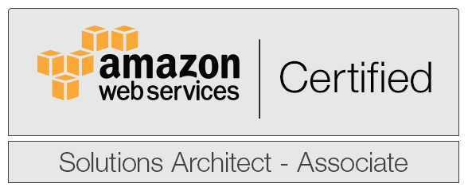
Contacts
Serhii Borysov
sborysov@softserveinc.com
simplyguru.dot@gmail.com
Skype: simplyguru
Twitter: @simplyguru_dot
Cell.: +38-063-3085354
LinkedIn: http://ua.linkedin.com/pub/serhii-dot/6a/832/25/

Slide 3
Agenda
Market Statistics
What is Baas/MBaaS?
MBaaS Features
MBaaS Types
MBaaS comparison Chart
Cloud MBaaS Providers
Opensource MBaaS Providers

Slide 4
Market Statistics
MarketsandMarkets forecasts the global BaaS market to grow from $216.5 million in 2012 to $7.7 billion in 2017
The factors driving the overall market include
Increase in adoption of smart phones, tablets.
Demand for fast time to develop and deploy.
Ability to address security and performance needs and challenges in vendor selection

Slide 5
What is MBaaS (in Short)?
“Turn-on infrastructure” for mobile applications.

Slide 6
What is MBaaS (in long)?
Solutions that provide pre-built, cloud hosted components for developing mobile application backends.
Reduce the time and complexity required to build mobile applications.
Allow developers to focus on core features instead of low-level tasks.

Slide 7
MBaaS Features
DataStore API for storage on cloud
Binary Storage
Device Syncing and Caching
Push Notifications
Online/offline workflow
Integration with Social Networking site (twitter/facebook etc)
Secure Connectivity
Ability to automatic generate REST-based interfaces to read and write data

Slide 8
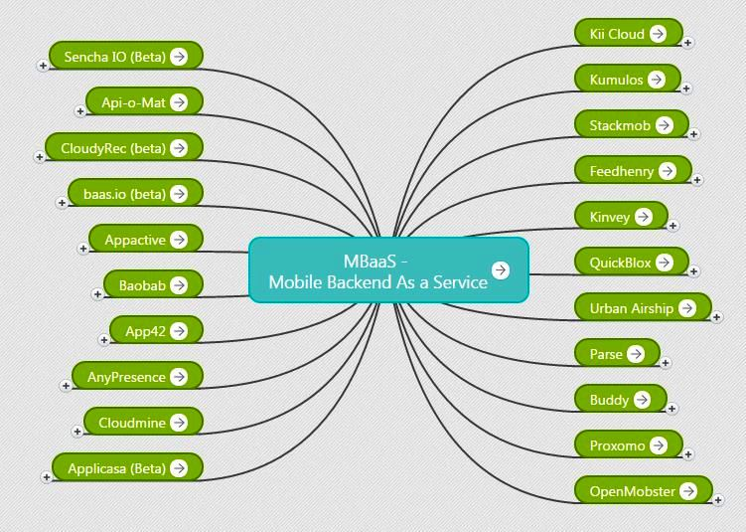
MBaaS Providers
Link

Slide 9
MBaaS Types
Cloud MBaaS
Cloud hosted solution.
Opensource MBaaS
An on-premise offering which is typically Free and Open Source in nature.

Slide 10
Comparison Chart
Feature
Ease of Use
Enterprise Integration
Cloud MBaaS
Yes. This is both from a Getting Started standpoint as well as Deployment standpoint
B2C offerings In majority of the offerings, Enterprise integration is not an option
Opensource MBaaS
No. Depending on the quality of documentation of the project, you can get up and running fairly quickly
B2E offerings Natural fit for Enterprise integration since it will usually come with out-of- the-box integration framework that is technology-agnostic
Pricing Structure
Usage per month based pricing
The software is Free and Open Source for use

Slide 11
Cloud MBaaS providers
Parse [https://www.parse.com/]
StackMob [https://www.stackmob.com/]
Sencha [http://docs.sencha.io/current/index.html/]
Kinvey [http://www.kinvey.com/]
Applicasa [http://www.applicasa.com/]
Anypresence [http://www.anypresence.com/]
Appacitive [http://appacitive.com/]
Cloudmine [https://cloudmine.me/]

Slide 12
Cloud MBaaS providers
Scottyapp [http://scottyapp.com/]
API-O-Mat [http://www.apiomat.com/]
APP42 CloudAPI [http://api.shephertz.com/]
Kii [http://www.kii.com/en/technology/kiicloud]
Kumulos [http://www.kumulos.com/]
Feedhenry [http://www.feedhenry.com/]
API Engine [https://apiengine.io/features]
Appcelerator Cloud http://www.appcelerator.com/cloud/]

Slide 13
Opensource MBaaS providers
OpenMobster [http://www.openmobster.com/l]
LoopBack [http://strongloop.com/strongloop-suite/loopback//l]
OpenKit [http://openkit.io/]
BaasBox [http://www.baasbox.com/]
Helios [http://helios.io/]

Slide 14
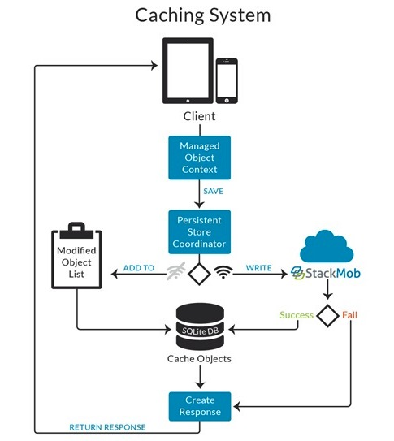
StackMob
Notes:
https://developer.stackmob.com/ios-sdk/offline-sync-guide

Slide 15
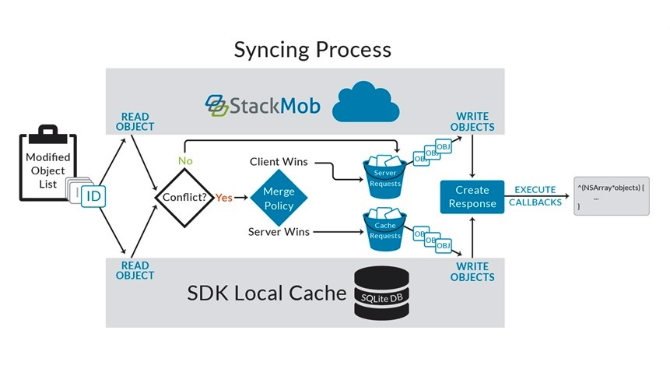
Stackmob syncing process
Notes:
(How it syncs, it checks after 300 seconds if the connection gets live then it send the offline data to the server and when the data get saved to the server then it notifies). It doesn't notify when the object is saved when it is offline and it also keeps the data only in-memory.

Slide 16
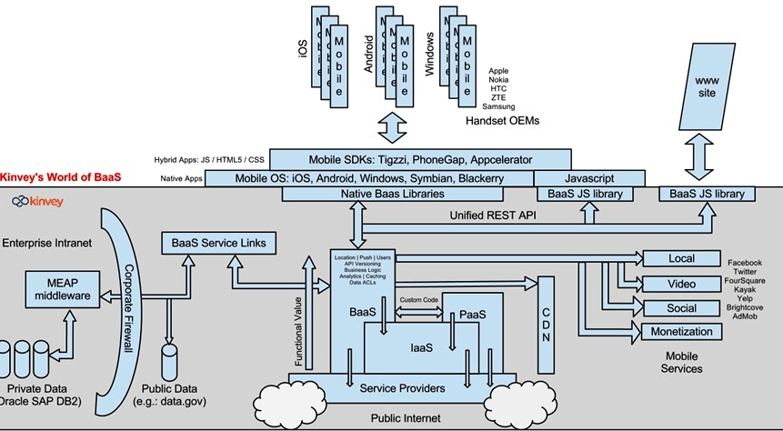
Kinvey

Slide 17
Features Comparison
Features | StackMob | parse | feedhenry | kinvey | LoopBack | Openmobster
Datastore API | x | x | x | x | x | x
Binary storage | x | x | x | x
Push API | x | x | x | x | x | x
Offline/caching | x |  | x | x |  | x
Offline/caching for PhoneGap |  |  |  | x
Geolocation | x | x | x | x | x
Social integration | x | x |  | x
Analytics | x |  | ? | x
Authentication Access control |  | x | ? | x | x

Slide 18
Possible future Types of MBaaS Stack
OpenSource MBaaS
Cloud MBaaS
Closed Source MBaaS
Home Grown

Slide 19
Which one to Choose?
There is no single right answer.
It depends on the project requirement.
Make yourself aware of the costs you will incur in using the service.
Take close look at the documentation.
Parse is relatively easy to get started but stackmob has rich set of API.

Slide 20
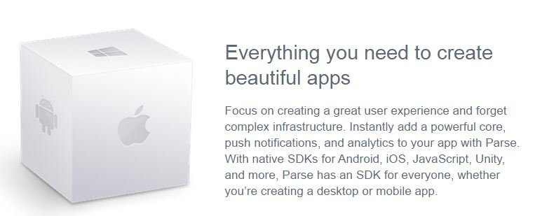
parse.com

Slide 21
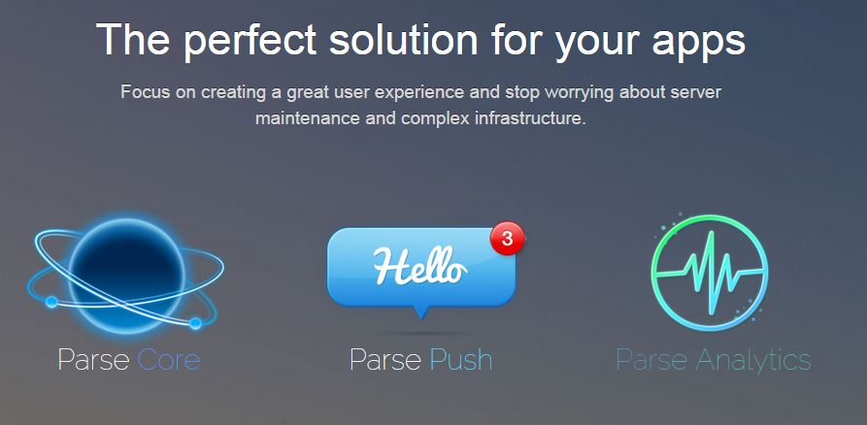
parse.com

Slide 22
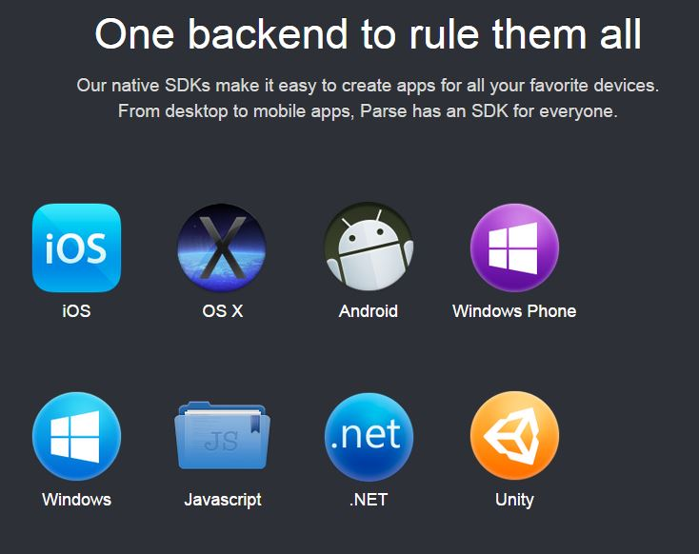
parse.com

Slide 23
Thank You

