Slide 1
Efficient NLP
Filip Mieszkowski ⏺ Stanisław Kurzątkowski

Slide 2
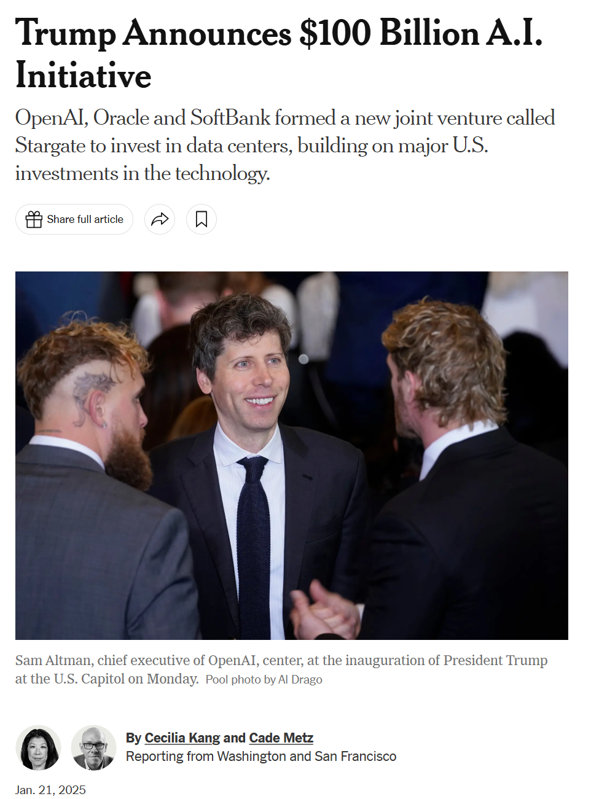


Slide 3
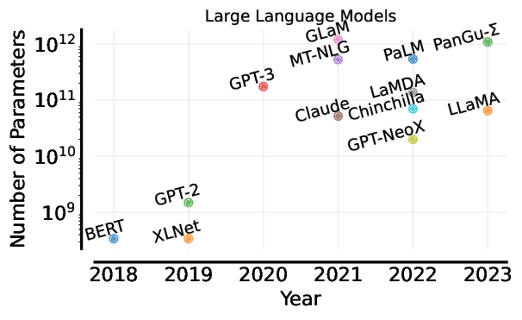

Slide 4
Quality over Quantity
Quality of the data
Design of the model
Training process
Inference
Hardware utilization

Slide 5
Main factors influencing the cost
Cost(R) ~ E × D × H
R - NLP model with a satisfactory performance, the result
E - cost of a single execution (complexity, size)
D - dataset size (gathering data, memory, processing)
H - number of training runs to tune hyperparameters

Slide 6
Quality of the data
Filtering
removing duplicates
removing irrelevant data
Active learning
model selects the most difficult examples
Curriculum learning
general, easy examples first
hard, specialized examples later

Slide 7
Model Design
What parts of the model's architecture are the bottlenecks for efficiency?

Slide 8
Model Design
What part of the model's architecture is the bottleneck for efficiency?
Attention Mechanism
Creates a contextualized representation of the input (scales with length)
Extracting the relations between words (not only stand-alone meaning)

Slide 9
Model Design
How to modify the attention?
Sparse Attention (token importance computed for fixed-size windows, local context)
Global context only for predefined tokens like “newline” or “tabulation”

Slide 10
Model Design
What else can be considered as a bottleneck for efficiency?
Generation
Large models perform more computations
No matter the input, the entire model will be invoked

Slide 11
Model Design
How to speed this up?
Mixture-of-Experts (MoE, collection of expert-networks and gating mechanism)
Retrieval-Augmented-Generation (RAG, trade-off between decreasing the size of the model and increasing the size of the database)

Slide 12
Pre-training
RTD - Random Token Detection
ELECTRA model
as opposed to MLM (Masked Language Modeling)
The most expensive process of training the model
The cat sits on the table and looks out the window.
➡The cat sits on the dog and looks out the window.
➡The cat sits on the [MASK] and looks out the window.

Slide 13
Fine-tuning to a downstream task
Parameter-efficient methods
fine-tuning just few parameters
fine-tuning under 1% of parameters can be enough
Adding adapters (transfer learning)
much faster
worse performance

Slide 14
Inference
We end up with a trained model.
Can we push the efficiency even further?

Slide 15
Inference
Knowledge Distillation
Teacher-Student framework (student learns on the distribution of “soft-labels” generated by the teacher, instead of hard data)
Loss function = Hard Loss (hard data labels)+ Soft Loss (teacher labels)
Results in much smaller student model which retains most of the teacher accuracy

Slide 16
Inference
Pruning
Removes model’s components
Structured: layers
Unstructured: weights

Slide 17
Inference
Adaptive Computation
Mixture-of-experts (already discussed)
Early Exit Confidence (whenever a sufficient threshold of confidence for the prediction is met, stop computation)

Slide 18
Hardware utilization
parallelization and use of GPU
joint design of hardware, software and compiler

Slide 19
Quiz

Slide 20
President Trump announced a joint venture, called [MASK] between OpenAI, SoftBank and Oracle to create at least $100 billion in computing infrastructure to power artificial intelligence.
President Trump announced a joint venture, called Stargate, between OpenAI, SoftBank and Oracle to create at least $100 billion in computing infrastructure to power artificial intelligence.

Slide 21
[MASK] learning is a training strategy where a model is first exposed to easier, simpler tasks and gradually progresses to more complex ones, mimicking how humans learn.
Curriculum learning is a training strategy where a model is first exposed to easier, simpler tasks and gradually progresses to more complex ones, mimicking how humans learn.

Slide 22
In natural language processing, [MASK] refers to identifying tokens in a sequence that have been randomly inserted.
In natural language processing, random token detection refers to identifying tokens in a sequence that have been randomly inserted.

Slide 23
The cost of obtaining a particular result is proportional to what quantities?
Cost(R) ~ E × D × H
R - NLP model with a satisfactory performance, the result
E - cost of a single execution (complexity, size)
D - dataset size (gathering data, memory, processing)
H - number of training runs to tune hyperparameters

Slide 24
Which efficiency solution (implemented by several project teams in this course :0 ) offers a trade-off between the sizes of the model and external database?
Retrieval-Augmented-Generation (RAG, trade-off between decreasing the size of the model and increasing the size of the database)

Slide 25
Which solution relies on local context of the input?
Sparse Attention (token importance computed for fixed-size windows, local context)

Slide 26
https://www.nytimes.com/2025/01/21/technology/trump-openai-stargate-artificial-intelligence.html
https://www.reuters.com/technology/artificial-intelligence/trump-announce-private-sector-ai-infrastructure-investment-cbs-reports-2025-01-21/
Efficient Methods for Natural Language Processing: A Survey, Marcos Treviso, Ji-Ung Lee, Tianchu Ji, Betty van Aken, Qingqing Cao, Manuel R. Ciosici, Michael Hassid, Kenneth Heafield, Sara Hooker, Colin Raffel, Pedro H. Martins, André F. T. Martins, Jessica Zosa Forde, Peter Milder, Edwin Simpson, Noam Slonim, Jesse Dodge, Emma Strubell, Niranjan Balasubramanian, Leon Derczynski, Iryna Gurevych, Roy Schwartz

Slide 27
Thank you!
Filip Mieszkowski Stanisław Kurzątkowski

