Slide 1
Chapter 15

Slide 2
PROTECTION
SEPERATION:
The basis of protection is separation:
Physical – Where different processes use different physical objects. In fact, it used to be that only certain software could run on certain hardware. The two combined to form very secure systems. But, due to a lawsuit (claiming a monopoly) this is no longer the case. Most modern OS’s only provide 1 level of separation between the software and hardware.
Temporal – Where different processes with different security concerns are executed at different times.
Logical - Where different processes are constrained such that it appears that no other process(s) are executing at the same time.
Cryptographic - Where different processes conceal their data and operations such that they are unintelligible to other processes.
The problem is that we occasionally to want/need to share resources.

Slide 3
PROTECTION
MEMORY PROTECTION:
A “fence” limits a program’s access to a range of memory (to one side of the “fence”). This can be implemented in a variety of ways. But this approach limits the number of processes that can run to 2 (OS and user’s program).
“Base/bounds registers” specify both a lower limit (base) and an upper limit (bound) to the memory available to a program. This method supports multi-programing, but does not work well with paged memory.
The “tagged architecture” adds a few bits to every word in memory indicating the access rights (e.g. read, write, execute).
Segmentation can also be used to protect the memory.
Paging actually makes protection harder as we arbitrarily divide the memory space into equal sized chunks making it impossible to know if areas of memory requiring different levels of protection are co-located in the same page.
Paging & segmentation.

Slide 4
PROTECTION
AUTHENTICATION:
User authentication can be done with passwords or by some physical means (biometrics).
Username / Password − User need to enter a registered username and password with Operating system to login into the system.
User card/key − User need to punch card in card slot, or enter key generated by key generator in option provided by operating system to login into the system.
User attribute - fingerprint/ eye retina pattern/ signature − User need to pass his/her attribute via designated input device used by operating system to login into the system.

Slide 5
PROTECTION
PASSWORDS:
vulnerable, can be stolen or guessed.
It is common practice that words not be allowed, that all one case not be allowed, and that some numbers be required. However, a 1979 study found:
0.5% were single ASCII characters
2% were 2 ASCII characters
14% were 3 ASCII characters
14% were 4 letters
21% were 5 letters(same case)
18% were 6 lower case letters
15% were dictionary words or names
A 2002 study found:
50% family member names
23% children’s names
19% spouse/partner name
9% their name
8% pets name
9% athletes names
9% celebrities names

Slide 6
PROTECTION
PASSWORDS :
It is also common that a password have a limited lifetime before the user is forced to select a new one. The intent is to eventually lock out a user who has already broken into an account. However:
Forcing a user to remember new passwords increases the likely hood that they will write the password down. Making it possible to steal the password.
Your password, and the attacker’s guess, are independent. The probability that the attacker’s next guess is correct is the same even if you change your password first.
It annoys users.
They end up having to work out a new password – which research shows is often is derived from the previous one in a way that is very easy to crack nearly half the time.
Additional support costs to cover users who have forgotten their password.

Slide 7
PROTECTION
PASSWORDS:
Encrypted passwords allow the password file to be readable by all. However, anyone with the encryption algorithm can, given enough time, break the codes.
To prevent network “sniffers” from acquiring valid passwords, shadow passwords may be used.
Salting – To prevent no two users from having the same password, We use a technique called "salting," which ensures that no two password hashes (the scrambled form in which passwords are stored) are ever the same, even if people key in the same password.
One time passwords – The user gets a book containing a list of passwords. Each time they log in they have to use the next password in the list.
See: http://xkcd.com/936/

Slide 8
PROTECTION
AUTHENTICATION:
Challenge respond – The user selects an algorithm (for example: x^2). Each time they log in they have to correctly solve the problem (so the computer would prompt with a “7” and the user would respond with “49”). Another variation on this would require the user to answer questions about themselves.
Limiting logins to certain days and times, allowing logins from specific terminals, and by setting up the modem pool to only allow connections that are made by the modem calling back the would be connector.
Increase the time it takes to verify an account name and password every time an invalid name or password is entered.
Lay traps. Fictitious account names with easy to guess passwords. Whenever someone logs in with this account, the security people are immediately notified.
Design a computer system with enough backup capability (storage and processing) to survive any intrusion.

Slide 9
PROTECTION
THREAT MONITORING:
Recording all logins can be used to log any possible security breeches. This is called auditing.
It is also possible to randomly check (audit) the system when the system load is low.
Use of a surveillance program is also possible. With these programs requests from users for OS services are first processed by the surveillance program. Sometimes, it is necessary to give the surveillance program greater access rights than the user, this is called amplification.

Slide 10
PROTECTION
  ACCESS CONTROL:
  A computer system is a collection of objects and processes. Objects are the hardware components and processes are the programs running. Processes interact with objects.
  A domain may be defined as individual users, individual processes, or individual procedures/functions/subroutines/threads. A given domain will have specific access privileges for each of the objects (in a computer system). All processes operate within a specific domain.
  Domains do not need to be, and frequently are not, disjoint (objects can be shared).
  Domain access privileges can be static or dynamic.
  Access privileges can be shared among domains, can be passed to other domains, and can be revoked (from a domain).

Slide 11
PROTECTION
  ACCESS CONTROL:
  The are several complimentary goals in protecting objects:
  We must check permissions on every access.
  A program should only have access to the objects necessary to accomplish the task.
  We should verify acceptable usage for each object.

Slide 12
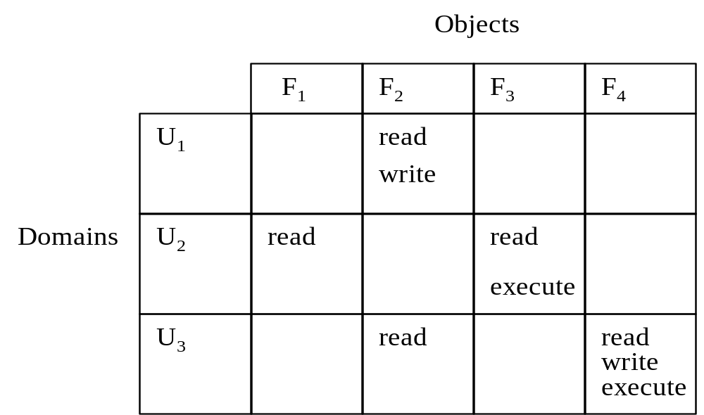
PROTECTION
  ACCESS MATRIX:
  A simple way to “view” the domain/object model of protection is with a matrix.
  Example. Let F_{i} represent objects (i.e. files - data or executable) and U_{i} represent domains (i.e. – users). The access matrix representing the read/write/execute permissions would look like:

Slide 13
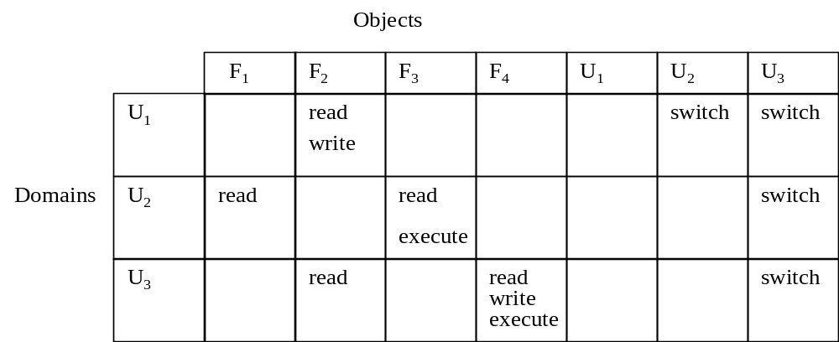
PROTECTION
  ACCESS MATRIX:
  To allow processes to switch from 1 domain to another, we can extend the access matrix to include/represent domains as objects and include a new permission call “switch”. Our access matrix would now look like:
  So, for example, U₁ could have the same access privileges as U₂ and U₃ by switching to those domains. NOTE: U₁ will not have U₁, U₂, and U₃ access privileges at the same time, but can switch between them.

Slide 14
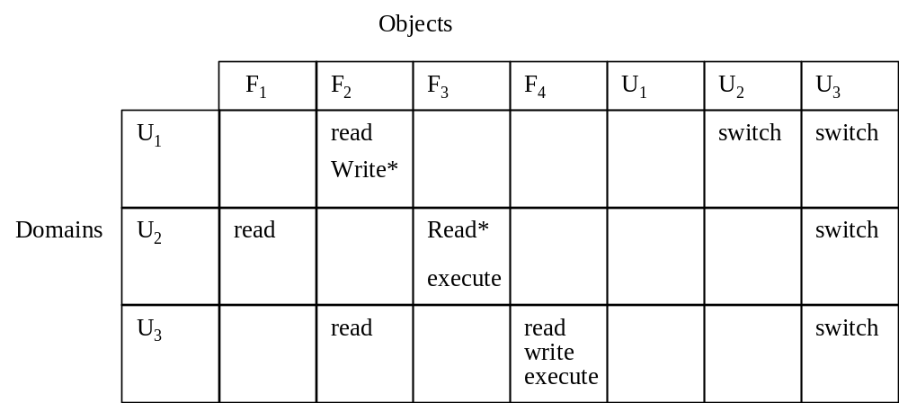
PROTECTION
  ACCESS MATRIX:
  To allow processes to grant other processes access rights to held objects, we can extend the access matrix to include the access rights that allow that right to be copied. Our access matrix would now look like:
So, for example, U₁ can grant any other user the ability to write file F₂. U₂ can grant any other user the ability to read file F₃

Slide 15
PROTECTION
  ACCESS MATRIX:
However, we have some additional considerations:
  If/when U₁ grants some other user write permission on F₂, does U₁ loose its write permission? If so we would have an access right transfer – not a copy.
  If/when U₁ grants some other user write permission on F₂, does this “other user” also have the ability to grant yet another user write permission for F₂? If so, we would have a propagation of access rights.
To allow processes to arbitrarily grant other processes access rights and to arbitrarily remove access rights (both to held objects), we can extend the access matrix to include the “owner” right. I.e. If you are the owner of a file, you can give anyone/everyone read permission.
To allow processes to arbitrarily modify other processes access rights, we can extend the access matrix to include the “control” right. I.e. U₁ could have permission to change U₂ to a read only type of user.

Slide 16
PROTECTION
  ACCESS MATRIX:
To implement the access matrix we need to consider 2 characteristics:
The size of the data structure.
We will need to search the data structure frequently – every time we attempt to access an object.
We also need to remember that for any method, the data structure would be kept in protected memory.

Slide 17
PROTECTION
  ACCESS MATRIX:
Global table – Use a table consisting of a set of ordered triples <domain, object, rights>. Easy, but the table would probably be large and sparse; this would be a waste of space and time.
Access list for objects – Combine each column into a linked-list of <domain, rights> ordered pairs. We could also produce a separate linked-list of all default permissions. Access lists correspond well to the needs of the users. Access lists also correspond well to the dynamic allotment of privileges.
Capability list for domains – Combine each row into a linked-list of <object, rights> ordered pairs. Capability lists correspond well to the needs of the processes. Capability lists do not correspond well to the dynamic allotment of privileges.
A lock-key – Use a table of bit patterns for each access right for each object. Each permission combination has a unique set of bit patterns. Each domain also has a unique set of bit patterns. A domain has access to an object only if the bit patterns match. Since the table only logs the objects, it would not be very large.
Comparison – We use a combination of access lists and capability lists.

Slide 18
PROTECTION
LANGUAGE PROTECTION:
An idea in its infancy. Or is it?
Why couldn’t the ideas of protection be incorporated into programs? Why couldn’t a “complete full-blown” program provide a given user with a limited set of the program’s capabilities based on the user’s licensing “level?” Whenever a user upgrades their licensing level, they would be given a new product code, which would “provide” them with additional access privileges.

Slide 19
PROTECTION
ENCRYPTION:
Encryption algorithms are not only useful for securing computer systems they are also very valuable for e-commerce.
ENCRYPTION CASE STUDY:
In 1972, the National Bureau of Standards (NIST now) issued the first request for an encryption algorithm. IBM submitted DES (Data Encryption Standard), which was the most commonly used method. However, DES used a 56 bit key and is rumored to have a NSA inspired “back-door”. Variations have appeared, but most have been too slow for real use.
In 1997, NIST announced the AES (Advanced Encryption Standard) program. 15 submissions were made. Now it is up to the contributors to attack each other’s methods while defending their own (changes to the algorithms are not allowed during this “slug-fest”).

Slide 20
PROTECTION
ENCRYPTION CASE STUDY:
On June 8, 1998, the associate attorney general denied that it was possible for the FBI (or anyone else) to crack the existing DES. The claim was that it took the FBI 4 months and 14000 Pentium II computers to crack a single encrypted message.
On July 17, 1998, the Electronic Frontier Foundation (EFF) announced that it had built a special purpose DES cracker chip (cost $220,000). The chip can crack any DES key in about 4.5 days. The chip not only does not use any new or unique design techniques, but can also be chained together with another chip to double the performance.
Using the latest design methods (of the time), it was expected that the chip’s performance could be improved by 5x.

Slide 21
PROTECTION
  ENCRYPTION CASE STUDY:
  “Slug-fest” candidates:
  CAST-256 – One of a family of ciphers. None had been broken. However, slow and a memory pig.
  LOKI-97 – Quickly broken.
  FROG – Quickly broken.
  MARS – IBM’s entry. Looked like a kitchen sink concoction, but it was fast.
  MAGENTA – Quickly broken.
  RC6 – RSA’s entry. Slow on some machines and memory hungry.
  DECORRELATED FAST CIPHER (DFC) – Very slow (requires 64 bit multiplies), but uses some very new ideas. A future approach?
  SERPENT – Not the fastest submission, but works well and with little memory.
  E2 - Not the fastest submission, but worked well and with little memory.
  RIJNDAEL - Not the fastest submission, but works well and with little memory.
  DEAL – A variation on a 128 bit DES method.
  HASTY PUDDING CIPHER (HPC) – A bizarre approach.
  CRYPTON – The author of this method violated the rules and was rejected.
  TWOFISH – Covered in Dec. 1998 Dr. Dobb’s Journal.
  SAFER+ - Very slow (designed to run of 8-bit machines).

Slide 22
PROTECTION
FUTILITY OF IT ALL:
It is possible to formally prove that the objects and processes in an operating system are protected from one another.
But, what does this really mean?
Not a damn thing!
There are always ways to “cheat” or to (intentionally) leak information between processes. In fact, it is all relatively straightforward! (Lampson 1973).

Slide 23
PROTECTION
FUTILITY OF IT ALL:
Assume we have 2 processes. The first process wants some work done by the second process. However, the first and second process to not trust each other. The first process is worried that the second process will record information about the first process.
  For example the first process may be someone who needs their tax forms filled out and who is trying to hide money. So the first process does not want this data to be made public. The second process is an accountant who is concerned that the first process will try to steal his tax materials.
  Now assume that we have a third process, which is collaborating with the second process.
Using a protection matrix, we can easily design a system that prevents any data from being passed from the second process to the third process (confinement). And, that still allows data to be passed from the first to the second process.

Slide 24
PROTECTION
FUTILITY OF IT ALL:
Unfortunately, covert communication channels are always possible that will provide for information to be leaked between two or more collaborating processes. For example, process 2 can “broadcast” bit streams to other processes using the following:
  Going to sleep for a fixed amount of time indicates a zero. While processing (using a for loop to guarantee no I/O interrupts) for a fixed amount of time indicates a 1. Process 3, by carefully monitoring its own response time, can detect/determine which bit it should assume.
  Process 2 can always “broadcast” bit streams to other processes by simply doing something that degrades system performance. Assuming that the system has a clock and that the collaborating process knows what to look for.
  Process 2 can “broadcast” bit streams to other processes by locking and unlocking resources. We could easily implement a semaphore using file locking. The same idea could be used to pass information.
Covert channels are obviously noisy. However, error correcting code (Hamming codes) can also be employed to correct errors on the covert channel.

Slide 25
PROTECTION
FUTILITY OF IT ALL:
On Covert Acoustical Mesh Networks in Air
Abstract—Covert channels can be used to circumvent system and network policies by establishing communications that have not been considered in the design of the computing system. We construct a covert channel between different computing systems that utilizes audio modulation/demodulation to exchange data between the computing systems over the air medium. The underlying network stack is based on a communication system that was originally designed for robust underwater communication. We adapt the communication system to implement covert and stealthy communications by utilizing the near ultrasonic frequency range. We further demonstrate how the scenario of covert acoustical communication over the air medium can be extended to multi-hop communications and even to wireless mesh networks.
Michael Hanspach and Michael Goetz, “On Covert Acoustical Mesh Networks in Air”, journal of Communications Vol. 8, No. 11, November 2013. http://www.jocm.us/uploadfile/2013/1125/20131125103803901.pdf

Slide 26
PROTECTION
FUTILITY OF IT ALL:
Bridgeware: The Air-Gap Malware
Air-gapped networks have no physical or logical connection to public networks (such as, the Internet).
Despite the physical isolation and lack of external connectivity, attackers have successfully compromised such networks in the past.
Covert channels include: Acoustic (speaker, fans, HDD actuator arm), EM (video card, video cable, CPU-RAM bus, GPIO, CPU, USB bus), thermal (CPU/GPU, HVAC, CPU).
Mordechai Guri and Yuval Elovici, “Bridgeware: The Air-Gap Malware,”
Communications of the ACM Vol. 61, No. 4, 2018. https://cacm.acm.org/magazines/2018/4/226377-bridgeware/fulltext

Slide 27
PROTECTION
SECURITY DEFENSES:
Security Policy - A security policy should be thought-out, agreed upon, and contained in a living document that everyone adheres to and is updated as needed. Contents include how often port scans are run, password requirements, virus detectors, etc.
Vulnerability Assessment – Periodically examine the system to detect vulnerabilities such as:
Port scanning.
Bad passwords.
SUID programs.
Unauthorized programs in system directories.
Incorrect permission bits set.
Program checksums / digital signatures which have changed.
Unexpected or hidden network daemons.
New entries in startup scripts, shutdown scripts, cron tables, or other system scripts or configuration files.
New unauthorized accounts.

Slide 28
PROTECTION
SECURITY DEFENSES:
Intrusion Detection - Intrusion detection attempts to detect attacks, both successful and unsuccessful attempts. Things to note:
The time that detection occurs.
The types of information examined to detect the attack(s). Some attacks can only be detected by analyzing multiple sources of information.
The response to the attack. Which may include diverting the attacker to a honeypot, on a honeynet. Honeypots are normally kept on a honeynet protected by a reverse firewall, which will let potential attackers in to the honeypot, but will not allow any outgoing. Honeypots are closely watched, and any suspicious activity carefully logged and investigated.
Intrusion Detection Systems, IDSs, raise the alarm when they detect an intrusion. Two major types are:
Signature-Based Detection scans network packets, system files, etc. looking for recognizable characteristics of known attacks.
Anomaly Detection looks for "unusual" patterns of traffic or operation, such as unusually heavy load or an unusual number of logins late at night.

Slide 29
PROTECTION
SECURITY DEFENSES:
Virus Protection - Modern anti-virus programs are basically signature-based detection systems, which also have the ability (in some cases) of disinfecting the affected files and returning them back to their original condition.
Some antivirus programs look for anomalies, such as an executable program being opened for writing (other than by a compiler).
Avoiding bootleg, free, and shared software can help reduce the chance of catching a virus, but even shrink-wrapped official software has on occasion been infected.
Some virus detectors will run suspicious programs in a sandbox, an isolated and secure area of the system which mimics the real system.
Tip: Rich Text Format, RTF, files cannot carry macros, and hence cannot carry Word macro viruses.
Known safe programs can be digitally signed, and periodically the files can be re-verified against the stored digital signatures. (Which should be kept secure, such as on off-line write-only medium.)

Slide 30
PROTECTION
SECURITY DEFENSES:
Auditing, Accounting, and Logging - These records can also be used to detect anomalous behavior. Some of the kinds of things that can be logged include authentication failures and successes, logins, running of suid or sgid programs, network accesses, system calls, etc. In extreme cases almost every keystroke can be logged for future analysis.
Tripwire Filesystem – This filesystem monitors files and directories for changes, on the assumption that most intrusions eventually result in some sort of undesired or unexpected file changes.
When first run, the selected properties for all monitored files are recorded in a database. Hash codes are used to monitor file contents for changes.
Subsequent runs report any changes to the recorded data, including hash code changes, and any newly created or missing files in the monitored directories.
For full security it is necessary to also protect the tripwire system itself.
Free and commercial versions are available at http://tripwire.org and http://tripwire.com.

Slide 31
PROTECTION
SECURITY DEFENSES:
Firewalls - Sit on the border between two security domains and monitor/log activity between them, sometimes restricting the traffic that can pass between them based on certain criteria. Firewalls themselves need to be resistant to attacks, and unfortunately have several vulnerabilities:
Tunneling, which involves encapsulating forbidden traffic inside of packets that are allowed.
Denial of service attacks targeted at the firewall itself.
Spoofing, in which an unauthorized host sends packets to the firewall with the return address of an authorized host.
In addition to the common firewalls, there are also some specialized forms of firewalls that have been recently developed:
Personal firewall
Application proxy firewall
XML firewalls
System call firewalls

Slide 32
