Slide 1
Chapter 17

Slide 2
DISTRIBUTED SYSTEMS
In many of today’s computational tasks a single processor machine simply cannot produce timely results. Fortunately, many of today’s computational tasks can be broken down into many smaller tasks that can each be computed independent of the others. This is the new domain for supercomputing – many parallel processors working together to complete the task.
According to the National Science Foundation (NSF) this was the new domain (3rd) of scientific endeavor (theoretical → experimental → computational) and is referred to as scientific computing or computational science. The foundation of which is parallel processing…
According to the National Science Foundation (NSF) the new domain (4rd) of scientific endeavor (theoretical → experimental → computational->Big Data) and is referred to as Big Data. The foundation of which is, again, parallel processing (and AI)…

Slide 3
DISTRIBUTED SYSTEMS
CENTRALIZED COMPUTING:
  Centralized computers – Where a few computers (mainframes) are all co-located.
  Centralized processing – Where all of the processing is done on the centralized computers.
  Centralized data – Where all of the data resides on the centralized computers.
DISTRIBUTED COMPUTING:
  Distributed computers – Where the computers (minicomputers / microcomputers) are at dispersed locations and connected via a network.
  Distributed processing – Where the processing spread over the distributed computers.
  Distributed data – Where the data is spread over the distributed computers.
There are many advantages of the “centralized” scheme. Cost tends to be reduced (economies of scale, fewer system administrators required, etc). Hence, this was a very popular scheme for many years. Then workstations became powerful and much cheaper (to buy, and maintain) and distributed schemes became popular.

Slide 4
DISTRIBUTED SYSTEMS
CLIENT-SERVER:
A very popular architecture is the client-server.
  Server – Usually a database system.
  Client – Usually a microcomputer that can access the server over a network and via some middleware.
  Middleware – The software that eases the client/server connectivity (i.e. ftp is NOT middleware). WEB-based applications could be considered middleware.

Slide 5
DISTRIBUTED SYSTEMS
CLIENT-SERVER:
Classes of client/server systems:
  Host-based processing – The client is essentially a dumb terminal and all of the processing is done by the server.
  Server-based processing – The client only provides the GUI (aka thin client). All of the data processing is done by the server.
  Client-based processing – The client performs the data processing (aka fat client) and the server only provides the data.
  Cooperative processing – Both systems provide processing.
  Three-tier architecture – A very popular scheme with web-based systems. Here the client (fat or thin) connects to the middleware server (web server) which connects to the backend server (database).

Slide 6
DISTRIBUTED SYSTEMS
MESSAGE PASSING:
In a distributed system, the computers involved are stand alone machines. They do not share a CPU or memory. However, they may share a common file system (NFS).
Regardless, there may be critical sections in the distributed processing that requires synchronization.
However, semaphores (nor any other interprocess communication facility) cannot be used to synchronize the distributed systems. Instead we rely on “message passing.”
Message passing systems rely on the sending and receiving of terse messages over the network to synchronize the distributed systems. Nowadays there are 2 major schemes:

Slide 7
DISTRIBUTED SYSTEMS
MESSAGE PASSING:
PVM (Parallel Virtual Machine) is a software package. Permits a heterogeneous collection of Unix and/or Windows computers connected by a network to be used as a single large parallel computer. (http://www.csm.ornl.gov/pvm/pvm_home.html).
MPI (Message Passing Interface) is a library specification for message-passing. Intended for a homogeneous collection of computers connected by a network to be used as a single large parallel computer (http://www.mpich.org/).
A person could use sockets and create their own message passing library. However, when doing so one must consider:
  Reliability of message delivery.
  Block or not – Will the library force a processes that sent messages to stop and wait for a reply. Or can the sending process continue on?

Slide 8
DISTRIBUTED SYSTEMS
REMOTE PROCEDURE CALLS:
RPC is a variation on the message passing theme. However, RPC’s look like a normal procedure/function calls:
  Parameters are only passed by value.
  When a program written on 1 language calls a procedure written in another language there is the issue of data/parameter representation differences between the 2 languages.
  Should the binding be persistent or nonpersistent? A persistent binding requires resources to maintain the connection, yet establishing the connection also requires resources?
  Should synchronous (blocking) or nonsynchronous (non-blocking) procedure calls be used?
  Should the RPC calls be object oriented (Microsoft’s Common Object Model (COM), the Common Object Request Broker Architecture (CORBA)).
Variations on RPC’s are getting popular and support many languages.

Slide 9
DISTRIBUTED SYSTEMS
CLUSTERS:
An alternative to multiprocessor machines is clusters of machines. Reasons include:
  Scalability – Add more machines get more power.
  Availability – Fault tolerance.
  Price/performance – Mainframe computers simply cannot match the performance per dollar that clusters can. In many cases, mainframe computers simply cannot match the performance at any price.
  Clusters have 2 major classifications:
  Passive standby – Where one machine does all the processing, unless it fails.
  Active secondary – Where all of the machines share in the processing.
  Cluster design issues:
  Fault tolerance – Increased hardware increases the probability of some failure.
  Load balancing – Data processing gets more complex (synchronization).
  Parallelizability – Increased algorithm complexity (network communications).

Slide 10
DISTRIBUTED SYSTEMS
CLUSTERS:
In late 1993 Donald Becker and Thomas Sterling began sketching the outline of a COTS (Commodity Off The Shelf) cluster system designed as a cost-effective alternative to large supercomputers. In early 1994, working at Center of Excellence in Space Data and Information Sciences (CESDIS) under the sponsorship of the ESS project, the Beowulf Project was start. The initial prototype was a cluster computer consisting of 16 486DX4 processors connected by channel bonded Ethernet.
Beowulf was written in Old English sometime before the tenth century A.D. and describes the adventures of a great Scandinavian warrior of the sixth century. Beowulf is the oldest surviving epic in British literature and exists in only one manuscript which survived both the wholesale destruction of religious artifacts during the dissolution of the monasteries by Henry VIII and a disastrous fire which destroyed the library of Sir Robert Bruce Cotton (1571-1631).

Slide 11
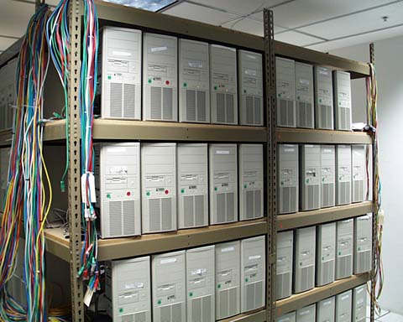
DISTRIBUTED SYSTEMS
CLUSTERS:
Typical Beowulf cluster:

Slide 12
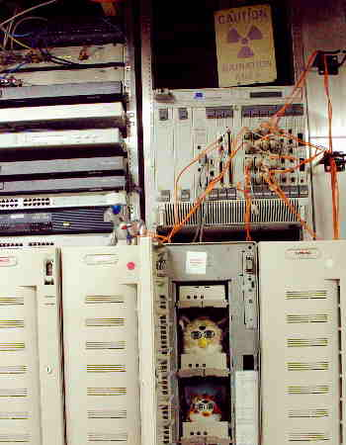
DISTRIBUTED SYSTEMS
CLUSTERS:
typical Furbeowulf cluster:
“The computing power of a single Furby still lags behind even Cray Computing's mid-range 2 gigaflop supercomputers, but it is, nonetheless, infinitely more powerful than a Pet Rock and carries a somewhat lower cost-of-ownership than the Cray, particularly when you take into account the price and availability of spares and replacements.”
“When Linux was first ported to the Furby platform, it suffered from significant stability and performance problems, which gave the Furby an unfortunate reputation as being unsuitable for enterprise-level computing.”
http://www.trygve.com/furbeowulf.html

Slide 13
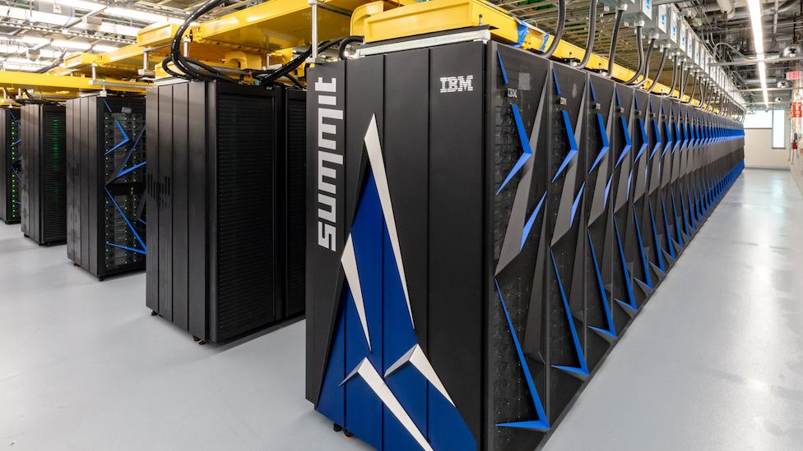
DISTRIBUTED SYSTEMS
CLUSTERS:
The new IBM AC922 CORAL Summit supercomputer located at Oak Ridge Leadership Computing Facility has a peak speed of 200 petaflops (200,000 trillion calculations per second).
Architecture | 9,216 POWER9 22-core CPUs 27,648 Nvidia Tesla V100 GPUs
Power | 13 MegaWatts
Storage | 250 PetaBytes
Speed Weight Size Cooling OS | 200 petaflops (peak) 340 tons 5600 sq. ft. 4000 gallons water / minute RedHat Linux 7.4
http://www.ornl.gov/

Slide 14


